Slide 1
Lobbying and
Profitability
Headline result
-174.6 pp
A $1M increase in lagged lobbying spend is associated with lower ROA, but the estimate is noisy.
Model sample
A simple, investor-facing readout of how firm lobbying spend lines up with future ROA in the merged 2010-2020 panel.
2,125 rows
Firm-years after lagging spend and dropping missing controls.
Panel scope
1,375 firms
Merged financial and lobbying panel covering 2010-2020.
Robustness
Negative sign
The sign stays mostly negative across lag, DiD, and bootstrap checks.
Prepared from the project’s cleaned panel, regression tables, and diagnostic figures.
Notes:
Open with the main takeaway: lobbying does not show a clear payoff in future profitability, and the point estimate is negative. Emphasize that this is a merged firm-year panel from 2010 to 2020, so the analysis is about repeated firm observations over time rather than one cross-section snapshot. Keep the tone careful: the estimate is informative as a pattern, not a definitive causal claim.

Slide 2
EXECUTIVE SUMMARY
What the data say in plain English
The key question is whether more lobbying is followed by better profits.
Lag used
The main fixed-effects model points to a negative relationship: a $1 million increase in lobbying spend next year lines up with about a 174.6 percentage-point drop in ROA. That estimate is not statistically strong, so it should be read as a pattern, not proof.
1 year
Lobbying is measured one year before ROA to reduce same-year reverse causality.
p-value
The same negative direction shows up in several checks, but the lead test warns that profitability may sometimes move before lobbying does. That makes the result useful for screening, not for treating lobbying as a reliable profit engine.
0.135
The clustered estimate is not conventionally significant.
Balanced panel
66 firms
A tighter sample is available for robustness checks.
Recommendation: do not overweight lobbying alone as a sign of future profitability. If you need a portfolio tilt, favor firms with steadier earnings and lower policy dependence, and stay cautious with heavy lobbyers until the relationship is clearer.
Executive summary based on results in results/tables/M3_regression_table.txt, results/reports/M3_interpretation.md, and robustness checks.
Notes:
State the main finding first: the point estimate is negative, but the standard error is large enough that it is not a clean signal. Translate the magnitude carefully. The number is large because ROA is a ratio, so the practical message is about direction and uncertainty, not exact dollar-for-dollar forecasting. Close with the recommendation: treat lobbying as a weak screening variable, not a basis for a strong overweight call by itself.

Slide 3
METHODOLOGY
How the panel was built and estimated
The setup is simple: clean the data, merge the firm-year records, then compare each firm to itself over time.
Data sources
Model equation
1. SEC XBRL 10-K filings provide assets, income, and revenue.
2. Senate Lobbying Disclosure Reports provide yearly lobbying spend.
3. A CIK-GVKEY crosswalk links the two sources into one firm-year panel.
ROA_it = β1 Lobbying_spend_i,t-1 + β2 log(Assets_it) + β3 log(Revenues_it) + firm FE + year FE + error_it
Variable meanings
ROA = net income divided by assets.
Lobbying spend = annual lobbying dollars, shifted one year earlier.
Assets and revenues are logged to keep the scale stable and to reduce skew.
Sample construction
Merged panel: 5,099 firm-years from 1,375 firms.
Main FE model: 2,125 firm-years after lagging lobbying spend and dropping missing controls.
Balanced robustness sample: 836 firm-years from 66 firms.
Inference
Standard errors are clustered at the firm level so the uncertainty reflects repeated observations within the same entity.
Sources: data/processed/financials_clean.csv, data/processed/lobbying_clean.csv, data/processed/cik_gvkey_crosswalk.csv, data/final/merged_financials_lobbying.csv.
Notes:
Walk through the data pipeline in order: financials, lobbying, crosswalk, then merged panel. Explain that lagging lobbying spend is the main design choice to reduce the obvious same-year reverse causality concern. Point out that the clustered standard errors are not a decoration; the diagnostics show heteroskedasticity, so clustered inference is the right default.

Slide 4
RESULTS
Table 1. Main fixed-effects regression
The coefficient is negative, but the uncertainty is large enough that the estimate is not conventionally significant.
Variable | Coef. | SE | t | p | Stars
Lobbying spend, t-1 ($M) | -174.587 | 116.934 | -1.49 | 0.135
Log(Assets) | 234.706 | 148.659 | 1.58 | 0.114
Log(Revenues) | 47.835 | 43.565 | 1.10 | 0.276
Key readout: the sign is negative, but the estimate is not tight enough to support a strong investment claim on its own.
Entity FE
Time FE
Observations
Yes
Yes
2,125
Each firm is compared with itself over time.
Common year shocks are absorbed.
Firm-years used in the main specification.
Table 1 uses clustered standard errors at the firm level. Significance stars follow the usual cutoffs: * p<0.10, ** p<0.05, *** p<0.01.
Notes:
Make the interpretation simple: the coefficient is negative, but the p-value says the effect is not sharp enough to treat as a strong result. Mention that the model already includes firm and year fixed effects, so the estimate is based on within-firm movement over time. If asked about the magnitude, remind the audience that ROA is a ratio and the sample is sparse, so the safer interpretation is direction plus uncertainty.

Slide 5
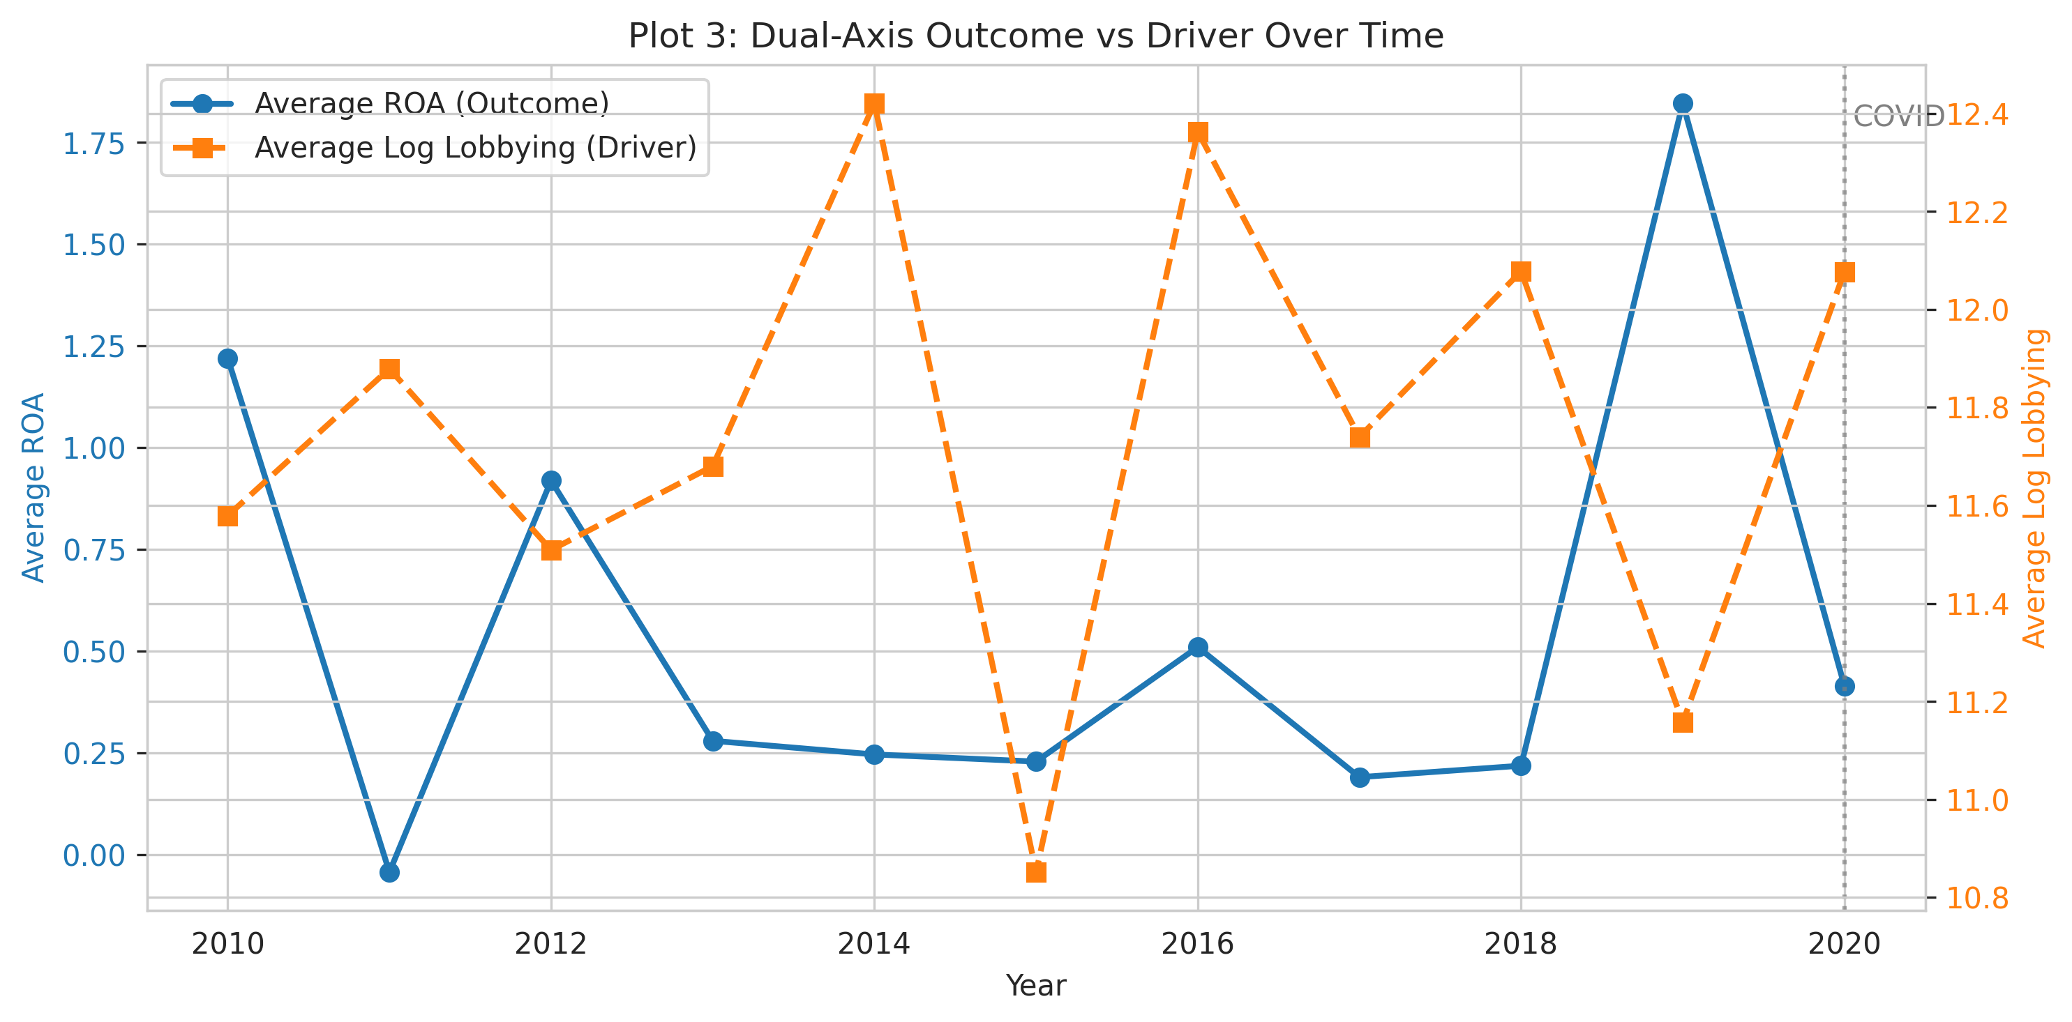
RESULTS
Table 2. Alternative specs and Figure 1
The sign mostly stays negative, but the size and precision shift when the timing or identification strategy changes.
Model | Headline result | Takeaway
Three-way FE | -159.5 | Same direction; still noisy.
Lead-1 placebo | -302.7* | Warning sign for reverse timing.
Staggered DiD | ATT ≈ -338.8 | Negative on average; limited support.
ARIMA benchmark | RMSE 523.5 | No gain over the naive forecast.
Cluster bootstrap | 95% CI [-517.6, 149.7] | Interval still crosses zero.
Figure 1. Dual-axis outcome vs. driver
../figures/M2/plot3_dual_axis_outcome_driver.png
Figure 1 source path when the deck lives in results/reports/: ../figures/M2/plot3_dual_axis_outcome_driver.png.
Notes:
Use this slide to show that the result is not a one-model story: alternative specifications tend to keep the same sign, but not the same certainty. Call out the placebo lead explicitly because it is the clearest caution against a simple causal story. For the ARIMA benchmark, the key message is that the annual series does not forecast better than a naive baseline, so the time-series angle does not create a tradeable edge.

Slide 6
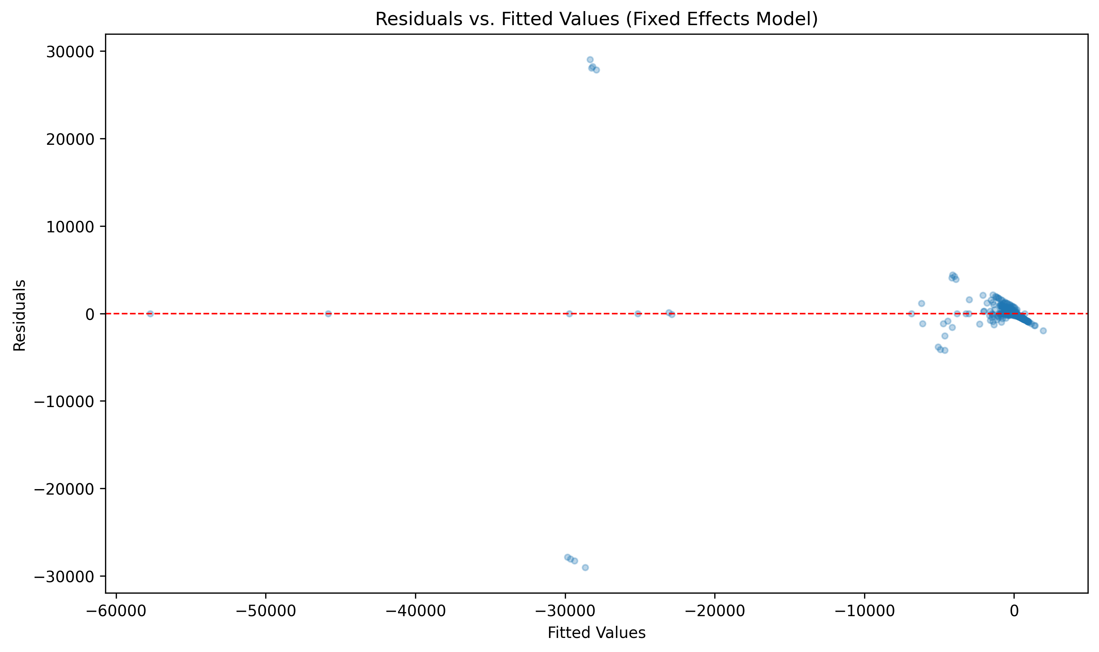
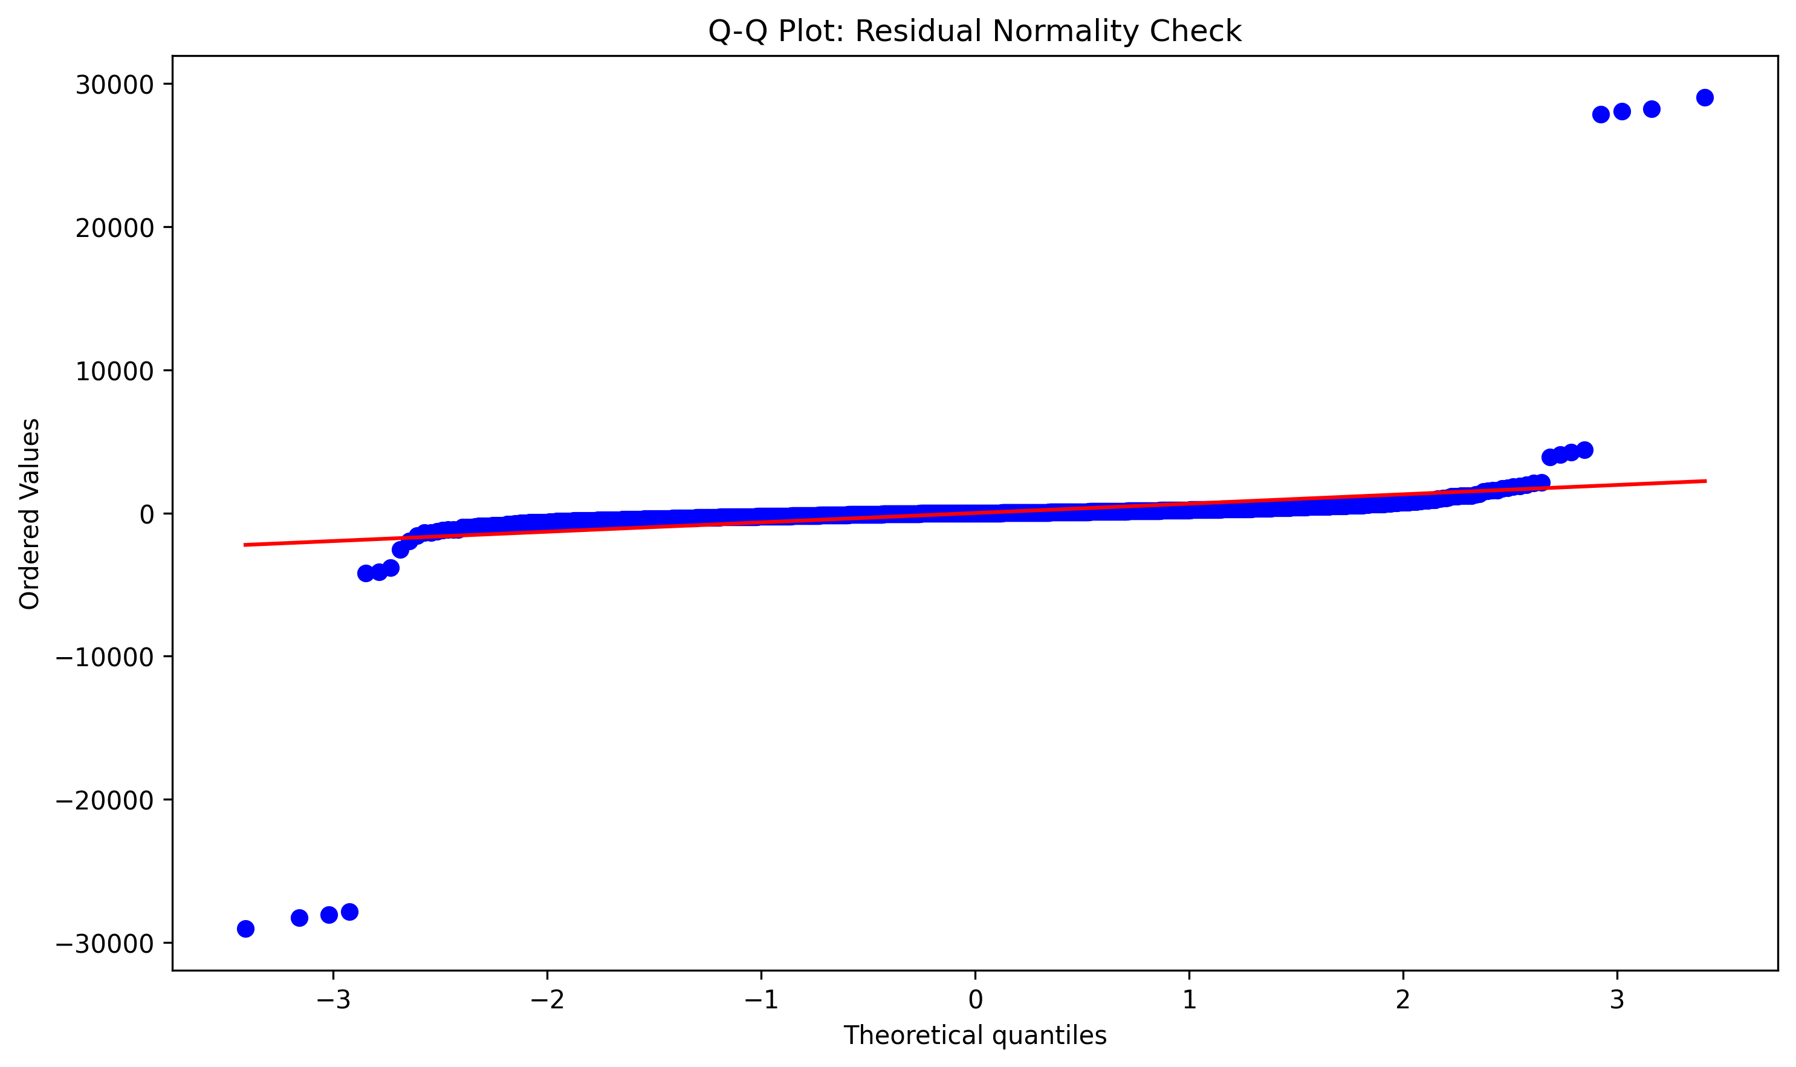
DIAGNOSTICS
Figure 2. Diagnostic plots
The residual checks do not look perfect, which is exactly why the clustered inference matters.
Figure 2A. Residuals vs. fitted
Figure 2B. Q-Q plot
../figures/M3_residuals_vs_fitted.png
../figures/M3_qq_plot.png
Breusch-Pagan p = 0.0000, so constant-variance errors are not a good assumption. The max VIF is 2.74, which is comfortably below the usual multicollinearity warning zone.
Bottom line: the data are noisy and uneven, but not so collinear that the main coefficient is being mechanically distorted.
Diagnostics summarized from results/reports/M3_diagnostics_summary.txt and results/tables/M3_vif_results.csv.
Notes:
Interpret the diagnostics as support for the modeling choices, not as decorative appendices. The heteroskedasticity result is the main reason the clustered standard errors are used throughout the presentation. The residual plots are a reminder that this is an empirical panel with uneven coverage and skewed firm outcomes, so the goal is robust patterns rather than perfect fit.

Slide 7
Conclusions &
Recommendations
Investment implications
Favor firms with steadier earnings and lower policy dependence. If you need a portfolio tilt, underweight heavy lobbyers only as a cautious screen, not as a standalone trade.
The most honest reading is that lobbying is a noisy signal, not a dependable profit lever.
Risk assessment
Main risks: reverse causality, omitted firm strategy, sparse lobbying coverage, and the usual fixed-effects assumptions. The sector signal is also weaker than a full classification-based study would allow.
Scenario view: if the lagged negative pattern is real, it should show up after a delay. If reverse causality dominates, the signal should weaken quickly.
Bottom line: do not pay up for lobbying as if it were a proven profitability engine.
Notes:
Finish with the direct takeaway: the evidence does not justify a strong positive story about lobbying and future profits. Be explicit that the recommendation is cautious and conditional. The data support a screening rule more than a hard allocation rule. If the audience asks for the next step, suggest richer sector classification, longer panels, or stronger identification to separate cause from timing.

