Slide 1
Python Libraires and Turtle Introduction
Dr. Séamus Cummins

Slide 2
Turtle movement and coordinates
PYTHON • 60 MINUTES
01
Create a turtle and move it.
02
Control turns and the pen.
03
Draw using x and y coordinates.

Slide 3
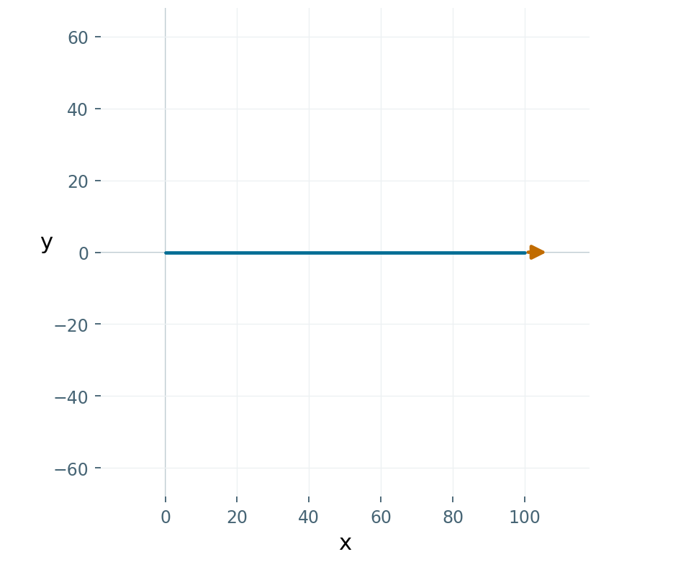
Create a drawing window
PYTHON
import turtle
screen = turtle.Screen()
t = turtle.Turtle()
t.forward(100)
turtle.done()
Path plot • arrow = final heading
Run as a saved .py file on a desktop.

Slide 4
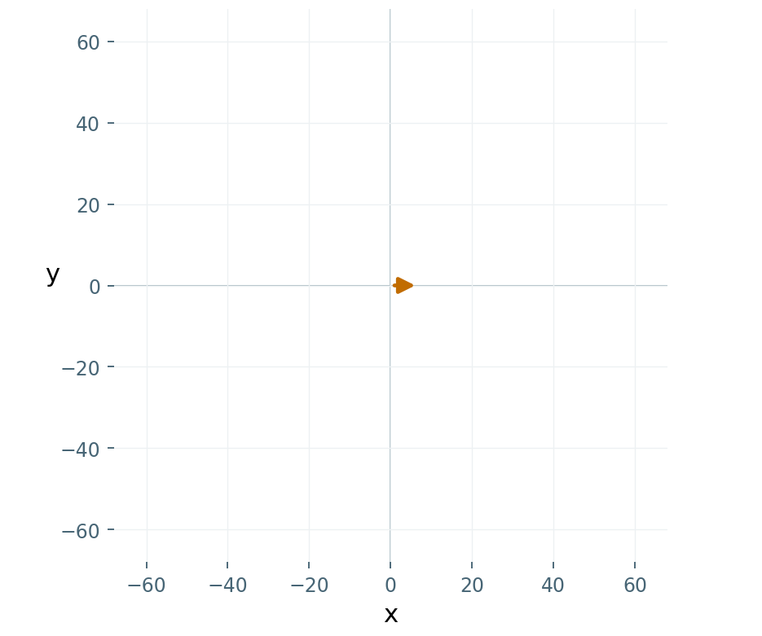
The starting position
PYTHON
print(t.position())
print(t.heading())
Path plot • arrow = final heading
Fresh turtle: (0, 0), facing east.

Slide 5
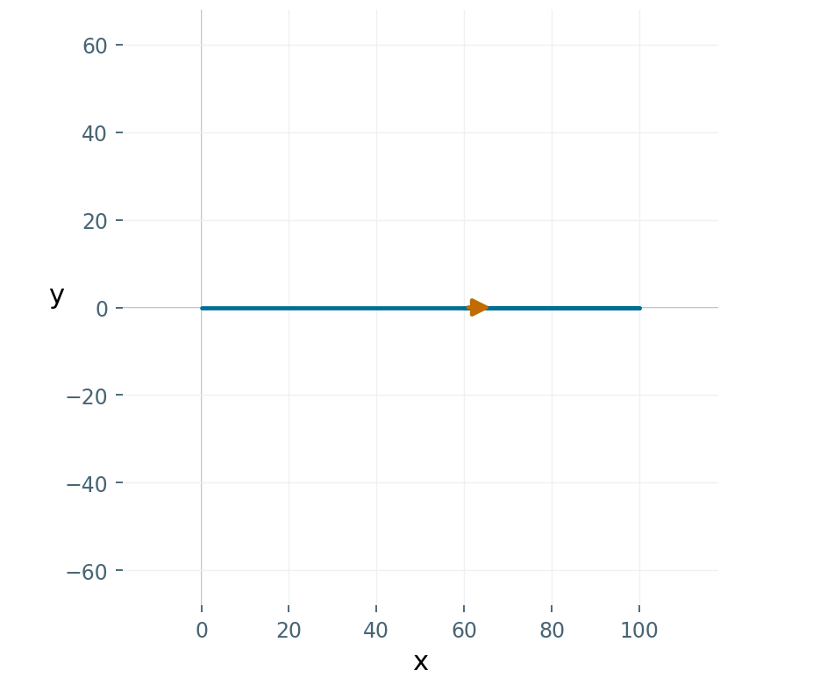
Move relative to the heading
PYTHON
t.forward(100)
t.backward(40)
Path plot • arrow = final heading
Forward and backward keep the same heading.

Slide 6
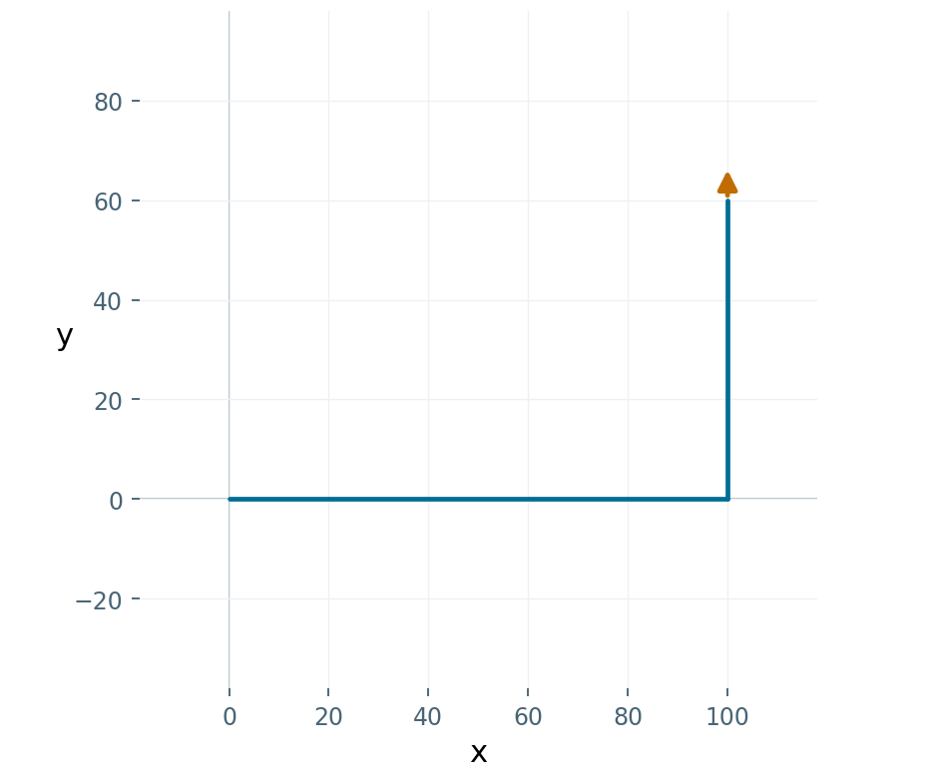
Turn, then move
PYTHON
t.forward(100)
t.left(90)
t.forward(60)
Path plot • arrow = final heading
left(90) turns anticlockwise.

Slide 7
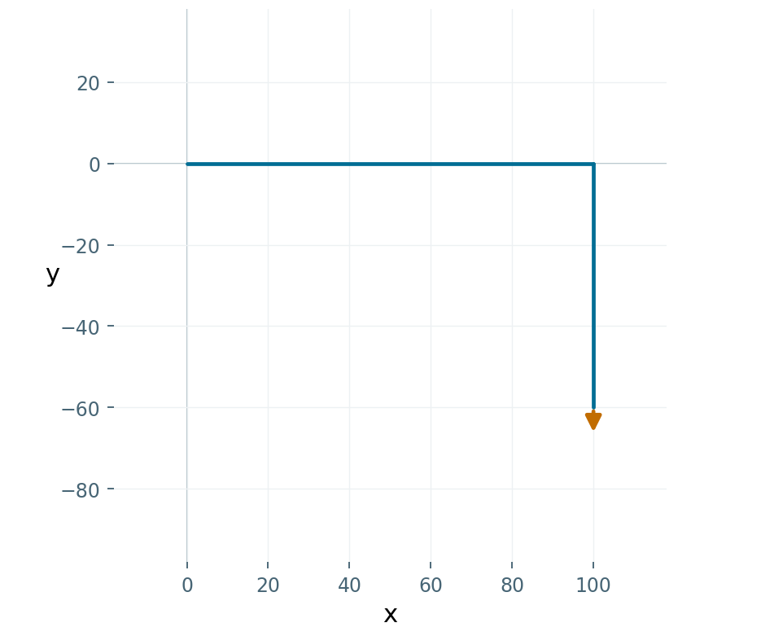
A right turn
PYTHON
t.forward(100)
t.right(90)
t.forward(60)
Path plot • arrow = final heading
right(90) turns clockwise.

Slide 8
Set an absolute heading
Command | Direction
t.setheading(0) | east
t.setheading(90) | north
t.setheading(180) | west
t.setheading(270) | south
setheading chooses a direction directly.

Slide 9
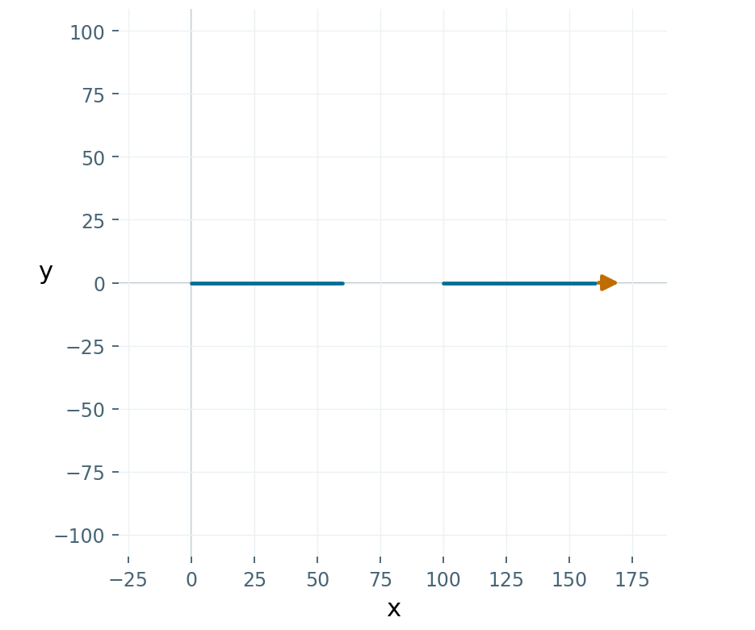
Travel without drawing
PYTHON
t.forward(60)
t.penup()
t.forward(40)
t.pendown()
t.forward(60)
Path plot • arrow = final heading
Pen up: no trail. Pen down: draw while moving.

Slide 10
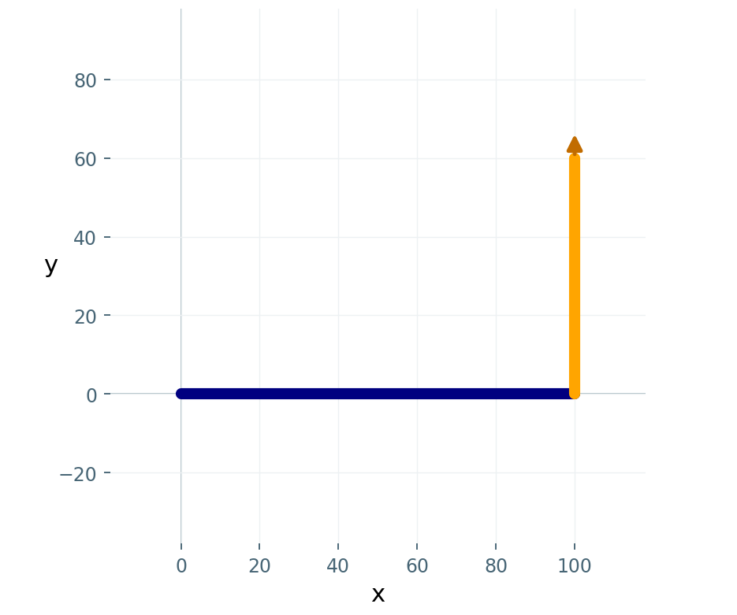
Change colour and thickness
PYTHON
t.pencolor("navy")
t.pensize(6)
t.forward(100)
t.left(90)
t.pencolor("orange")
t.forward(60)
Path plot • arrow = final heading
Style changes affect later strokes.

Slide 11
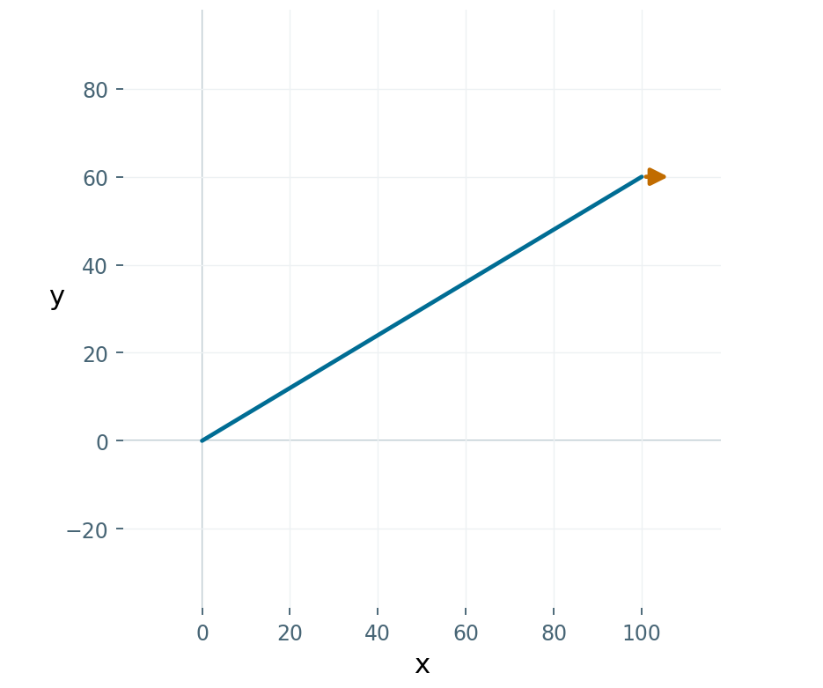
Move to an exact point
PYTHON
t.goto(100, 60)
Path plot • arrow = final heading
goto(x, y) uses absolute coordinates.

Slide 12
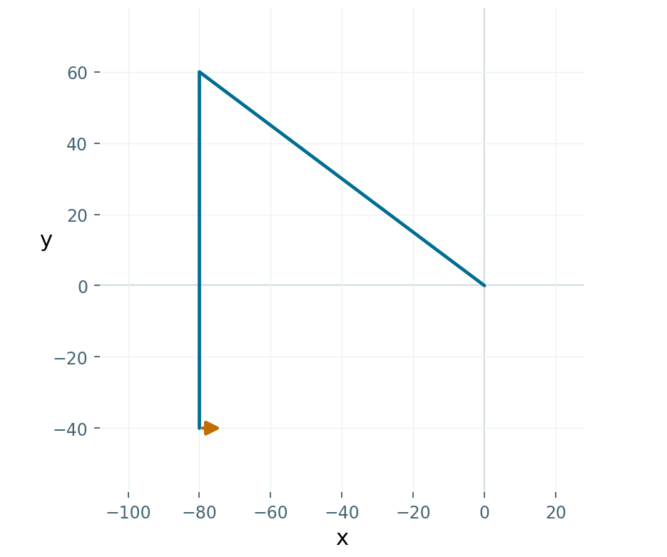
Negative coordinates
PYTHON
t.goto(-80, 60)
t.goto(-80, -40)
Path plot • arrow = final heading
Negative x: left. Negative y: down.

Slide 13
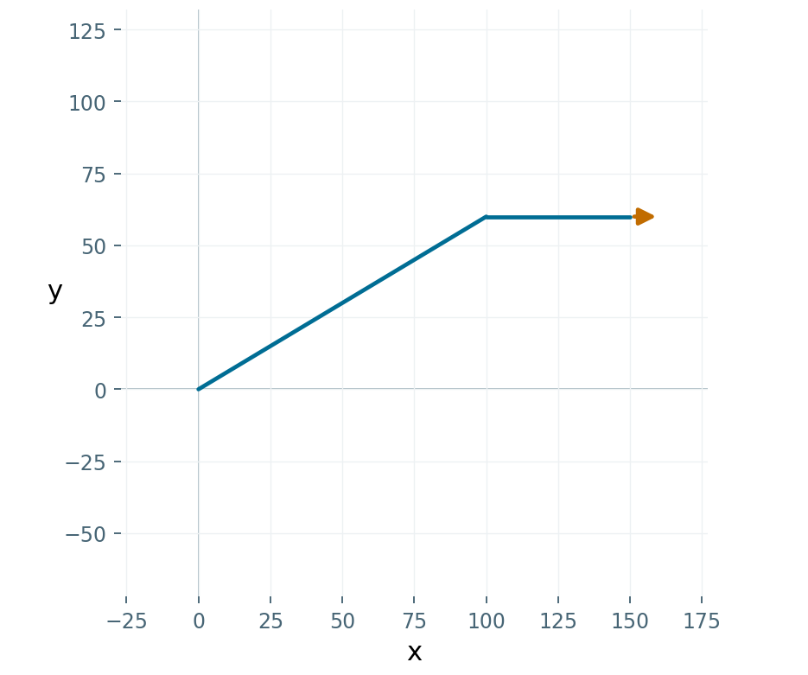
Position and direction are separate
PYTHON
t.goto(100, 60)
t.forward(50)
Path plot • arrow = final heading
goto does not point the turtle at the target.

Slide 14
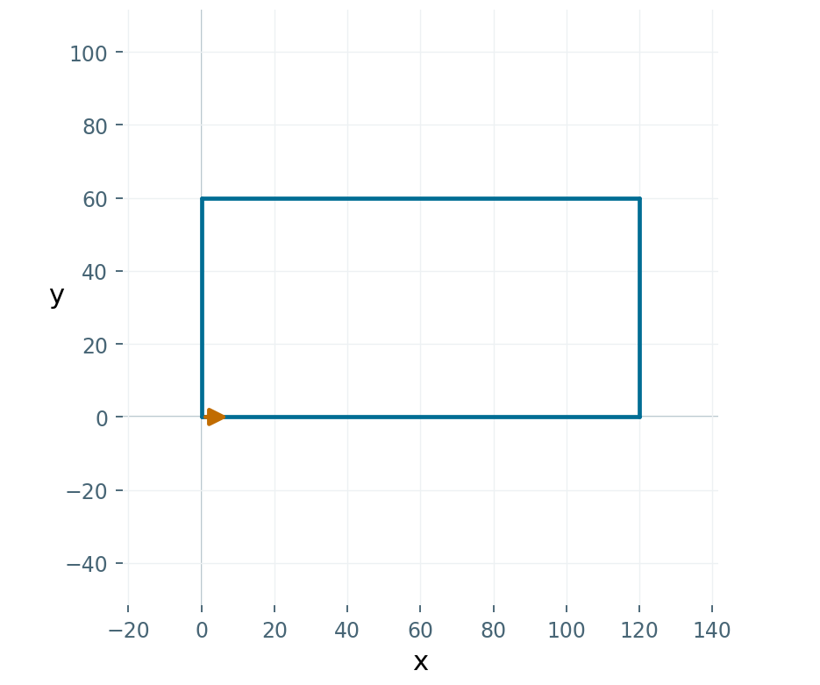
Draw a rectangle
PYTHON
t.forward(120)
t.left(90)
t.forward(60)
t.left(90)
t.forward(120)
t.left(90)
t.forward(60)
t.left(90)
Path plot • arrow = final heading
Opposite sides match; four turns total 360°.

Slide 15
Clear the drawing
PYTHON
OUTPUT
t.forward(100)
t.clear()
print(t.position())
(100.00,0.00)
clear() removes strokes, not position.

Slide 16
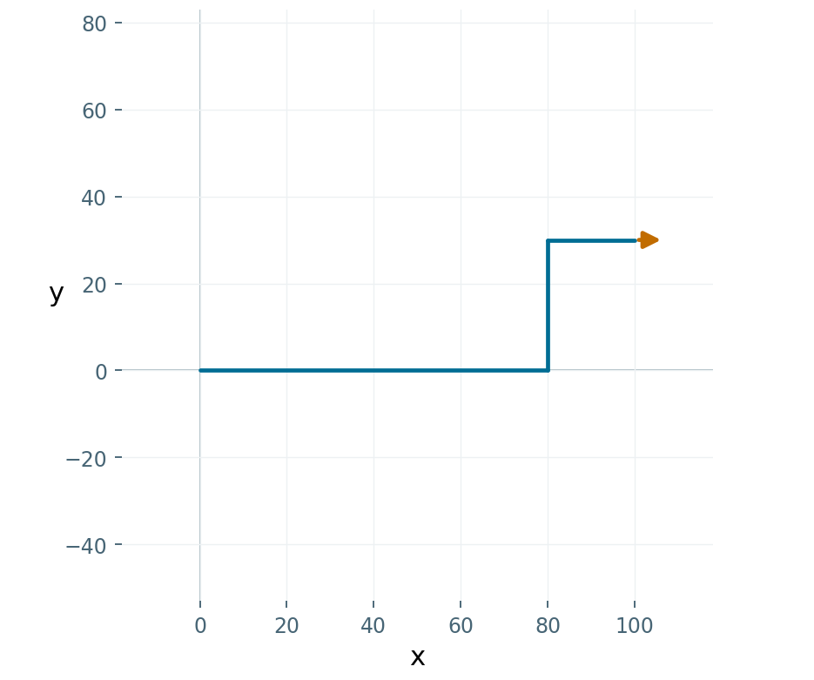
Trace the endpoint
PYTHON
t.forward(80)
t.left(90)
t.forward(30)
t.right(90)
t.forward(20)
Path plot • arrow = final heading
Use each move to find the final coordinates.

Slide 17
Your turn: a coordinate triangle
12 MINUTES
Check your work
01
Move without drawing to (−80, −40).
Three connected sides
02
Draw to (80, −40), then (0, 80).
A closed triangle
No line from the origin
03
Return to (−80, −40).

Slide 18
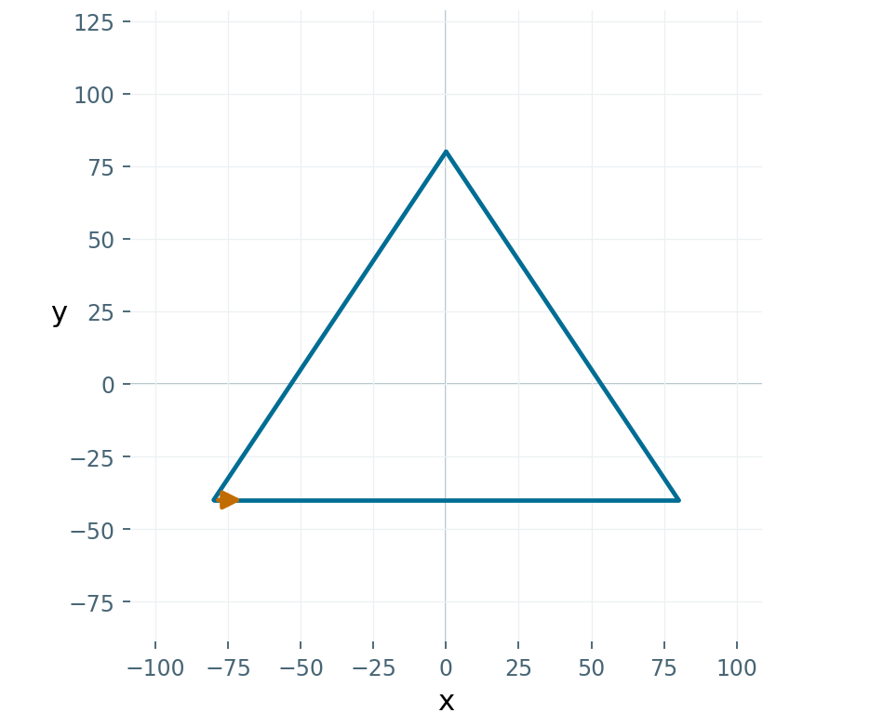
Check your solution
PYTHON
t.penup()
t.goto(-80, -40)
t.pendown()
t.goto(80, -40)
t.goto(0, 80)
t.goto(-80, -40)
Path plot • arrow = final heading
Compare the result. Explain one line.

Slide 19
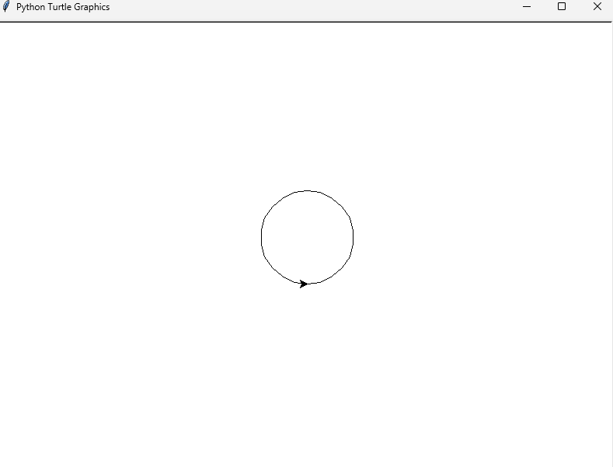
Draw Circle
PYTHON
t.circle(70, 80)
Size
Angle of arc
Compare the result. Explain why it is not a full circle.

Slide 20
draw initials
PYTHON
Now Try and Draw your Initials

Slide 21
Before you leave
01
Does left(90) move the turtle?
02
Does goto change its heading?
03
Why use penup before goto?

Slide 22
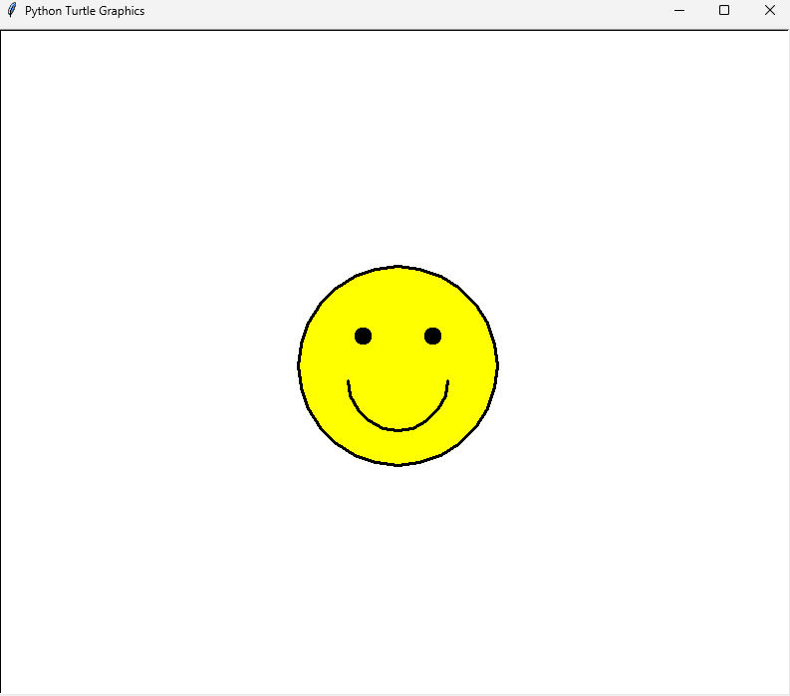
Homework - Draw smiley face
PYTHON

