Slide 1
Python IDE
and Getting Started
The IDE, variables and operators
Worked examples and student tasks
Dr. Séamus Cummins

Slide 2

Python: history and context
Created by Guido van Rossum
First public release in 1991.
A general-purpose language
Used for automation, data analysis and applications.
Our starting point
Small Python 3 programs that we can understand and test.
Python takes its name from Monty Python’s Flying Circus.

Slide 3
Python, interpreter and IDE
Term | Meaning
Python | The programming language we write.
Interpreter | The software that executes our Python code.
IDE | A workspace for writing, running and debugging programs.
IDLE | Python’s Integrated Development and Learning Environment.
IDE means Integrated Development Environment.

Slide 4
Python IDEs: downloads and comparison
IDE and download | Useful for | Setup / limitation
IDLE (free) python.org/downloads | First scripts and following this lesson | Install Python with IDLE. Fewer project tools.
Thonny (free) thonny.org | Learning step by step and viewing variables | Python bundled on Windows and macOS. Simple interface.
VS Code (free) code.visualstudio.com | Several languages and customising your workspace | Install Python and the Microsoft Python extension.
PyCharm (free core) jetbrains.com/pycharm | Larger Python projects and code assistance | Configure Python. More menus to learn. Pro extras cost extra.

Slide 5
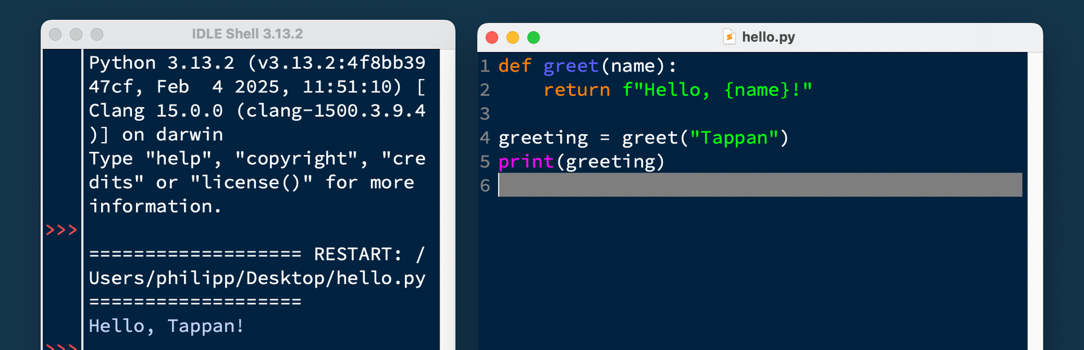
IDLE: Editor and Shell
Shell
Editor
Read output and error messages.
Write and save .py files.

Slide 6
Your first saved program
# My first Python program
print("Hello, DCU!")
print(2 + 3)
File > New File
Save as hello.py
Run > Run Module (F5)
Expected output: Hello, DCU! followed by 5 on the next line.

Slide 7
The shell and a saved script
Shell
Script
Try one expression:
2 + 3
The shell displays 5.
Write an instruction:
print(2 + 3)
Run the file to display 5.
The >>> symbol is the shell prompt. Do not copy it into your script.

Slide 8
Variables name values
score = 10
score = score + 5
print(score)
Read the right side first.
Then assign the result
to the name on the left.
What value does score have after the second line?

Slide 9
Four common data types
Type | Example | Represents
int | age = 18 | A whole number
float | distance = 2.5 | A floating-point number
str | name = "Maya" | Text
bool | ready = True | True or False
Is "18" a number or a string?

Slide 10
Input begins as text
name = input("Name: ")
age = int(input("Age: "))
print("Hello", name)
print("Next year:", age + 1)
input() returns a string.
int() converts suitable
text to a whole number.
Use float() when you need a value such as 2.5.

Slide 11
Task 1: predict the output
Text values
Number values
a = "5"
b = "2"
print(a + b)
a = 5
b = 2
print(a + b)
Predict both results, then run the two examples separately.

Slide 12
Task 1: answers
Strings
Numbers
"5" + "2" produces "52".
print() displays:
52
5 + 2 produces 7.
print() displays:
7
The data type affects what the operator does.

Slide 13
4. Arithmetic operators
Operator Meaning Example Result
+
addition
7 + 3
10
-
subtraction
7 - 3
4
*
multiplication
7 * 3
21
/
division
7 / 2
3.5
//
floor division
7 // 2
3
%
remainder
7 % 2
1
**
power
2 ** 3
8

Slide 14
Comparison operators
==
equal
5 == 5
True
!=
not equal
5 != 3
True
>
greater
8 > 10
False
<
less
8 < 10
True
>=
greater/equal
5 >= 5
True
<=
less/equal
4 <= 3
False
= assigns; == compares.

Slide 15
Order of operations
Multiplication first
Parentheses first
2 + 3 * 4
= 2 + 12
= 14
(2 + 3) * 4
= 5 * 4
= 20
Use parentheses to make your intended calculation clear.

Slide 16
Task 2: predict, then check
Calculate
Calculate
A. 10 + 4 * 2
B. (10 + 4) * 2
C. 19 // 4
D. 19 % 4
E. 3 ** 2
F. 9 / 2
Write your predictions before using the Python shell.

Slide 17
Task 2: answers
Question | Result | Reason
A | 18 | 4 * 2 comes first
B | 28 | Parentheses come first
C | 4 | Four complete groups
D | 3 | Three left over
E | 9 | 3 squared
F | 4.5 | Ordinary division
For C and D: four complete groups, with three left over.

Slide 18
Assignment and comparison
= assigns a value
== compares values
score = 10
score += 2
score now contains 12.
score == 12
The result is True.
score == 10 is False.
For numbers, score += 2 updates score to score + 2.

Slide 19
Comparison operators
Operator | Question | Example result
== | Equal to? | 5 == 5 gives True
!= | Not equal to? | 5 != 5 gives False
< and > | Less than / greater than? | 4 < 7 gives True
<= and >= | Less / greater than or equal? | 7 >= 7 gives True
What does 7 > 7 produce?

Slide 20
Logical operators combine conditions
age = 18
has_ticket = True
print(age >= 18 and has_ticket)
print(age < 18 or has_ticket)
print(not has_ticket)
and: both are true
or: at least one is true
not: reverses a Boolean
Predict the three results. Then change has_ticket to False.

Slide 21
Three kinds of problem
Problem | Example | What to check
Syntax error | print("Hi" | Missing bracket or quote
Runtime error | 10 / 0 | An operation cannot complete
Logic error | length + width for an area | The code runs but uses the wrong calculation
Read the error type and line number, then inspect that part of the code.

Slide 22
Task 3: fix the program
age = input("Age: ")
next_age = age + 1
print("Next year:", next_age)
Expected behaviour:
Enter 18.
The program should
display Next year: 19.
What causes the error? Change one line and test again.

Slide 23
Task 3: one corrected solution
age = int(input("Age: "))
next_age = age + 1
print("Next year:", next_age)
Test with 18: result 19
Test with 20: result 21
Test with 0: result 1
What happens if someone types eighteen instead of 18?

Slide 24
Mini task: a packing calculator
The program should
Test cases
Ask for a number of items.
Use boxes holding 6 items.
Display full boxes
and items left over.
20 items: 3 boxes, 2 left
12 items: 2 boxes, 0 left
5 items: 0 boxes, 5 left
Save as packing.py. Use input(), int(), //, % and print().

Slide 25
Mini task: one possible solution
items = int(input("Items: "))
BOX_SIZE = 6
full_boxes = items // BOX_SIZE
leftovers = items % BOX_SIZE
print("Full boxes:", full_boxes)
print("Left over:", leftovers)
Try 20, 12 and 5.
Check both outputs
against the expected
results.
BOX_SIZE is a constant by convention. Python can still reassign it.

Slide 26
Exit task
Explain
Predict
1. Where do you save a
reusable program in IDLE?
2. How do = and == differ?
3. What is 14 % 4?
4. What is (3 + 2) ** 2?
5. Why convert input
before adding numbers?
Answer without running code, then check your reasoning.

Slide 27
Exit task: answers
Question | Answer
1 | Write in the editor and save a .py file.
2 | = assigns a value. == tests equality.
3 | 14 % 4 is 2.
4 | (3 + 2) ** 2 is 25.
5 | input() returns text. Convert it for numeric arithmetic.
Next: using conditions with if, then repeating work with loops.

