Slide 1
Iteration
Dr. Séamus Cummins

Slide 2
Iteration with Python and turtles
examples, debugging and practice
Write for and while loops and explain how they stop.
Build totals, draw patterns and repair broken code.
NCUK IFY Computer Science Dr Séamus Cummins

Slide 3
The lesson outline
Focus | Practice
for, range and lists | Turtle shapes and a times table
Changing values and while | Totals, sentinels and spirals
Nested loops and loop control | Debugging and a turtle pattern

Slide 4
Iteration repeats a block
One iteration
One pass through the repeated instructions.
for
Takes each item from an iterable, such as a list or range.
while
Tests a condition before each pass and repeats while it is True.
For every loop, identify what repeats, what changes and why it stops.

Slide 5
A first for loop
PYTHON
for turn in range(3):
print("Hello")
print("Finished")
Output
Hello
Hello
Hello
Finished
Why?
The indented print repeats three times. The final print runs once.
A colon begins the block. Use consistent indentation, normally four spaces.

Slide 6
The loop variable changes automatically
PYTHON
for turn in range(4):
print("Turn", turn)
Output
Turn 0
Turn 1
Turn 2
Turn 3
The loop variable
Python assigns the next value to turn before running the body.
range(4) supplies four values. The first value is 0.

Slide 7
range: start, stop and step
Expression | Values | Count
range(4) | 0, 1, 2, 3 | 4
range(1, 5) | 1, 2, 3, 4 | 4
range(2, 9, 2) | 2, 4, 6, 8 | 4
range(5, 0, -1) | 5, 4, 3, 2, 1 | 5
range(3, 3) | No values | 0
Start is included. Stop is excluded. Arguments must be integers and step cannot be 0.

Slide 8
Counting backwards
PYTHON
for count in range(5, 0, -1):
print(count)
print("Launch!")
Output
5
4
3
2
1
Launch!
The step
-1 decreases the value. range(5, 0) is empty: its default step is +1.
The step must move towards the stopping boundary.

Slide 9
Broken code 1: a missing repetition
BROKEN CODE
for number in range(1, 6):
print(number)
Required behaviour
Print the numbers 1 through 6, including 6.
Your task
Predict the actual output. Identify the smallest correction.
Write the first value, last value and number of iterations before running.

Slide 10
Repair 1: the stop must be beyond 6
PYTHON
for number in range(1, 7):
print(number)
Output
1
2
3
4
5
6
Cause
range(1, 6) stops before 6. range(1, 7) gives six values.
An off-by-one error gives one too many or one too few iterations.

Slide 11
Lists store values in order
PYTHON
names = ["Comet", "Meteor", "Nova"]
print(names[0])
print(names[-1])
names[1] = "Orbit"
names.append("Luna")
print(len(names))
Output
Comet
Nova
4
List operations
Index 0 is first. Index -1 is last. Assignment changes an item. append adds at the end.
The final list is ["Comet", "Orbit", "Nova", "Luna"].

Slide 12
A for loop visits each list item
PYTHON
colours = ["red", "green", "blue"]
for colour in colours:
print(colour)
print("Done")
Output
red
green
blue
Done
Order
colour takes the values in list order. Reassigning colour does not replace a list item.
Looping directly through values avoids unnecessary list indexes.

Slide 13
len and the empty list
PYTHON
scores = []
print(len(scores))
for score in scores:
print(score)
print("Finished")
Output
0
Finished
No items
An empty list makes the body run zero times. scores[0] would raise IndexError.
len returns the number of items. It does not return the last index.

Slide 14
The shared turtle setup
PYTHON
import turtle
screen = turtle.Screen()
screen.setup(800, 650)
t = turtle.Turtle()
t.shape("turtle")
t.speed(5)
# Drawing code goes here
turtle.done()
How to run
Use desktop Python with turtle/tkinter, for example IDLE or Thonny.
Later turtle slides
Insert their code before turtle.done(). Each example uses a fresh turtle.
The code pack contains complete programs. Close one turtle window before running the next.

Slide 15
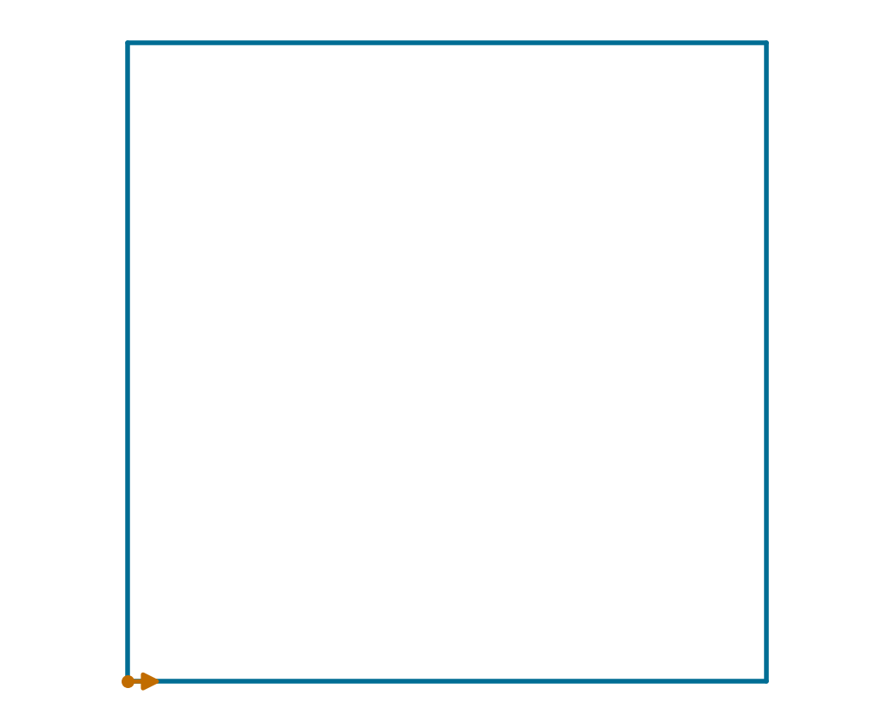
A square without iteration
PYTHON
t.forward(100)
t.left(90)
t.forward(100)
t.left(90)
t.forward(100)
t.left(90)
t.forward(100)
t.left(90)
The same move-and-turn pair appears four times.

Slide 16
A square with a for loop
PYTHON
for side in range(4):
t.forward(100)
t.left(90)
side takes 0, 1, 2 and 3. Both indented statements run each time.
Four iterations make four sides and four turns.

Slide 17
Broken code 2: the square became a line
BROKEN CODE
for side in range(4):
t.forward(100)
t.left(90)
Required drawing
A square with four sides of length 100.
Before running
How often does forward run? How often does left run?
Your task
Fix the indentation. Explain why Python accepts the broken version.
Use the complete file in the code pack to keep the line inside the window.

Slide 18
Repair 2: the turn belongs inside
PYTHON
for side in range(4):
t.forward(100)
t.left(90)
Only indented statements belong to the loop body.
Broken version: 400-unit line, then one turn. Fixed version: a square.

Slide 19
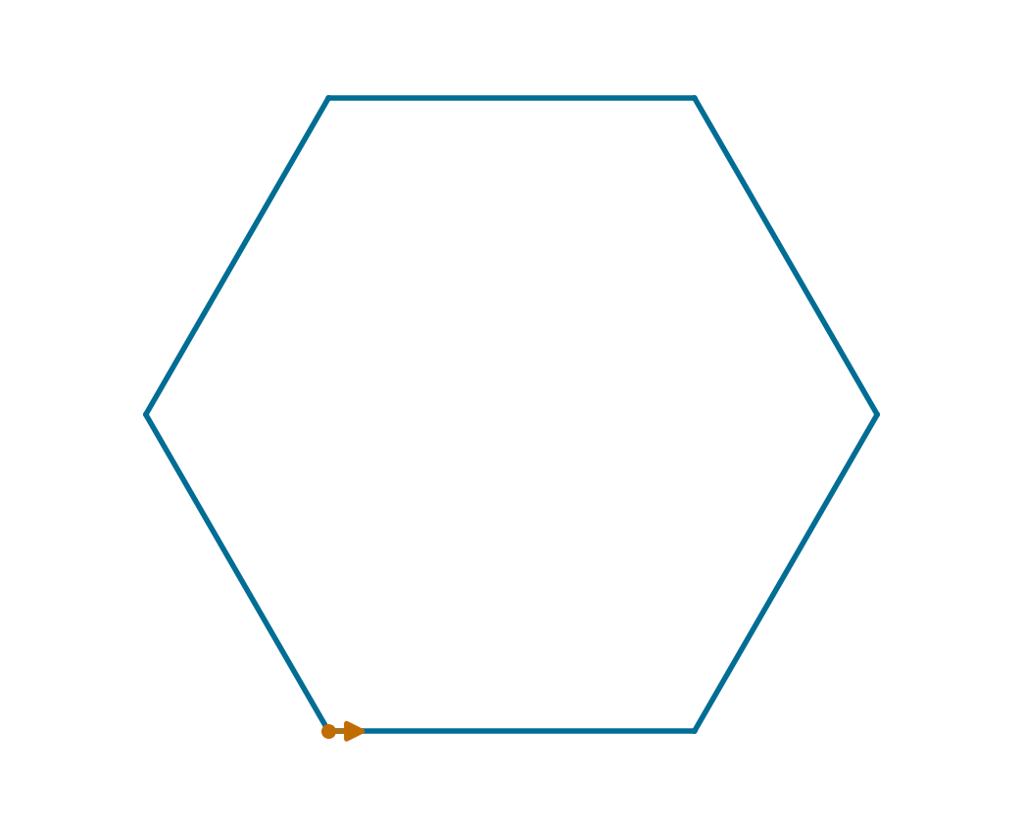
Regular polygons
PYTHON
sides = 6
for side in range(sides):
t.forward(80)
t.left(360 / sides)
Try sides = 3 or sides = 5. Keep sides an integer of at least 3.
The exterior turn is 360 / sides. Six sides need 60° turns.

Slide 20
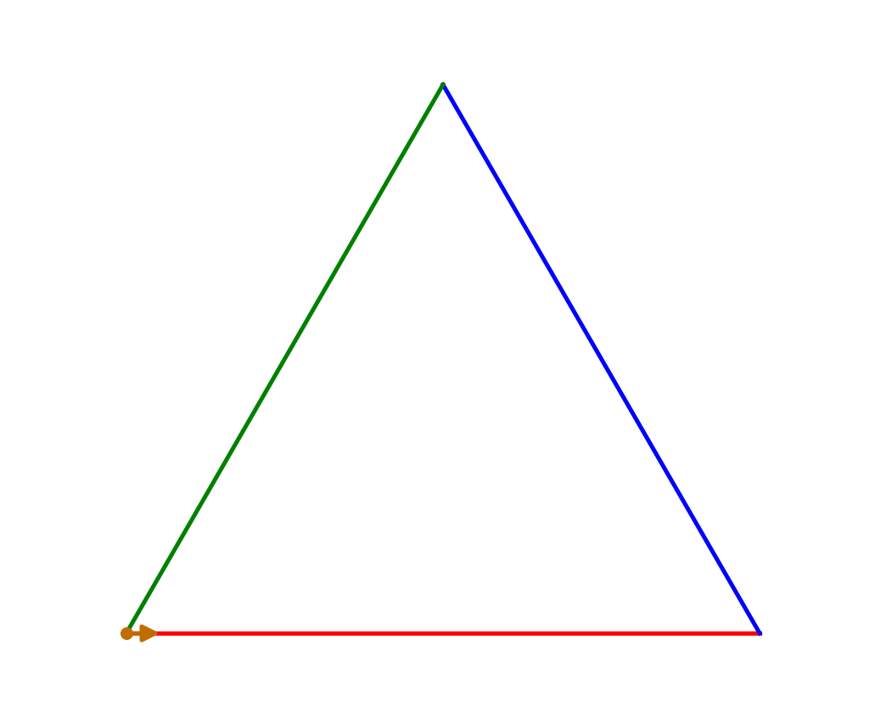
Looping through turtle colours
PYTHON
for colour in ["red", "blue", "green"]:
t.pencolor(colour)
t.forward(90)
t.left(120)
Three 120° exterior turns close the triangle.
Each iteration chooses a colour, draws one side and turns.

Slide 21
Prediction: what will print?
PYTHON
for n in range(1, 5):
print(n * 2)
Without running
How many lines appear? What is the last printed value?
Explain your answer
Separate the value of n from the expression n * 2.
The answer follows on the next slide.

Slide 22
Prediction answer
n | n * 2
1 | 2
2 | 4
3 | 6
4 | 8
Four lines print. The last value is 8. The loop never assigns 5 to n.

Slide 23
Task 1: a times table
8-MINUTE TASK
Write a program
Ask for an integer. Print its multiples from 1 to 10.
Show each calculation
For input 3, begin with 3 x 1 = 3 and end with 3 x 10 = 30.
Test your work
Use 3, 0 and -2. Every run must print exactly ten calculation lines.
2 min plan, 4 min code, 2 min test. Assume input is a valid integer.

Slide 24
Task 1 solution
PYTHON
number = int(input("Number: "))
for i in range(1, 11):
answer = number * i
print(number, "x", i, "=", answer)
Output for input 3
3 x 1 = 3
3 x 2 = 6
...
3 x 10 = 30
Why it works
range(1, 11) supplies 1 through 10. print combines the values with spaces.
For input 0 every product is 0. For input -2 the last product is -20.

Slide 25
Check your understanding
Does range(5) include 5?
No. It gives 0, 1, 2, 3 and 4.
What does len([6, 8, 10]) return?
3, because the list has three items.
Where does the loop body end?
At the first statement that returns to the earlier indentation level.
A for loop gets its next value automatically.

Slide 26
Updating a variable
PYTHON
length = 10
length = length + 5
print(length)
length += 5
print(length)
Output
15
20
Meaning
Evaluate the right side first, then store the result. For numbers, += 5 adds 5 to the current value.
Initialise a variable before using its current value in an update.

Slide 27
An accumulator remembers a total
PYTHON
scores = [4, 7, 2]
total = 0
for score in scores:
total = total + score
print(total)
Output
13
The accumulator
total keeps the sum so far. Initialise it once before entering the loop.
Each pass adds one score to the previous total.

Slide 28
Tracing the accumulator
Current score | Total before | Total after
Before loop | Not assigned | 0
4 | 0 | 4
7 | 4 | 11
2 | 11 | 13
The next iteration starts with the total left by the previous one.

Slide 29
Broken code 3: a total that forgets
BROKEN CODE
scores = [4, 7, 2]
for score in scores:
total = 0
total = total + score
print(total)
Required result
The sum of all three scores is 13.
Your task
Trace total through all three passes. Predict the output and move one line to fix it.
Do not add extra calculations. Find the assignment that discards earlier work.

Slide 30
Repair 3: initialise outside the loop
PYTHON
scores = [4, 7, 2]
total = 0
for score in scores:
total = total + score
print(total)
Broken output
2. Every pass reset total to 0.
Correct output
13. total now keeps earlier contributions.
Another useful test
With scores = [], the corrected version prints 0.
In the broken version an empty list would leave total unassigned.

Slide 31
A counter counts matching items
PYTHON
scores = [49, 50, 80, 20]
passes = 0
for score in scores:
if score >= 50:
passes += 1
print(passes)
Output
2
Two kinds of update
A counter adds 1 per match. An accumulator adds the values themselves.
Indentation
The if runs four times. passes += 1 runs only twice.
For this classroom rule, a score of 50 or more counts as a pass.

Slide 32
An average needs an empty-list check
PYTHON
scores = [4, 7, 2]
total = 0
for score in scores:
total += score
if len(scores) == 0:
print("No scores")
else:
print(total / len(scores))
Nonempty list
The mean is 13 / 3, approximately 4.33.
Empty list
The total stays 0. Print No scores instead of dividing by zero.
Test no items, one item and several items.

Slide 33
A while loop tests a condition
PYTHON
count = 3
while count > 0:
print(count)
count = count - 1
print("Go!")
Output
3
2
1
Go!
Control
Start at 3. Test before each pass. Subtract 1 inside the body.
When count becomes 0, the test is False and the loop ends.

Slide 34
Tracing a while loop
count at test | count > 0 | Action
3 | True | Print 3, update to 2
2 | True | Print 2, update to 1
1 | True | Print 1, update to 0
0 | False | Leave the loop
Three body executions need four condition tests, including the final False test.

Slide 35
A while loop can run zero times
PYTHON
count = 0
while count > 0:
print(count)
count -= 1
print("Finished")
Output
Finished
Why?
The first test is False. Python skips the whole body.
The condition is checked before the body, not after it.

Slide 36
Broken code 4: no way to finish
BROKEN CODE
count = 3
while count > 0:
print(count)
print("Finished")
Inspect without running
What is count after the first pass? What about the second?
Your task
Add an update so the program prints 3, 2, 1, then Finished.
An endless loop can be stopped with the IDE Stop control or Ctrl+C in a terminal.

Slide 37
Repair 4: move towards False
PYTHON
count = 3
while count > 0:
print(count)
count -= 1
print("Finished")
Output
3
2
1
Finished
Why it terminates
Each pass reduces count. It eventually reaches 0. An update after the loop would never be reached.
Changing count += 1 would move away from the stopping condition.

Slide 38
Choosing for or while
Situation | Good choice | Reason
Each score in a list | for | Visit every item
Draw exactly 6 sides | for with range | Known repetition count
Ask until input is valid | while | Repetition depends on input
Draw until length > 200 | while | Repetition depends on state
Both can express many of the same algorithms. Choose the clearer version.

Slide 39
A sentinel ends input
PYTHON
word = input("Word or stop: ")
while word != "stop":
print(word.upper())
word = input("Word or stop: ")
print("Finished")
Example inputs
hello, python, stop
Output
HELLO
PYTHON
Finished
Sentinel
stop ends entry. It is not processed as an ordinary word.
The second input updates word so the condition can change.

Slide 40
Testing a sentinel loop
Input sequence | Expected output | What it tests
stop | Finished | Zero ordinary entries
hello, stop | HELLO then Finished | One ordinary entry
a, b, stop | A, B then Finished | Several entries
STOP, stop | STOP then Finished | Exact, case-sensitive match
To ignore case, compare word.lower() with "stop". Read new input on every pass.

Slide 41
Repeat-until behaviour in Python
PYTHON
while True:
word = input("Word or stop: ")
if word == "stop":
break
print(word.upper())
print("Finished")
Post-test repetition
REPEAT...UNTIL runs at least once and stops when its ending test is True.
Python version
Python has no repeat...until keyword. This input/test/break pattern prompts at least once.
Test the sentinel before processing it. Inputs hello, stop print HELLO then Finished.

Slide 42
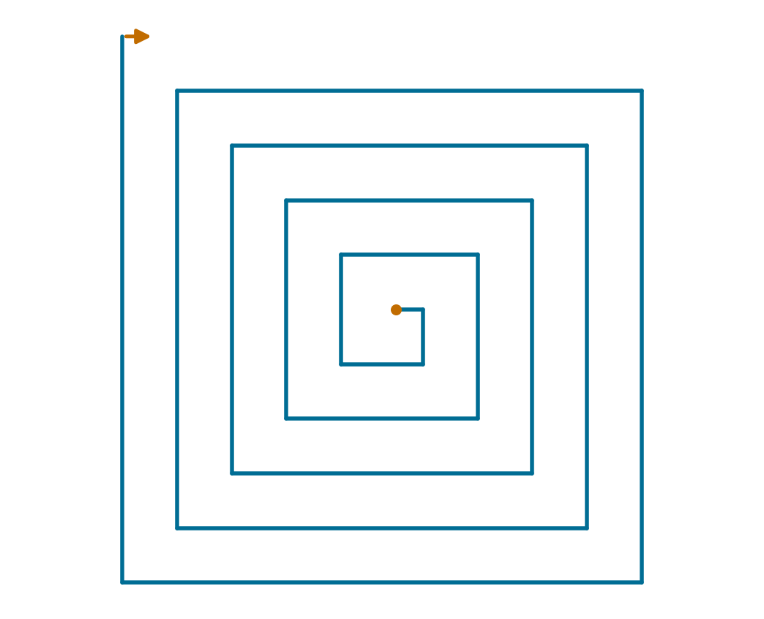
A growing square spiral
PYTHON
length = 10
for step in range(20):
t.forward(length)
t.right(90)
length += 10
The body repeats, but the value used by forward changes.
Dot: start Arrow: final heading
Distances are 10, 20, 30, ... , 200.

Slide 43
The same spiral using while
PYTHON
length = 10
while length <= 200:
t.forward(length)
t.right(90)
length += 10
The same distances and turns produce the same path.
Dot: start Arrow: final heading
At length = 210, the next condition test is False.

Slide 44
Drawing distance and final stored value
Pass | Distance drawn | length after update
1 | 10 | 20
2 | 20 | 30
3 | 30 | 40
20 | 200 | 210
The final stored value is 210, but the last drawn segment is 200.

Slide 45
Task 2: a spiral in two ways
8-MINUTE TASK
The drawing
Draw 25 lines. Start at length 5, add 5 each time, and turn right 90°.
Two versions
Write a for version and a while version in separate files.
Checks
First line 5, last line 125, exactly 25 forward movements.
Extension: change the turn to 89°. Use the complete turtle starter in the code pack.

Slide 46
Task 2 solutions
FOR VERSION
WHILE VERSION
length = 5
for step in range(25):
t.forward(length)
t.right(90)
length += 5
length = 5
while length <= 125:
t.forward(length)
t.right(90)
length += 5
Both finish with length = 130. The while condition is tested 26 times.

Slide 47
Five-minute break
Save your work
Keep both spiral versions so you can compare them later.
Next section
Use one loop inside another, then control loops with break and continue.
Return for repeated shapes, random trials and a final debugging challenge.

Slide 48
Nested loops
PYTHON
for row in range(1, 4):
for column in range(1, 3):
print(row, column)
Output
1 1
1 2
2 1
2 2
3 1
3 2
Execution order
For each row, the inner loop completes both columns before the row changes.
3 outer passes × 2 inner passes = 6 executions of print.

Slide 49
Tracing the inner and outer loops
Outer row | Inner columns | Outputs
1 | 1 then 2 | 1 1, then 1 2
2 | 1 then 2 | 2 1, then 2 2
3 | 1 then 2 | 3 1, then 3 2
The inner range starts again for each row. If either range is empty, no pair prints.

Slide 50
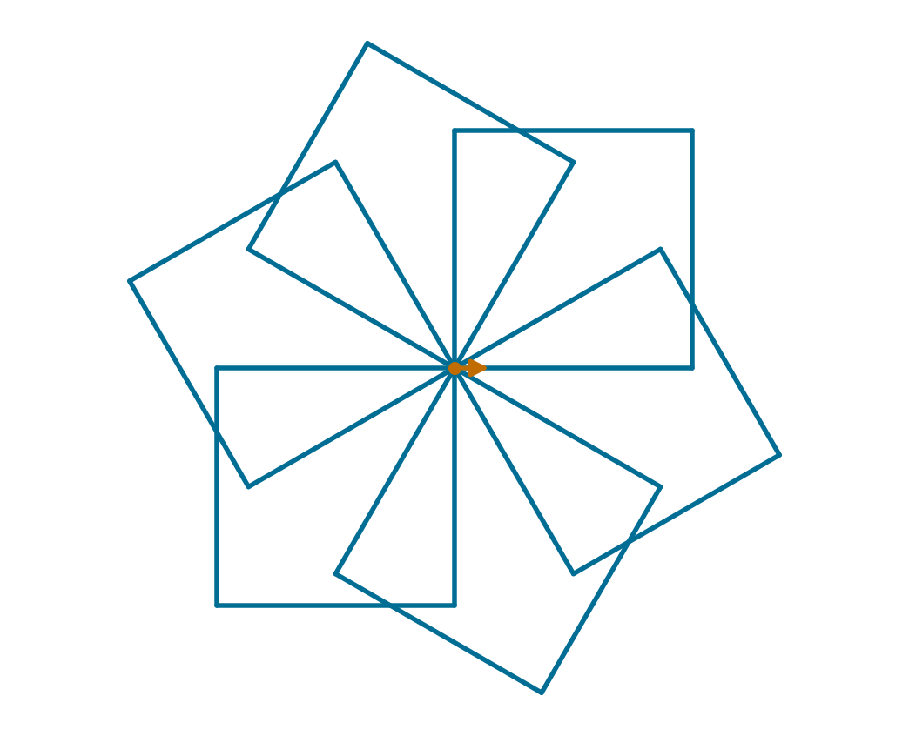
Nested turtle loops
PYTHON
for shape in range(6):
for side in range(4):
t.forward(70)
t.left(90)
t.left(60)
forward runs 24 times. The outer left(60) runs 6 times.
Dot: start Arrow: final heading
The inner loop draws a square. The outer loop repeats and rotates it.

Slide 51
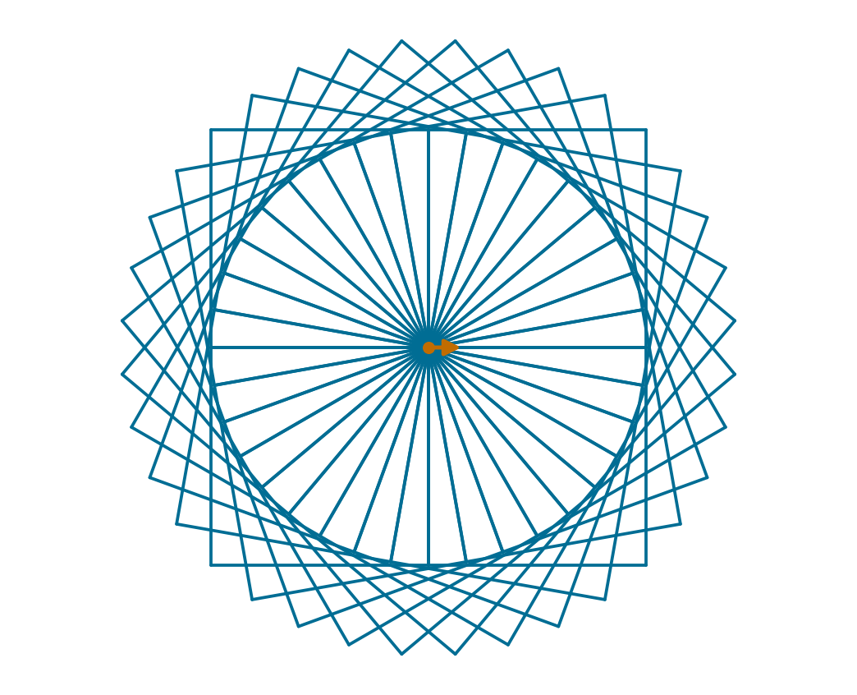
A square rosette
PYTHON
for shape in range(36):
for side in range(4):
t.forward(100)
t.left(90)
t.left(10)
360 / 36 gives the outer turn of 10°. t.speed(0) draws faster.
Dot: start Arrow: final heading
36 squares × 4 sides = 144 forward movements.

Slide 52
Broken code 5: the pattern overlaps
BROKEN CODE
for shape in range(6):
for side in range(4):
t.forward(70)
t.left(90)
t.left(60)
Required drawing
Six squares at different angles around the same starting point.
Your task
Predict where every square starts. Decide where the final turn belongs.
There is no syntax error. The indentation changes how often the turn runs.

Slide 53
Repair 5: rotate after every square
PYTHON
for shape in range(6):
for side in range(4):
t.forward(70)
t.left(90)
t.left(60)
Broken version: six overlapping squares, then one final turn.
Dot: start Arrow: final heading
The 60° turn belongs inside the outer loop, outside the inner loop.

Slide 54
break exits a loop early
PYTHON
for value in [2, 4, -1, 8]:
if value < 0:
break
print(value)
print("Done")
Output
2
4
Done
What happens at -1?
break leaves this loop immediately. Neither -1 nor 8 prints.
Execution continues with the first statement after the loop.

Slide 55
continue skips the rest of one pass
PYTHON
for value in [2, 4, -1, 8]:
if value < 0:
continue
print(value)
print("Done")
Output
2
4
8
Done
What happens at -1?
continue skips print for that pass. The for loop then takes the next item, 8.
continue does not end the whole loop.

Slide 56
break and continue compared
At the negative value | break version | continue version
Current iteration | Stops | Skips remaining statements
Remaining list items | Not visited | Still visited
Printed values | 2, 4 | 2, 4, 8
After the loop | Prints Done | Prints Done
Choose break to stop processing. Choose continue to skip an item.

Slide 57
break leaves only the nearest loop
PYTHON
for row in range(1, 3):
for column in range(1, 4):
if column == 2:
break
print(row, column)
Output
1 1
2 1
Why row 2 still runs
break exits the inner column loop. The outer row loop continues.
Without break there would be six printed pairs. Here there are two.

Slide 58
continue in while needs care
PYTHON
n = 0
while n < 5:
n += 1
if n == 3:
continue
print(n)
Output
1
2
4
5
Why update first?
If continue skipped the update while n stayed 3, the loop could repeat forever.
Every repeated path must still allow the loop to make progress.

Slide 59
Repeated random trials: dice
PYTHON
import random
random.seed(7)
for turn in range(3):
roll = random.randint(1, 6)
print("Roll:", roll)
Sample output here
Roll: 3
Roll: 2
Roll: 4
Random values
randint(1, 6) includes 1 and 6. Rolls may repeat. The fixed seed repeats this trial in the same environment.
Random outcomes need not be different. Deliberate tests are still needed.

Slide 60
Counting heads in 20 trials
PYTHON
import random
random.seed(7)
heads = 0
for trial in range(20):
if random.randint(0, 1) == 1:
heads += 1
print("Heads:", heads)
print("Tails:", 20 - heads)
The rule
Treat 1 as heads and 0 as tails. The counter only changes for heads.
Checks
heads must be between 0 and 20. Heads plus tails must equal 20.
Sample output here
Heads: 6
Tails: 14
Twenty trials do not guarantee ten heads. Change the seed and compare.

Slide 61
Useful loop tests
Test | Example | What to check
Zero passes | [] or range(0) | No body execution
One pass | [7] or range(1) | Exactly one update
Several passes | [4, 7, 2] | Correct order and final result
Boundary | length = 125 | Does <= include the last line?
Immediate exit | First input is stop | Sentinel is not processed
Write expected results before running. Check counts as well as final outputs.

Slide 62
Debugging challenge: two small faults
A: WRONG COUNT
B: WRONG SHAPE
positives = 0
for value in [3, -2, 1]:
if value > 0:
positives += value
print(positives)
for side in range(3):
t.forward(100)
t.left(60)
A: count positive values. B: draw a closed equilateral triangle. Predict, fix and test.

Slide 63
Debugging challenge: solutions
A: ADD ONE PER MATCH
B: EXTERIOR TURN
positives = 0
for value in [3, -2, 1]:
if value > 0:
positives += 1
print(positives)
for side in range(3):
t.forward(100)
t.left(120)
A: output is 2, not 4. B: three exterior turns of 120° make a full 360°.

Slide 64
Final task: eight rotated squares
8-MINUTE TASK
The pattern
Use nested loops to draw 8 squares. Each square has side length 60.
The rotation
Turn left 45° after each complete square. Start each square at the same point.
Checks and extension
32 forward movements and 8 outer turns. Extension: try 12 squares with 30° turns.
2 min plan, 4 min code, 2 min test. Keep the two indentation levels clear.

Slide 65
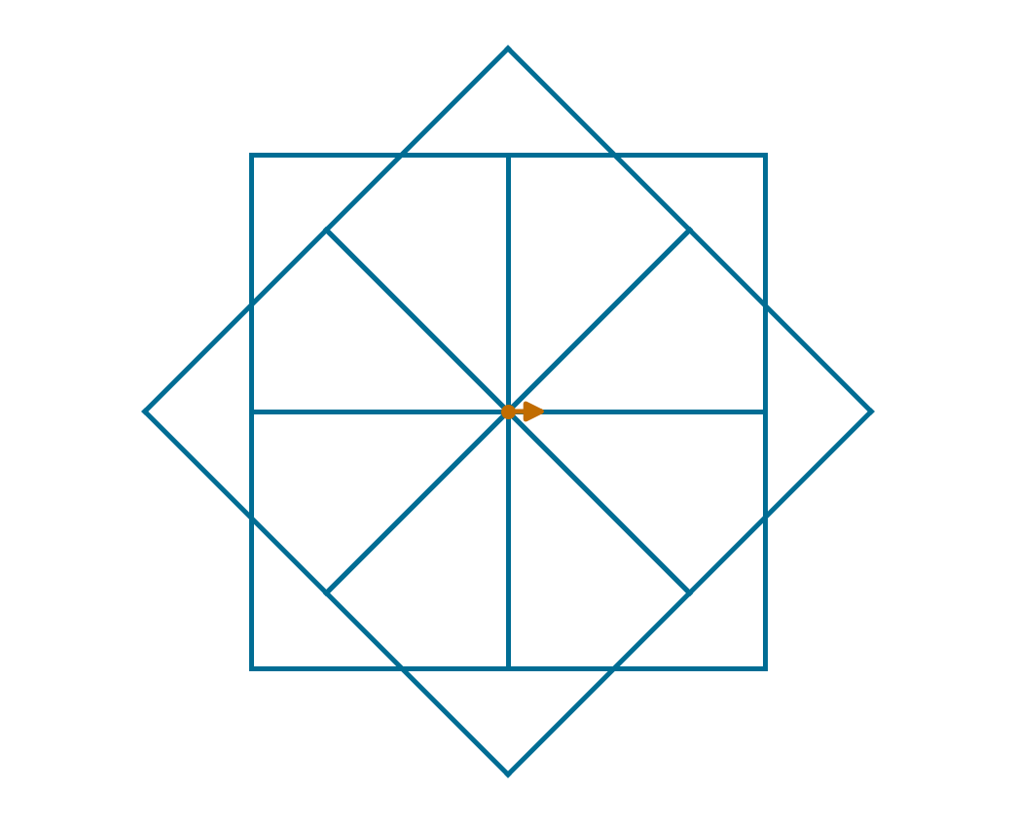
Final task solution
PYTHON
for shape in range(8):
for side in range(4):
t.forward(60)
t.left(90)
t.left(45)
The inner body runs 8 × 4 = 32 times. The outer turn runs 8 times.
Dot: start Arrow: final heading
4 turns close each square. 8 outer turns distribute the squares around 360°.

Slide 66
Exit questions
1. Range and totals
What values does range(2, 8, 2) give? Where should total = 0 go?
2. Stopping
Why can a while loop run zero times? What must change in a countdown?
3. Loop control
How does break differ from continue? How many sides do 7 squares draw?
Answer without running code. Then check the next slide.

Slide 67
Exit answers
1. Range and totals
2, 4, 6. Initialise the total before the loop so it keeps earlier contributions.
2. Stopping
A False first test skips the body. Decrease the countdown until its test is False.
3. Loop control
break exits the nearest loop. continue skips the rest of one pass. 7 × 4 = 28 sides.
You should be able to explain the output, the state changes and the stopping rule.

Slide 68
Course alignment and reading
How to Think Like a Computer Scientist
Learning with Python 3: §§3.3-3.4, 7.2-7.4, 7.15-7.18, 7.22 and Chapter 11.
Other core books
Irv Kalb, Learn to Program with Python 3 (2018), Chapter 6. OCR AS/A Level Computer Science, Chapter 55, pp. 299-302.

