Slide 1
Binary and
hexadecimal
How computers represent numbers
Worked examples and student tasks
Dr. Séamus Cummins

Slide 2
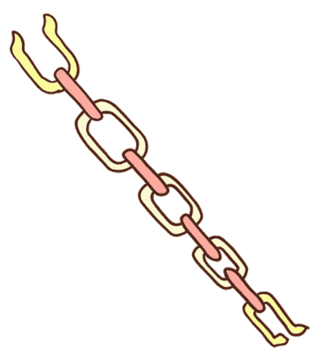
Dr. Kavanagh’s Chain Problem
Your rent is overdue and you have no money to pay until next month. Your very reasonable landlord is willing to make a deal, if you can give something as collateral each day, they will let you pay at the end of August instead of the beginning.
You have a gold chain that is 31 cm long, so you propose to give 1 cm of it to the landlord per day and if you cannot pay then they keep it in place of the rent. You can exchange previous pieces for new longer piece of the chain previously given to the landlord.
What is the best way to split the chain to avoid breaking it into too many pieces and make the repair at the end of the month easier?
Again, we need an answer but more importantly a clear reasoning!

Slide 3

Solution
1
2
4
8
16
Need to hand over 1cm per day
Could make 30 cuts to make 31 pieces but this would be difficult to reassemble.
1st day need 1cm
2nd day need 2cm
3rd day need 3cm
Can exchange previous pieces for new longer piece
Minimum solution:
  1,2,4,8,16
Check if you can make any number from 1 to 31!
Why does it work?
Binary!
  16, 8, 4, 2, 1
  1, 1, 1, 1, 1 = 31
  23 = 10111
  15 = 01111

Slide 4
By the end of this lesson
You will be able to
You will also be able to
Explain binary and hex.
Convert between binary,
decimal and hexadecimal.
Show your working.
Explain why hex is useful
for colours and addresses.

Slide 5
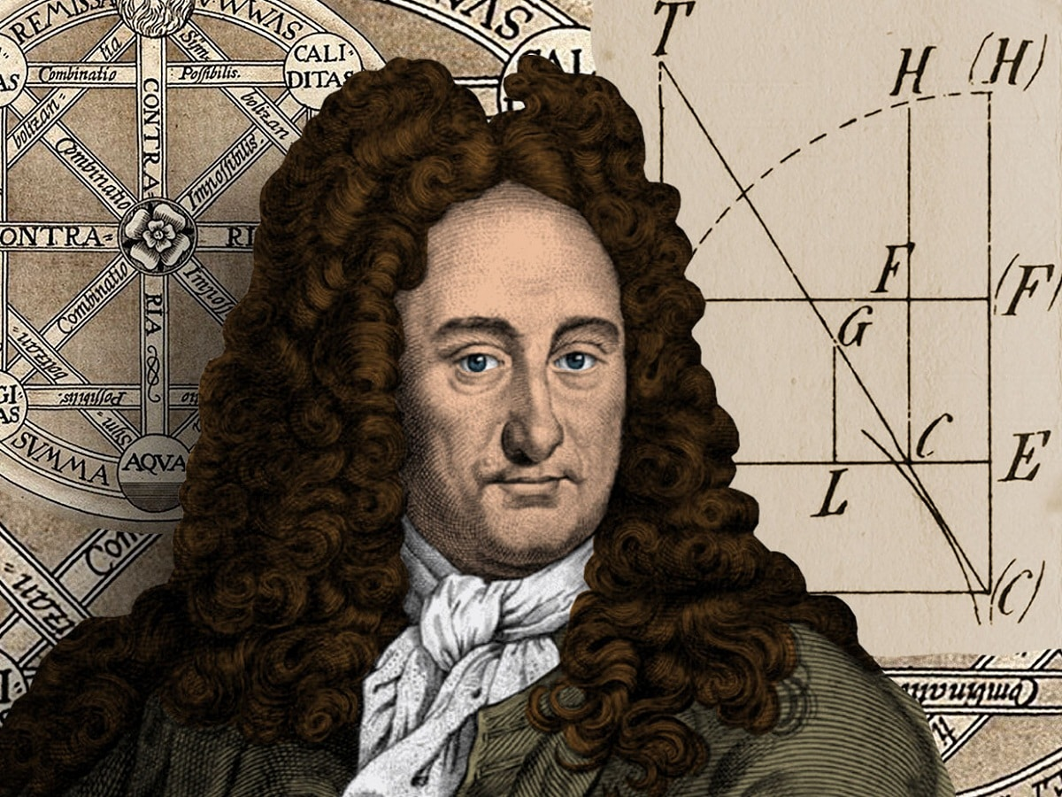
History and context
1703: Leibniz
Describes arithmetic using only 0 and 1.
1938: Shannon
Links Boolean logic to switching circuits.
1960s: hexadecimal
Computer manuals use hex as compact binary notation.
Binary predates electronic computers by centuries.

Slide 6
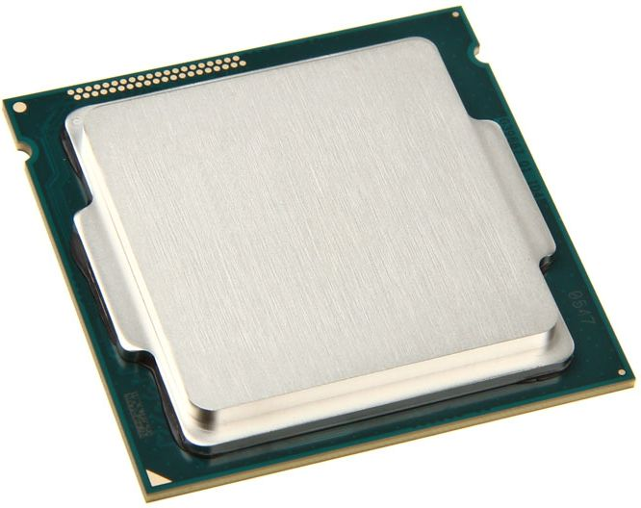
Why computers use binary
Two logical states
Circuits distinguish states represented as 0 and 1.
One bit
One binary digit: either 0 or 1.
Patterns of bits
Represent numbers, text, images and instructions.
A byte is a group of 8 bits.

Slide 7
Decimal (Denary) place value
Position | Hundreds | Tens | Ones
Place value | 100 | 10 | 1
Digit in 347 | 3 | 4 | 7
Contribution | 300 | 40 | 7
347 = (3 × 100) + (4 × 10) + (7 × 1)

Slide 8
Binary place value
Place | 128 | 64 | 32 | 16 | 8 | 4 | 2 | 1
Bit | 0 | 0 | 1 | 0 | 1 | 1 | 0 | 1
Each step left doubles the place value. Only 0 and 1 are allowed.

Slide 9
Worked example: binary to decimal
00101101 in binary
Add the values
Place values with a 1:
32, 8, 4, 1
32 + 8 + 4 + 1 = 45
00101101 in binary
= 45 in decimal
Read the bits one at a time. Include only positions containing 1.

Slide 10
Task 1: binary to decimal
Convert these numbers
Show your working
A. 00001101
B. 00010110
C. 10100101
Write the place values.
Add the values selected
by the 1 bits.
Two minutes alone, then compare and explain one answer.

Slide 11
Task 1: answers
Binary | Working | Decimal
00001101 | 8 + 4 + 1 | 13
00010110 | 16 + 4 + 2 | 22
10100101 | 128 + 32 + 4 + 1 | 165
A final 1 means the unsigned number is odd.

Slide 12
Worked example: decimal to binary
Make decimal 26
Mark each position
16 fits. Remaining: 10
8 fits. Remaining: 2
4 does not fit.
2 fits. Remaining: 0
1 is not needed.
Places: 16, 8, 4, 2, 1
Bits: 1, 1, 0, 1, 0
26 in decimal
= 11010 in binary
In 8 bits, write 00011010. Check: 16 + 8 + 2 = 26.

Slide 13
Task 2: decimal to binary
Write each in 8 bits
Place values
A. 19
B. 42
C. 200
128, 64, 32, 16,
8, 4, 2, 1
Check by converting
your answer back.
Extension: can 256 fit in an unsigned 8-bit number?

Slide 14
Task 2: answers
Decimal | Working | 8-bit binary
19 | 16 + 2 + 1 | 00010011
42 | 32 + 8 + 2 | 00101010
200 | 128 + 64 + 8 | 11001000
Leading zeroes fill the requested width without changing the value.

Slide 15
Hexadecimal is base 16
Sixteen symbols
Why use letters?
0 1 2 3 4 5 6 7 8 9
A B C D E F
A = 10, B = 11, C = 12
D = 13, E = 14, F = 15
One position needs
16 different symbols.
After F comes 10.
Hex 10 means decimal 16.
In programming, 0x2F often means the hexadecimal number 2F.

Slide 16
One hex digit represents four bits
Decimal | Binary | Hex
0 | 0000 | 0
1 | 0001 | 1
2 | 0010 | 2
3 | 0011 | 3
4 | 0100 | 4
5 | 0101 | 5
6 | 0110 | 6
7 | 0111 | 7
Decimal | Binary | Hex
8 | 1000 | 8
9 | 1001 | 9
10 | 1010 | A
11 | 1011 | B
12 | 1100 | C
13 | 1101 | D
14 | 1110 | E
15 | 1111 | F
Four bits have 16 possible patterns: exactly enough for one hex digit.

Slide 17
Worked example: hex to decimal
2F in hexadecimal
A second example
Place values: 16 and 1
2F = (2 × 16) + (15 × 1)
= 32 + 15 = 47
3A = (3 × 16) + (10 × 1)
= 48 + 10 = 58
What is 10 in hexadecimal worth in decimal?

Slide 18
Worked example: decimal to hex
Convert decimal 94
The result
94 ÷ 16 = 5 remainder 14
5 goes in the sixteens place.
14 becomes the hex digit E.
94 in decimal = 5E in hex
Check:
(5 × 16) + 14 = 94
This two-digit method works for values from 0 to 255.

Slide 19
Worked example: binary to hex
Group from the right
Convert each group
11010110
1101 0110
D 6
1101 = 13 = D
0110 = 6
11010110 in binary = D6 in hex
A shorter example: 10110 becomes 0001 0110, so it is hex 16.

Slide 20
Worked example: hex to binary
Expand each hex digit
Keep all four bits
3A
3 = 0011
A = 1010
3A in hex
= 0011 1010 in binary
= 58 in decimal
Hex 0F becomes 0000 1111 when written as one byte.

Slide 21
Task 3: conversions in both directions
Binary and hex
Decimal and hex
A. 11110000 (binary) to hex
B. 7B (hex) to 8-bit binary
C. 2C (hex) to decimal
D. 63 (decimal) to hex
E. 80 (decimal) to hex
Use the lookup table. Show one line of working for each answer.

Slide 22
Task 3: answers
Question | Working | Answer
A | 1111 = F, 0000 = 0 | F0 hex
B | 7 = 0111, B = 1011 | 01111011 binary
C | (2 × 16) + 12 | 44 decimal
D | 63 = (3 × 16) + 15 | 3F hex
E | 80 = (5 × 16) + 0 | 50 hex
Same value, different notation.

Slide 23

Hexadecimal in colour codes
Six-digit RGB notation
#RRGGBB: red, green and blue.
Each pair is one byte
00 means 0. FF means 255.
Example: #FF0000
Full red, zero green, zero blue.
What colour does #0000FF describe?
Notes:
Number systems. Slide 21 of 25.
Timing: 49–52 minutes (3 minutes). Session total: 60 minutes.
Answer: blue. The photograph shows the RGB subpixels of a display; it illustrates the channels, not the abstract stored numbers themselves. Ask for #FFFFFF (white) and #000000 (black) if time allows. The six-digit CSS form uses two hex digits per channel, so values run from 00 to FF. Other valid CSS colour syntaxes exist but are outside this lesson. Source: https://developer.mozilla.org/en-US/docs/Web/CSS/Reference/Values/hex-color
Syllabus: NCUK IFY Computer Science Module Specification v1.2, LO2 AC2.1. Exemplar Teaching Plan v1.1, number systems, pp. 52–54. This lesson covers unsigned whole-number representations. Signed integers, binary arithmetic and overflow receive later lessons. Practice questions are teacher-created, not official assessment items.
Image: https://www.notebookcheck.net/Gigaset-ME-Smartphone-Review.160174.0.html
Asset URL: https://www.notebookcheck.net/fileadmin/Notebooks/Gigaset/ME/subpixel_Gigaset_ME.jpg
Online image used as a teaching illustration. Photographs do not depict this DCU class. Historical screenshots and maps are conceptual examples, not current operational guidance.

Slide 24
Bytes, ranges and memory addresses
Unsigned 8-bit range
A compact address
8 bits have 256 patterns.
00000000 = 0
11111111 = 255
Hex range: 00 to FF
Example memory address:
0x3A7F
Binary: 0011 1010 0111 1111
Hex uses fewer written digits. The underlying bit pattern is unchanged.

Slide 25
Exit task: explain as well as convert
Calculate
Explain
1. 00111001 binary to decimal
2. 45 decimal to hex
3. A5 hex to 8-bit binary
4. Why can one hex digit
represent exactly four bits?
5. Is 256 the largest
unsigned 8-bit value?
Work independently, then check your reasoning with the answer slide.

Slide 26
Exit task: answers
Question | Answer
1 | 32 + 16 + 8 + 1 = 57
2 | 45 = (2 × 16) + 13, so the answer is 2D
3 | A = 1010 and 5 = 0101, so the answer is 10100101
4 | Four bits give 16 patterns, matching the 16 hex symbols
5 | No. There are 256 patterns, representing 0 to 255
A correct method makes your answer easy to check.

Slide 27
The essential ideas
Binary
Hexadecimal
Base 2 uses 0 and 1.
Place values double
as you move left.
Base 16 uses 0–9 and A–F.
One hex digit represents
four bits.
Decimal, binary and hex can all describe the same number.

Slide 28
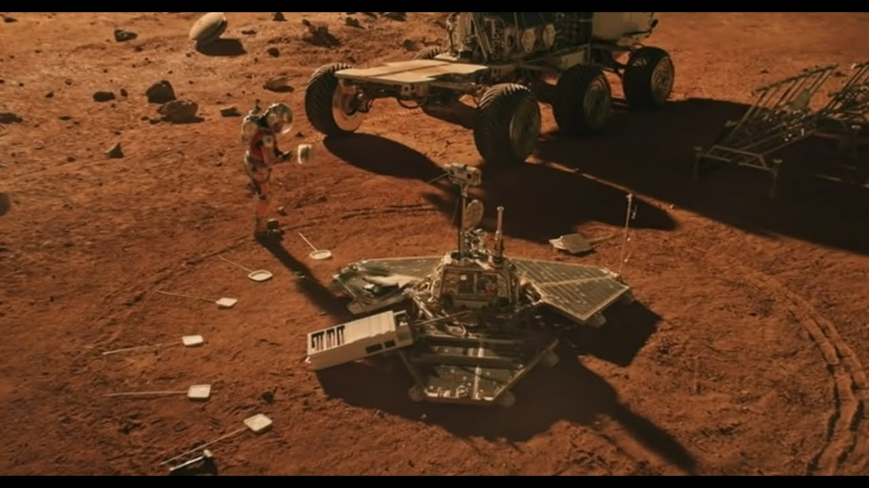
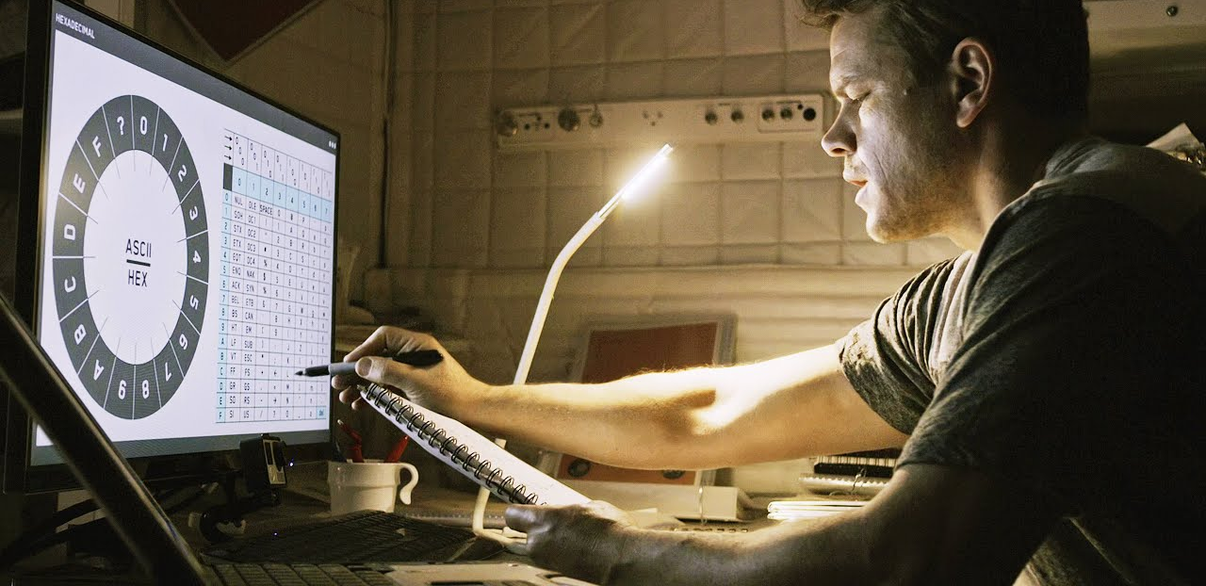
“We’ll need to talk faster than yes/no questions every half hour. The camera can rotate 360 degrees, and I have plenty of antenna parts. Time to make an alphabet. But I can’t just use the letters A through Z. Twenty-six letters plus my question card would be twenty-seven cards around the lander. Each one would only get 13 degrees of arc. Even if JPL points the camera perfectly, there’s a good chance I won’t know which letter they meant.”

Slide 29
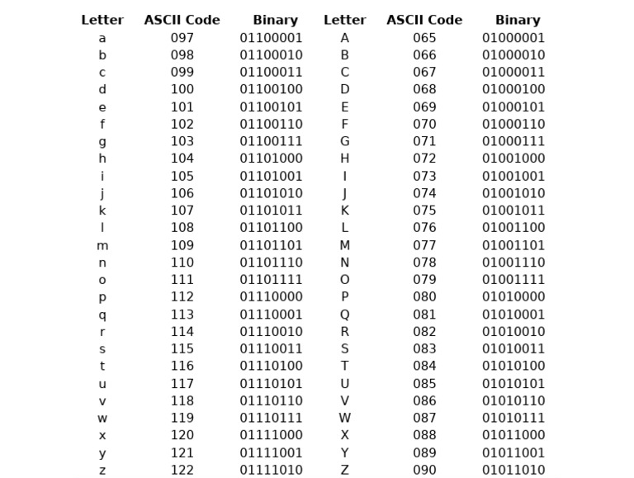

Slide 30
Thank you.

