Slide 1
Python Functions
Dr. Séamus Cummins

Slide 2
The lesson
A new way to organise code
Give a useful operation a name, pass data into it and return a result.
What you will practise
Definitions, calls, parameters, scope, turtle functions and small automated tests.

Slide 3
A repeated calculation
PYTHON
width = 6
height = 4
area = width * height
print(area)
width = 9
height = 3
area = width * height
print(area)
Output
24
27
The repeated idea
Calculate the area of a rectangle. The dimensions change, but the rule stays the same.
A function names the rule so that callers can reuse it.

Slide 4
Functions and procedures
Function
A named block that can receive data and return a value to its caller.
Procedure
A subroutine used mainly for an action, such as printing or drawing. Python also defines it with def.
Python return value
Every completed Python function call returns a value. With no explicit value, it returns None.

Slide 5
A first definition and call
PYTHON
def greet():
print("Hello, programmers!")
greet()
greet()
Output
Hello, programmers!
Hello, programmers!
Definition and call
def creates the function. Each greet() call runs its body.
The colon and indentation mark the function body.

Slide 6
Execution follows the calls
PYTHON
def ping():
print("Inside")
print("Before")
ping()
print("After")
Output
Before
Inside
After
Return to caller
After the function finishes, execution continues after the call.

Slide 7
Tracing a function call
Step | What happens | Output
1 | Execute def and create ping | None yet
2 | Run first top-level print | Before
3 | Call ping and enter its body | Inside
4 | Return and run final print | After
Creating a function does not run its body.

Slide 8
Broken code: no call
BROKEN CODE
def greet():
print("Welcome")
greet
Actual behaviour
No output in a saved script.
Your task
The final line refers to the function but does not call it. Add the required punctuation.
The repair is greet(), with parentheses.

Slide 9
Parameters receive arguments
PYTHON
def greet(name):
print("Hello", name)
greet("Maya")
greet("Omar")
Output
Hello Maya
Hello Omar
Vocabulary
name is the parameter in the definition. "Maya" is an argument supplied by a call.

Slide 10
Parameters and arguments
Part | Example | Meaning
Definition | def greet(name): | name is a parameter
Call with a literal | greet("Maya") | Argument value is "Maya"
Call with a variable | greet(student) | The value of student is passed
Caller and parameter variable names do not have to match.

Slide 11
Two parameters and argument order
PYTHON
def show_trip(city, days):
print(city, "for", days, "days")
show_trip("Dublin", 3)
show_trip(days=2, city="Cork")
Output
Dublin for 3 days
Cork for 2 days
Two calling styles
Positional arguments match by order. Keyword arguments match the parameter names.
Use clear parameter names. Required arguments must be supplied.

Slide 12
Broken code: a missing argument
BROKEN CODE
def show_trip(city, days):
print(city, "for", days, "days")
show_trip("Dublin")
Failure
TypeError: the required days argument is missing.
Repair
Call show_trip("Dublin", 3). Expected output: Dublin for 3 days.

Slide 13
Task 1: a reusable greeting
8-MINUTE TASK
Your program
Write greet(name, course). It must print Welcome NAME to COURSE. Call it for two different students.
Required checks
greet("Ada", "Python") prints Welcome Ada to Python. The second call must use different values.
Plan and explain
Keep input outside the function. Use two parameters and no return value yet.
Work independently, then compare the reasoning with a partner.

Slide 14
Task 1 solution
PYTHON
def greet(name, course):
print(f"Welcome {name} to {course}")
greet("Ada", "Python")
greet("Maya", "Computing")
Output
Welcome Ada to Python
Welcome Maya to Computing
Reuse
Both calls run the same definition with different arguments.

Slide 15
Returning a calculated value
PYTHON
def rectangle_area(width, height):
return width * height
answer = rectangle_area(6, 4)
print(answer)
print(rectangle_area(9, 3))
Output
24
27
Data flow
The function computes a value. The caller chooses whether to store or print it.
return sends a value back and immediately ends this call.

Slide 16
Print and return have different jobs
PYTHON
def show_double(n):
print(n * 2)
result = show_double(5)
print("Stored:", result)
Output
10
Stored: None
Why
print displays 10. show_double reaches its end without returning a value, so its result is None.

Slide 17
A returned value can be reused
PYTHON
def double(n):
return n * 2
result = double(5)
print(result + 3)
Output
13
Why
double returns 10. The caller can use that value in another calculation.
A return value alone is not automatically printed by a saved script.

Slide 18
Broken code: missing return
BROKEN CODE
def add(a, b):
total = a + b
answer = add(3, 4)
print(answer + 1)
Required result
8
Actual failure
add returns None. Adding 1 to None raises TypeError.
Add return total inside the function, after the calculation.

Slide 19
Repair: return the result
PYTHON
def add(a, b):
total = a + b
return total
answer = add(3, 4)
print(answer + 1)
Output
8
Trace
Arguments 3 and 4 become a and b. total becomes 7. The caller receives 7.

Slide 20
Return ends the current call
PYTHON
def label(score):
if score >= 50:
return "Pass"
return "Try again"
print(label(50))
print(label(49))
Output
Pass
Try again
Branches
The first return ends a passing call. A lower score reaches the final return.
These are classroom thresholds. Assume score is a number from 0 to 100.

Slide 21
Broken code: an uncovered route
BROKEN CODE
def label(score):
if score >= 50:
return "Pass"
print(label(49))
Output
None
Your task
Supply a return value for the failing route. Test scores 49, 50 and 51.
Repair: add return "Try again" after the if block, as on the previous slide.

Slide 22
Local names belong to a call
PYTHON
score = 10
def add_bonus(score):
score = score + 5
return score
print(add_bonus(score))
print(score)
Output
15
10
Scope
The parameter score is local to the call. Reassigning it does not reassign the caller's score.
To keep the new value outside, use score = add_bonus(score).

Slide 23
Broken code: a local name outside
BROKEN CODE
def rectangle_area(width, height):
area = width * height
return area
rectangle_area(6, 4)
print(area)
Failure
NameError: area is local to the function.
Your repair
Store the returned value in a caller variable, then print that variable.

Slide 24
Repair: explicit data passing
PYTHON
def rectangle_area(width, height):
area = width * height
return area
result = rectangle_area(6, 4)
print(result)
Output
24
Names
area exists inside the call. result belongs to the caller. return passes the value between them.

Slide 25
Local and global variables
Local
Parameters and names assigned inside a function normally belong to that call.
Global
A name assigned at the top level belongs to the module. Functions can read it unless a local name shadows it.
Clear data flow
Prefer parameters for required inputs and return for results. Avoid functions that secretly change global variables.
global can rebind a module-level name from inside a function, but these examples do not need it.

Slide 26
Task 2: a temperature function
10-MINUTE TASK
Your program
Write celsius_to_fahrenheit(celsius). Return celsius * 9 / 5 + 32. Keep input and print outside the function.
Required checks
0 gives 32.0. 100 gives 212.0. -40 gives -40.0.
Plan and explain
Call the function three times and compare each result with its expected value.
Work independently, then compare the reasoning with a partner.

Slide 27
Task 2 solution and checks
PYTHON
def celsius_to_fahrenheit(celsius):
return celsius * 9 / 5 + 32
print(celsius_to_fahrenheit(0))
print(celsius_to_fahrenheit(100))
print(celsius_to_fahrenheit(-40))
Output
32.0
212.0
-40.0
Contract
Accept a numeric temperature in Celsius and return its Fahrenheit equivalent.

Slide 28
A Boolean function answers a question
PYTHON
def is_even(number):
return number % 2 == 0
for number in [3, 4, 0, -2]:
if is_even(number):
print(number)
Output
4
0
-2
Use
The function returns True or False. if uses that result directly.
For integer inputs, a remainder of 0 means divisible by 2.

Slide 29
A function can contain a loop
PYTHON
def count_vowels(text):
count = 0
for letter in text.lower():
if letter in "aeiou":
count += 1
return count
print(count_vowels("Education"))
Output
5
Return position
Return after the whole traversal. Each call starts its own counter at 0.

Slide 30
Broken code: returning too soon
BROKEN CODE
def count_vowels(text):
count = 0
for letter in text.lower():
if letter in "aeiou":
count += 1
return count
print(count_vowels("banana"))
Actual output
0
Your task
The function stops after the first character. Move return so every character is visited.
The repaired version returns 3 for banana and 0 for an empty string.

Slide 31
Break, continue and return
Statement | Where it acts | What follows
break | Nearest enclosing loop | Continue after that loop
continue | Current loop pass | Next iteration or condition test
return value | Current function call | Caller receives value
A return inside a nested loop leaves the whole function call.

Slide 32
Small automated tests
PYTHON
def count_vowels(text):
count = 0
for letter in text.lower():
if letter in "aeiou":
count += 1
return count
assert count_vowels("") == 0
assert count_vowels("AE") == 2
assert count_vowels("Sky!") == 0
Success
No output: all assertions passed.
Failure
A false assertion raises AssertionError. Expected results should come from the requirement.
Assertions are development checks. Use normal validation for user input.

Slide 33
A useful function contract
Input
count_vowels accepts a string. It treats A, E, I, O and U like lowercase vowels.
Result
It returns an integer count. Empty input returns 0.
Behaviour
It does not ask for input or print. This makes automated checks straightforward.

Slide 34
A docstring explains the function
PYTHON
def square(number):
"""Return number multiplied by itself."""
return number * number
print(square(6))
Output
36
Documentation
A docstring is the first statement in the body. It explains purpose, inputs or results.
Choose a meaningful name and a short, useful description.

Slide 35
Functions can call other functions
PYTHON
def square(number):
return number * number
def sum_of_squares(a, b):
return square(a) + square(b)
print(sum_of_squares(3, 4))
Output
25
Trace
square(3) returns 9. square(4) returns 16. Their sum returns to the caller.
Both definitions must have executed before the bottom call runs.

Slide 36
The shared turtle setup
PYTHON
import turtle
screen = turtle.Screen()
screen.setup(800, 650)
t = turtle.Turtle()
t.speed(0)
# Definitions and calls go here
turtle.done()
Where to put code
Place the following drawing definitions and calls before turtle.done().
Complete programs
Use the code pack in a desktop Python environment with turtle/tkinter.

Slide 37
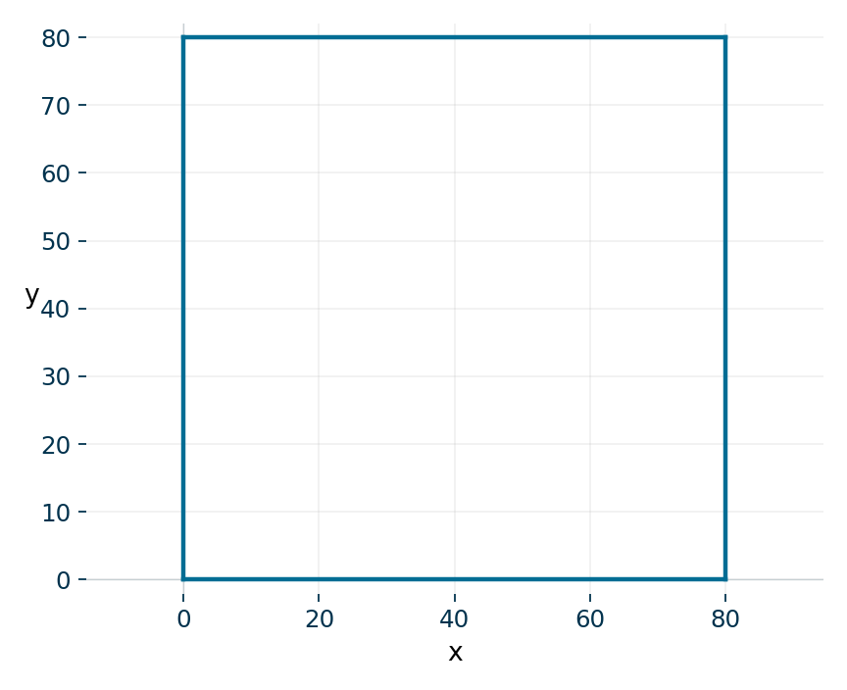
A turtle function receives the turtle
PYTHON
def draw_square(pen, size):
for side in range(4):
pen.forward(size)
pen.left(90)
draw_square(t, 80)
pen receives the turtle object. size receives the side length. The turtle draws a square and finishes at its starting position and heading.

Slide 38
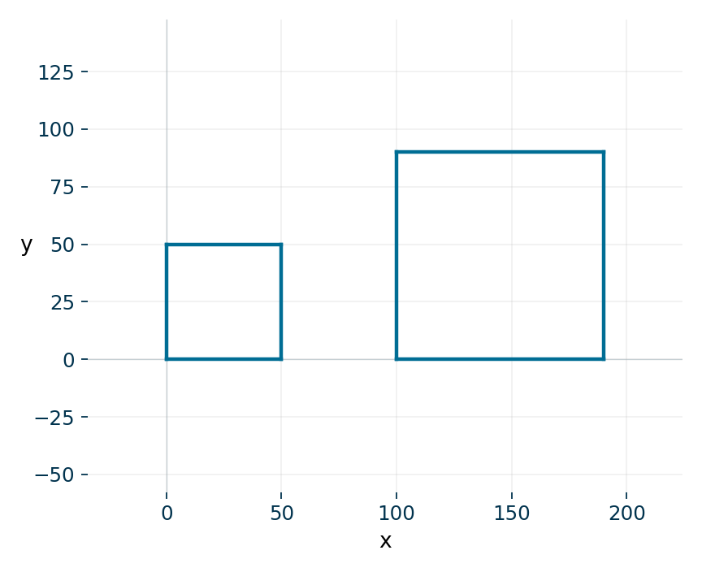
Reuse the drawing at a new position
PYTHON
def draw_square(pen, size):
for side in range(4):
pen.forward(size)
pen.left(90)
draw_square(t, 50)
t.penup()
t.goto(100, 0)
t.pendown()
draw_square(t, 90)
Two squares with side lengths 50 and 90. No joining line. One definition draws both sizes. The caller controls position.

Slide 39
Parameters can refer to mutable objects
PYTHON
def add_score(scores, value):
scores.append(value)
marks = [40, 60]
add_score(marks, 80)
print(marks)
Output
[40, 60, 80]
Shared object
scores and marks refer to the same list during this call. append changes that list.
Reassigning a local name and mutating a shared object have different effects.

Slide 40
A small modular program
Input and output
The caller reads values and displays results.
Processing
A function calculates or classifies using its parameters.
Benefits
You can test the calculation without typing input and reuse it in another program.
A function should have one clear purpose. A short function is easier to reason about.

Slide 41
Task 3: a reusable polygon
10-MINUTE TASK
Your program
Write draw_polygon(pen, sides, length). Use a loop and an exterior turn of 360 / sides. Call it for a triangle and a hexagon.
Required checks
With sides 3 or 6, the shape closes and the final heading matches the starting heading.
Plan and explain
Assume sides is an integer at least 3 and length is positive. Move with penup between calls.
Work independently, then compare the reasoning with a partner.

Slide 42
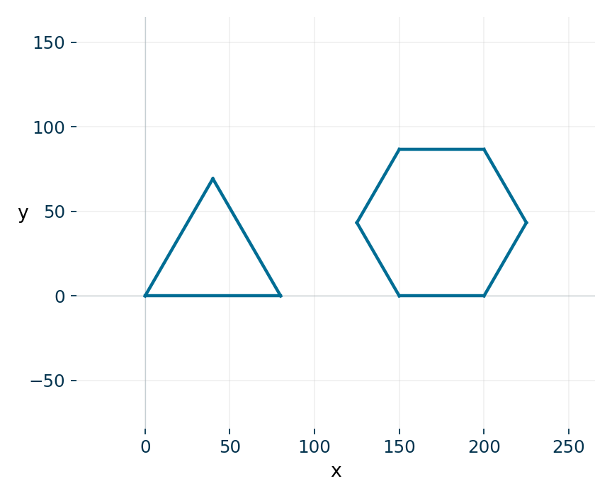
Task 3 solution
PYTHON
def draw_polygon(pen, sides, length):
for side in range(sides):
pen.forward(length)
pen.left(360 / sides)
draw_polygon(t, 3, 80)
t.penup()
t.goto(150, 0)
t.pendown()
draw_polygon(t, 6, 50)
sides is an integer of at least 3. length is positive. The total turn is 360 degrees for each call. Tiny coordinate rounding is normal.

Slide 43
Exit questions
Definitions and calls
What happens when def executes? What is the difference between a parameter and an argument?
Data
How does return differ from print? Why might a function return None?
Scope and loops
Can the caller use a local name directly? Why does return usually follow an accumulator loop?

Slide 44
Exit answers
Definitions and calls
def creates a function. Parameters receive the argument values supplied by a call.
Data
return sends a value to the caller. print displays text. A call that reaches the end returns None.
Scope and loops
A local name belongs to the call. Return after accumulation so all items contribute.
Next: decompose larger problems into several small functions with clear contracts.

Slide 45
Course alignment and reading
How to Think Like a Computer Scientist
Learning with Python 3, §§4.1-4.7, 6.1-6.7 and 11.13-11.15.
Other core books
Kalb, Learn to Program with Python 3, Chapter 4. OCR Computer Science, Chapter 56, subroutines and scope. Recursion is a later topic.
Use the examples and exercises to practise the specified Python skills.

