Slide 1
Python loop
problem solving
Dr. Séamus Cummins

Slide 2
The lesson
After iteration
Apply loops to strings, lists, input validation and turtle patterns.
Before functions
Keep each program small. Notice repeated solutions that could later become functions.

Slide 3
Warm-up: the loop facts
Count
How many values are in range(2, 9, 2)? What is the final value?
Stop
Can a while loop run zero times? What changes its condition?
Control
What does break leave? What does continue skip?

Slide 4
Warm-up answers
Count
Four values: 2, 4, 6, 8. The stop value 9 is excluded.
Stop
Yes, when its first test is False. Updates or new input can change the condition.
Control
break leaves the nearest loop. continue skips the remaining statements in one pass.

Slide 5
A string can be traversed
PYTHON
word = "Mars"
for letter in word:
print(letter)
Output
M
a
r
s
Traversal
letter receives one character on each pass. Spaces also count as characters.
An empty string gives zero passes.

Slide 6
Counting a selected character
PYTHON
text = "Banana".lower()
count = 0
for letter in text:
if letter == "a":
count += 1
print(count)
Output
3
Roles
The loop visits every character. The if decides whether to increment the counter.

Slide 7
Tracing the character counter
Character | Matches a? | Count after pass
b | False | 0
a | True | 1
n | False | 1
a | True | 2
n | False | 2
a | True | 3
Initialise the counter once, before traversal.

Slide 8
Broken code: resetting the count
BROKEN CODE
text = "banana"
for letter in text:
count = 0
if letter == "a":
count += 1
print(count)
Expected
3
Your task
Predict the actual result. Move one line and test an empty string.
A correct repair must also work when the loop has no passes.

Slide 9
Repair: one initialisation
PYTHON
text = "banana"
count = 0
for letter in text:
if letter == "a":
count += 1
print(count)
Output
3
Empty input
With text = "", count stays 0 and print still works.

Slide 10
Membership checks several alternatives
PYTHON
letter = "e"
print(letter in "aeiou")
print("z" in "aeiou")
print("ar" in "Mars")
Output
True
False
True
Meaning
For strings, in checks whether a substring occurs. A loop variable here holds one character.
For this lesson, vowels mean the English letters a, e, i, o and u.

Slide 11
Task 1: count vowels
12-MINUTE TASK
Your program
Ask for a phrase. Count vowels regardless of capital letters. Ignore spaces and punctuation.
Required checks
"Education" gives 5. "Sky!" gives 0. Empty input gives 0.
Plan and explain
Use lower, a for loop, membership and a counter.
Work independently, then compare the reasoning with a partner.

Slide 12
Task 1 solution
PYTHON
text = input("Phrase: ").lower()
vowels = 0
for letter in text:
if letter in "aeiou":
vowels += 1
print("Vowels:", vowels)
Example input
Education
Output
Vowels: 5
Check
A non-vowel makes no change to the count.

Slide 13
Building a new string
PYTHON
text = "meet me"
result = ""
for letter in text:
if letter == " ":
result += "_"
else:
result += letter
print(result)
Output
meet_me
Accumulator
result keeps the text built so far. Each pass adds one character.
The original string stays unchanged.

Slide 14
Task 2: hide the vowels
10-MINUTE TASK
Your program
Build a new version of a phrase with each vowel replaced by *. Preserve every other character and its case.
Required checks
"Hello Mars!" becomes "H*ll* M*rs!". "AE" becomes "**". Empty input stays empty.
Plan and explain
Test letter.lower() for membership, but append the original letter when it is not a vowel.
Work independently, then compare the reasoning with a partner.

Slide 15
Task 2 solution
PYTHON
text = input("Phrase: ")
result = ""
for letter in text:
if letter.lower() in "aeiou":
result += "*"
else:
result += letter
print(result)
Input
Hello Mars!
Output
H*ll* M*rs!
Preserved
Uppercase consonants, spaces and punctuation.

Slide 16
A list stores separate values
PYTHON
scores = [12, 7, 19, 7]
print(len(scores))
print(scores[0])
scores.append(10)
print(scores)
Output
4
12
[12, 7, 19, 7, 10]
Mutation
append changes the existing list by adding one item at the end.
A list may contain repeated values.

Slide 17
Filtering into a new list
PYTHON
scores = [42, 80, 50, 19]
passed = []
for score in scores:
if score >= 50:
passed.append(score)
print(passed)
Output
[80, 50]
Filter
Visit every item. Keep the items that satisfy the condition.
The original scores list remains unchanged.

Slide 18
Broken code: append returns None
BROKEN CODE
passed = []
passed = passed.append(80)
print(passed)
Output
None
Your task
The item was added, but the assignment lost the list reference. Repair the statement.

Slide 19
Repair: append as a statement
PYTHON
passed = []
passed.append(80)
print(passed)
Output
[80]
Reason
append mutates the list and returns None. Do not assign its return value to passed.

Slide 20
A search flag remembers success
PYTHON
names = ["Ada", "Maya", "Omar"]
target = "Maya"
found = False
for name in names:
if name == target:
found = True
break
print(found)
Output
True
Early exit
Once a match is found, the answer cannot change. break avoids more comparisons.
No match, including an empty list, leaves found as False.

Slide 21
Broken code: an answer per item
BROKEN CODE
names = ["Ada", "Maya", "Omar"]
target = "Maya"
for name in names:
if name == target:
print("Found")
else:
print("Not found")
Actual output
Not found
Found
Not found
Required result
One final answer for the whole search. Explain why each non-match proves too little.

Slide 22
Repair: report after searching
PYTHON
names = ["Ada", "Maya", "Omar"]
target = "Maya"
found = False
for name in names:
if name == target:
found = True
break
print("Found" if found else "Not found")
Output
Found
New expression
A if condition else B chooses one value. Here it selects the final message.
The print statement runs once, after the loop.

Slide 23
Finding the largest value
PYTHON
values = [-7, -2, -9]
largest = values[0]
for value in values:
if value > largest:
largest = value
print(largest)
Output
-2
Precondition
values must contain at least one number. Start with a real item, not an invented 0.
Every pass preserves the largest value seen so far.

Slide 24
Tracing a maximum
Current item | Largest before | Largest after
Initialise from first item | Not assigned | -7
-7 | -7 | -7
-2 | -7 | -2
-9 | -2 | -2
Starting at 0 would incorrectly return 0 for this all-negative list.

Slide 25
Task 3: filter temperatures
12-MINUTE TASK
Your program
For temperatures = [-3, 0, 8, -1, 12], build a list of values below 0 and print its length.
Required checks
Expected list: [-3, -1], count 2. Test an empty list and a list containing only 0.
Plan and explain
Build a new list while visiting the original. Avoid deleting items during traversal.
Work independently, then compare the reasoning with a partner.

Slide 26
Task 3 solution
PYTHON
temperatures = [-3, 0, 8, -1, 12]
freezing = []
for value in temperatures:
if value < 0:
freezing.append(value)
print(freezing)
print(len(freezing))
Output
[-3, -1]
2
Boundary
0 is excluded because the rule says below 0.

Slide 27
Validation has two questions
Can it convert?
int("hello") raises ValueError. Handle this with try/except.
Is it allowed?
int("150") succeeds, but a score of 150 is outside 0 to 100.
When to repeat
Keep asking while the entry is invalid. Stop only after a valid score.

Slide 28
A loop that accepts a valid score
PYTHON
while True:
try:
score = int(input("Score 0-100: "))
except ValueError:
print("Enter an integer")
continue
if 0 <= score <= 100:
break
print("Outside range")
print("Accepted:", score)
Try in order
hello, 101, 80
Output
Enter an integer
Outside range
Accepted: 80
continue retries after conversion failure. break ends the loop after valid input.

Slide 29
Tests for the input loop
Entries | Expected behaviour
hello, then 0 | Conversion message, then accept 0
-1, then 100 | Range message, then accept 100
101, then 99 | Range message, then accept 99
50 | Accept immediately
Test both included boundaries and values just outside them.

Slide 30
A sentinel must be checked first
PYTHON
total = 0
while True:
value = int(input("Number (-1 stops): "))
if value == -1:
break
total += value
print("Total:", total)
Input contract
Enter integers. -1 is reserved for stopping and cannot be data.
Example
Inputs 4, 7, -1 produce Total: 11.
Checking the sentinel before addition keeps it out of the total.

Slide 31
Broken code: the stop value is added
BROKEN CODE
total = 0
while True:
value = int(input("Number (-1 stops): "))
total += value
if value == -1:
break
print(total)
Inputs
4, 7, -1
Task
Predict the wrong result. Move the addition after the stopping test.
Repair output: 11. Immediate -1 should give 0.

Slide 32
Sentinel repair and test
Correct order
Read value. Test for -1. Break if matched. Otherwise add value.
The fault
The broken program adds -1 before exiting, so it reports 10 instead of 11.
Immediate stop
The correct version reports 0 because no data value was processed.
The complete corrected code is on the preceding sentinel example slide.

Slide 33
Two loops can describe coordinates
PYTHON
for row in range(2):
for column in range(3):
x = column * 60
y = row * 60
print(x, y)
Output
0 0
60 0
120 0
0 60
60 60
120 60
Count
2 rows × 3 columns = 6 positions.

Slide 34
The turtle setup for this lecture
PYTHON
import turtle
screen = turtle.Screen()
screen.setup(800, 650)
t = turtle.Turtle()
t.speed(0)
# Drawing code goes here
turtle.done()
Complete files
The code pack includes the setup with each drawing example.
Movement
Use penup while moving to a new drawing position.

Slide 35
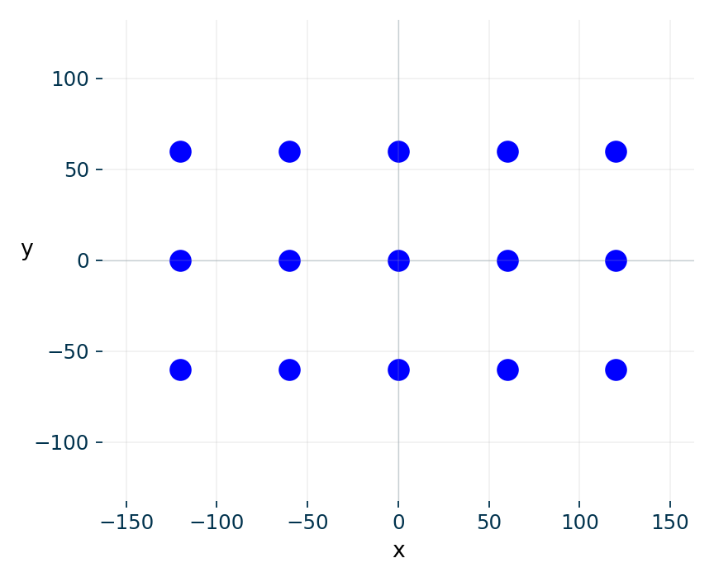
A grid of turtle dots
PYTHON
t.penup()
for row in range(3):
for column in range(5):
x = -120 + column * 60
y = -60 + row * 60
t.goto(x, y)
t.dot(20, "blue")
15 blue dots in 3 rows of 5. The centres are 60 units apart. dot draws even when the pen is up.

Slide 36
Task 4: a coloured dot grid
12-MINUTE TASK
Your program
Draw 4 rows of 6 dots, spaced 50 units apart. Start at (-125, -75). Even-numbered rows are blue, odd-numbered rows are red.
Required checks
24 dots. Rows 0 and 2 blue. Rows 1 and 3 red. No joining lines.
Plan and explain
Use row % 2 to select the colour and nested loops for the coordinates.
Work independently, then compare the reasoning with a partner.

Slide 37
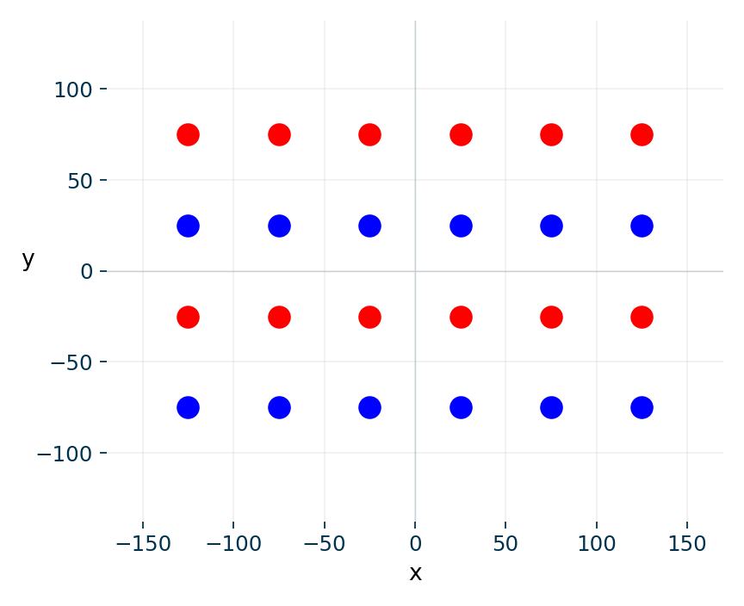
Task 4 solution
PYTHON
t.penup()
for row in range(4):
if row % 2 == 0:
colour = "blue"
else:
colour = "red"
for column in range(6):
x = -125 + column * 50
y = -75 + row * 50
t.goto(x, y)
t.dot(20, colour)
4 outer passes, 24 inner passes, 24 dots. Final position: (125, 75). Heading remains 0 degrees.

Slide 38
Exit questions
Strings
Why build a new string? What happens to a counter on empty input?
Lists
Why does maximum = 0 fail for an all-negative list?
Input
Where must the sentinel test go? What does continue do after ValueError?

Slide 39
Exit answers
Strings
Strings are immutable. A counter initialised before the loop remains 0 on empty input.
Lists
0 is larger than every negative item. Start from a real item in a nonempty list.
Input
Test before adding the sentinel. continue begins another input attempt.
Next: package a useful calculation or drawing into a named function.

Slide 40
Course alignment and reading
How to Think Like a Computer Scientist
Learning with Python 3, Chapter 7, §§8.5, 8.9 and 8.11, and Chapter 11.
Other core books
Kalb, Learn to Program with Python 3, Chapters 6, 7 and 8. OCR Computer Science, Chapter 55.
Use the examples and exercises to practise the specified Python skills.

