Slide 1
Python and Boolean Operators
Dr. Séamus Cummins

Slide 2
Comparison operators
Operator | Example | Meaning
== | code == "30" | Equal values
!= | answer != "yes" | Different values
< and > | age < 16, age > 16 | Strictly less or strictly greater
<= and >= | score <= 100, age >= 16 | Inclusive boundary
= | age = 16 | Assignment, not a comparison
Use == to test equality and = to assign a value. A comparison can be stored in a Boolean variable such as eligible = age >= 16.

Slide 3
Combining Boolean values
A | B | A and B | A or B | not A
False | False | False | False | True
False | True | False | True | True
True | False | False | True | False
True | True | True | True | False
and requires both conditions. or allows either or both. not reverses the truth value. Python spells these operators in lowercase.

Slide 4
A simple if statement
temperature = 32
if temperature > 30:
print("High temperature")
print("Reading complete")
The indented statement executes only if the condition is true. The final print runs regardless.
At temperature 32, both messages appear. At 30, only Reading complete appears because > excludes equality.

Slide 5
Two-way selection
number = -4
if number >= 0:
print("Non-negative")
else:
print("Negative")
Exactly one branch executes. For -4, the output is Negative.
Zero follows the first branch because >= includes the boundary.
The colon introduces a block. Indentation determines which statements belong to that block.

Slide 6
Multiple selection with elif
score = 72
if score >= 80:
medal = "Gold"
elif score >= 60:
medal = "Silver"
elif score >= 40:
medal = "Bronze"
else:
medal = "Practice round"
print(medal)
The score 72 fails the first condition and passes the second. The result is Silver. Python skips the remaining branches.
These are illustrative category thresholds. Order the upper thresholds from highest to lowest so that a high score does not match a lower category first.
Test 39, 40, 59, 60, 79 and 80.

Slide 7
Independent if statements
score = 85
if score >= 40:
print("Bronze threshold reached")
if score >= 60:
print("Silver threshold reached")
if score >= 80:
print("Gold threshold reached")
All three messages print because each if statement starts a separate decision.
Use independent if statements when several actions may apply. Use an if/elif/else chain when exactly one category should be selected.
A program can be syntactically correct while choosing the wrong structure for the requirement.

Slide 8
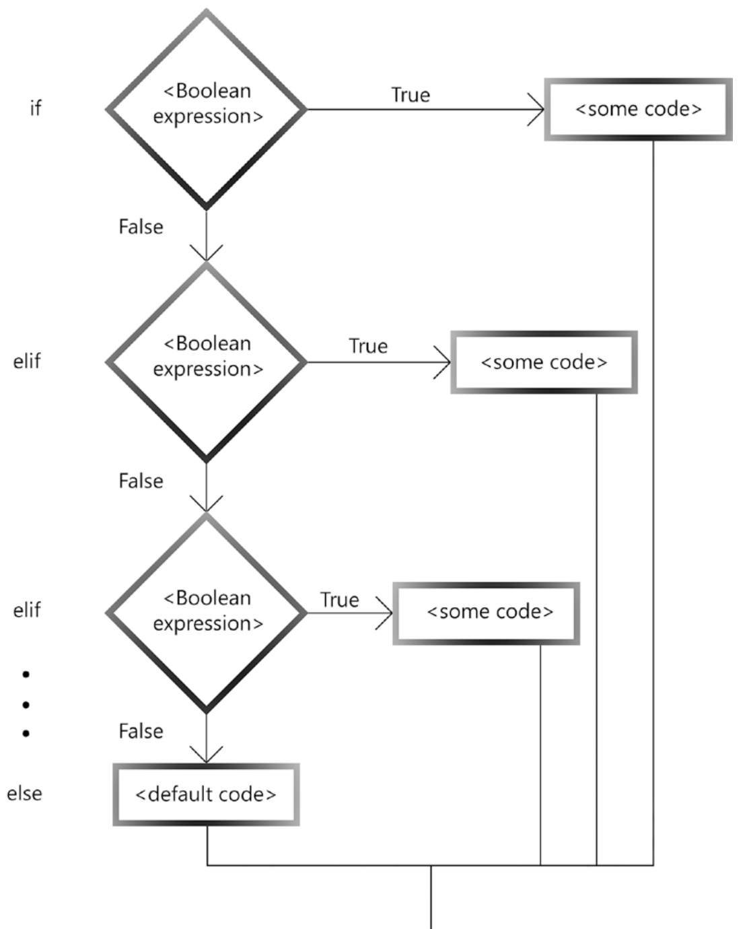
Control flow through elif
Each False result moves execution to the next condition. The first True result executes its block and then continues after the whole chain.
The final else runs only when every earlier condition is False.
Trace score 72 through the medal example: fail >= 80, pass >= 60, then skip the remaining branches.
Kalb, Learn to Program with Python 3, Figure 5-5, printed p. 116.

Slide 9
Boolean precedence and short-circuiting
For the Boolean operators here, not has higher precedence than and, which has higher precedence than or. Parentheses can make the intended grouping explicit.
Python can stop evaluating when the overall answer is already determined.
For A and B, a false A means B need not be evaluated. For A or B, a true A means B need not be evaluated.
amount != 0 and total / amount > 10 checks the nonzero condition before dividing. The order protects the second expression from a zero denominator.

Slide 10
Compound conditions
age = 15
member = True
allowed = member and age >= 16
print(allowed)
print(member or age >= 16)
The outputs are False and True.
and requires both Boolean conditions. or requires at least one. The same data can therefore produce different decisions.
Parentheses make a larger expression’s intended grouping easier to read.

Slide 11
Nested selection
number = 12
if number > 0:
if number % 2 == 0:
print("Positive and even")
else:
print("Positive and odd")
else:
print("Zero or negative")
The inner test executes only when the outer condition is true. For 12, the output is Positive and even.
For -4, Python skips the entire nested block. Each else belongs to the if at the same indentation level.

Slide 12
Validation and decision rules
A converted integer is not automatically sensible data. int("-5") succeeds, but a negative age violates the problem’s domain.
Check the data’s permitted range and categories before using it to make the main decision. Distinguish invalid input from valid input that leads to refusal.
An age of 15 with no adult is valid data that fails an admission rule. An age of -5 is invalid data.
Similarly, a reply of “maybe” should not silently become “no” when the program requests yes or no. Normalise case and whitespace, then check the permitted answers.

Slide 13
Worked boundary analysis
Question
Worked reasoning
A discount applies to quantities of at least 10. Which comparison is correct?
For quantity 10, predict quantity > 10 and quantity >= 10.
Choose three useful boundary tests.
The correct comparison is quantity >= 10.
At 10, > produces False and >= produces True.
Test 9, 10 and 11. These exercise the value immediately below, at and above the boundary.

Slide 14
Worked Boolean grouping
Question
Worked reasoning
Compare A and B or C with A and (B or C).
Find values for which they disagree.
Explain why a low threshold placed first in an elif chain can hide a higher category.
With A = False and C = True, the first expression is True and the second is False. and binds more tightly than or.
An elif chain stops at the first true condition. A high value can satisfy a low threshold before the higher test is reached.

Slide 15
Boolean grouping: truth table
Python evaluates and before or: A and B or C means (A and B) or C.
A | B | C | (A and B) or C | A and (B or C)
F | F | F | F | F
F | F | T | T | F
F | T | F | F | F
F | T | T | T | F
T | F | F | F | F
T | F | T | T | T
T | T | F | T | T
T | T | T | T | T
They disagree when A is False and C is True, regardless of B.
T = True F = False Gold rows show different results.

Slide 16
Review questions
Questions
Key points
Distinguish = from ==.
Explain if, elif and else.
Compare independent and nested conditions.
Use a truth table to justify a compound decision.
= assigns and == compares.
An elif chain selects the first matching branch.
Independent decisions may all execute, while nested decisions depend on an outer branch.
and, or and not combine Boolean results.

Slide 17
Reading and further practice
Book sections
Think ch. 5; Kalb ch. 5; OCR ch. 54.
Independent practice
Explain the main terms in your own words.
Trace a short example on paper.
Check one boundary or unusual case.
Explain the cause of a common error.

Slide 18
Challenge: the astronaut airlock
In a space game, your astronaut needs to open an airlock.
The rules
The astronaut needs a key OR the correct code.
An active alarm blocks entry, even with a key.
K = has key C = correct code A = alarm active
Your mission · 3 minutes
1. Write one Boolean expression for opening the door.
2. Predict each result below: OPEN or LOCKED?
3. Sketch a flowchart for your rule.
K = True, C = False, A = False | K = False, C = True, A = False | K = True, C = False, A = True
OPEN or LOCKED? | OPEN or LOCKED? | OPEN or LOCKED?

Slide 19
Solution: can the astronaut enter?
Start
K or C?
The Boolean rule
No
(K or C) and not A
Yes
The test cases
Alarm active?
Yes
Keep locked
1. OPEN
2. OPEN
3. LOCKED
No
Open door
Bonus: spot the bug
K or C and not A
End
Which test case breaks this rule?

