Slide 1


Clothes with a
second first impression.
One-off urban womenswear from Lulu’s wardrobe, ready to move through the city.
FULL NAME FOR THE BRAND · JU/W FOR SMALL SPACES
Cocoa
Coral
Warm paper
JUSTURBANWEARS
01

Slide 2





BRAND PROOF
The brand, from full name to tiny icon.
ON LIGHT
WHITE ARTWORK · NO BACKGROUND
GIVE IT ROOM
FULL NAME + SMALL ICON
APP + BROWSER
CORAL ON WHITE
Full name
Browser icon
App icon
Small icon
Browser icon
Cocoa
Coral
Warm paper
Nothing crowds the JU/W
Both stay clear and familiar
JUSTURBANWEARS
02

Slide 3
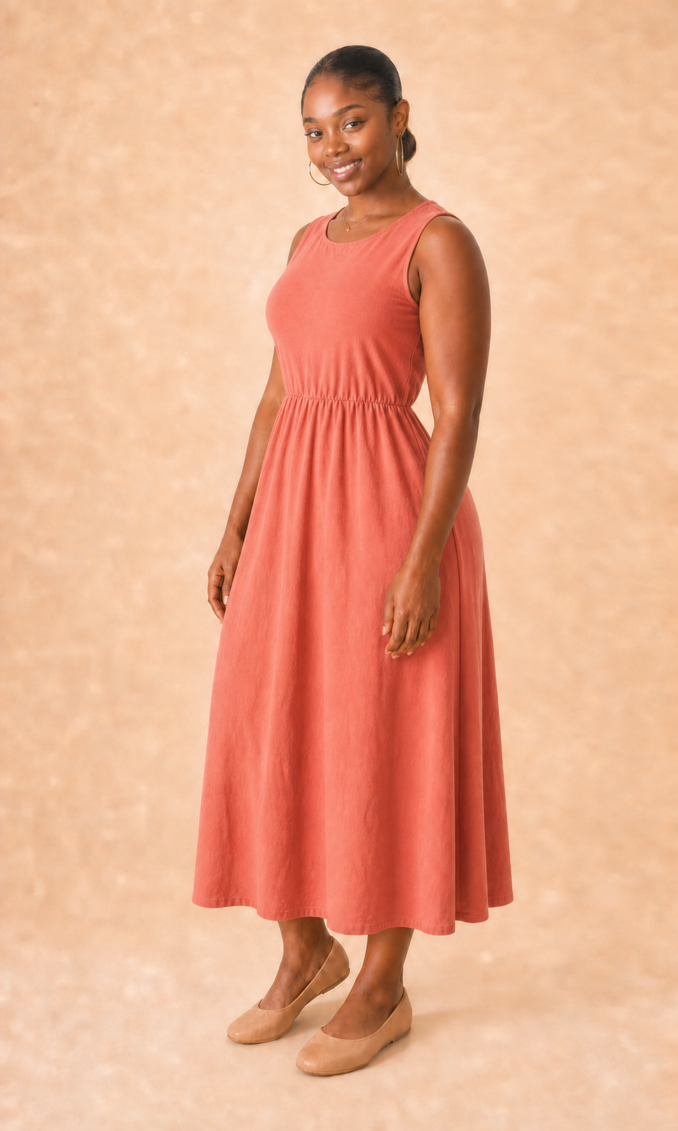
DROP 01 · LAGOS
One approved
piece carries
the whole identity.
CORAL DRIFT DRESS
JUW-001 · AVAILABLE · ₦24,500
Drop 01 brand concept
LULU · JUW-001
JUSTURBANWEARS
03

Slide 4
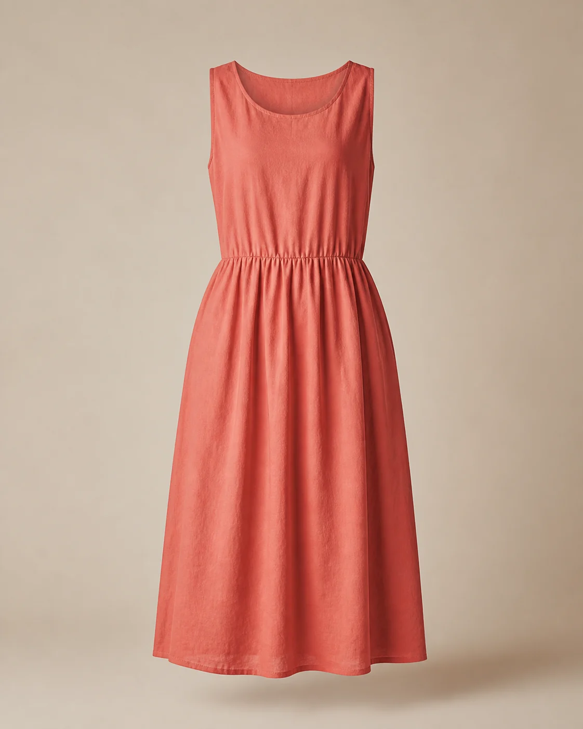
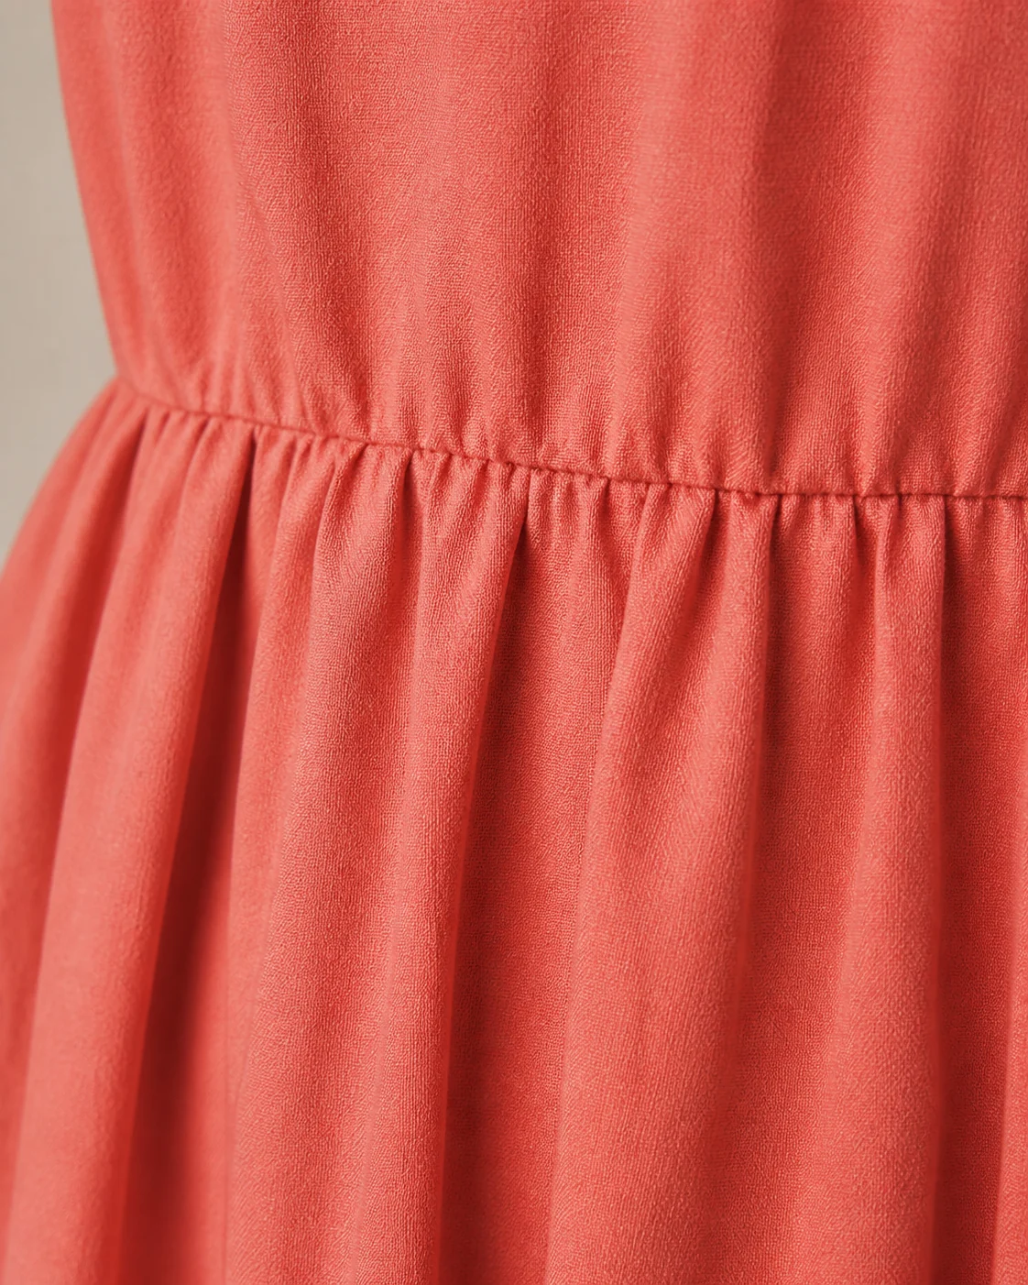
ONE PIECE, ONE RECORD
Every detail earns trust.
CORAL DRIFT DRESS
JUW-001
ORIGINAL BRAND
Not recorded in current catalogue
CONDITION
Excellent pre-loved
TAGGED SIZE
UK 10
MEASUREMENTS
Bust 88 cm · Waist 74 cm · Length 121 cm
PRICE
₦24,500
AVAILABILITY
AVAILABLE · one piece
The missing original-brand value is shown honestly, never guessed.
JUSTURBANWEARS
04

Slide 5
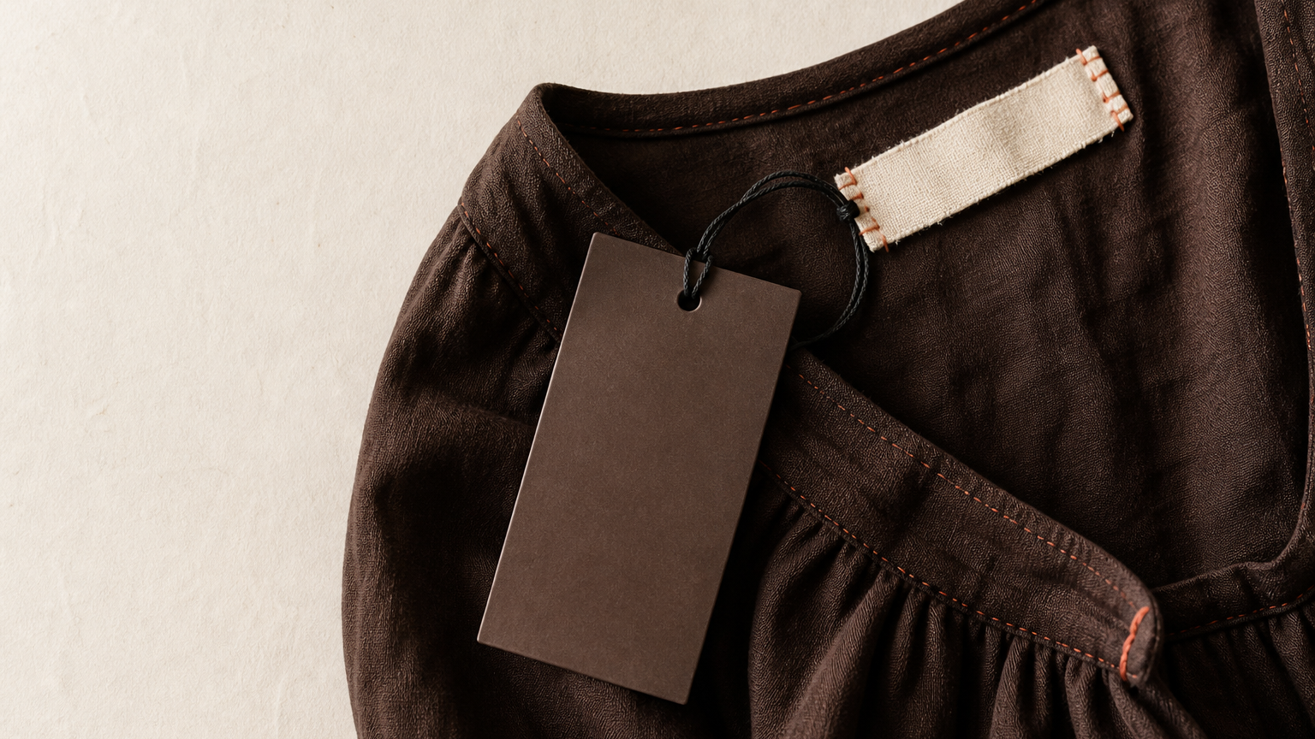
CURATED, NOT MANUFACTURED
Removable
provenance.
Original label:
untouched.
JU/W identifies the edit—
not the garment’s maker.
HANG TAG CONCEPT
JUSTURBANWEARS
05

Slide 6
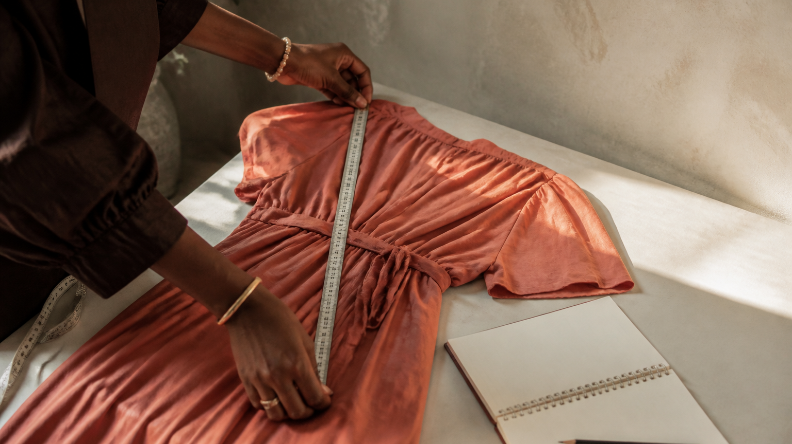
BEHIND THE EDIT
Evidence first.
Inspect. Measure. Record.
Condition, fit and measurements make a one-off piece safer to choose at a distance.
BEHIND THE EDIT · CONCEPT
JUSTURBANWEARS
06

Slide 7
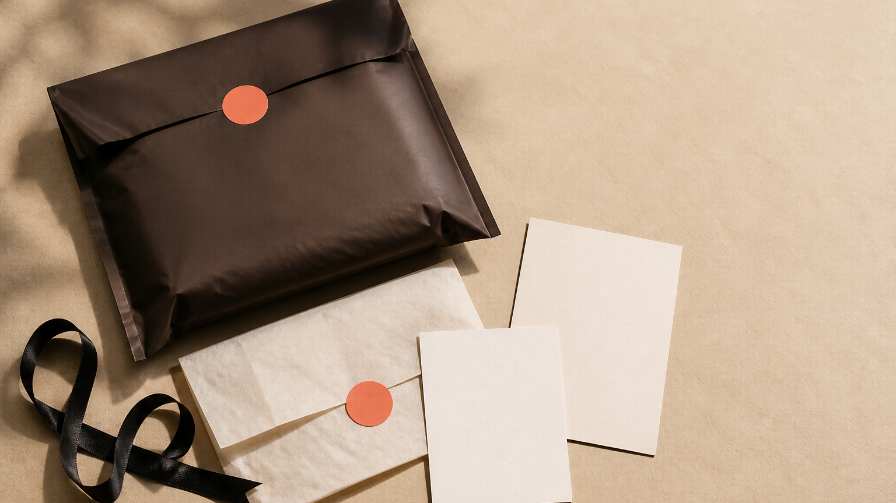
PACKED BY LULU
One piece.
Packed with care.
Mailer · warm-paper tissue · JU/W seal
Full-name thank-you card · order + condition card
PACKAGING CONCEPT
JUSTURBANWEARS
07

Slide 8
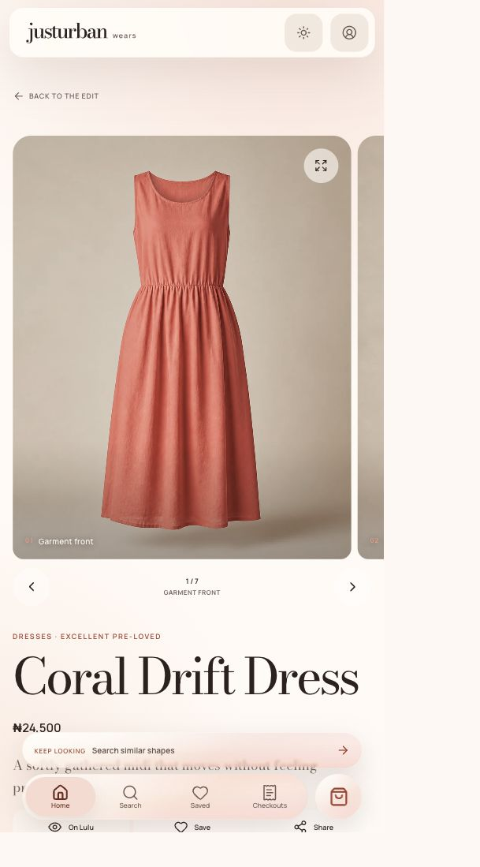
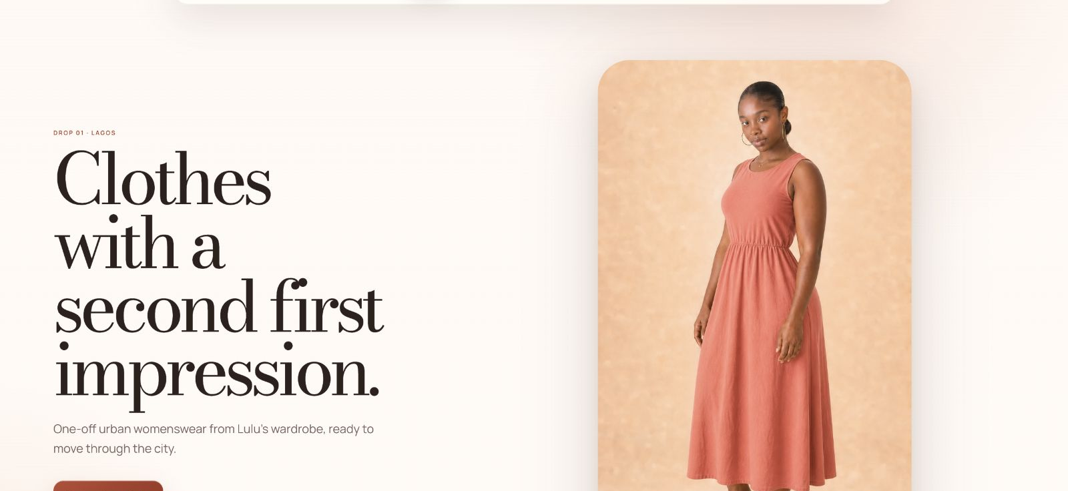
DIGITAL DISCOVERY
The identity holds at every screen size.
LULU · JUW-001
APP ICON
BROWSER ICON
JUSTURBANWEARS
08

Slide 9
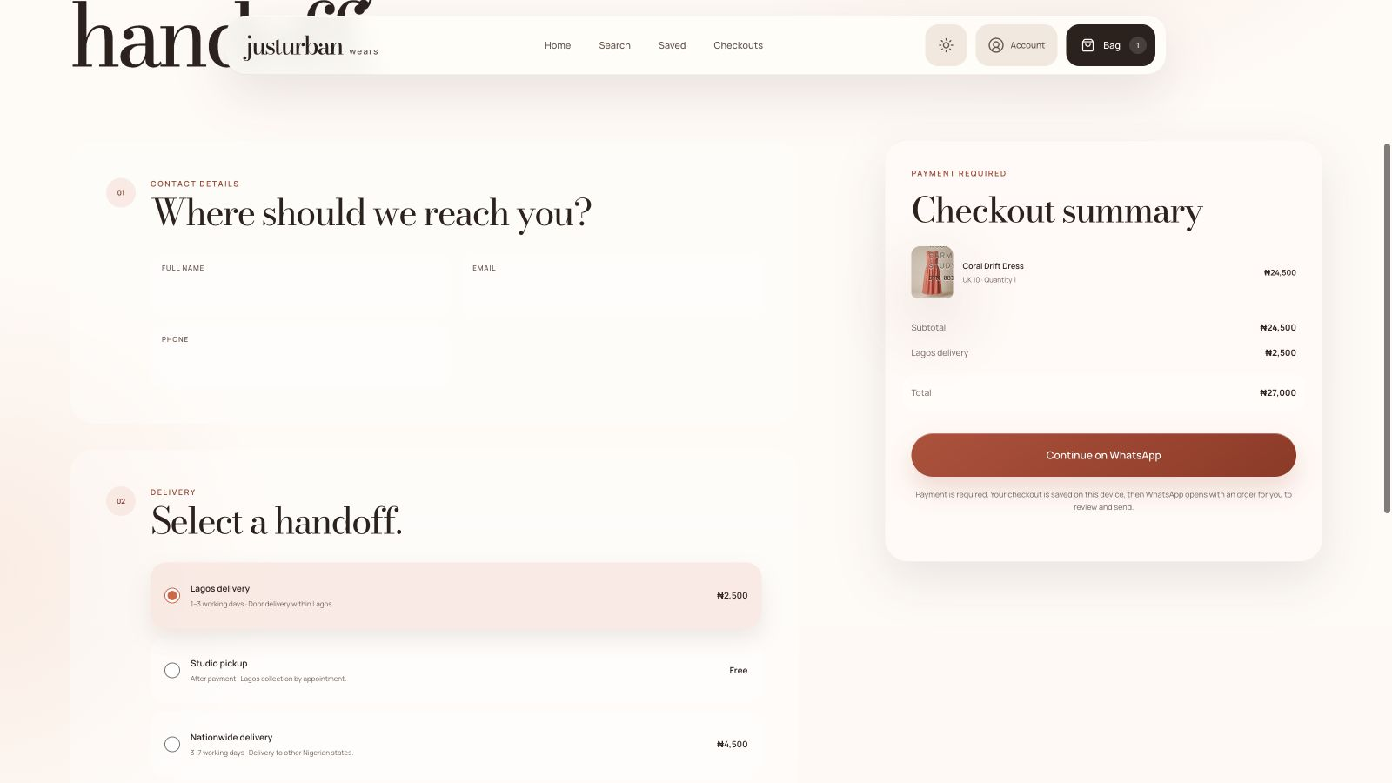
SOCIAL AND WHATSAPP COMMERCE
Discovery stays human through the handoff.
LULU · JUW-001
JUW-001 · ONE PIECE
SOCIAL CONCEPT · LULU + JUW-001
SHOPPER REVIEWS THE ORDER, THEN SENDS IT ON WHATSAPP
JUSTURBANWEARS
09

Slide 10
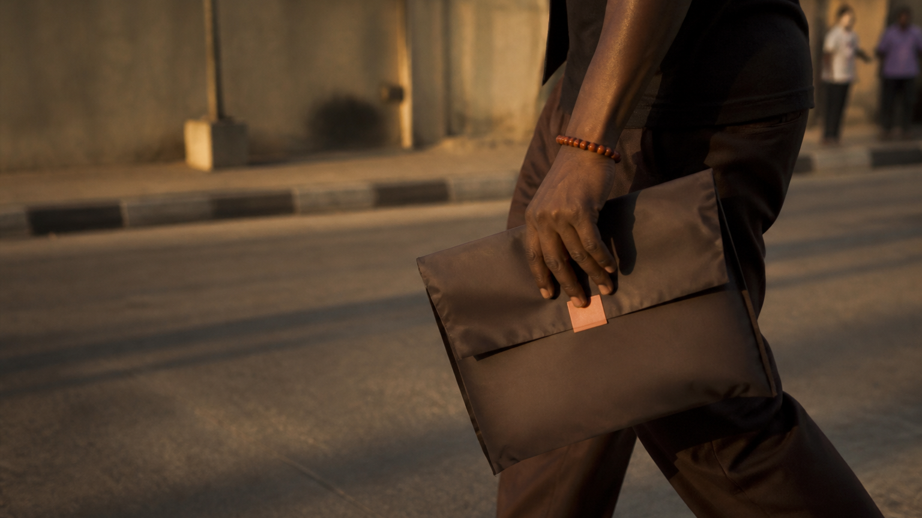
LAGOS HANDOFF
One piece,
back in motion.
Studio pickup after payment, by appointment.
Lagos delivery in 1–3 working days.
LAGOS HANDOFF · CONCEPT
JUSTURBANWEARS
10

Slide 11
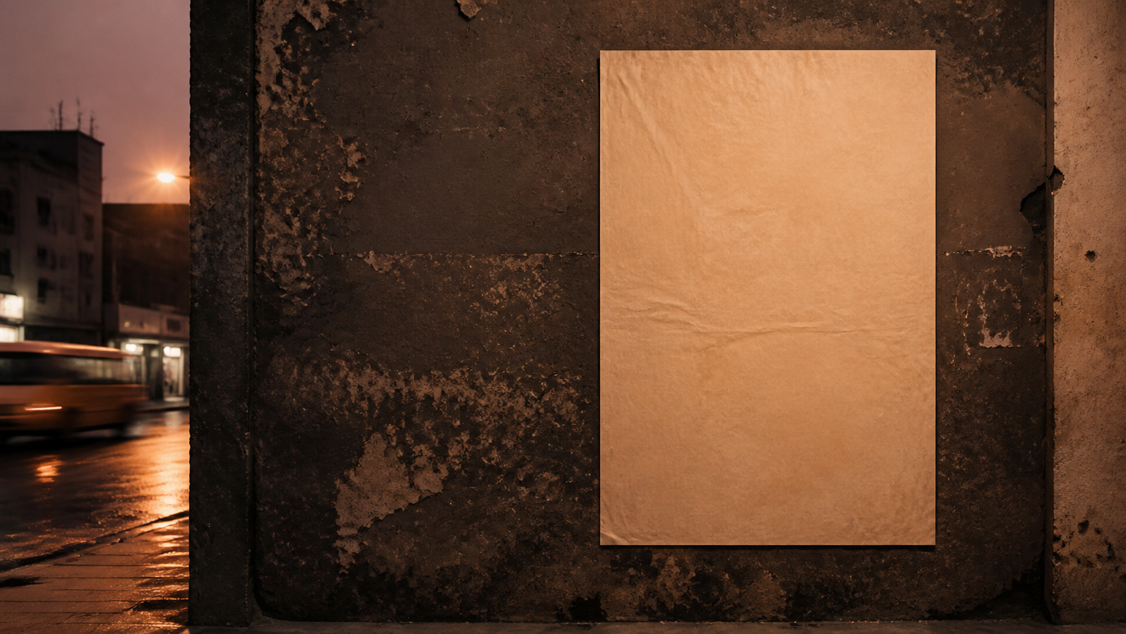
FUTURE CAMPAIGN CONCEPT
Clothes with
a second first
impression.
One-off urban womenswear from Lulu’s wardrobe, ready to move through the city.
LULU · JUW-001
DROP 01 · LAGOS
JUW-001 · ONE PIECE
FUTURE CAMPAIGN CONCEPT
JUSTURBANWEARS
11

