Slide 1
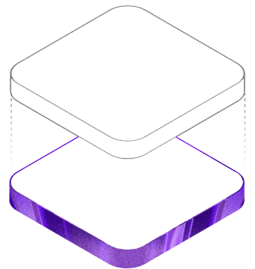
El-Kapitan
COSC 4P02 Final Project Presentation
Group 7
Web-based plagiarism detection for programming assignments

Slide 2
Project Overview
Web application for detecting similar student code submissions
Designed for instructors managing courses and assignments
Students can submit work without creating an account
Instructors can review similarity results
Supports Java, C, and C++ submissions

Slide 3
Brief Project History
Started with the plagiarism detection engine
Added tokenization support for Java, C, and C++
The engine is built on ANTLR to handle tokenization
Built the Spring Boot backend submission pipeline
Connected Supabase database and storage
Created the React and vite frontend for the instructors
Final stage focused on integration, documentation, and demo showcase

Slide 4
System Architecture
React Frontend
Frontend handles user interaction
Backend controls uploads and processing
Tokenizer and K-gram engine compare submissions
Supabase stores files, users, courses, assignments, and results
Tokenizer + K-Gram Engine
Spring Boot Backend
Supabase Database + Storage

Slide 5
Data storage and processing
Takes in zip file alongside user's personal identifiable information (PII).
Unpacks zip files and concatenate into a single code file.
Trims out any non-code files.
Encrypts PII
Inputs submission record into database.

Slide 6
Theory of Operation
for (int i = 0; i < n; i++)
Tokens represent meaningful parts of code
K-grams are small windows of K consecutive tokens
Matching K-grams suggest similar code structure
Simple formatting changes have less impact
FOR, LPAREN, INT,
IDENTIFIER, ASSIGN, NUMBER...
Similarity = matching unique K-grams / smaller K-gram count

Slide 7
Plagiarism Engine
Compares K-gram hashes between submissions to identify similarity
Uses unique hash intersection to calculate plagiarism similarity percentage
Tracks start and end line numbers for every K-gram during tokenization
Detects continuous matching K-gram sequences using diagonal matching logic
Builds exact line-number pairs showing where copied code occurs in both files
Merges consecutive matching regions into larger plagiarism blocks
Removes duplicate and fully contained matches to reduce report noise
Produces final plagiarism regions such as “File A lines 10–45 ↔ File B lines 12–47”
Sends cleaned plagiarism matches to the side-by-side comparison interface

Slide 8
Submission Workflow
Student uploads zip code
Backend receives file
File saved to Supabase Storage
Submission saved in database
Existing submissions downloaded
Tokenizer and K-gram comparison run
Top similarity results stored
Submissions are grouped by course and assignment
Duplicate submissions can be replaced
New submissions are compared against previous submissions

Slide 9
Frontend Features
Student submission
Public submission page, no student account required
Assignment key connects the upload to a specific assignment run
Student name and email are collected for instructor records
Zip upload with client-side validation
Upload loading state , success message and error feedback
Instructor workspace
Instructor signup and login through superbase Auth
Course and assignment run management
Repository upload and result generation
Review queue , report page and side by side comparison view

Slide 10
Challenges and Lessons learned
Challenges
Connecting frontend, backend, database, and storage
Handling ZIP files and multiple languages
Ignoring comments and whitespace correctly
Tracking useful matching line regions
RLS issues
Testing while in production
Lessons learned
Having a deeper understand of git and how to collaborate on Github.
How to manage a team, meeting deadlines, and resolving conflicts between people.
How to document the project properly.

Slide 11
Conclusion
Conclusion
Working full-stack plagiarism detection workflow
Tokenization and K-gram hashing compare code structure
Integrated frontend, backend, database, and storage

Slide 12
Thank You

