Slide 1
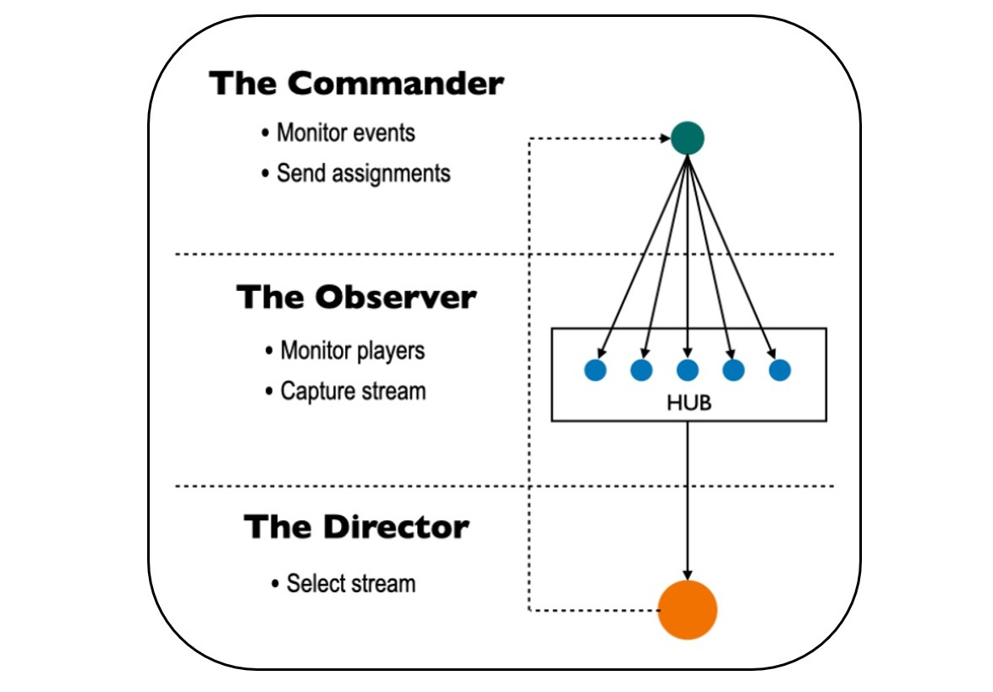
A novel team structure instance for live streaming. The commander monitors events and assigns tasks to observers. The observers stream their target players' activities based on the commander's instructions. Observers' streaming signals are live on the director's monitor screen. The director gives instructions to the commander if there is any missing camera view.

Slide 2
