Slide 1
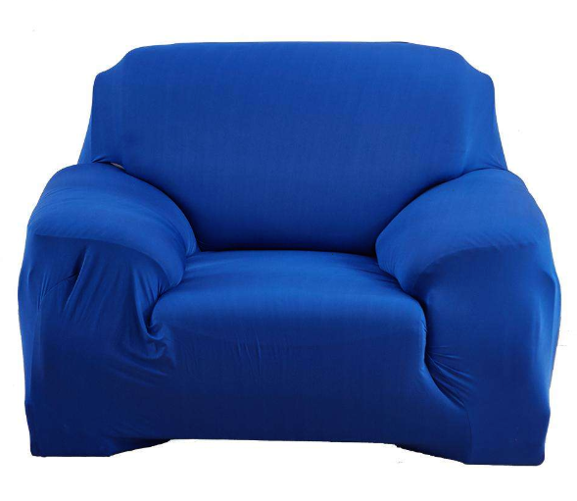

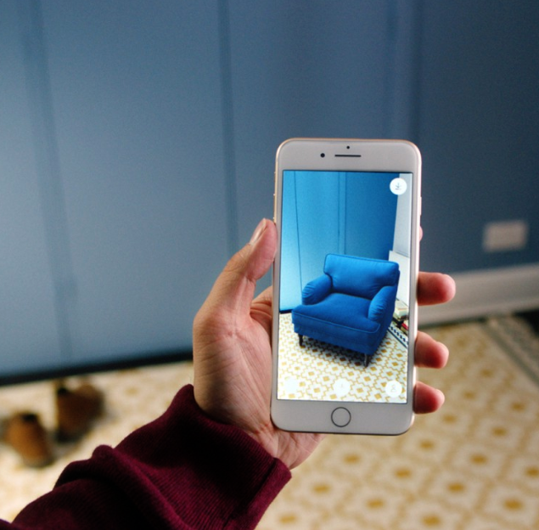
Front Page
Bundle Adjustment
Surface Reconstruction
Texture Map Parameterization
Texture Atlas Generation
3D Reconstruction Pipeline
3D Model
Node Server

