Slide 1

RBP-Score
RBP-Score: An integrative bioinformatic pipeline for the identification of phage Receptor Binding Proteins
Sequence · Phylogeny · Structure
Project in Bioinformatics · 2025–2026
Centre of Biological Engineering · University of Minho
André Gomes & Sílvio Santos
BLASTp
MUSCLE
FastTree
ColabFold
Foldseek
01/12

Slide 2
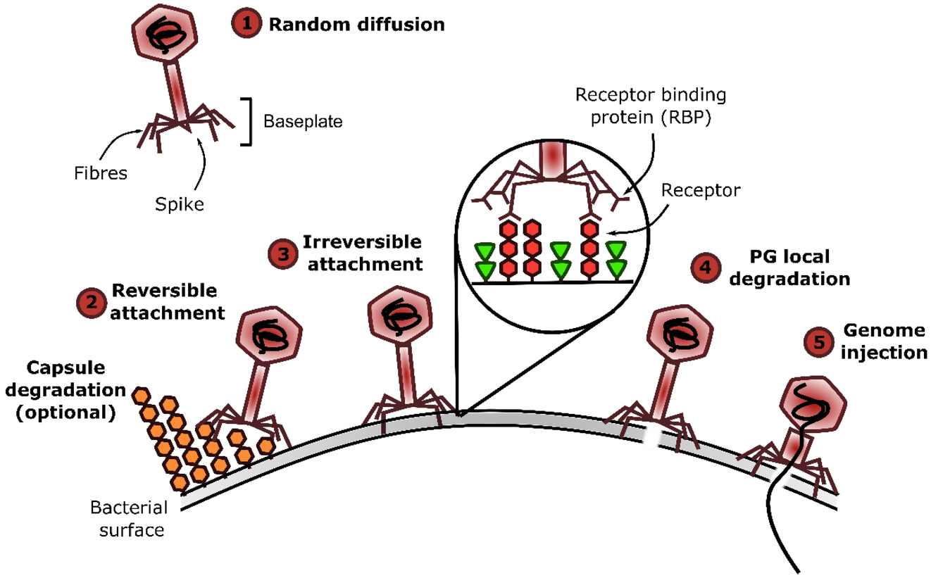
CONTEXT · MOTIVATION · OBJECTIVES
Biological motivation
Phage host specificity is largely mediated by receptor-binding proteins
Phage infection starts with adsorption to bacterial surface receptors.
RBPs are typically located in distal virion structures, such as tail fibers, tail spikes or baseplate components.
Why identify RBPs?
Host-range determination
Phage engineering
Candidate prioritization in phage genomes
Source: Leprince & Mahillon, Viruses, 2023;15:196. DOI: 10.3390/v15010196
KEY MESSAGE
RBPs determine host specificity but remain difficult to identify computationally.
02/12

Slide 3
CONTEXT · MOTIVATION · OBJECTIVES
Computational challenge and objective
Why sequence homology alone is not enough?
Sequence divergence
Annotation gap
Project objective
RBPs are often poorly conserved at the amino-acid level.
Many phage proteins remain hypothetical or inconsistently annotated.
Build a reproducible, interpretable prioritization workflow.
RBP-Score addresses this challenge by integrating sequence, phylogenetic and structural evidence into a candidate prioritization workflow.
KEY MESSAGE
The pipeline integrates complementary evidence instead of relying on a single similarity measure.
03/12

Slide 4
METHODOLOGY · DEVELOPMENT
Reference database
Curated RBP database and explicit metadata
58 experimentally validated RBPs from 52 bacteriophages.
Headers encode accession, host, phage, morphotype and role.
Non-RBP outgroups were added as negative controls.
Field | Example
accession | P07537
host | Bacillus
phage | Bacteriophage_PZA
morphotype | Podo
role | RBP / OUTGROUP
KEY MESSAGE
The database was standardized to distinguish reference RBPs from non-RBP outgroups.
04/12

Slide 5
METHODOLOGY · DEVELOPMENT
Workflow architecture
A modular Snakemake pipeline
Rules include database construction, query processing, BLAST search, alignment/tree construction, structure prediction and final score calculation.
The workflow can be rerun selectively when inputs, scripts or configuration parameters are updated.
Inputs
Analyses
Partial scores
Query FASTA
BLASTp
Sequence score
Curated RBP DB
MUSCLE
+
FastTree
Phylogeny score
RBP-Score
Outgroup FASTA
ColabFold
+
Foldseek
Structural score
Reference PDBs
KEY MESSAGE
Snakemake links independent analyses into a reproducible workflow.
05/12

Slide 6
METHODOLOGY · DEVELOPMENT
Sequence homology analysis
BLASTp-based similarity layer
Positive RBP evidence uses identity, coverage, bitscore and e-value.
Strict filters are applied to avoid weak positive assignments.
Outgroup BLAST hits are handled separately as negative evidence using relaxed filters, without contributing to positive RBP assignments.
Positive RBP evidence
Outgroup evidence
Strict filters: identity + coverage + e-value.
Relaxed filters detect weak negative evidence but do not create positive RBP calls.
KEY MESSAGE
BLASTp provides sequence-level evidence, not final classification.
06/12

Slide 7
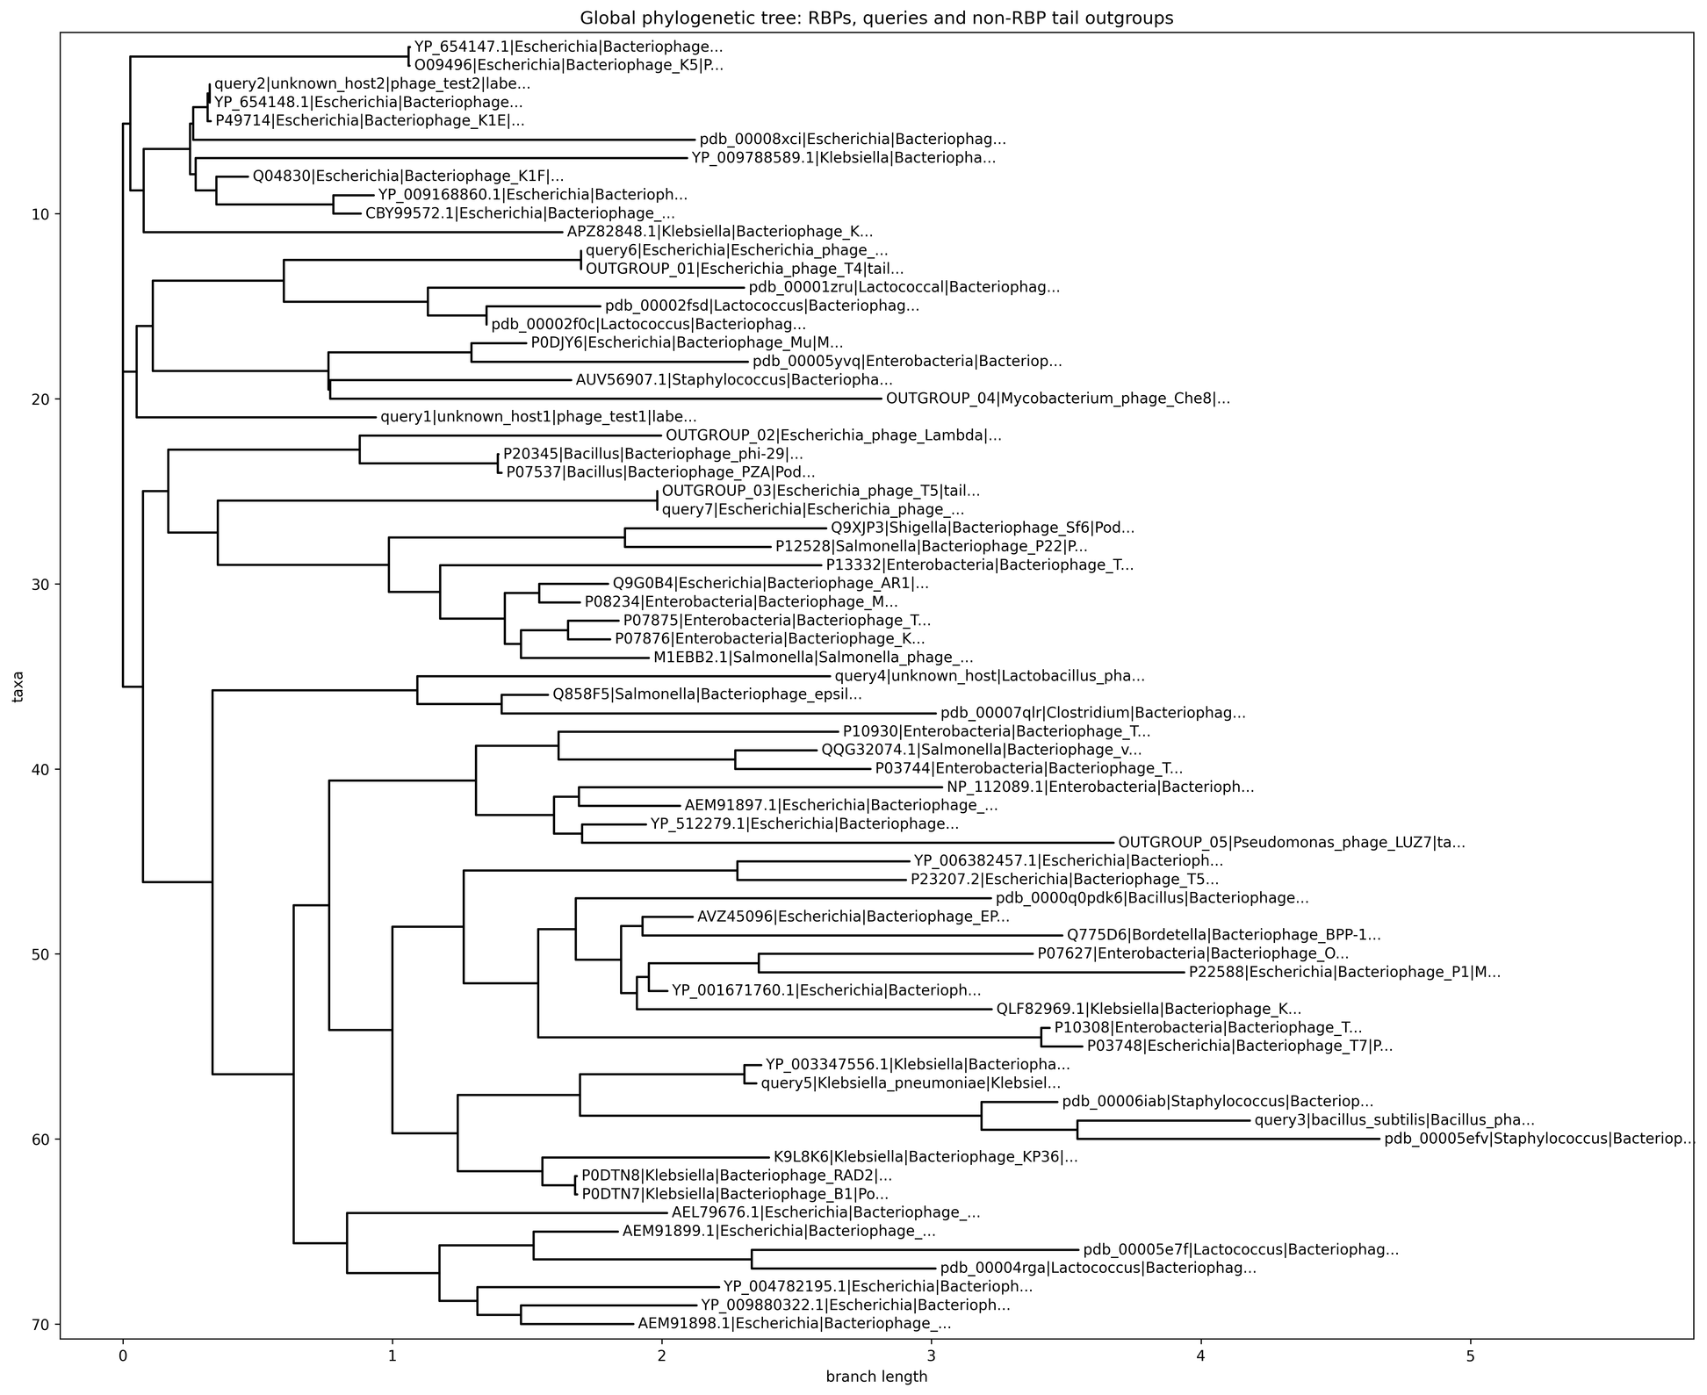
METHODOLOGY · DEVELOPMENT
Evolutionary analysis
Global phylogenetic tree and distance-based scoring
Query sequences were aligned together with reference RBPs and non-RBP outgroups to compute phylogenetic distances.
MUSCLE is used for multiple sequence alignment; FastTree is used for tree construction.
Shorter phylogenetic distances to known RBPs increase the phylogenetic component of the score.
Interpretation
A query close to known RBPs gains support; proximity to outgroup branches is interpreted cautiously.
RBP cluster
Query
Outgroup branch
KEY MESSAGE
Phylogeny adds evolutionary context to sequence similarity.
07/12

Slide 8
METHODOLOGY · DEVELOPMENT
Structural analysis
ColabFold and Foldseek for scalable comparison
Query structures are predicted with ColabFold.
Reference structures were precomputed and stored.
Foldseek outputs qTM-score, alnTM-score and RMSD, which are converted into the structural component of RBP-Score.
Why Foldseek?
Fast · local · automatable · compatible with Snakemake
Role of DALI
Complementary validation for selected top structural hits.
FASTA
PDB
Structural hit
KEY MESSAGE
Foldseek was selected for scalable screening; DALI remains useful for validation.
08/12

Slide 9
RESULTS · DISCUSSION
Scoring framework
Weighted integration of partial evidence
Sequence score = 35%
Phylogeny score = 25%
Structural score = 40%
Weights and thresholds are configurable in config.yaml.
All partial and final scores are normalized to [0,1].
Sequence
35%
Phylogeny
25%
Structure
40%
RBP-Score = 0.35 × sequence + 0.25 × phylogeny + 0.40 × structure
KEY MESSAGE
The score is transparent and configurable; current weights are exploratory.
09/12

Slide 10
RESULTS · DISCUSSION
Final output
Ranked candidate table with positive and negative controls
Rank | Query | Label | RBP-Score
1 | query2 / positive control | positive_control | 0.954
2 | query5 / K. pneumoniae K5 | pharbp_candidate | 0.814
3 | query3 / Chedec_11 | pharbp_candidate | 0.479
4 | query1 / random control | random_candidate | 0.319
5 | query4 / ViSo_2018a | pharbp_candidate | 0.186
6 | query6 / T4_OUTGROUP | outgroup | 0.086
7 | query7 / T5_OUTGROUP | outgroup | 0.039
One row per query protein.
Final RBP-Score, with partial evidence available in detailed output files.
Detailed files allow inspection of the best references and supporting evidence.
Positive and outgroup controls were included to evaluate expected behavior.
KEY MESSAGE
The positive control ranks highest, while outgroup controls are strongly deprioritized.
10/12

Slide 11
RESULTS · DISCUSSION
Outgroup-based penalty
Negative evidence across the three analysis layers
Non-RBP tail-associated proteins were used as outgroup controls.
For each query, the best outgroup match is reported separately for:
Sequence analysis
Evolutionary analysis
Structural analysis
Outgroup similarity reduces the corresponding effective score.
Penalization is proportional to outgroup similarity and configurable.
Formula
effective score = raw score − penalty × outgroup similarity
Interpretation
A candidate should show stronger support from RBP references than from non-RBP tail-associated controls.
KEY MESSAGE
The pipeline scores specificity, not only similarity.
11/12

Slide 12
CONCLUSIONS · ONGOING WORK
Conclusions and ongoing work
Current status and next steps
Implemented: reproducible workflow, annotated database and integrated RBP-Score.
Positive and outgroup controls show the expected ranking behavior.
Next: expand positive/negative validation sets and calibrate cut-offs.
Next: validate top Foldseek hits with DALI and expand the curated database.
Main conclusion
RBP-Score provides a reproducible and interpretable framework for candidate RBP prioritization.
Work in progress
Weight calibration · larger controls · DALI validation · curated database expansion
KEY MESSAGE
RBP-Score is a working prototype for interpretable prioritization of candidate phage RBPs.
12/12

