Slide 2
Biologically inspired algorithms Exercise 9
Ing. Lenka Skanderová, Ph. D.

Slide 3
Content
Firefly algorithm

Slide 4
History
Swarm algorithm
Developed in 2010
Some researchers point out the fact that it is too similar to PSO

Slide 5
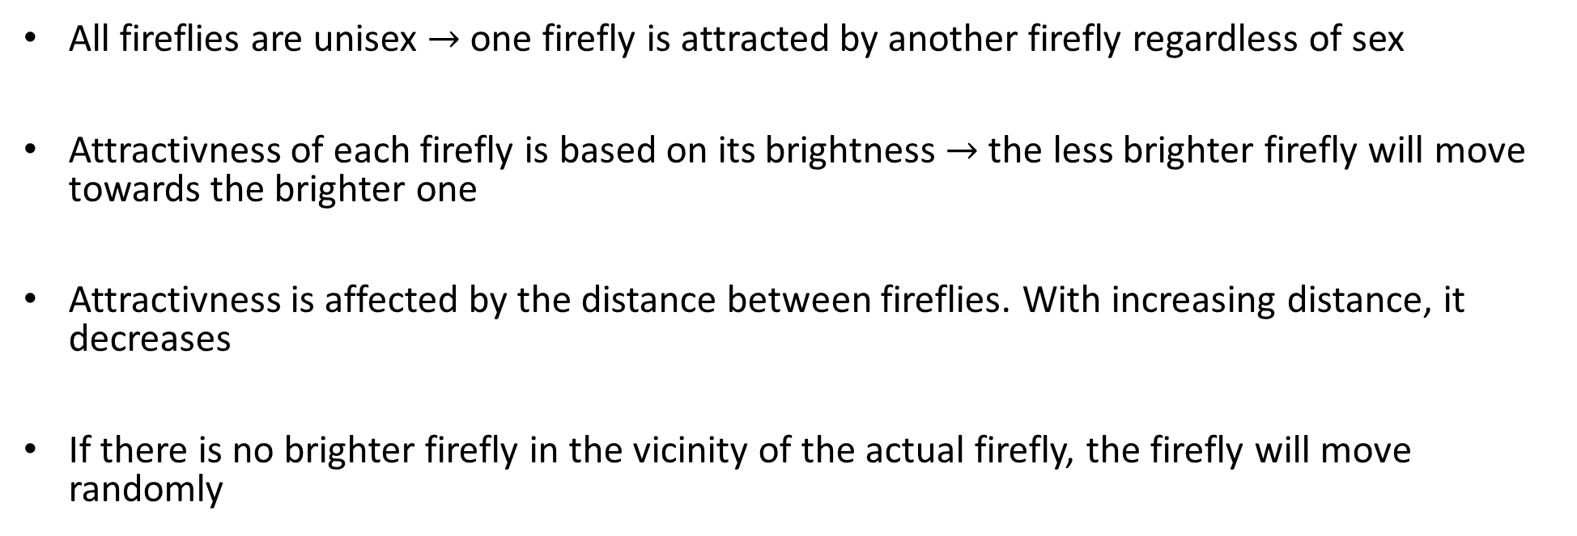
Firefly
All fireflies are unisex $→$ one firefly is attracted by another firefly regardless of sex
Attractivness of each firefly is based on its brightness $→$ the less brighter firefly will move towards the brighter one
Attractivness is affected by the distance between fireflies. With increasing distance, it decreases
If there is no brighter firefly in the vicinity of the actual firefly, the firefly will move randomly

Slide 6

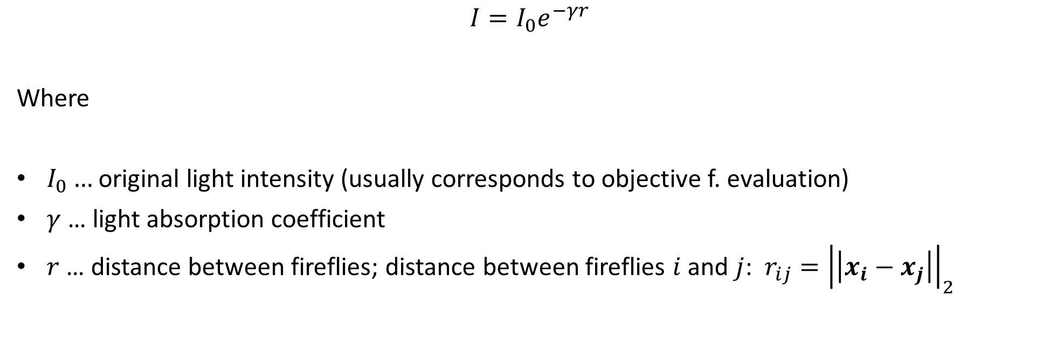
Light intensity $I(r)$ of a firefly
$$I=I_{0}e^{−γr}$$
Where
$I_{0}…$original light intensity (usually corresponds to objective f. evaluation)
$γ$… light absorption coefficient
$r$ … distance between fireflies; distance between fireflies $i$ and $j$: $r_{ij}={\left|\left|x_{i}−x_{j}\right|\right|}_{2}$

Slide 7

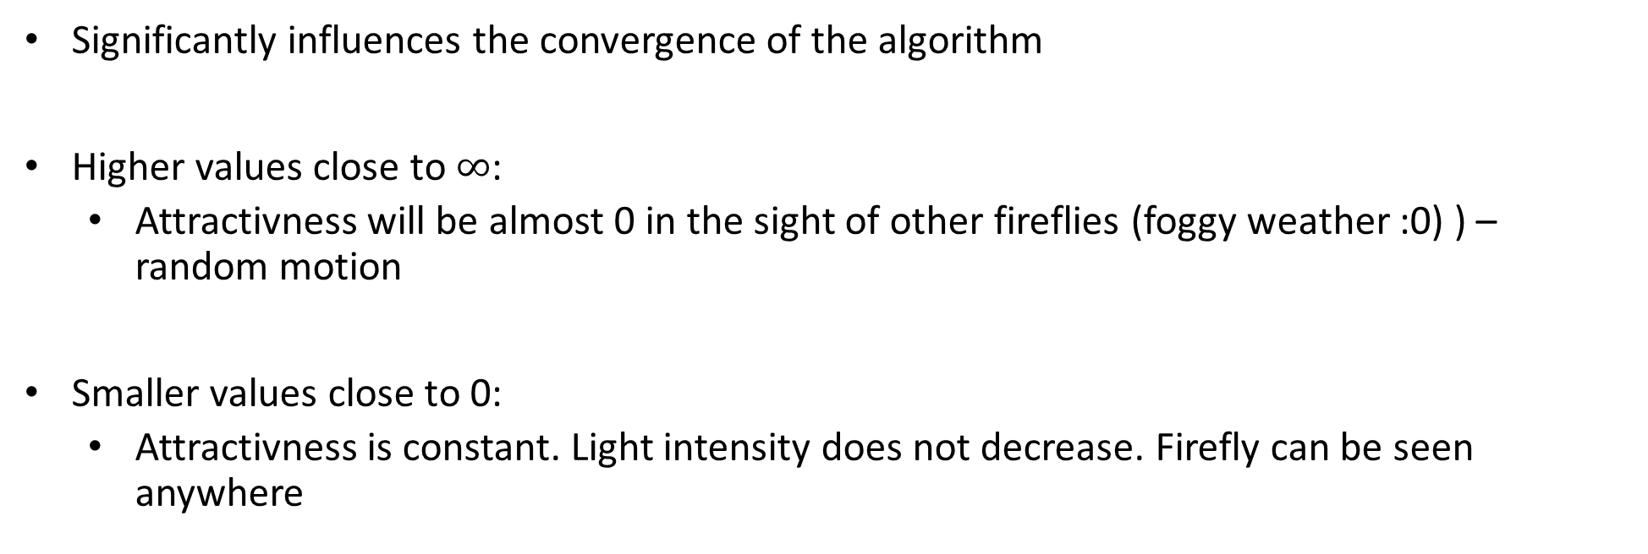
Light absorption coefficient $γ$
Significantly influences the convergence of the algorithm
Higher values close to $∞$:
Attractivness will be almost 0 in the sight of other fireflies (foggy weather :0) ) – random motion
Smaller values close to 0:
Attractivness is constant. Light intensity does not decrease. Firefly can be seen anywhere

Slide 8

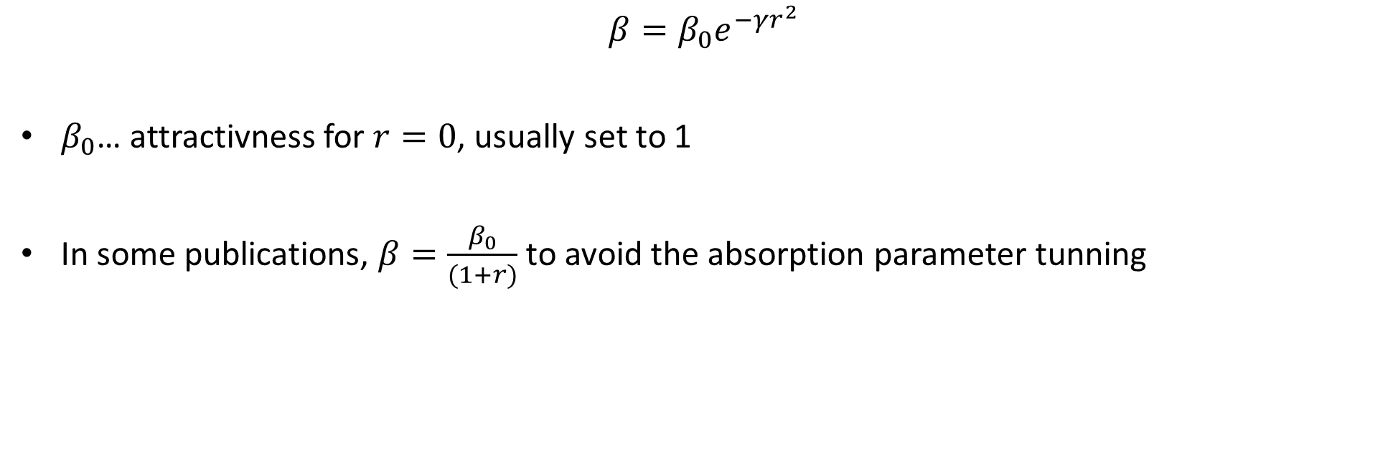
Attractivness of a firefly $β$
$$β=β_{0}e^{−γr^{2}}$$
$β_{0}$… attractivness for $r=0$, usually set to 1
In some publications, $β=\frac{β_{0}}{(1+r)}$ to avoid the absorption parameter tunning

Slide 9
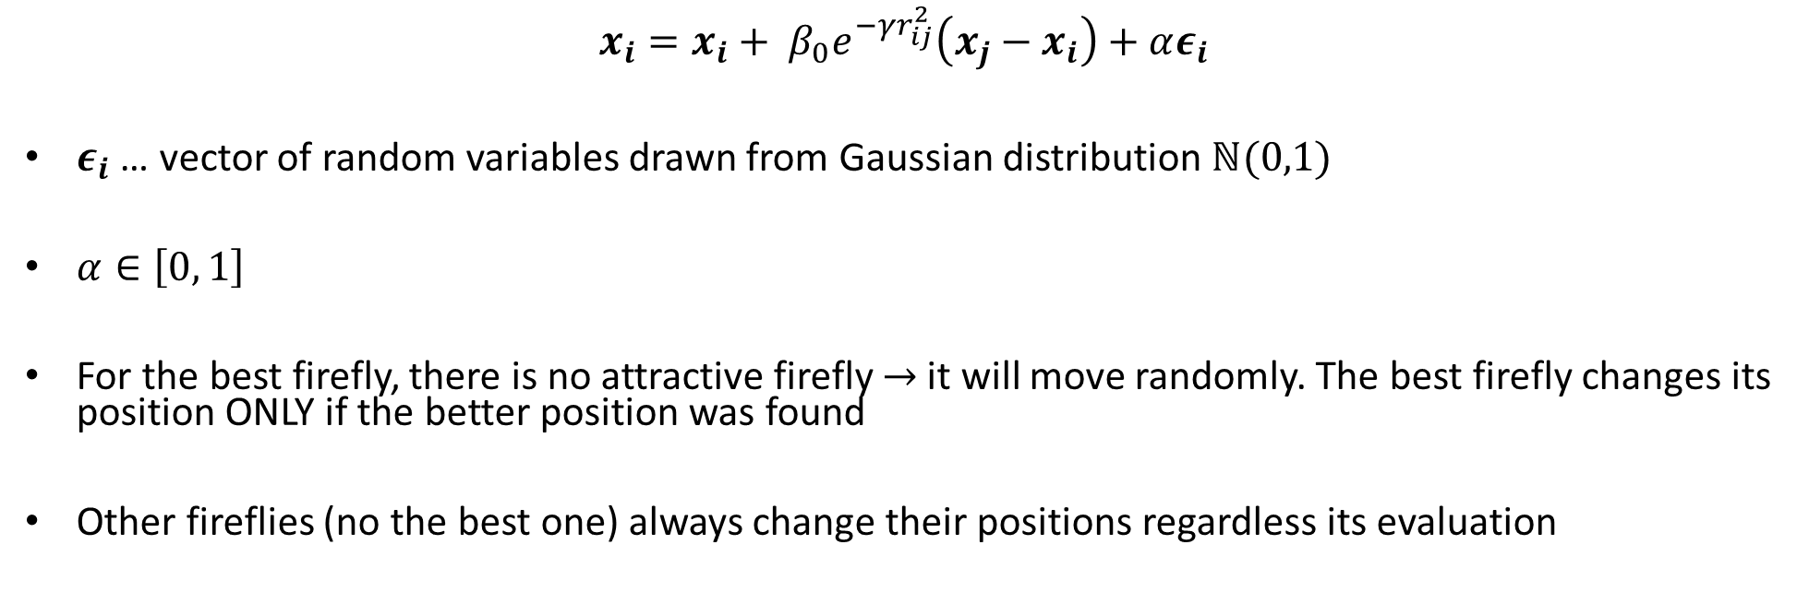
New position of firefly
$$x_{i}=x_{i}+ β_{0}e^{−γr_{ij}^{2}}\left(x_{j}−x_{i}\right)+αε_{i}$$
$ε_{i}$ … vector of random variables drawn from Gaussian distribution $ℕ(0,1)$
$α∈\left[0, 1\right]$
For the best firefly, there is no attractive firefly $→$ it will move randomly. The best firefly changes its position ONLY if the better position was found
Other fireflies (no the best one) always change their positions regardless its evaluation

Slide 10
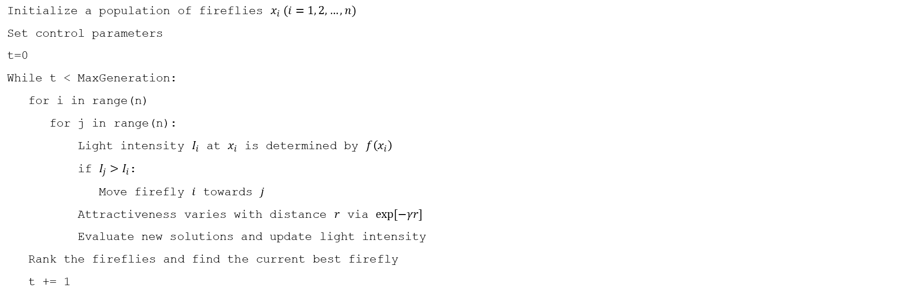
Algorithm
Initialize a population of fireflies $x_{i} (i=1, 2, …, n)$
Set control parameters
t=0
While t < MaxGeneration:
for i in range(n)
for j in range(n):
Light intensity $I_{i}$ at $x_{i}$ is determined by $f\left(x_{i}\right)$
if $I_{j}>I_{i}$:
Move firefly $i$ towards $j$
Attractiveness varies with distance $r$ via $exp⁡[−γr]$
Evaluate new solutions and update light intensity
Rank the fireflies and find the current best firefly
t += 1

Slide 11
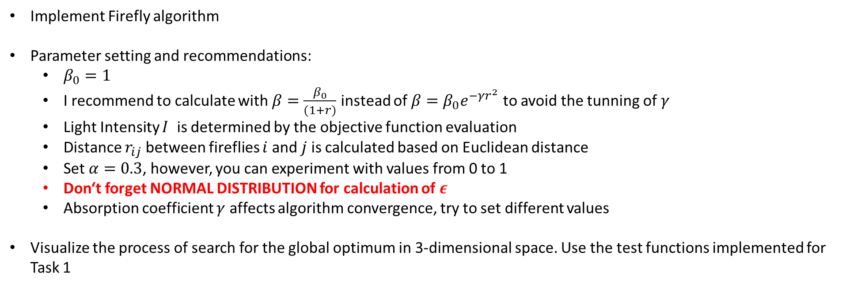
Task
Implement Firefly algorithm
Parameter setting and recommendations:
$β_{0}=1$
I recommend to calculate with $β=\frac{β_{0}}{(1+r)}$ instead of $β=β_{0}e^{−γr^{2}}$ to avoid the tunning of $γ$
Light Intensity $I$ is determined by the objective function evaluation
Distance $r_{ij}$ between fireflies $i$ and $j$ is calculated based on Euclidean distance
Set $α=0.3$, however, you can experiment with values from 0 to 1
Don‘t forget NORMAL DISTRIBUTION for calculation of $ε$
Absorption coefficient $γ$ affects algorithm convergence, try to set different values
Visualize the process of search for the global optimum in 3-dimensional space. Use the test functions implemented for Task 1

Slide 12
Literature
This presentation is based on the following publication:
YANG, Xin-She. Firefly algorithm, stochastic test functions and design optimisation. International journal of bio-inspired computation, 2010, 2.2: 78-84.

Slide 13
Thank you for your attention
Ing. Lenka Skanderová, Ph.D.
EA 407
+420 597 325 967
lenka.skanderova@vsb.cz
homel.vsb.cz/~ska206

