Slide 1

SMART INDIA HACKATHON 2026
TITLE PAGE
Problem Statement ID - SIH26247
Problem Statement Title - AI-Enabled Drone & Counter-Drone Threat Simulation Trainer
Theme - Robotics and Drones
PS Category - Software
Team ID-
Team Name (Registered on portal)

Slide 2
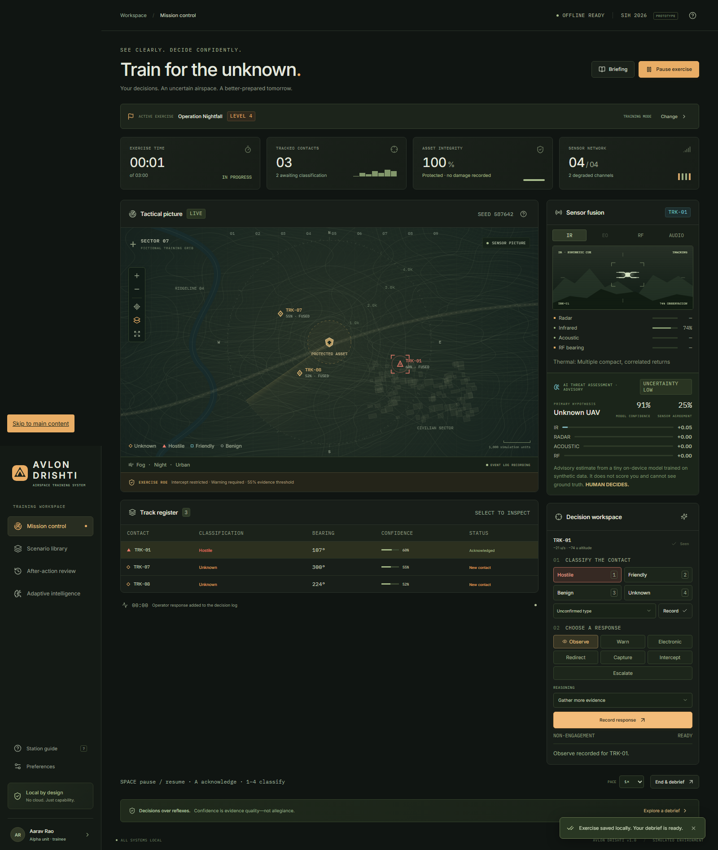
AVLON DRISHTI
Your Team Name
Offline, adaptive drone-threat decision trainer.
▸ Problem: cheap drones + swarms are decisive — Op Sindoor (May 2025): hundreds of drones in waves vs India’s integrated grid. Training = slides + rare live drills → too few reps. ~385 Ashni platoons (×20–25 operators each) need exactly this trainer.
▸ Solution: laptop, offline, no GPU. Imperfect sensor picture → acknowledge → classify → reasoned response → explainable score → sensor-vs-truth replay → adaptive next exercise.
▸ Coverage: 10 scripted exercises (L1–L5) + unlimited seeded generation · 8-node decision-tree scoring · AAR + unit dashboard · fingerprint diversity ends rote learning.
▸ Uniqueness: we score judgment under uncertainty — with receipts: byte-identical replay, fairness-gated AI, advisory-only models.
“Confidence is evidence quality, not permission to act.”

Slide 3
TECHNICAL APPROACH
Your Team Name
Stack (checkable): React 19 + TypeScript + Canvas · Node 24 + Express + built-in SQLite · one pure-TS sim-core runs in browser, server, tests · Vitest 82/82 + Playwright 2/2, typecheck clean.
Loop: SIMULATED SENSORS → 15-feature model → hypothesis + confidence + evidence → HUMAN DECIDES → deterministic scoring → replay → skill model → adaptive challenge → generator ↺
Four kinds of “AI”, named honestly: TRAINED ML = threat classifier only · STATISTICAL = Bayesian skill model · RULE-BASED = patterns, challenge mapping · DETERMINISTIC = sim, scoring, replay, fairness gate.
Measured, not promised: 15 features → 6 classes · 14,874 synthetic observations · 230 simulated scenarios · held-out test: accuracy 70.3% · macro F1 0.622 · balanced acc. 0.692 · ECE 0.109→0.046 · ~2 KB weights · <1 ms CPU · offline.
AI DOES: interpret sensor evidence · estimate hypothesis · expose uncertainty · find weaknesses · recommend next exercise. DOES NOT: touch scoring/ROE · see ground truth · need cloud/GPU · decide.
AI recommends. Deterministic simulation verifies. Human decides.

Slide 4
FEASIBILITY AND VIABILITY
Your Team Name
It runs today, on an ordinary laptop.
▸ Vendored offline bundle (Node included, zero prerequisites) or Docker. Dev: npm install + npm run dev (UI :5173, API :3001) · single-port: npm run build + npm start. M1–M7 built and checklist-gated.
▸ Risk → mitigation: experimental node:sqlite → runtime pinned + vendored, 10+ persistence tests · no real sensor data → synthetic-but-schema-faithful fixtures, replay-verified, transfer disclaimed · disputed scores → byte-identical replay from scenario + seed + action log.
▸ Scope discipline protects the core — explicitly out: VR/WebXR, networked team roles, RL adversary, Hindi UI, photorealism, real weapon specs.
▸ Demo-ready: 4-minute judge script (nightfall → deliberate mistake → debrief → replay toggle → adaptive → readiness) with live → bundle → video → deck fallbacks.

Slide 5
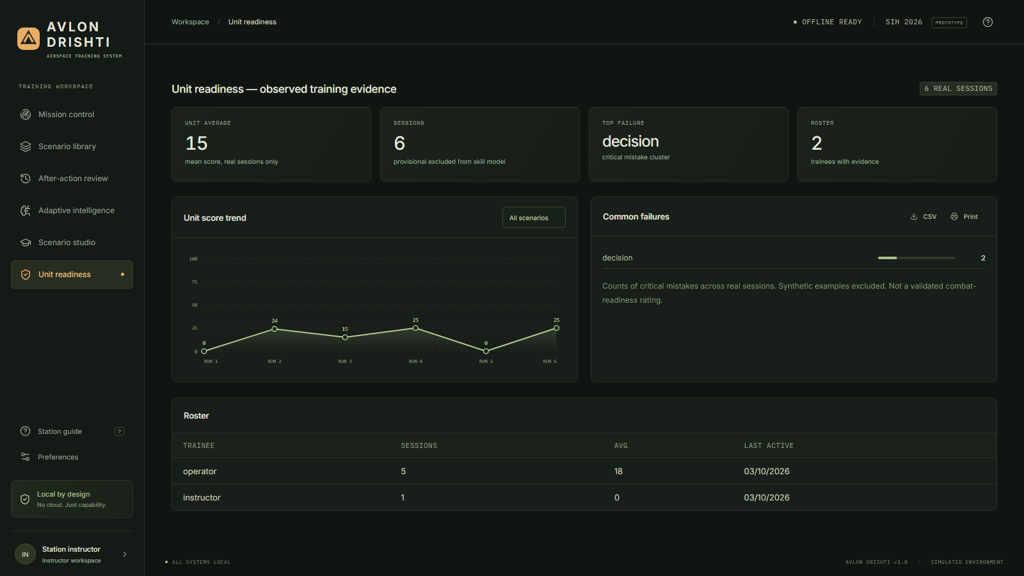
IMPACT AND BENEFITS
Your Team Name
600 decision-reps a month, at ~₹0 marginal cost.
▸ Math (shown working): 1 station × 30 trainees × 20 reps/month = 600 reps/month vs one live-fire drill day. Ashni scale: ~385 platoons × 20–25 troops.
▸ Who gains: trainees (reps under pressure) · instructors (author once, assign, track trends) · commanders (observed unit evidence) · DSSC evaluators (all 4 SIH outcomes, one workflow).
▸ Cost: ₹0 new hardware (existing laptop, integrated graphics OK) · ₹0 licences (no cloud/API/telemetry) · backup = copy one SQLite file (~5 min) · air-gap friendly, CSV rollup.
▸ Benefits: unlimited fair repetitions · judgment under uncertainty · explainable, replayable feedback · weakness-targeted practice, zero rote learning · honest boundaries — no false readiness claims.

Slide 6
RESEARCH AND REFERENCES
Your Team Name
▸ SIH26247 verified against the official listing (ID, title, org, category, theme, all four outcomes) — desktop alone satisfies outcome 1.
▸ Engineering: Fiedler fixed-timestep (deterministic replay) · Reynolds boids (swarm motion, no neural engine) · pyBKT context (we use a simpler documented Beta model) · MDN offline reasoning · SQLite file-DB rationale · node:sqlite docs.
▸ Warfare grounding (open sources): Ukraine FPV revolution + cost-exchange crisis (interceptors cost 20–50× the drone) · Shahed night/acoustic/volley-saturation traits · TB2 lesson: effectiveness is context-dependent · Op Sindoor, May 2025: hundreds of drones in waves vs Integrated Counter-UAS grid + indigenous Akash/Akashteer · Ashni platoons in ~385 battalions (Oct 2025) · ATP 3-01.81 detect→decide · EU SeDaFuV sim · ATLAS decision-intelligence.
Same seed + same decisions = byte-identical replay. Ask us to prove it live.

