Slide 1
Survoler Presentation
4:3
The preview must preserve the presentation's standard page size and aspect ratio.
Notes:
This test slide uses the standard 4:3 page setting so the renderer can verify fixed slide geometry.

Slide 2
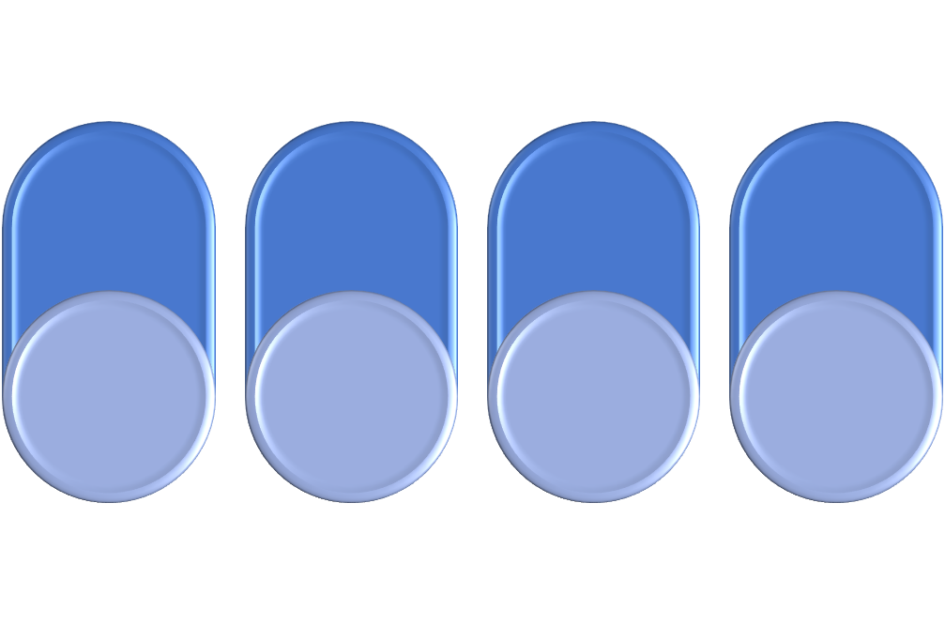
Survoler Presentation
Notes:
This test slide uses the standard 4:3 page setting so the renderer can verify fixed slide geometry.

