Slide 1

Common Application Libraries
What and Why

Slide 2
Common Application Libraries
What: A set of class libraries designed to enable the rapid development of highly scalable applications. Focused on Extensibility, Federated Execution, Asynchronous Processing, Multi-Tenant Data Access and Security.
Why: Aggregates solutions to common challenges around building these types of applications.
Common
Common.Providers
Common.Data
Common.Messaging
qEvent Subsystem
Common.Web
Common.IO
Common.Net
Common.Util
Common.Rulesets
Common.Environment (coming in release 3.2.0.0)

Slide 3
Common
Contains the building blocks of all other components of the framework.
Examples include: Status Codes, Status tracking objects, Serialization and System namespace extensions...
Class | Description
Status | Contains a rolling history of log info and Common.Codes. This core component can be used as a message envelope, exception manager, logging vehicle, return construct and object public state property.
Codes | An extensible Enum based on HTTP status codes
IStatus | Status Interface
ITrackable | Base interface for enabling distributed transaction tracing Implements IStatus and Tracker:Guid
ITenantTrackable | A tenant (client) aware ITrackable

Slide 4
Common.Providers
This namespace provides the core provider model, static provider factory and ProviderMonitor singleton that enable automatic publishing of Status logs, events and notifications.
Class | Description
IStatusProvider | Defines the requirements to implement a class that can subscribe to status publishing requests.
IStatusProviderElement | System.Configuration element with base status provider properties
ProviderMonitor | Manages status publishing including thresholds, throttling, provider subscription and failover.
StatusProviderFactory | Factory class for generating StatusProviderBase and IStatusProvider instances
Default Status Providers | Including: XmlLogFile, SqlLogTable, SMTPMail, WindowsEvent, qEvent Deprecated: W3CLogFile, AllscriptsMessageEnvelope

Slide 5
Common.Data
This namespace contains methods and extensions for both Standard and Federated/Multi-Tenant Data Access.
Class | Description
IClientNodeConnector | Provides the minimum information required to build a list of SQL connectionstrings to client specific data nodes and databases.
ClientNodeConnectionsHelper | A static helper that provides methods for constructing IClientNodeConnectors.
ITenantDataTrackable | Defines the members required to support transparent federated data requests in a client/tenant aware class.
ClientNodeConnectionsExtensions | Provides IClientNodeConnector methods for the transparent routed execution of SQL stored procedures and qEvent (or other) messaging with the correct server and database context.

Slide 6
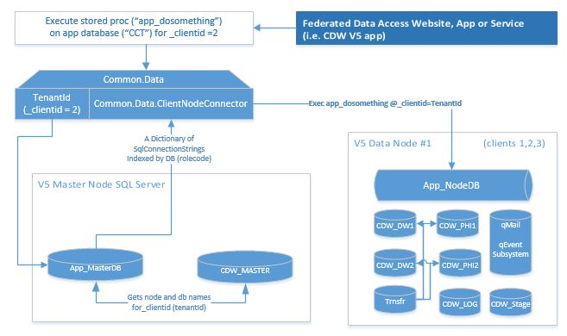
Common.Data
Query the right Data Node for your client with an IClientNodeConnector or ITenantDataTrackable class.

Slide 7
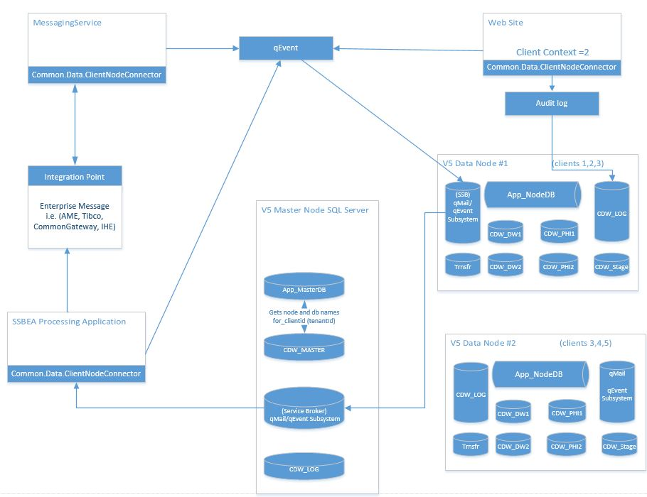
How it all fits together

Slide 8
qEvent subsystem
What, When & How

Slide 9
What: is the qEvent Subsystem
IT IS …
IT IS NOT…
A data-centric Publish and Subscribe message routing framework built on SQL Server Service Broker
Single stand-alone SQL database install.
Scales “Out”. Parallel processing is configurable and can be throttled.
Dynamic federated routing by client.
Distributed internal and external transaction tracking
Workflow engine for asynchronous batch and UI initiated processing.
Built on a provider model pattern which offers HTTP, Hub/AME, T-SQL and executable event handlers.
T-SQL and C# APIs
Deployed for 3 years in a high volume Production environment
A replacement or competing solution for messaging in the cloud.
It is complementary and could be a component of the above.
Context specific
It can be dropped into existing systems
Insecure
The security model was designed in partnership with SaaS
Slow
Prod systems have processed in excess of 1,300 messages per second
Hard to Use
Simple publish message interface and subscriptions table with API documentation

Slide 10
When: to use the qEvent Subsystem
For multi-step batch processing
Even is some steps are in SQL and others require external interaction
Your solution needs to track distributed workflow progress across application boundaries or between SQL databases
You require intelligent federated routing of events and messages
You need to communicate data events to web applications or services
MSMQ is not meeting your processing/throughput requirements
Your design requires persistent, fault tolerant, self-healing and archiving queues
Your UI or service needs to initiate long running processes and receive progress updates.

Slide 11
How: to use the qEvent Subsystem
Coming Soon – developer documentation, tutorials and resources

