Slide 1
Advanced VRP Optimization
Approach, Formulation, Implementation, Solution, Testing
Last Updated: August 5, 2021

Slide 2
Quick Business Perspective
Overall setup:
A Service Manager, set of Technicians, each technician have multiple maintenance jobs
Set of customers, each customer has contract with company of how many times they should be visited for regular check up.
Plan is on monthly basis.
The plan includes a schedule / timetable indicating which technician goes where, at what time.
Each maintenance job has specific duration of 60 minutes.
Emergency demand from the customers has to be fulfilled by technician on priority basis.
Service Manager plans for the disruptions and handle the schedule manually.
Emergency from customers may arise for different reasons: AC is not working, people got stuck inside an Elevator, building fire alarms are not working etc.
Goal is to generate most cost-effective plan to fulfill given set of demands.

Slide 3
Technician Side
Technicians
Each company has multiple technicians.
Each technician can maintain one or more maintenance jobs, one maintenance job at a time though
Maintenance of a different job than current one requires a driving time and a fixed time of 60 minutes for maintenance job.
Each technician has operating hours from 7 am to 4 pm.
Driving time may also vary across locations.

Slide 4
Demand Side
Demand
All customer emergency demands are rolled over to the corresponding Service Manager, while maintaining a regular monthly schedule.
Emergency demand can be of different priority. Example:
AC is not working,
People got stuck inside an Elevator,
Building fire alarms are not working …..etc.
Emergency demand types have different priorities. In this case, the emergency demand can be categorized as:
Priority 3 : AC is not working,
Priority 1 : People got stuck inside an Elevator,
Priority 2 : Building fire alarms are not working
In case of a capacity / availability constraint, the higher priority demand needs to be fulfilled first.
In addition, meeting the demand of an earlier hours has a higher priority over a demand of a later hour in a particular day.
Example: Meeting priority 1 demand has higher priority over meeting priority 1 demand of any day.
If there are multiple customers requesting same priority demand on same hour, and all demands cannot be met, we need to take a call considering minimum distance.

Slide 5
Objective Function
Total of
Minimizing total distance covered
Meeting maximum maintenance jobs
Penalty of unmet emergency demand
In future enhancements, we can add further costs and capacities on
limited technicians
holidays
shifting hours
to fulfill certain limit of jobs per technician
technician can not exceed certain limit
traffic on roads
vehicle not working etc.

Slide 6
Deterministic Optimization Detailed Formulation

Slide 7
Notations
Entities
T = {t}: Set of all technicians
L = {l}: Set of all locations across all technicians
Note: Locations(t) = Set of locations for technician t
I = {i}: Set of all Emergency demands
K = {k}: Set of all Emergency demand priority types
Time discretization
Time is discretized at hourly level in the working time horizon
H = {h}: Set of hours over time horizon (7 am – 8am, 8am – 9am, 9am – 10am, 10am – 11am, 11am-12pm, 12pm – 1pm, 1pm-2pm, 2pm-3pm, 3pm-4pm)

Slide 8
Inputs
Demand (at Service Manager level)
demand(k,h) = demand of emergency priority k, on hour h
Capacity and Compatibility
compatible(i,l) = {true,false}. If the location l and emergency demand i location are compatible. This means, if emergency demand location i is on the way of location l for any technician.

Slide 9
Inputs
Time Duration
operating(l,h) = 1, if location l is being operated at hour h. Else, 0
drive_hr(l₁,l₂,t) = driving time from location l₁ to location l₂ for technician t
avail_hrs(l,d) = set of hours available, for line l, on day d

Slide 10
Inputs
Costs
unmet_demand_penalty(k,h) = cost of not meeting the demand of priority k on hour h
drive_distance(l₁,l₂,t) = driving distance per event, from location l₁ to location l₂, for technician t
Note:
unmet-demand penalty shall be defined in such a way that
Emergency demand of higher priority has higher weightage than that of lower priority
demand of earlier hour has higher weightage than demand of later hour
Q: If a tradeoff between priority and hour, which one wins? Hour WINS

Slide 11
Operating Decision Variables
Operating decision variable:
x(l,t,h₁,h₂) = {0,1}. If location l is being operated by technician t in batch starting at hour h₁ and ending at hour h₂ where t∈T, l∈L, compatible(l,t) = true, h₁∈H, h₂∈H, and
h₁ <= drive_distance(l_{i},l,t) + 1 = h₂
Notation:
hours(x(l, t,h₁,h₂)) = Hours for which line is working when the variable x(l, t,h₁,h₂) is active
x_vars(l,t) = Set of all (h₁,h₂) such that there is a variable x(l,t,h₁,h₂) is defined
x_vars(l,t,h) = Set of all (h₁,h₂) such that there is a variable x(l,t,h₁,h₂) is defined and h₁ ≤ h ≤ h₂
x_vars(l,t,h,_) = Set of all (h₁,h₂) such that there is a variable x(l,t,h₁,h₂) is defined and h₁ =h
x_vars(l,t,_,h) = Set of all (h₁,h₂) such that there is a variable x(l,t,h₁,h₂) is defined and h = h₂

Slide 12
Technician Decision Variables
Driving variable
d(l₁,l₂,t,h) = {0,1}, Denoting a driving from location l₁ to location l₂ by technician t where location l₁ operation ending at time h, for all l₁∈L l₂∈L, h∈H, t∈T
d(l₁,l₂,t,h) = 0, for all l₁∈L l₂∈L, h∈H, t∈T where compatible(i, l₁) = false or compatible(i, l₂) = false

Slide 13
Demand Decision Variables
Demand fulfilled variable
y(k,h) = Amount by which demand of priority k, on hour h is met, for all k∈K, h∈H
0 ≤ y(k,h) ≤ demand(k,h)

Slide 14
Constraint: Activity of a technician
Constraint 1: No overlap of activities on any hour for technician
Only one operating activity/ driving allowed at any hour h for technician t
∑ _{(h’,h’’)∈ x_vars(l, t, h)} x(l,t, h’,h’’) // -- technician busy in maintenance
+ ∑l1∈L, l2∈L, h-drive_hr(l1,l2,t) ≤ h’<h d(l₁,l₂,t, h’) //-- technician driving
≤ 1 for all t,h // -- at most one activity at a time

Slide 15
Constraints: Mass Balance
Constraint 2: Balance of completed works at any hour
w_done(k, h-1) // -- work done at previous hours: if h = 0, skip this term
+ ∑ _{l∈Locations(t)} ∑ _{(h’,h’’)∈ x_vars(l,t)} ∑_{h’ ≤ h≤ h’’} work_rate(t) * x(l,t,h’,h’’)// -- work done at h hour
= w_done(k,h) // -- work done at end of hour h
for all k, h

Slide 16
Constraints: Drive-hour
Constraint 3a: Drive hour After Maintenance
Every Maintenance has a corresponding driving variable after it:
∑_{(h’,h)∈ x_vars(x,l,_,h)} x(l,t, h’,h) = ∑_{l2∈L} d(l,l₂,t,h) , for all t,l,h
Constraint 3b: Drive hour Before Maintenance
Every Maintenance has a corresponding driving variable before it:
∑ _{h∈ H | h’<=h} ∑ _{(h’,h’’)∈ x_vars(x,l)} x(l, t, h’,h’’) <= ∑i2∈I, 1 ≤ h’ < h- drive_hr(i2,i,l) d(l₂,l,t,h’) for all t,l,h
x(l, t, h,h’) <= ∑i2∈I, 1 ≤ h’ < h- drive_hr(i2,i,l) d(l₂,l,t,h’) for all l,t,h, and (h,h’) in x_vars(l,t,h_)

Slide 17
Objective Function Terms
Term 1: Non-fulfillment emergency demand cost
z₁ = ∑_{k} ∑_{h} unmet_demand_penalty(k,h) * (demand(k,h)- y(k,h))
Term 2: Driving distance
z₂ = ∑_{l1} ∑_{l2} ∑_{t} ∑_{h} drive_hour(l₁,l₂,t) * d(l₁,l₂,t,h)
Objective Function: Weighted sum of all costs: Minimize z = w₁*z₁+ w₂*z₂

Slide 18
Stochastic Optimization Detailed Formulation

Slide 19
Overall Setup
The Tool : exploits GIS location of any technician and the location of emergency demand at a certain time. Hence, it provides current schedule/timetable of a technician considering the disruptions.
Know the position of each technician.
Help the technician to reach quickly to the emergency location.
Track the technician in real-time.
Here is a basic scenario when an emergency call arrives.
Service Manager point of view:
Information about the emergency location is inputted in the software.
Location information is processed, a set of technicians which suit to, needs to be created
The selection of a technician in the previously created set is done via an optimization algorithm.
The emergency location is inserted in the technician’s road.
From a technician point of view:
The technician receives an emergency request, and he is geo-guided to the emergency location via GPS.
When the maintenance is finished, he inputs results and notes that are immediately transferred to the central database.
Then he goes on with the next customer.

Slide 20




Diagram of Overall Setup
Data Exchange after emergency call:
Priority check (2)
And Customer’s details
Service Manager
Emergency call (1)
Emergency location
Location (3)
Emergency location information (4)
Driving to Emergency location (5)
GPS location
Technician

Slide 21
Scope of the Tool and Dynamic Optimization
The tool improves reaction time to emergency calls.
It also update the database with information about customers and so facilitate the next regular check up.
It is a real time tool which can select the appropriate technician.
This project uses new technologies like GPS, wireless data communication, artificial intelligence and optimization for dynamic problems.
Basis of the Dynamic Optimization Tool :
The emergency calls are highly dynamic and most or all requests are unknown at the beginning. We have no information about their arrival time. The response time must be very low because lives can be in danger based on the priority of emergency causes.
The static VRP is defined on a set V = {v0, v1, ..., vN} of vertices, where vertex v0 is a Service Manager location at which are based m technicians of capacity Q, while the remaining N vertices represent customers. A non-negative distance is defined for each edge (vi, vj) ∈ V × V. Each customer has a non-negative service time s(vi) = 60 minutes. A technician route is a circuit on vertices. The VRP consists of designing a set of m technician’s routes of least total distance, each starting and ending at the service manager location, such that each customer is visited exactly once by a technician, the total demand of any route does not exceed Q, and the total duration of any route does not exceed a preset bound T = 9 hours (7am – 4 pm).

Slide 22
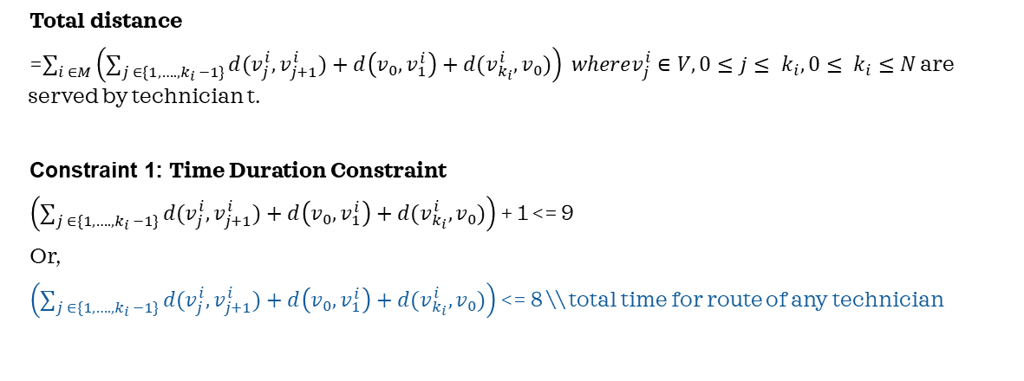
Objective Function Terms
Total distance
=$\sum_{i ∈M}{\left(\sum_{j ∈\{1, …. , k_{i} −1\}}{d(v_{j}^{i},v_{j+1}^{i})}+d\left(v_{0},v_{1}^{i}\right)+d(v_{k_{i}}^{i}, v_{0})\right) wherev_{j}^{i}∈V, 0≤j≤ k_{i}, 0≤ k_{i}≤N}$ are served by technician t.
Constraint 1: Time Duration Constraint
$\left(\sum_{j ∈\{1, …. , k_{i} −1\}}{d(v_{j}^{i},v_{j+1}^{i})}+d\left(v_{0},v_{1}^{i}\right)+d(v_{k_{i}}^{i}, v_{0})\right)$ + 1 <= 9
Or,
$\left(\sum_{j ∈\{1, …. , k_{i} −1\}}{d(v_{j}^{i},v_{j+1}^{i})}+d\left(v_{0},v_{1}^{i}\right)+d(v_{k_{i}}^{i}, v_{0})\right)$ <= 8 \\ total time for route of any technician

Slide 23
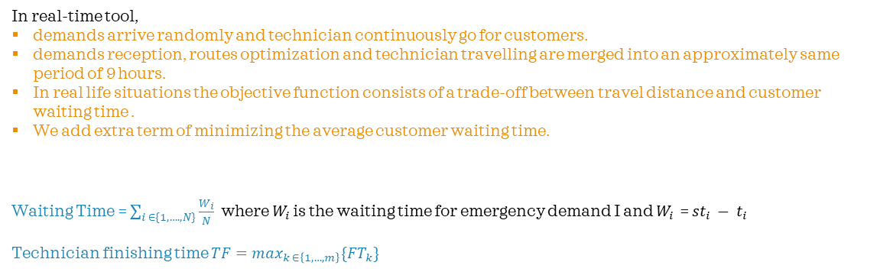
Objective Function Terms
In real-time tool,
demands arrive randomly and technician continuously go for customers.
demands reception, routes optimization and technician travelling are merged into an approximately same period of 9 hours.
In real life situations the objective function consists of a trade-off between travel distance and customer waiting time .
We add extra term of minimizing the average customer waiting time.
Waiting Time = $\sum_{i ∈\{1, …. , N\}}{\frac{W_{i}}{N}}$ where $W_{i}$ is the waiting time for emergency demand I and $W_{i}$ = ${st}_{i} − t_{i}$
Technician finishing time $TF=\max_{k ∈\left\{1, …, m\right\}}\{{FT}_{k}\}$

Slide 24
Process Design of the Tool
Process 1: We develop a multi-agents simulator. Its role is to schedule main entities present in a VRP. Each entity is represented by a process.
The environment process is dedicated to generate events during the simulation.
The company process simulates a real company. It receives requests and plans routes
Technician follow routes given by the company and serve requests.
All these processes are synchronized on a same clock owned by the service manager.
One simulation step lasts millisecond in real time
Process 2: we have the optimization part.
The optimization process can be viewed as receiving the current solution and the requests and giving back a better solution.
Service Manager has the role of asking the optimizer to optimize current solution.
In a short time, manager reads the solution and gives new plans to the technician

Slide 25
Optimization Engine
The Optimizer has a 2-level architecture. Macro Optimizer and Micro Optimizer
The top level uses a global metaheuristic strategy and controls several solver agents.
In the lower level, we can use different heuristics for solving VRP.
Given a certain route and upcoming emergency calls, we may not attend all customers but can achieve optimal result given restrictions
Simulated Annealing
Conditions :
Time Window
Working hours
Current location of technician
Emergency customer location
Minimize
Distance travelled and waiting time of customers
Monthly plant of route for technician
Emergency call location,
Emergency priority
# of technicians & route for a particular technician
#of Customers
#of Priorities of emergency calls
.
As business goal is to minimize objective function, Simulated Annealing is best which is designed specially to be applicable in optimizing function with time complexity polynomial time
Bandit Black Box algorithm/ Greedy/ Tabu Search
Real-time revised route for technician
.
Probabilistic method which counts the possibility of all Depot-Channel-Category-Subcategory combinations and gives the best solution out of all other available possibilities with polynomial time complexity and minimum space complexity

Slide 26
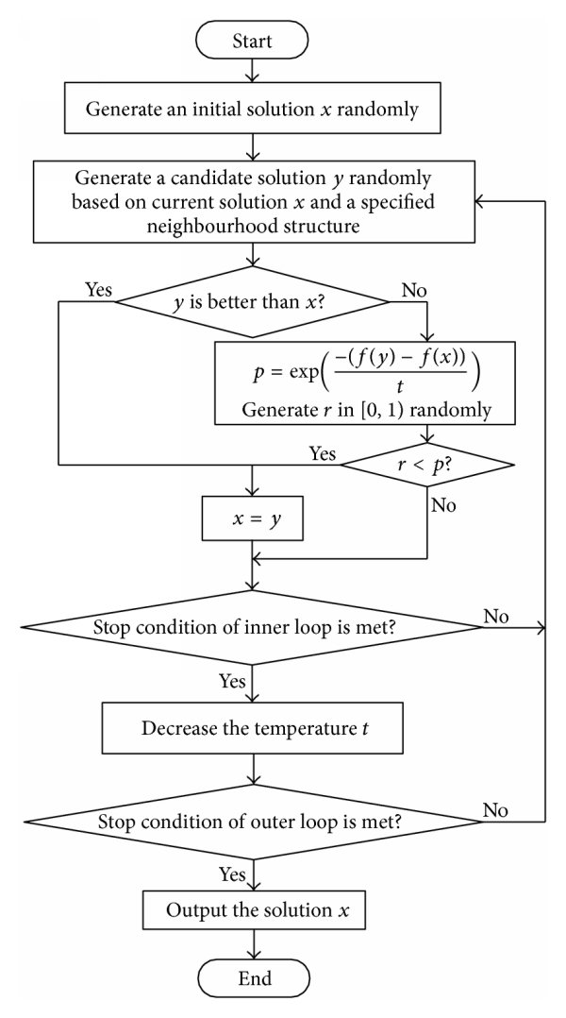
I/O of Simulated Annealing
# of technicians & route for a particular technician
#of Customers
#of Priorities of emergency calls
Minimize
Distance travelled and waiting time of customers,
Time window
.
Route for technician monthly plan

Slide 27
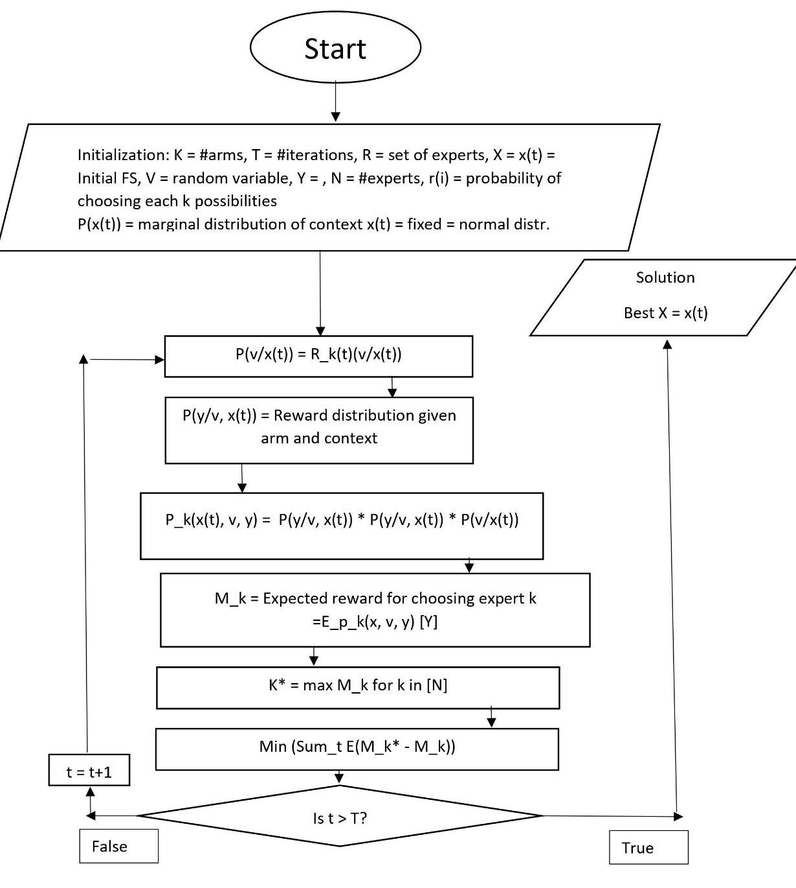
I/O of Bandid Black Box
Simulated Annealing
.
Revised route for technician real time
Real-time route for technician monthly plan
Emergency call location,
Emergency priority

Slide 28
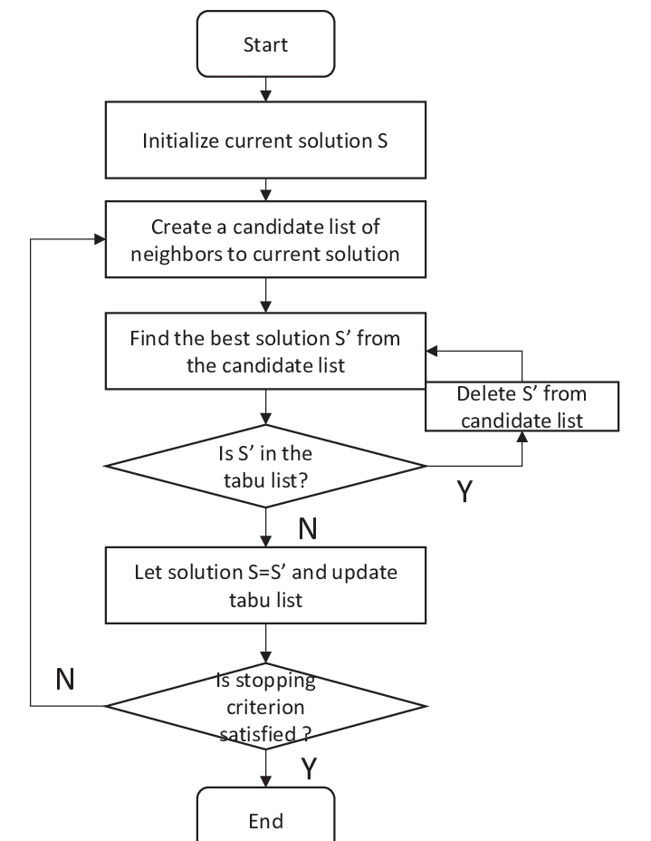
I/O of Tabu Search
Simulated Annealing
.
Revised route for technician real time
Real-time route for technician monthly plan
Emergency call location,
Emergency priority

Slide 29
I/O of Greedy Search
Simulated Annealing
.
Revised route for technician real time
Real-time route for technician monthly plan
Emergency call location,
Emergency priority

Slide 30
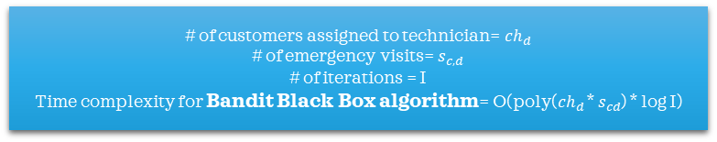



Time Complexity
# of technicians = n
Time complexity for Simulated Annealing = O($n^{4}$)
.
# of customers assigned to technician= ${ch}_{d}$
# of emergency visits= $s_{c,d}$
# of iterations = I
Time complexity for Bandit Black Box algorithm= O(poly(${ch}_{d}$ * $s_{cd}$) * log I)
# of customers assigned to technician= ${ch}_{d}$
# of emergency visits= $s_{c,d}$
Time complexity for Tabu Search= O(poly(${ch}_{d}$ * $s_{cd}$ ) )
# of customers assigned to technician= ${ch}_{d}$
# of emergency visits= $s_{c,d}$
Time complexity for Greedy Search= O(poly(${ch}_{d}$ * $s_{cd}$) )

Slide 31
Screen Design
Technician i
Emergency location l
.
Assigned Route
Emergency priority
Last completed maintenance task
Distance from technician to emergency location l
Assign technician i
Wait time for customer
Route revised

Slide 32
Limitations and Comparisons
Deterministic Optimization
Stochastic Optimization
Simulated Annealing/ Bandit/ Tabu/Greedy algorithms
.
Run time fast
For large problem, commercial solver required, costly solution
Too many disruptions can not be handled
Can not be integrated with ML models
Open source available but can not handle large problem
Run time slow for all methods
For large problem, open source suitable
Too many disruptions can be handled
Can be integrated with ML models
Open source available and can handle large problem
Time complexity : polynomial time
Space complexity : good enough
Run time : very fast
Solvable : in Open Source
Implemented : on Python

Slide 33
Scenarios and Corner Cases
Smoke Test :
No run-time error
All files reading accurately
Single technician, single emergency call working or not?
Single technician, multiple emergency call working or not?
Multiple technician, multiple emergency call working or not?
Feature Testing :
Minimum Distance condition is working fine or not?
Minimum waiting time condition is working fine or not?
Emergency Prioritization : Based on priority of emergency call, the tool is working or not?
On same priority call, the location with minimum distance is taken or not?
Integration Testing :
All features together
Corner Cases :
Same emergency priority, same distance location, which one is taken by technician?
.

Slide 34
Thank you

