Slide 1

Artificial Intelligence
Collective Intelligence
Genetic Algorithms
Realized by : Zoubia Oussama, Zeghina Assaad Oussama

Slide 2
Content
Introduction
Artificial intelligence
Collective intelligence
Definition of genetic algorithms
Philosophy behind the GAs
Genes, Chromosomes, Population
Fitness function
Parent selection
Crossover and mutation
The Unity Engine
Applications of GAs in Unity
Conclusion

Slide 3
Introduction
Introduction
Artificial intelligence
Collective intelligence
Definition of genetic algorithms
Philosophy behind the GAs
Genes, Chromosomes, Population
Fitness function
Parent selection
Crossover and mutation
The Unity Engine
Applications of GAs in Unity
Conclusion
The first ideas of Artificial Intelligence methods are all
inspired from the biological and psychological mechanisms of the living creatures.
They were based on the observation of humans at their environment and were continuously innovated and updated from relatively recent discoveries and theories presented by the scientific community.
In this presentation, we present to you one of these methods which is Genetic Algorithms
1/24

Slide 4
Introduction
Introduction
Artificial intelligence
Collective intelligence
Definition of genetic algorithms
Philosophy behind the GAs
Genes, Chromosomes, Population
Fitness function
Parent selection
Crossover and mutation
The Unity Engine
Applications of GAs in Unity
Conclusion
Our presentation will be divided into four main sections:
AI and Collective Intelligence
The definition of genetic algorithms and their components.
The Unity game engine.
Concrete examples of the Application of GAs
2/24

Slide 5
Artificial Intelligence
Introduction
Artificial intelligence
Collective intelligence
Definition of genetic algorithms
Philosophy behind the GAs
Genes, Chromosomes, Population
Fitness function
Parent selection
Crossover and mutation
The Unity Engine
Applications of GAs in Unity
Conclusion
Artificial intelligence is a branch of computer science that develops algorithms in the goal of emulating the human intelligence
AI algorithms reach the solution of problem without the programmer explicitly defining the steps
“a machine that could interact with humans without the humans identifying it as a machine,
could be said to be “intelligent””
-Alan Turing
3/24

Slide 6
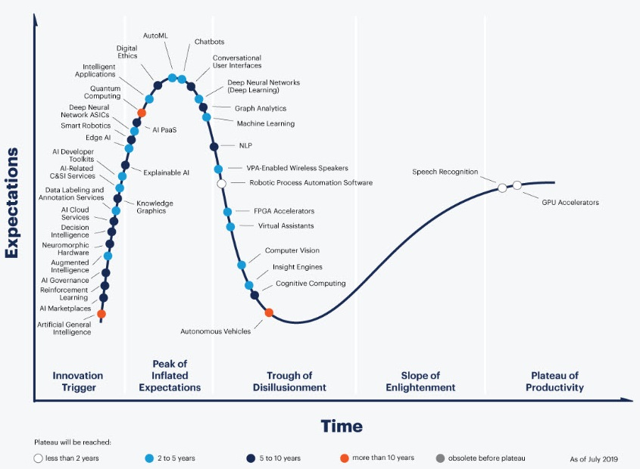
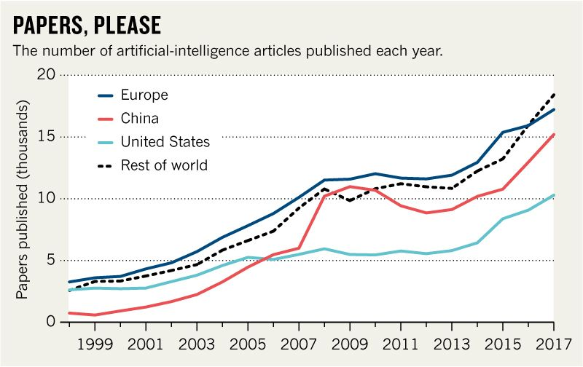
Artificial Intelligence
Introduction
Artificial intelligence
Collective intelligence
Definition of genetic algorithms
Philosophy behind the GAs
Genes, Chromosomes, Population
Fitness function
Parent selection
Crossover and mutation
The Unity Engine
Applications of GAs in Unity
Conclusion
A little bit of history class!
Creation of AI
AI winters
“Commercial AI”
4/24

Slide 7
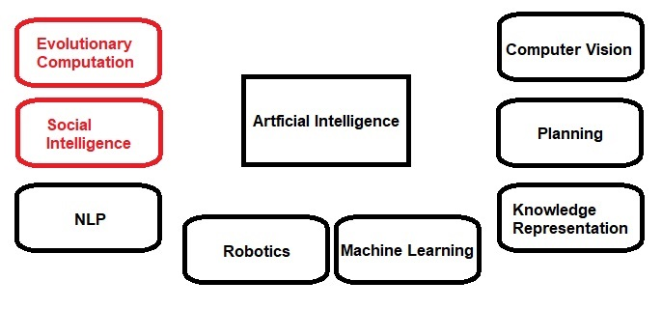
Artificial Intelligence
Introduction
Artificial intelligence
Collective intelligence
Definition of genetic algorithms
Philosophy behind the GAs
Genes, Chromosomes, Population
Fitness function
Parent selection
Crossover and mutation
The Unity Engine
Applications of GAs in Unity
Conclusion
Fields of AI :
5/24

Slide 8
Collective Intelligence
Introduction
Artificial intelligence
Collective intelligence
Definition of genetic algorithms
Philosophy behind the GAs
Genes, Chromosomes, Population
Fitness function
Parent selection
Crossover and mutation
The Unity Engine
Applications of GAs in Unity
Conclusion
Collective Intelligence is a form of universally distributed intelligence
The Decisions made by a group of individuals is more accurate than the decision made by an individual
The research in this field didn’t flourish until recent years with the advancements in sociology and AI
Examples of collective intelligence in nature can be seen in Ant colonies, migrating of birds…
6/24

Slide 9
Collective Intelligence
Introduction
Artificial intelligence
Collective intelligence
Definition of genetic algorithms
Philosophy behind the GAs
Genes, Chromosomes, Population
Fitness function
Parent selection
Crossover and mutation
The Unity Engine
Applications of GAs in Unity
Conclusion
The main goal of CI is collaborative learning which can defined as a group of agents sharing information to achieve a certain goal
The genetic algorithms consist of agents sharing their information with the population to improve the upcoming generation
7/24

Slide 10
Definition of genetic algorithms
Introduction
Artificial intelligence
Collective intelligence
Definition of genetic algorithms
Philosophy behind the GAs
Genes, Chromosomes, Population
Fitness function
Parent selection
Crossover and mutation
The Unity Engine
Applications of GAs in Unity
Conclusion
Genetic algorithms (GAs) have been firstly introduced by Holland in the 1960s
Due to being computationally heavy GAs were not put into use until 1990s
GAs are a random search-based optimization techniques
They are slow gradual processes that make slight changes to the solutions iteratively until reaching the goal
8/24

Slide 11
Definition of genetic algorithms
Introduction
Artificial intelligence
Collective intelligence
Definition of genetic algorithms
Philosophy behind the GAs
Genes, Chromosomes, Population
Fitness function
Parent selection
Crossover and mutation
The Unity Engine
Applications of GAs in Unity
Conclusion
GAs work well where other complex methods fail
They offer multiple solution to the problem unlike other methods
They can find the solution without the need to explicitly specifying the problem
They do not encounter the problem of local optima
9/24

Slide 12
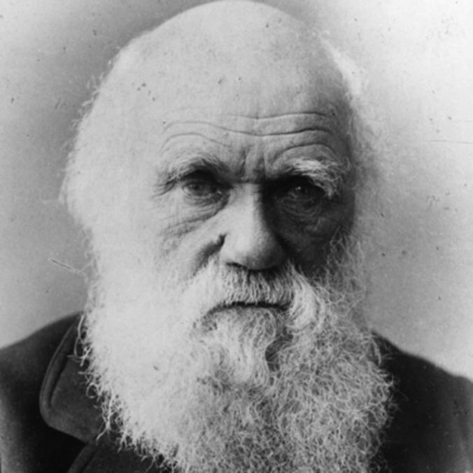
Philosophy behind the GAs
Introduction
Artificial intelligence
Collective intelligence
Definition of genetic algorithms
Philosophy behind the GAs
Genes, Chromosomes, Population
Fitness function
Parent selection
Crossover and mutation
The Unity Engine
Applications of GAs in Unity
Conclusion
Darwin’s theory of evolution was the main idea behind the Genetic algorithms concept, they share the same philosophy of survival of the fittest
Charles Darwin
1809-1882
10/24

Slide 13
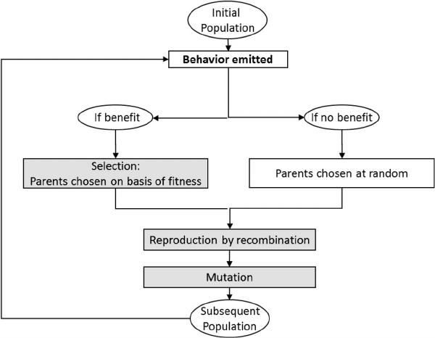
Philosophy behind the GAs
Introduction
Artificial intelligence
Collective intelligence
Definition of genetic algorithms
Philosophy behind the GAs
Genes, Chromosomes, Population
Fitness function
Parent selection
Crossover and mutation
The Unity Engine
Applications of GAs in Unity
Conclusion
Semantic diagram of the evolutionary theory
11/24

Slide 14
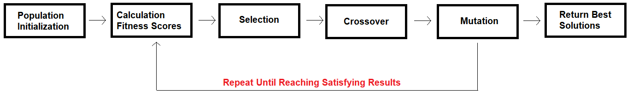
Philosophy behind the GAs
Introduction
Artificial intelligence
Collective intelligence
Definition of genetic algorithms
Philosophy behind the GAs
Genes, Chromosomes, Population
Fitness function
Parent selection
Crossover and mutation
The Unity Engine
Applications of GAs in Unity
Conclusion
Resume of the process of Genetic algorithms
12/24

Slide 15
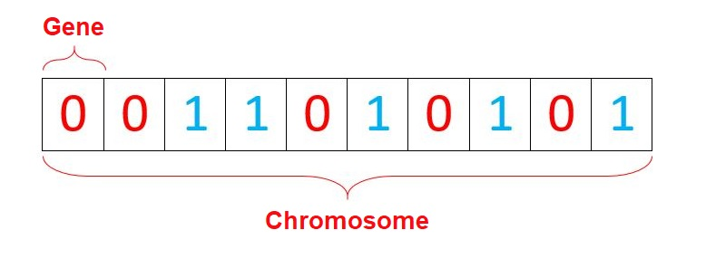
Genes, Chromosomes, Population
Introduction
Artificial intelligence
Collective intelligence
Definition of genetic algorithms
Philosophy behind the GAs
Genes, Chromosomes, Population
Fitness function
Parent selection
Crossover and mutation
The Unity Engine
Applications of GAs in Unity
Conclusion
Genes and chromosomes mimic the functionality of the biological genes and chromosomes
They represent a decision, a step for a solution, a functionality or a property of a creature
13/24

Slide 16
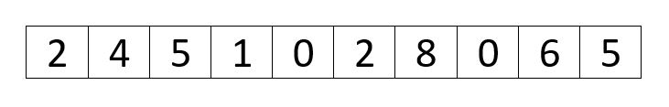
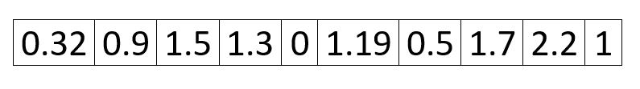
Genes, Chromosomes, Population
Introduction
Artificial intelligence
Collective intelligence
Definition of genetic algorithms
Philosophy behind the GAs
Genes, Chromosomes, Population
Fitness function
Parent selection
Crossover and mutation
The Unity Engine
Applications of GAs in Unity
Conclusion
There are various representation of the genes:
Integer representation
Real value representation
14/24

Slide 17
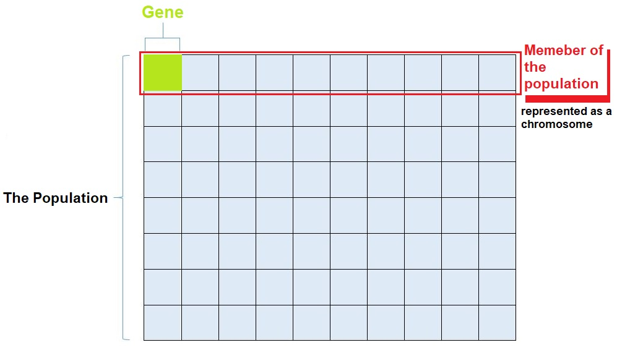
Genes, Chromosomes, Population
Introduction
Artificial intelligence
Collective intelligence
Definition of genetic algorithms
Philosophy behind the GAs
Genes, Chromosomes, Population
Fitness function
Parent selection
Crossover and mutation
The Unity Engine
Applications of GAs in Unity
Conclusion
A population can be considered as a set of combinations of all the possible values of the genes
Each combination is considered as a member of the population
15/24

Slide 18
Genes, Chromosomes, Population
Introduction
Artificial intelligence
Collective intelligence
Definition of genetic algorithms
Philosophy behind the GAs
Genes, Chromosomes, Population
Fitness function
Parent selection
Crossover and mutation
The Unity Engine
Applications of GAs in Unity
Conclusion
A population can be initialized Randomly or by using a heuristic function (heuristic initialization)
Each population is considered as a generation, the best members of the population will be chosen to create the new generation (evolutionary approach)
The choice of the members is based on a fitness score calculated by a fitness function
16/24

Slide 19
Fitness function
Introduction
Artificial intelligence
Collective intelligence
Definition of genetic algorithms
Philosophy behind the GAs
Genes, Chromosomes, Population
Fitness function
Parent selection
Crossover and mutation
The Unity Engine
Applications of GAs in Unity
Conclusion
The fitness function can be considered as the core of the Genetic algorithm
It takes an individual’s status as an input and returns its fitness score
Since it will be calculated multiple times (for every individual in all generation), the fitness function must be well optimized
17/24

Slide 20
Parent selection
Introduction
Artificial intelligence
Collective intelligence
Definition of genetic algorithms
Philosophy behind the GAs
Genes, Chromosomes, Population
Fitness function
Parent selection
Crossover and mutation
The Unity Engine
Applications of GAs in Unity
Conclusion
Some of the population will be considered as parents. Parent selection is the phase in Genetic algorithms where a parent (individual) is chosen
and allowed to breed and pass its genes to the next generation
This Selection is based on the fitness score
18/24

Slide 21
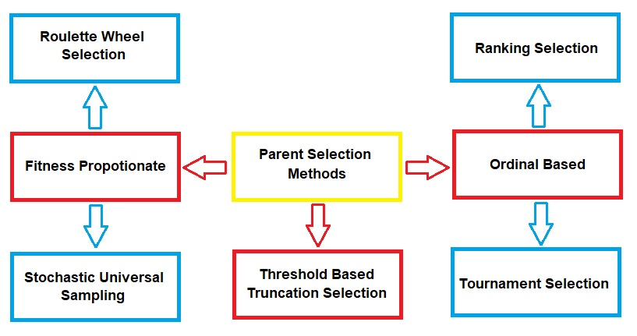
Parent selection
Introduction
Artificial intelligence
Collective intelligence
Definition of genetic algorithms
Philosophy behind the GAs
Genes, Chromosomes, Population
Fitness function
Parent selection
Crossover and mutation
The Unity Engine
Applications of GAs in Unity
Conclusion
There are many Parent selection methods to choose from:
19/24

Slide 22
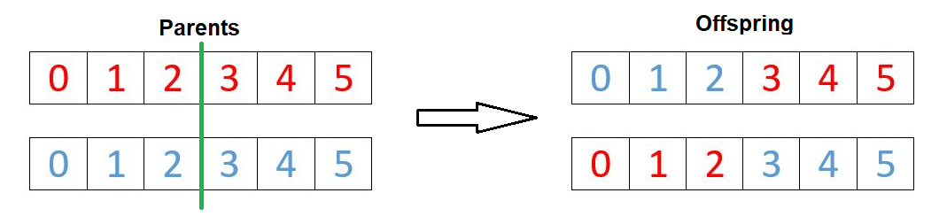
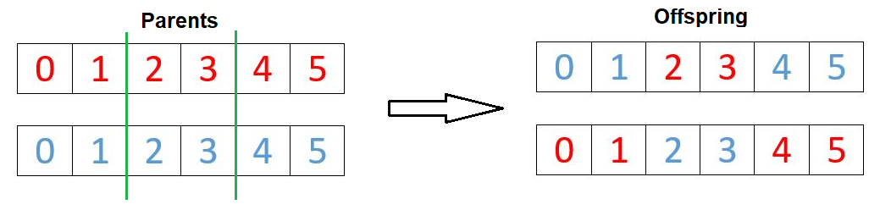
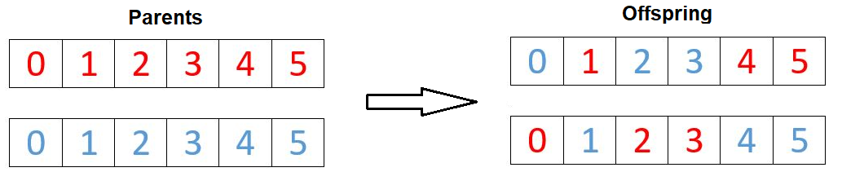
Crossover and mutation
Introduction
Artificial intelligence
Collective intelligence
Definition of genetic algorithms
Philosophy behind the GAs
Genes, Chromosomes, Population
Fitness function
Parent selection
Crossover and mutation
The Unity Engine
Applications of GAs in Unity
Conclusion
The crossover operation is similar to the biological reproduction operation to produce offspring
20/24

Slide 23
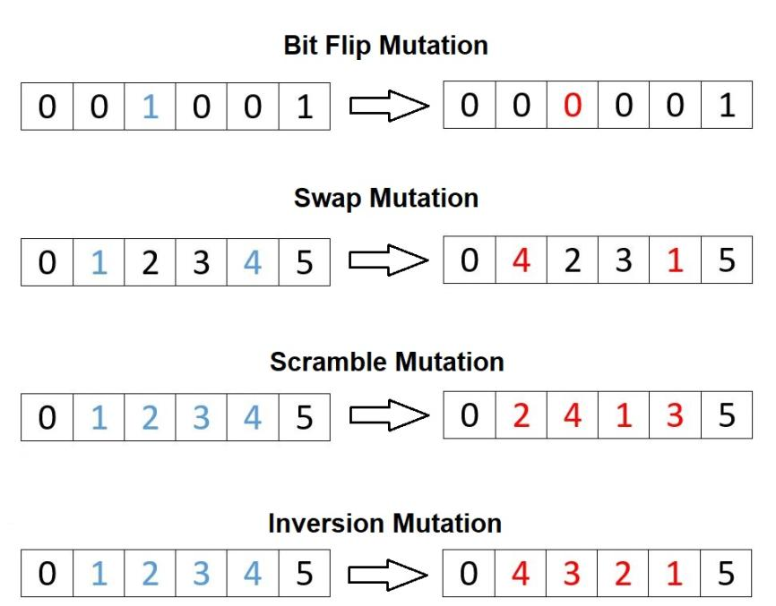
Crossover and mutation
Introduction
Artificial intelligence
Collective intelligence
Definition of genetic algorithms
Philosophy behind the GAs
Genes, Chromosomes, Population
Fitness function
Parent selection
Crossover and mutation
The Unity Engine
Applications of GAs in Unity
Conclusion
The mutation is a random modification in some genes
21/24

Slide 24
The Unity Engine
Introduction
Artificial intelligence
Collective intelligence
Definition of genetic algorithms
Philosophy behind the GAs
Genes, Chromosomes, Population
Fitness function
Parent selection
Crossover and mutation
The Unity Engine
Applications of GAs in Unity
Conclusion
The Unity engine is a game engine recently gained popularity as a simulation tool for artificial intelligence models
It uses the C# programming language
It is used to develop 2D and 3D games
It supports multiple platforms (more than 25 platform)
22/24

Slide 25
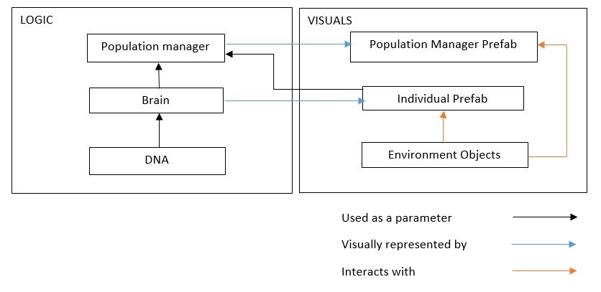
Applications of GAs in Unity
Introduction
Artificial intelligence
Collective intelligence
Definition of genetic algorithms
Philosophy behind the GAs
Genes, Chromosomes, Population
Fitness function
Parent selection
Crossover and mutation
The Unity Engine
Applications of GAs in Unity
Conclusion
Implementation of Genetic Algorithms in Unity
23/24

Slide 26
Conclusion
Introduction
Artificial intelligence
Collective intelligence
Definition of genetic algorithms
Philosophy behind the GAs
Genes, Chromosomes, Population
Fitness function
Parent selection
Crossover and mutation
The Unity Engine
Applications of GAs in Unity
Conclusion
In this presentation we explored Genetic algorithms and gave a brief introduction to this wide sub domain of Artificial intelligence, We determined its relationship with evolutionary algorithms and collective.
The presented work was nothing but a soft demonstration of what genetic algorithms can achieve since GAs have been used in much more complex problems in robotics or even in molecular dynamics.
24/24

Slide 27
THANK YOU FOR YOUR ATTENTION
Feel free to ask us any question

