Slide 1

Cognitive Testing Platform for Nonhuman Primates
CDC Cognitive Testing Platform Team

Slide 2




Objective
Redesign the Primate Cognitive Testing Platform at the CDC to:
Upgrade system interfaces and improve performance
Upgrade legacy game code from Visual Basic to Python
Reduce unit costs by 75%
Improve reliability of the pellet feeder

Slide 3
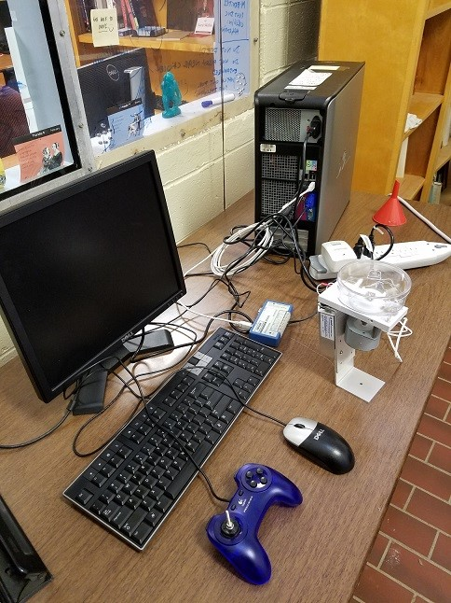
Background
CDC System to test primate cognitive
performance using:
Visual stimulus in the form of a game
Joystick response
Feeder system feedback reward

Slide 4
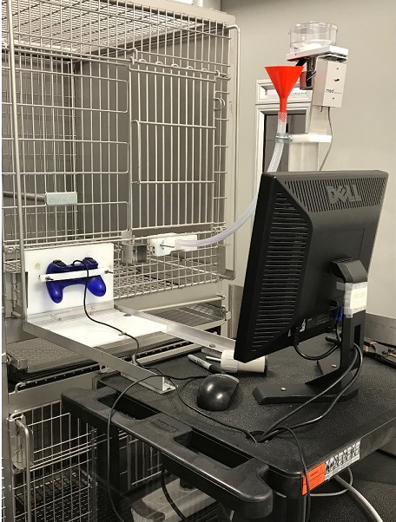
Concerns
High unit cost
Games coded in Visual Basic
Stability in gameplay
Feeder design causes jamming or multiple pellets to be dispersed

Slide 5
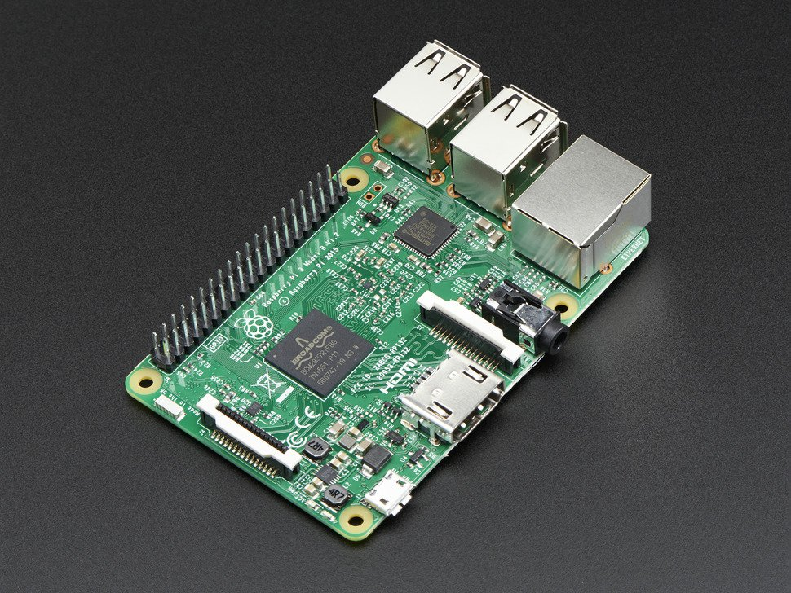
Design Approach
We propose modernizing the system with:
A Raspberry Pi 3 to interface peripherals and run the game code
Python coding for the games
A new 3D printed feeder apparatus to eliminate system jamming
A stepper motor to control pellet dispensing
A new enclosure to secure these components

Slide 6
Technical Specifications 1: Pellet Feeder
Feature | Requirement
Pellet Bowl | Does not become clogged with pellets
Stepper Motor Electric and Mechanical Design | V_input = 3.2V, 200 PPR, I_input < 3A [3]
Feeder Tube Measurements | Diameter = 2 x Diameter of Pellet, Length = 3’
Dispenser Module for pellets | Attach point = Outer Diameter of feeder tube
Notes:
Touch on the fact the pellet feeder will not be powered by the Pi, empla

Slide 7
Technical Specifications 2: Python Interface
Feature | Requirement
Response time between signal and feedback | 20us
Customization of Individual Game Parameters | Between Sessions by GUI
Processor Overhead | 30-35%
Formatting of Result Output | CSV
Piping of Result Output | Serial

Slide 8
Project Demonstration
Successfully completing a game with the device under CDC supervision
Ensuring that the delay between response and feedback is sufficiently minimal as determined by a CDC expert.
Validating that the new feeder mechanism does not become jammed.
Validating that the output CSV is properly formatted for processing.

Slide 9
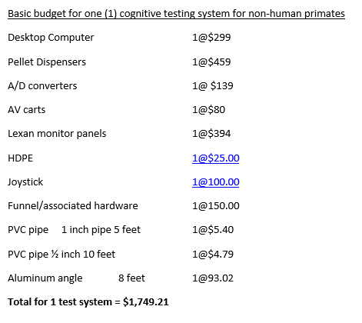
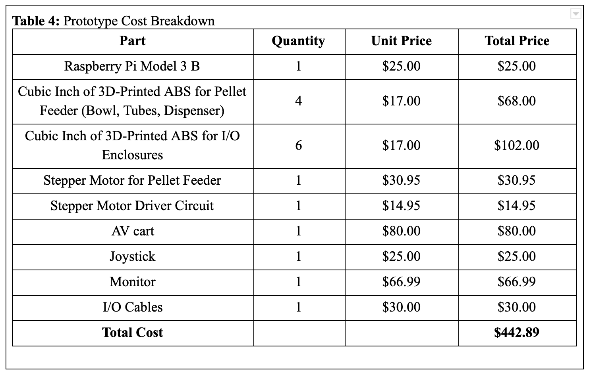
Marketing and Cost Analytics

Slide 10
Current Status
Taking more concrete measurements of the current system and cages to begin printing feeder parts right away
Compiling list of games and their specifications to start Python codebase
Set to meet with the CDC next week

