Slide 1
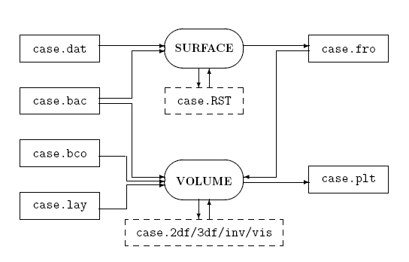

Slide 2
Using Trimmed Surfaces

Slide 3
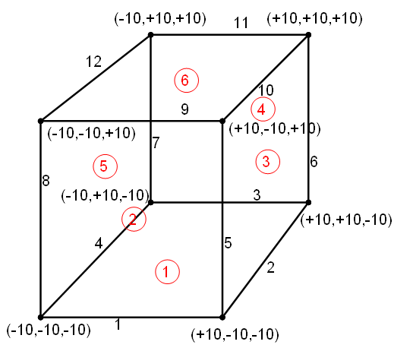

Slide 5
Surface Mesh File Format

Slide 6
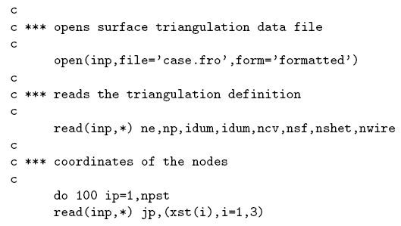
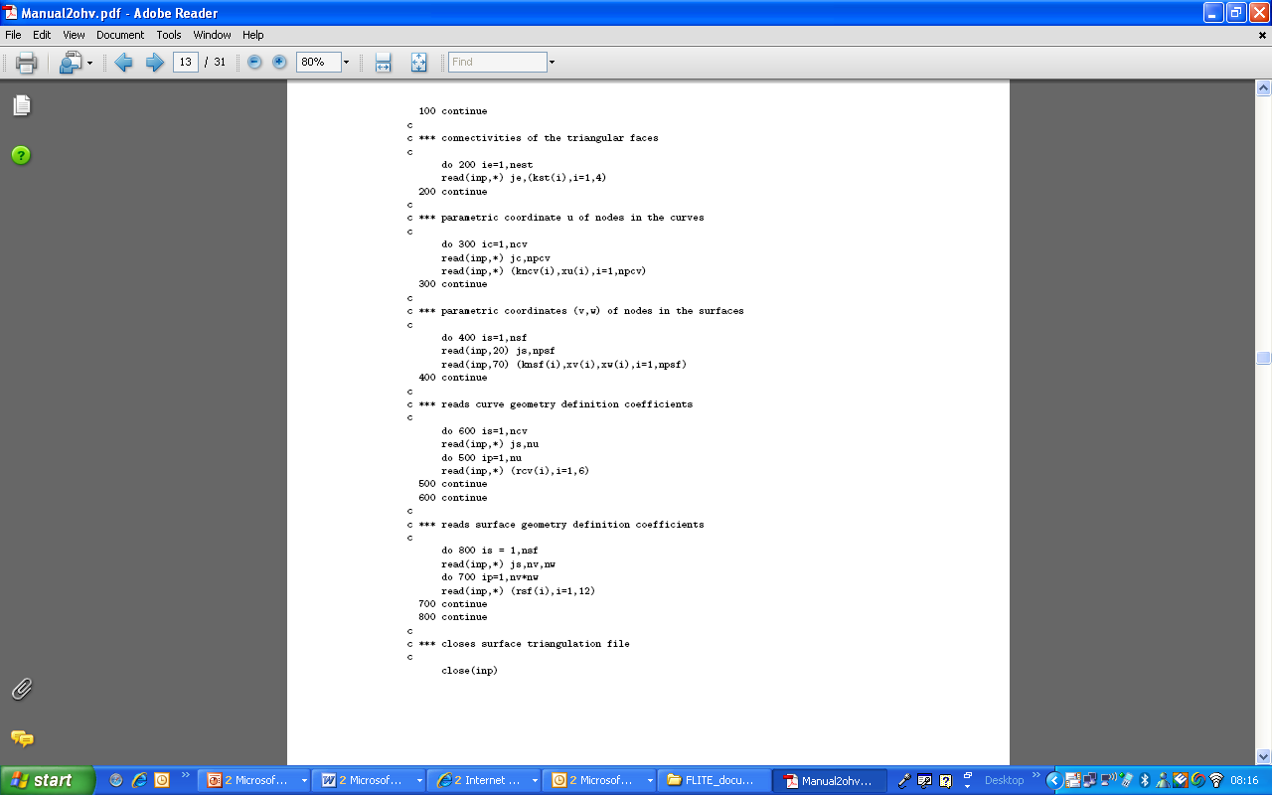
.fro file

Slide 7
Volume Mesh File Format

Slide 8
open( inp, file=‘case.plt’, form=‘unformatted’)
read(inp) numTetrahedra, numNodes, numTriangles
read(inp) ((tets(in,ie),ie=1,numTetrahedra),in=1,4)
read(inp) ((coor(in,ip),ip=1,numNodes,),in=1,3)
read(inp) ((tris(in,ie),ie=1,numTriangles),in=1,5)
close(inp)
Column 5 is the Surface Number
Tetrahedral .plt file

Slide 9
open( inp, file=‘case.plt’, form=‘unformatted’)
read(inp) totalNumElements, numNodes, totalNumBndFaces, numHexahedra,
numPrisms, numPyramids, numTetrahedra, numQuads, numTriangles
read(inp) ((hexs(in,ie),ie=1,numHexahedra),in=1,8)
read(inp) ((prisms(in,ie),ie=1,numPrisms),in=1,6)
read(inp) ((pyramids(in,ie),ie=1,numPyramids),in=1,5)
read(inp) ((tets(in,ie),ie=1,numTetrahedra),in=1,4)
read(inp) ((coor(in,ip),ip=1,numNodes),in=1,3)
read(inp) ((quads(in,if),if=1,numQuads),in=1,5)
read(inp) ((tris(in,ie),ie=1,numTriangles),in=1,5)
close(inp)
Column 5 is the Surface Number
Hybrid .plt file

Slide 10
.gco File Format

Slide 11
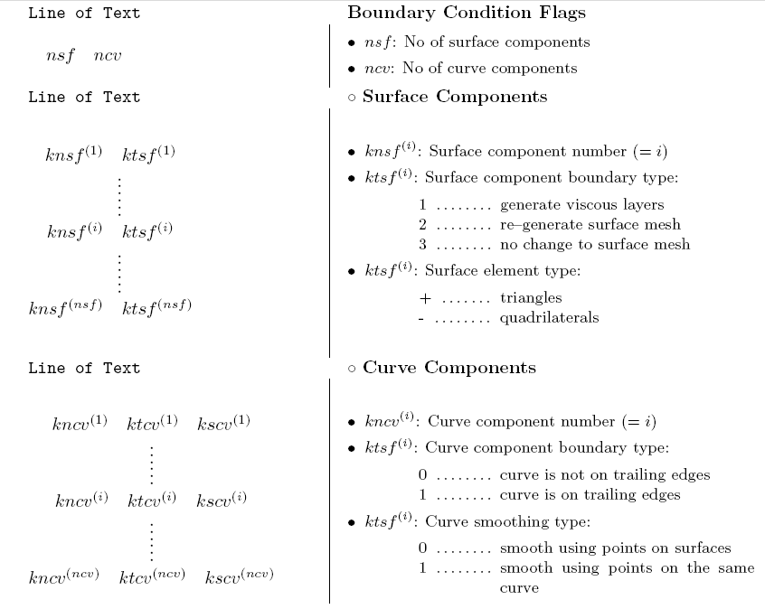
.gco file

Slide 12
Viscous Layers File Format

Slide 13
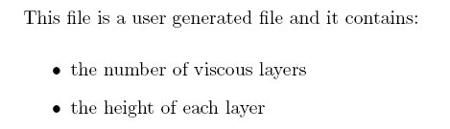
.lay file
e.g. 10
0.001
0.002
0.003
0.005
0.008
0.012
0.016
0.020
0.025
0.030

Slide 14
Running the Flow Solver

Slide 15
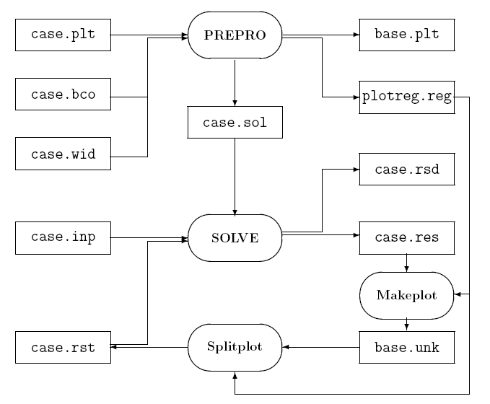

Slide 16
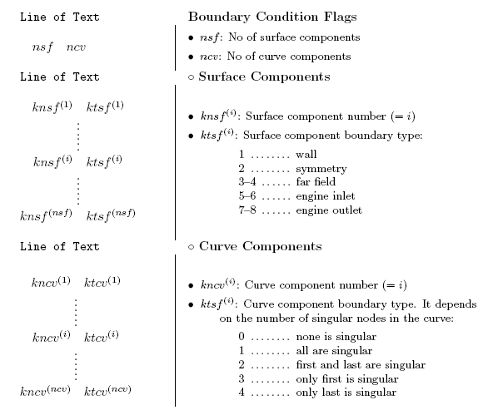
.bco file

Slide 17
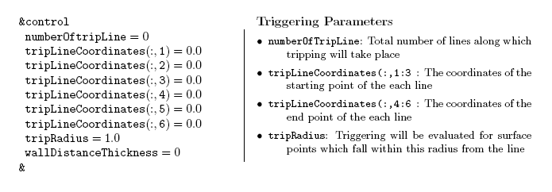
.wid file

Slide 18
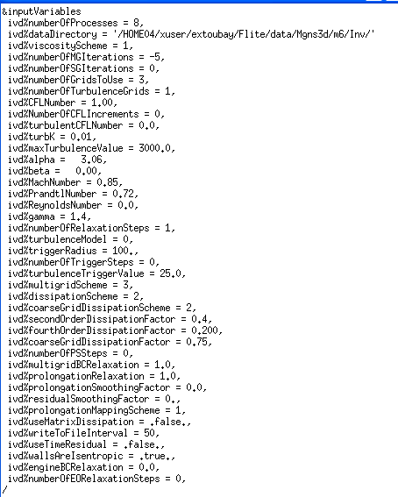
.inp file

Slide 20
open( inp, file=‘case.unk’, form=‘unformatted’)
read(inp) numNodes
read(inp) ((unk(in,ip),ip=1,numNodes),in=1,5)
close(inp)
Solution file Format (.unk)

