Slide 1
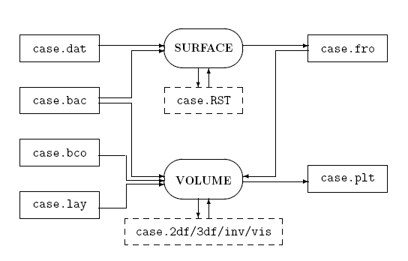

Slide 2
Generating a Simple Cube

Slide 3
Cube
6
Guide to the .dat geometry file format
(-10,+10,+10)
(+10,+10,+10)
(-10,-10,+10)
(+10,-10,+10)
(-10,+10,-10)
(+10,+10,-10)
(-10,-10,-10)
(+10,-10,-10)

Slide 4
Cube
6
Curve Specification
1 1
2
-10 -10 -10
-10 -10
1
2
-10 -10
10 10 -10
1
2
10 -10
-10 10 -10
1
2
-10 -10 -10
-10 10 -10
1
2
.
.
.
Guide to the .dat geometry file format
(-10,+10,+10)
11
(+10,+10,+10)
12
10
9
(-10,-10,+10)
(+10,-10,+10)
7
6
8
(-10,+10,-10)
3
(+10,+10,-10)
4
5
2
(-10,-10,-10)
1
(+10,-10,-10)

Slide 5
.
.
Support Surface Specification
1
2
-10 -10 -10
-10 -10
-10 10 -10
10 10 -10
1
2 2
-10 -10 -10
-10 -10
-10 -10 10
-10 10
1
2
.
.
.
Guide to the .dat geometry file format
(-10,+10,+10)
11
(+10,+10,+10)
12
6
10
9
4
(-10,-10,+10)
(+10,-10,+10)
7
5
3
6
8
(-10,+10,-10)
3
2
(+10,+10,-10)
4
5
1
2
(-10,-10,-10)
1
(+10,-10,-10)

Slide 6
.
.
.
Connectivity Data
6
Curve Segments
1 1
2 1
3 1
4 1
5 1
6 1
7 1
8 1
9 1
10 1
11 1
12 1
.
.
.
Guide to the .dat geometry file format
(-10,+10,+10)
11
(+10,+10,+10)
12
6
10
9
4
(-10,-10,+10)
(+10,-10,+10)
7
5
3
6
8
(-10,+10,-10)
3
2
(+10,+10,-10)
4
5
1
2
(-10,-10,-10)
1
(+10,-10,-10)

Slide 7
.
.
Surface Boundary Data
1 1 1
4
1 2 3 4
2 1 1
4
5 9 8
3 1 1
4
6 10 5
4 1 1
4
.
.
.
Guide to the .dat geometry file format
(-10,+10,+10)
11
(+10,+10,+10)
12
6
10
9
4
(-10,-10,+10)
(+10,-10,+10)
7
5
3
6
8
(-10,+10,-10)
3
2
(+10,+10,-10)
4
5
1
2
(-10,-10,-10)
1
(+10,-10,-10)

Slide 8
Cube
6
Curve Specification
1 1
2
-10 -10 -10
-10 -10
1
2
-10 -10
10 10 -10
1
2
10 -10
-10 10 -10
1
2
-10 -10 -10
-10 10 -10
1
2
.
.
.
.
.
Support Surface Specification
1
2
-10 -10 -10
-10 -10
-10 10 -10
10 10 -10
1
2 2
-10 -10 -10
-10 -10
-10 -10 10
-10 10
1
2
.
.
.
.
.
.
Connectivity Data
6
Curve Segments
1 1
2 1
3 1
4 1
5 1
6 1
7 1
8 1
9 1
10 1
11 1
12 1
.
.
.
.
.
Surface Boundary Data
1 1 1
4
1 2 3 4
2 1 1
4
5 9 8
3 1 1
4
6 10 5
4 1 1
4
.
.
.

Slide 9
Generating a
Cube within a Cube

Slide 10
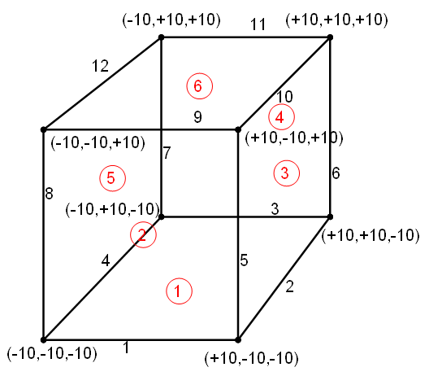

Slide 11
* background mesh
8 6 0 0 0
1 -100 -100 -100
1.0 0.0 0.0 2.0
0.0 1.0 0.0 2.0
0.0 0.0 1.0 2.0
2 100 -100 -100
1.0 0.0 0.0 2.0
0.0 1.0 0.0 2.0
0.0 0.0 1.0 2.0
3 100 100 -100
1.0 0.0 0.0 2.0
0.0 1.0 0.0 2.0
0.0 0.0 1.0 2.0
4 -100 100 -100
1.0 0.0 0.0 2.0
0.0 1.0 0.0 2.0
0.0 0.0 1.0 2.0
5 -100 -100 100
1.0 0.0 0.0 2.0
0.0 1.0 0.0 2.0
0.0 0.0 1.0 2.0
6 100 -100 100
1.0 0.0 0.0 2.0
0.0 1.0 0.0 2.0
0.0 0.0 1.0 2.0
7 100 100 100
1.0 0.0 0.0 2.0
0.0 1.0 0.0 2.0
0.0 0.0 1.0 2.0
8 -100 100 100
1.0 0.0 0.0 2.0
0.0 1.0 0.0 2.0
0.0 0.0 1.0 2.0
.
.
.
.
.
1 1 2 4 8
2 1 2 8 6
3 1 6 8 5
4 2 3 4 7
5 2 7 4 8
6 2 7 8 6
* points
* lines
* triangles

Slide 12
Using Trimmed Surfaces

Slide 15
Defining Mesh Point Density
(Point, Line and Triangle Sources)

Slide 16
* background mesh
8 6 2 1 1
.
.
.
* Points
Point 1
-10 -10 -10 1.0 3.0 5.0
Point 2
-10 10 -10 1.0 2.0 4.0
Point 2
* Lines
Line 1
-10 -10 10 0.5 1.0 3.0
-10 10 10 0.2 0.5 2.0
* Triangles
Planar 1
10 -10 -10 1.0 2.0 4.0
10 10 -10 0.5 4.0 6.0
10 10 10 0.3 1.0 3.0
Sc
D
D
Sc

