Slide 1
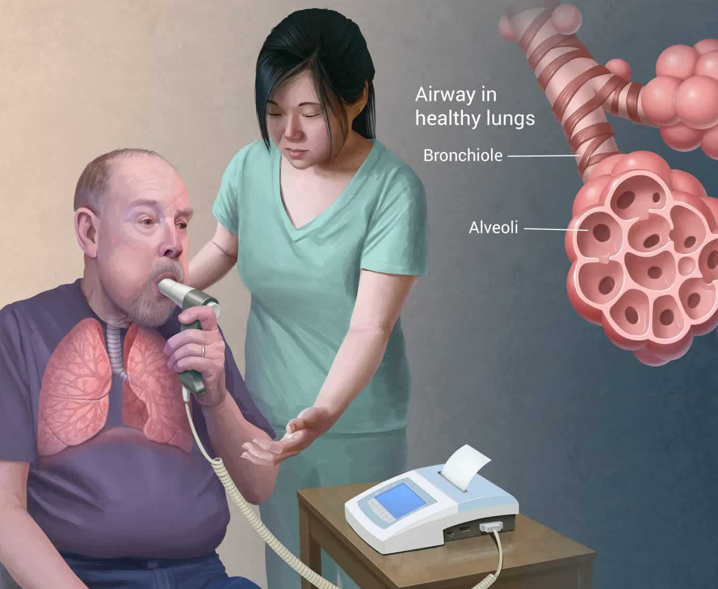
Respiratory Diseases from a data driven perspective
to the management team of the
Good Hope
Physiotherapy Clinics
Benjamin Gross
Physiotherapy Technical Leads Coordinator
04.12.2023
Benjamin Gross
Notes:
- Greeting the management team
- I was asked to do this small research becauser rising concerns of our physiotherapists about a rise in resp. diseaes
- Im am the coordinator for 24 Clinics in Europe

Slide 2
Key findings
Environment circumstances have an influence on health.
Lifestyle choises affect the risk of developing a respiratory disease.

Slide 3
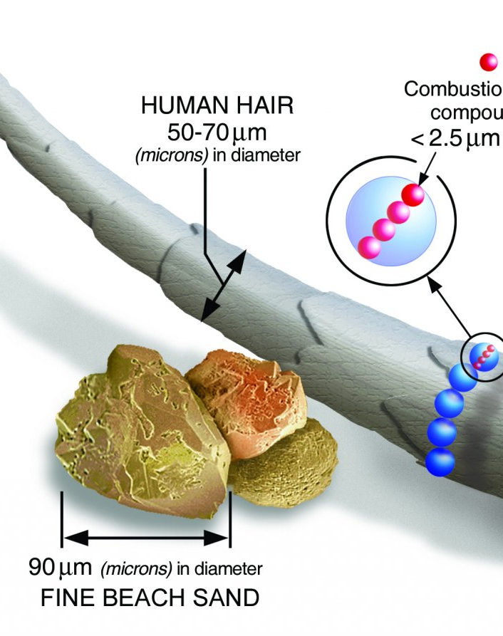
Air pollution (Particulate matter)
A mixture of solid particles and liquid droplets found in the air. Some particles, such as dust, dirt, soot, or smoke, are large or dark enough to be seen with the naked eye. Others are so small they can only be detected using an electron microscope (EPA, 2023).
Particle pollution includes:
PM₁₀ : inhalable particles, with diameters that are generally 10 micrometres and smaller
PM_{2.5} : fine inhalable particles, with diameters that are generally 2.5 micrometres and smaller.
Reference
EPA (2023), ‘Particulate Matter’, United States Environmental Protection Agency, Available at https://www.epa.gov/pm-pollution/particulate-matter-pm-basics
Notes:
- how small a particle is

Slide 4
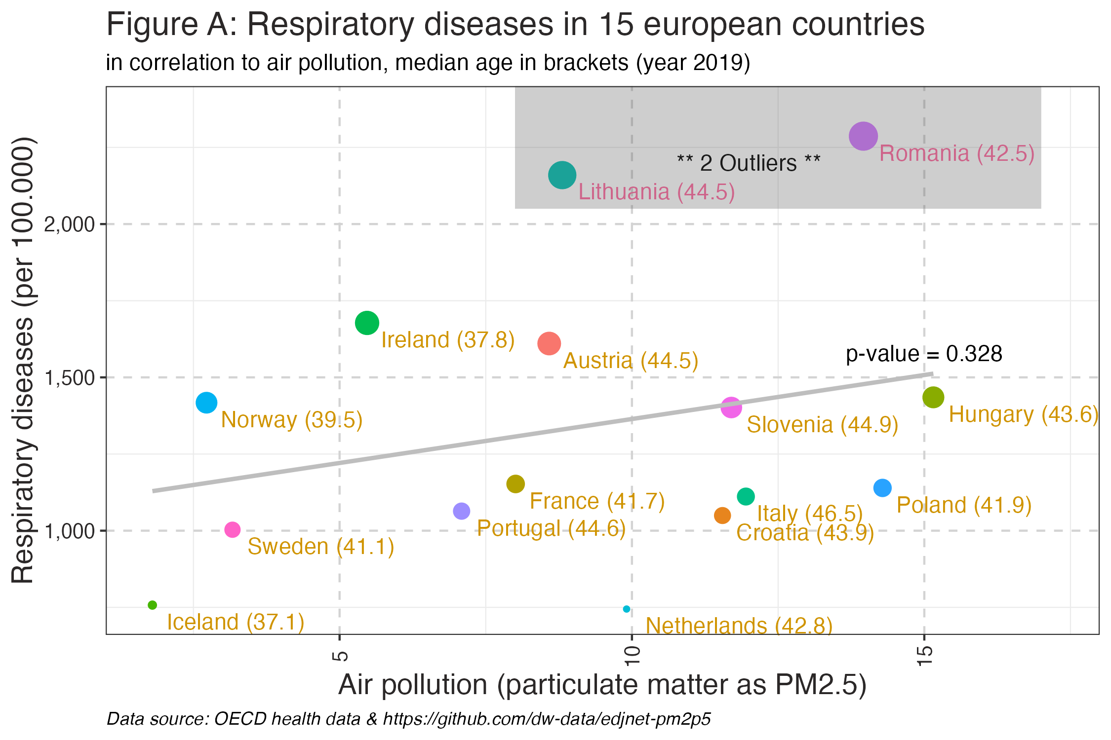
Air pollution
Notes:
- moderate correlation, p-value 0.33
- a confounder could be the average age of the population of a country.

Slide 5
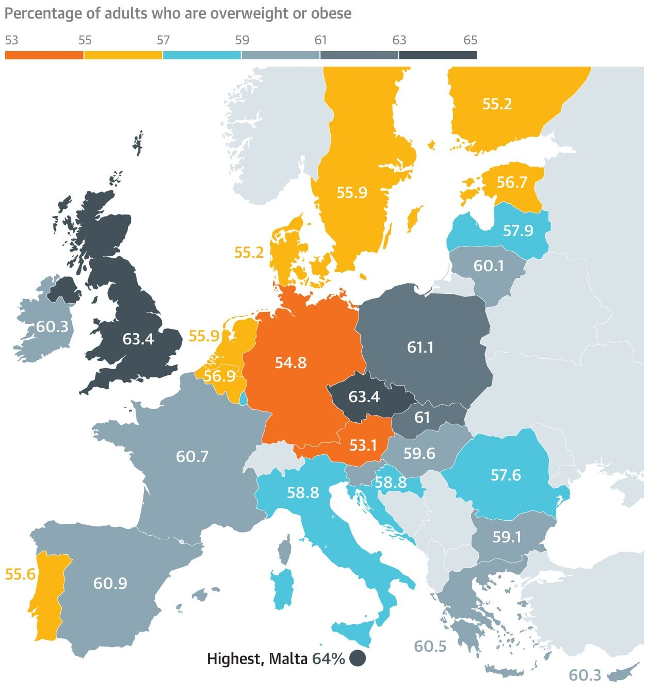
Obesity
Obesity is a common, serious and costly chronic disease of adults and children. It has nearly tripled since 1975 (WHO, 2021).
Body-Mass-Index BMI 25.0 to 30 is in the overweight range.
BMI 30.0 or higher is within the obesity range.
Reference
WHO (2021), ‘Obesity and overweight’, World Health Organization, Available at
https://www.who.int/news-room/fact-sheets/detail/obesity-and-overweight
Notes:
- explain the BMI ranges

Slide 6
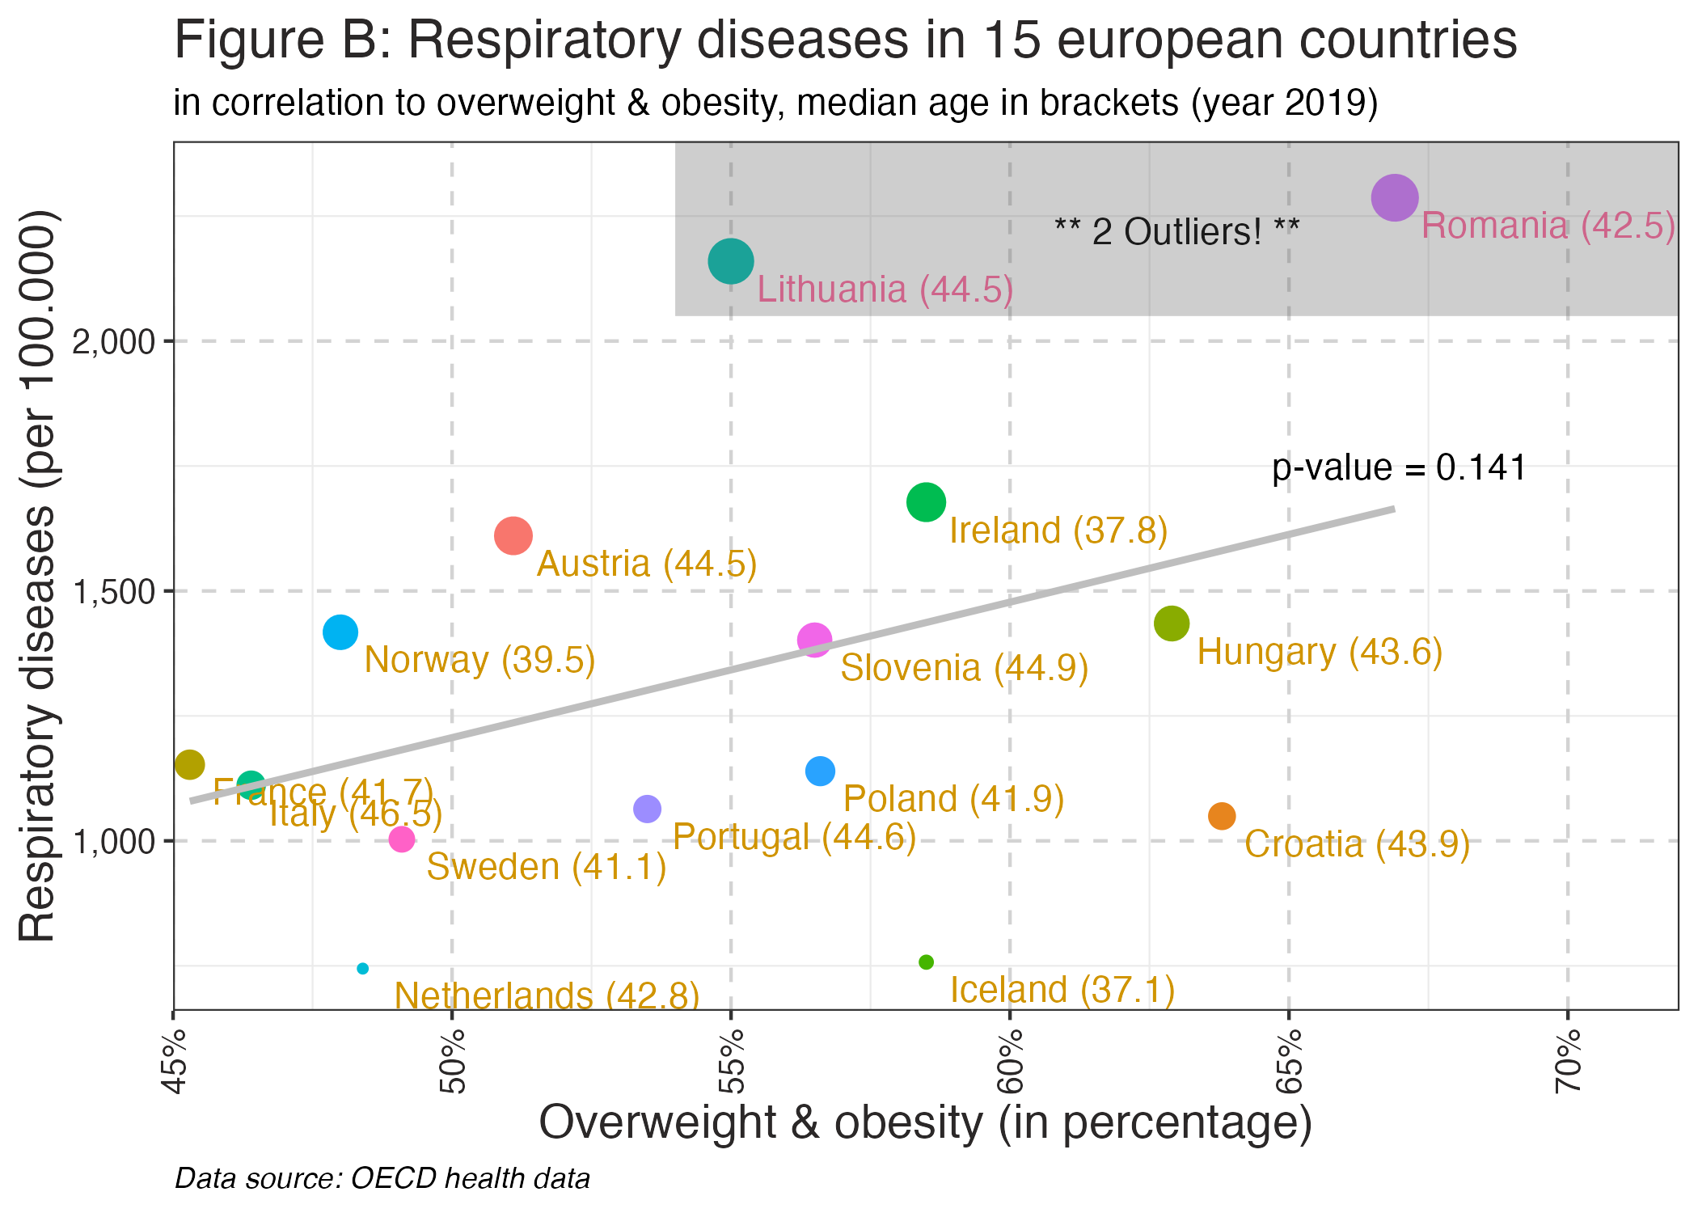
Overweight & Obesity
Notes:
- a stronger correlation found with obesity
- here the avg. age of a country could be a mediator impacting both, the depentend (rate of resp. diseases) and the independent (overweight)

Slide 7
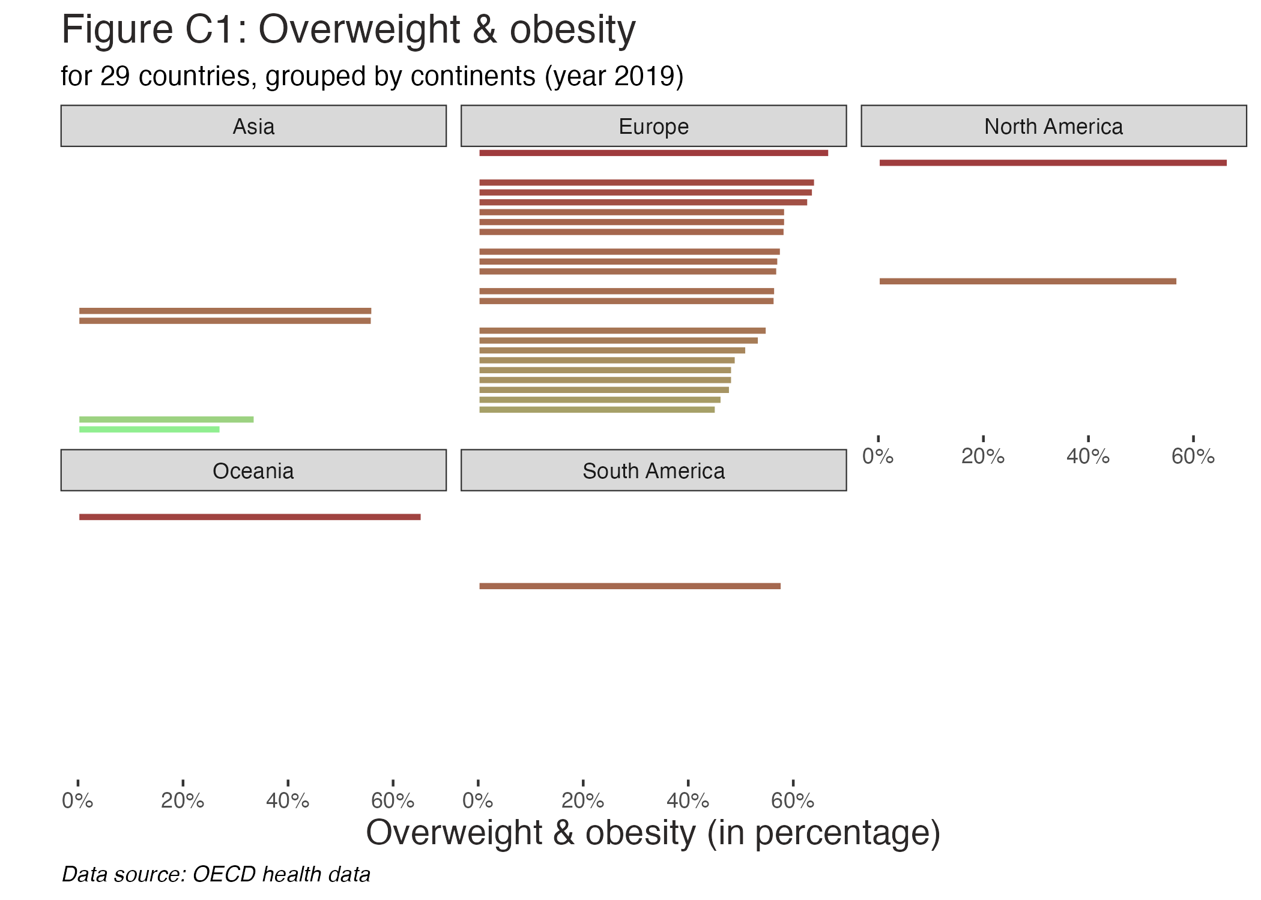
Overweight & obesity in countries grouped by continents
Notes:
- not much data in the OECD dataset

Slide 8
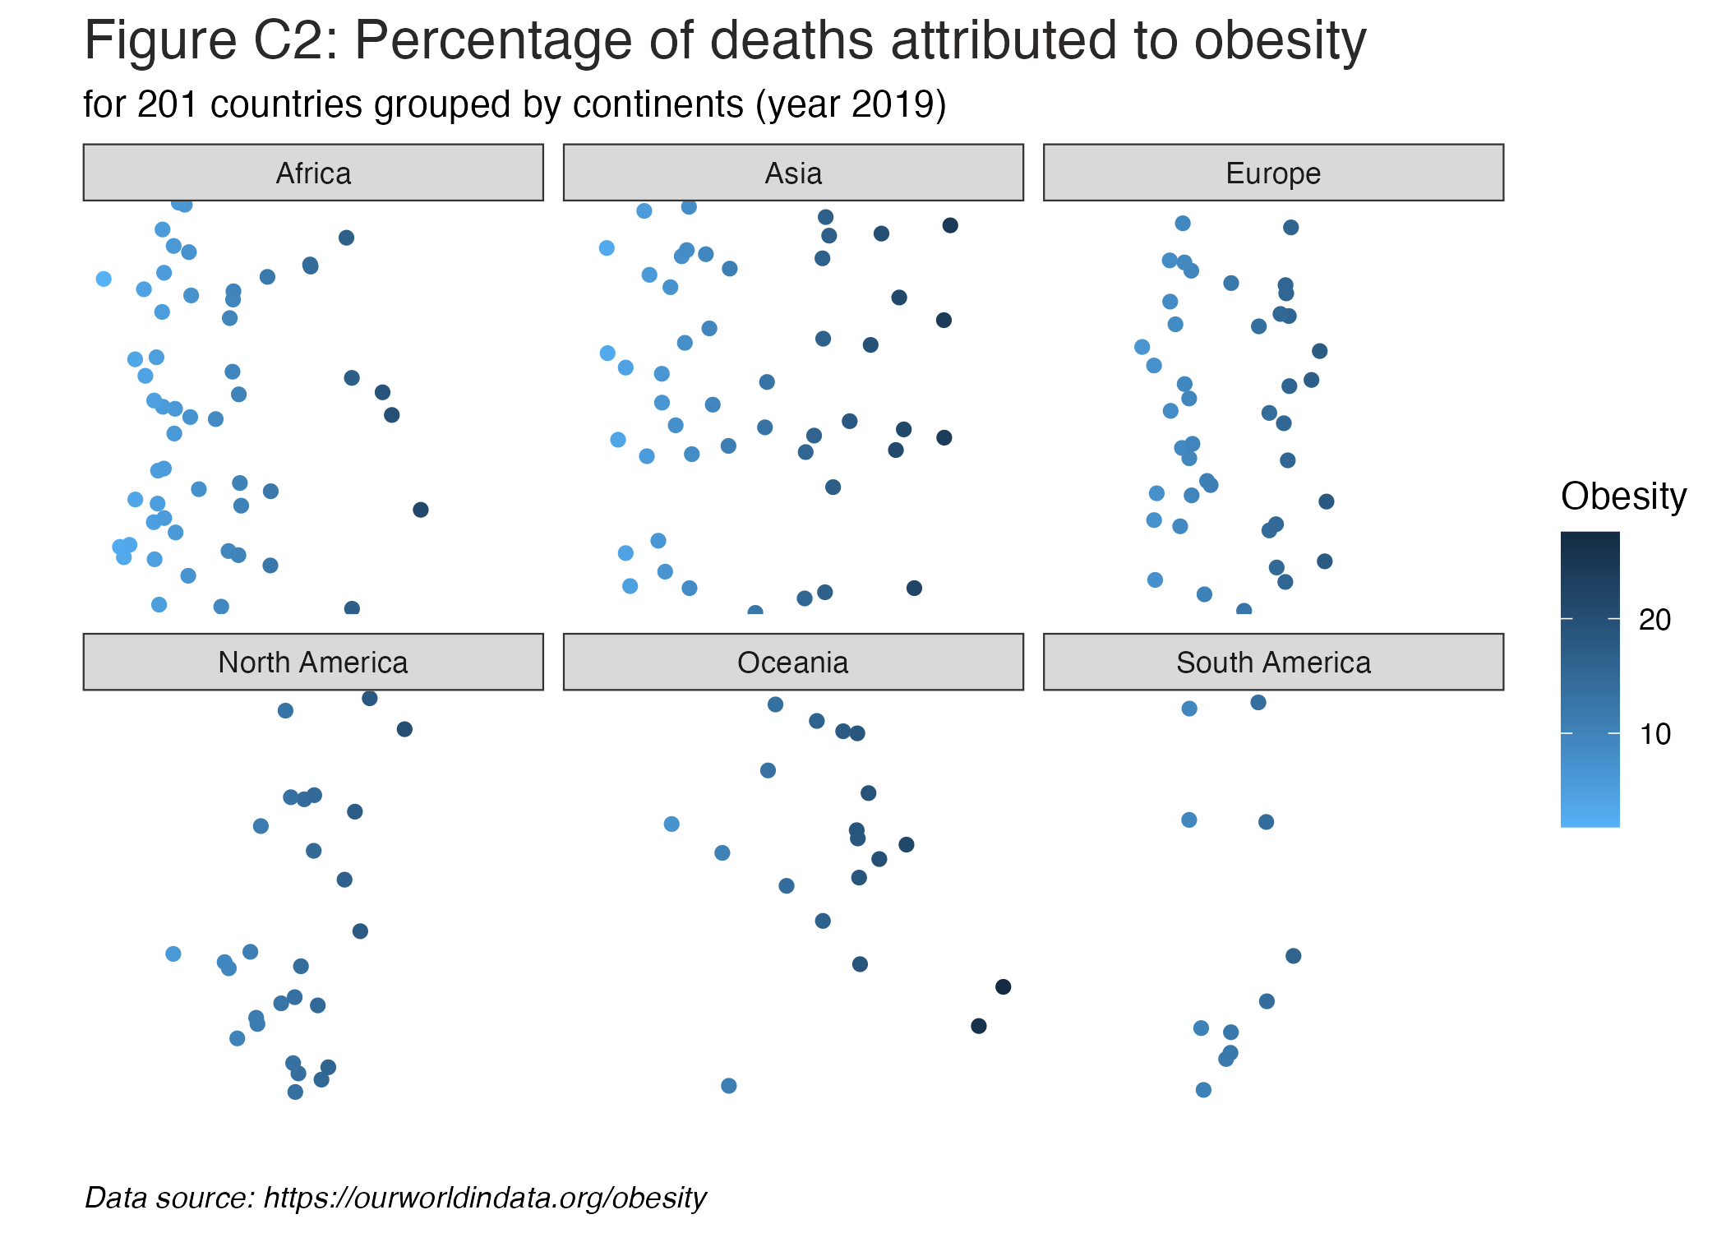
Deaths attributed to obesity in countries grouped by continents
Notes:
- a mediator could be the lack of physical activity

