Slide 2
Agent-based model

Slide 3
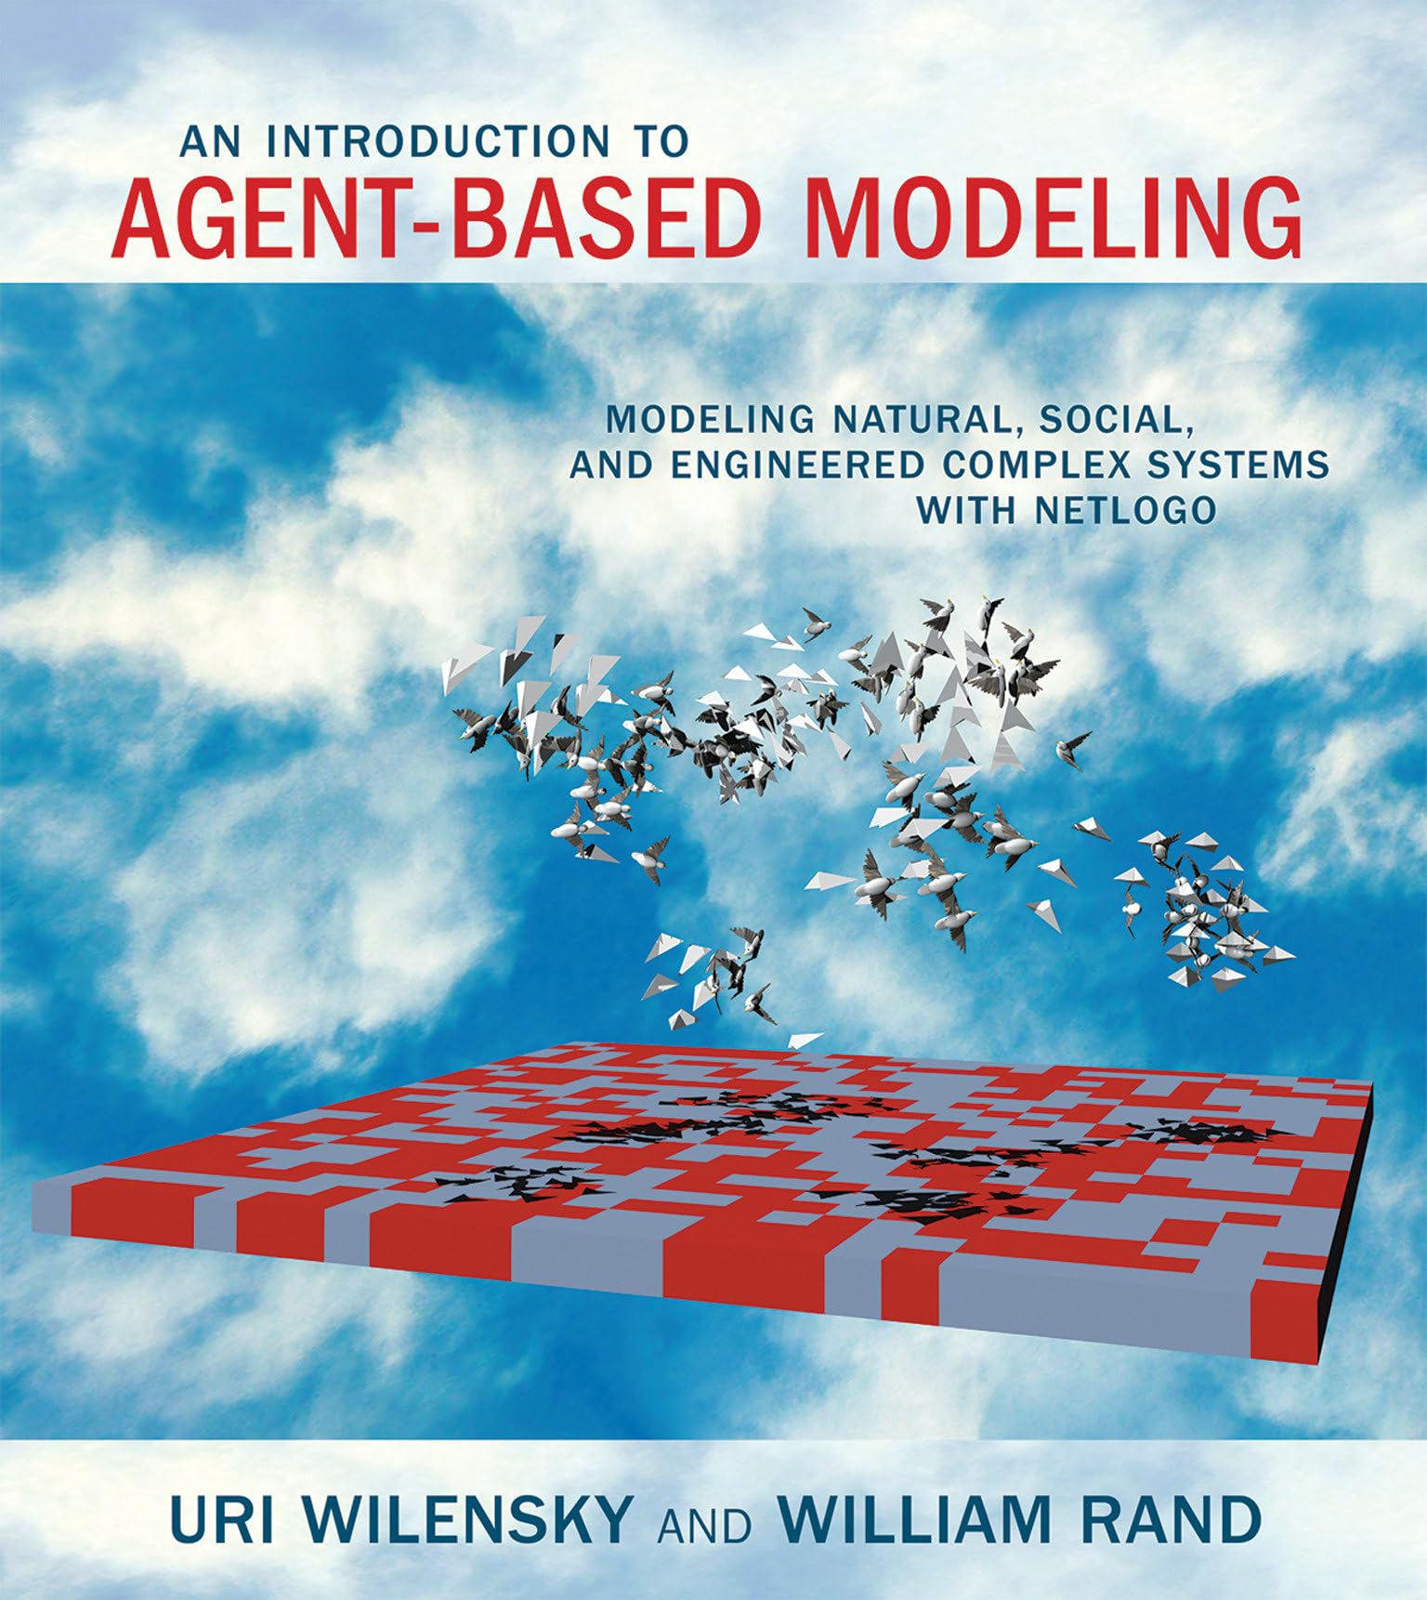
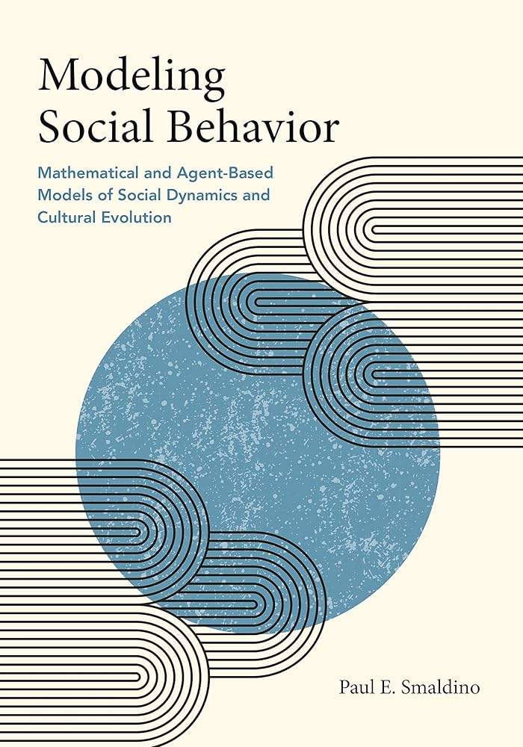
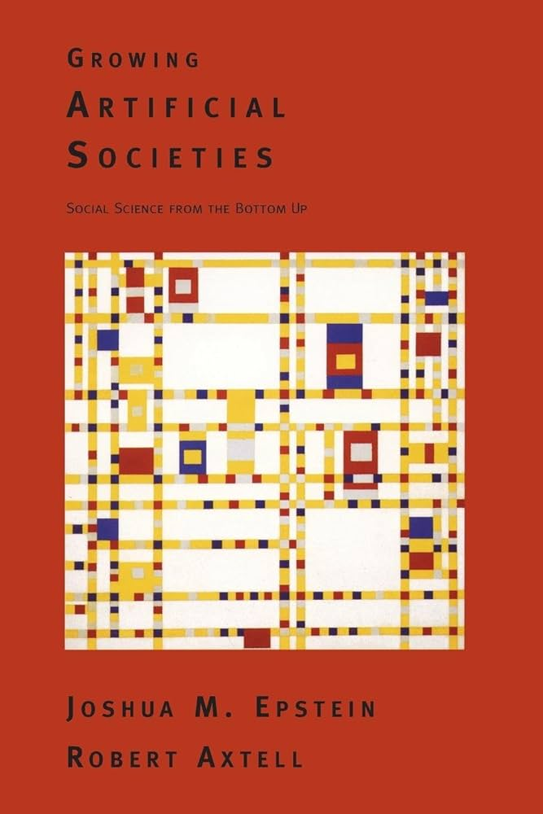

Slide 4
What’s an Agent-Based Simulation?

Slide 5
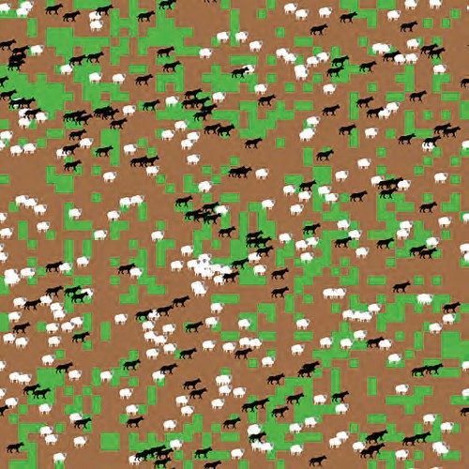
Core concepts - Agents
Agents
The basic units or “people” of ABM.
Two main aspects:
Properties
Actions
Agent have cognition helping them understanding their environment and take actions accordingly
Agent-based Wolf Sheep Predation Model (Wilensky, 1997)

Slide 6
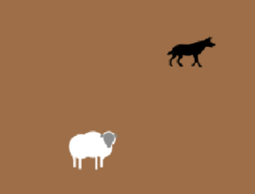
Core concepts - Agents
Agents
The basic units or “people” of ABM.
Two main aspects:
Properties
Actions
Agent have cognition helping them understanding their environment and take actions accordingly
sheep
wolf
xcor
ycor
energy
size
move
eat-grass
death
reproduce
energy?
position?
xcor
ycor
energy
size
move
eat-sheep
death
reproduce
energy?
position?
« Oversimplifcation is hard to accept, but assumptions essential » Paul E. Smaldino

Slide 7
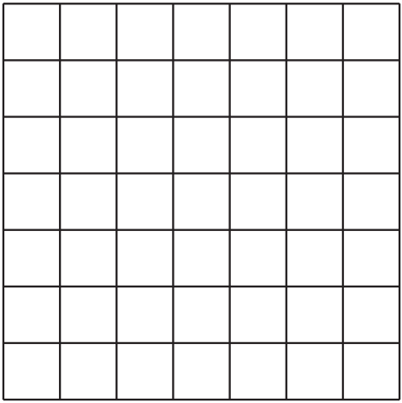
Core concepts - Environment
Environment
The space where agents interact.
The environment affect agent actions but also can be affected by agent actions.
grid
network
none?
?
Agent-based Wolf Sheep Predation Model (Wilensky, 1997)

Slide 8
Core concepts - Environment
Environment
The space where agents interact.
The environment affect agent actions but also can be affected by agent actions.
grid
grid
network
none?
?
dirt
grass
grow-grass
eat-grass (sheep)
Paul E. Smaldino

Slide 9
Core concepts - Rules
Rules
A set of instruction for interaction between agents and their environment.
Can be classified in five basic classes:
agent-self
environment-self
agent-agent
environment-environment
agent-agent
Agent-based Wolf Sheep Predation Model (Wilensky, 1997)
Notes:
Show the model in class running after this slide

Slide 10
Core concepts
Emergence
“the arising of novel and coherent structures, patterns, and properties through the interactions of multiple distributed elements”.
« One of the main challenge in social science is to explain how constraints, preferences, and affordances interact to produce population-level outcomes » Paul E. Smaldino
Notes:
Separation
Avoid crowding neighbours (short range repulsion)
Alignment
Steer towards average heading of neighbours
Cohesion
Steer towards average position of neighbours (long range attraction)

Slide 11
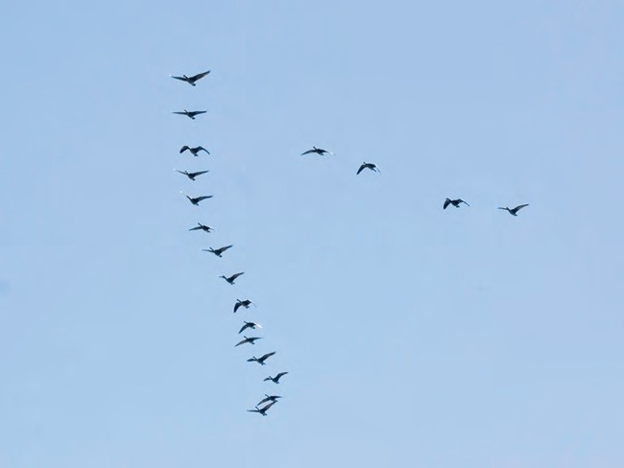
Core concepts
Emergence
“the arising of novel and coherent structures, patterns, and properties through the interactions of multiple distributed elements”.
ABM
Flocking
Separation
Avoid crowding neighbours (short range repulsion)
Alignment
Steer towards average heading of neighbours
Cohesion
Steer towards average position of neighbours (long range attraction)

Slide 12
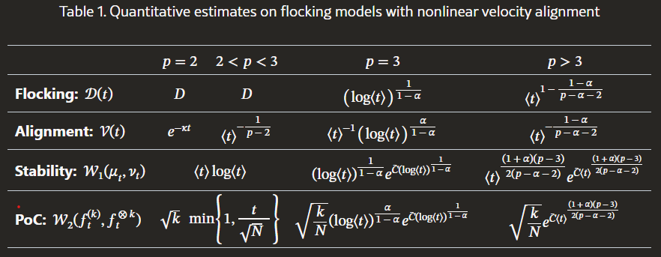
Core concepts
Flocking
Emergence
“the arising of novel and coherent structures, patterns, and properties through the interactions of multiple distributed elements”.
ABM
Analytical model
Separation
Avoid crowding neighbours (short range repulsion)
Alignment
Steer towards average heading of neighbours
Cohesion
Steer towards average position of neighbours (long range attraction)
Nguyen et. al. 2025
Notes:
Show the model in class running after this slide

Slide 13
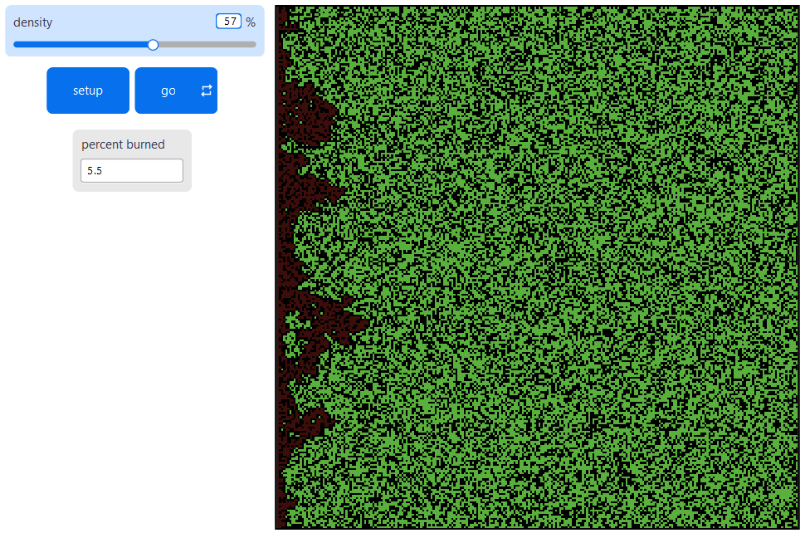
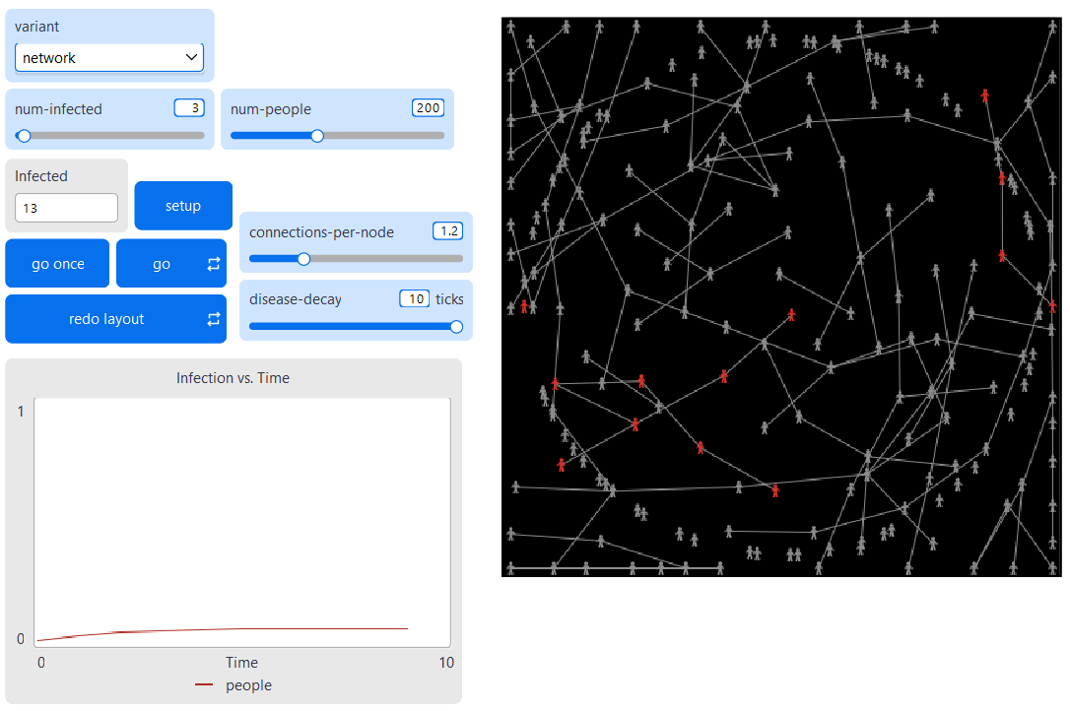
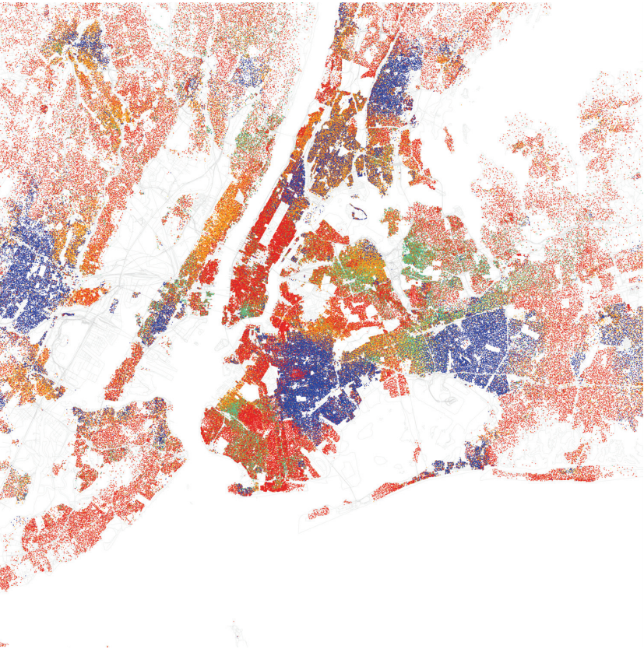
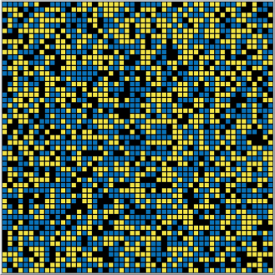
Three model to explore
Fire
Spread of Disease
Segregation
Critical threshold (tipping point)
Network and impact of environment
Real example of ABM used to impact social policy
For these three models, follow along the XXX document on the Dropbox/GitHub.
If you want, you can explore any models available in the model library. I recommend: ants, altruism, mammoths, all variation of wolf sheep predation, HIV, boiling, the cellular automata category, climate change, grand canyon, virus on a Network, Sugarscape, fruit wars, language change, party, rebellion, traffic basic, voting.
For all models, read the info tab (what is it?, how it works, how to use it, things to notice, things to try). Build your modelling intuition!

