Slide 1
Age
EmployeeID
Surname
Name
Room
Last Name
MedID
n
1
Employee
senior resident
goes to
n
n
n
First Name
ResID
takes
has information about
has shift
intake frequency
Concentration?
1
m
shift schedule
EmployeeID
1
Medication
Name
Date
MedID
ShiftID

Slide 2
Senior resident
ResID | Name | Surname | Room | StationID ↑ | Age
Medication
MedID | Name
Shift schedule
ShiftID | EmployeeID ↑ | Date | Category
Medplan
MedID | ResID | Intake frequency | Concentration
Incidents
IncidentID | Description | ResID ↑ | ShiftID ↑
Station
StationID | Name
Employee
EmployeeID | Name | Surname |  | Age | StationID ↑

Slide 3
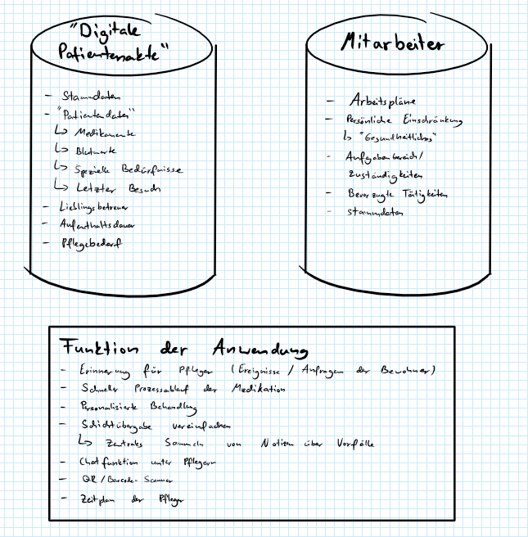

Slide 4
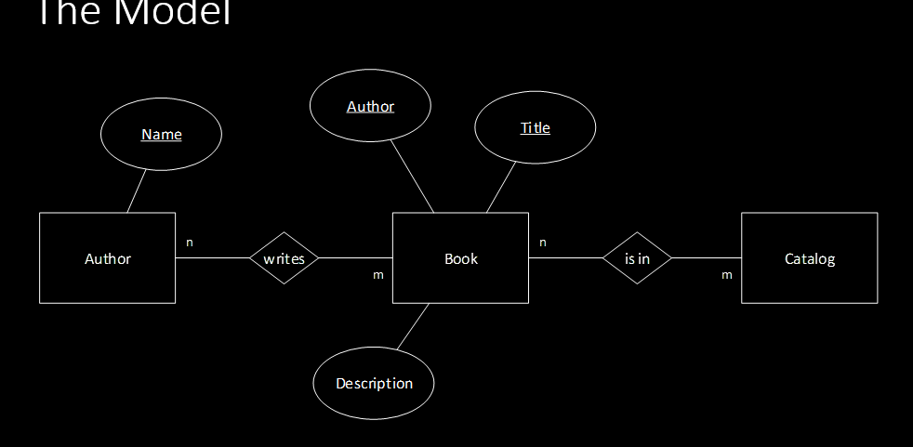

Slide 5
Programm
list of patients
-edit information button
- delete button
some textfields with information
update process (after shifts)
load process
edit process
add process
delete process
consistency checks
undo/redo?
Excel (Mockup)
SQL
Database

Slide 6
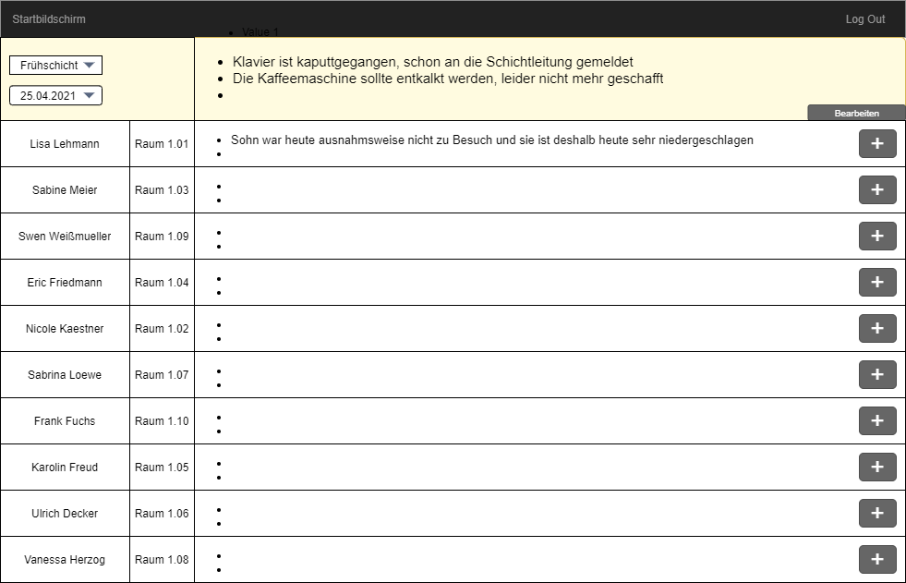

Slide 7
Interfaces

