Slide 1


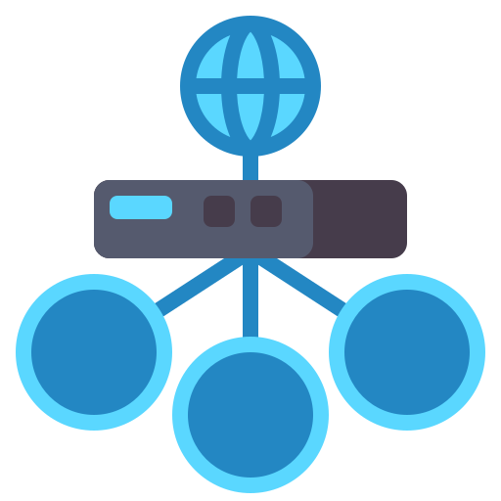
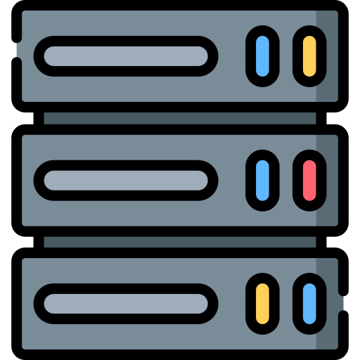



Client
WEB
35.172.196.179/drupal/
AWS
Load balancer 35.172.196.179
Host/drupal/
Cloud watch
Host:3306
AZ1
AZ2
Sec. group 1 SSH/HTTP/ICMP
Sec. group 2 SSH/HTTP/ICMP
EC2 instance
EC2 instance
Sec. group 3 TCP:3306
RDS instance

