Slide 1

Data Modelling One to Many
Charles Severance
www.dj4e.com

Slide 2

Browser
Linux
D
O
M
N
G
I
N X
WGSIConfig
settings.py
Django
Routing
urls.py
views.py
Parse
Response
Views
Templates
forms.py
Javascript
Database
Shell
Models
models.py
/admin
admin.py

Slide 3
Model Design

Slide 4
Model Design
Model design is an art form of its own with particular skills and experience
Our goal is to avoid the really bad mistakes and design clean and easily understood models
Model design starts with a sample data set and draws a picture

Slide 5
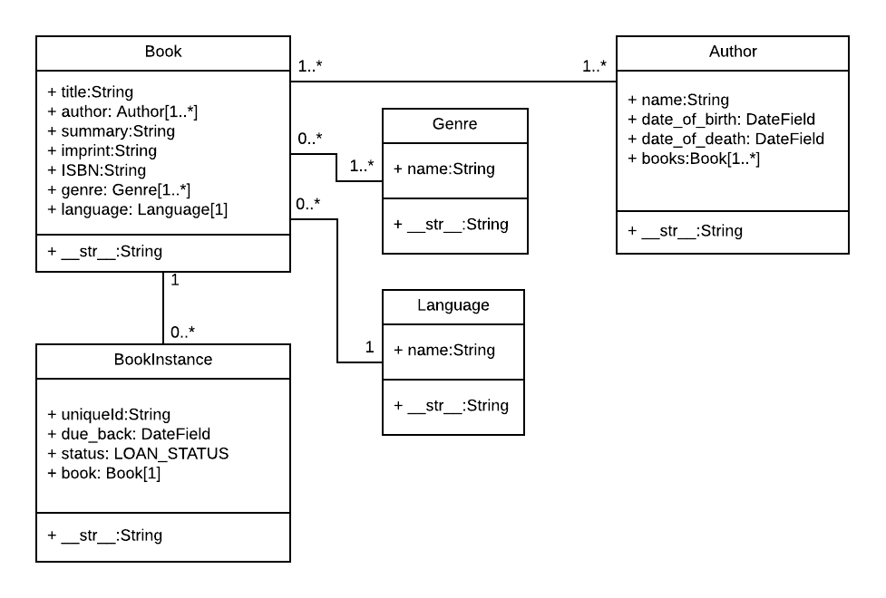
Table
Field
Method
"One Book can have between zero and infinite number of BookInstances"
https://developer.mozilla.org/en-US/docs/Learn/Server-side/Django/Models

Slide 6
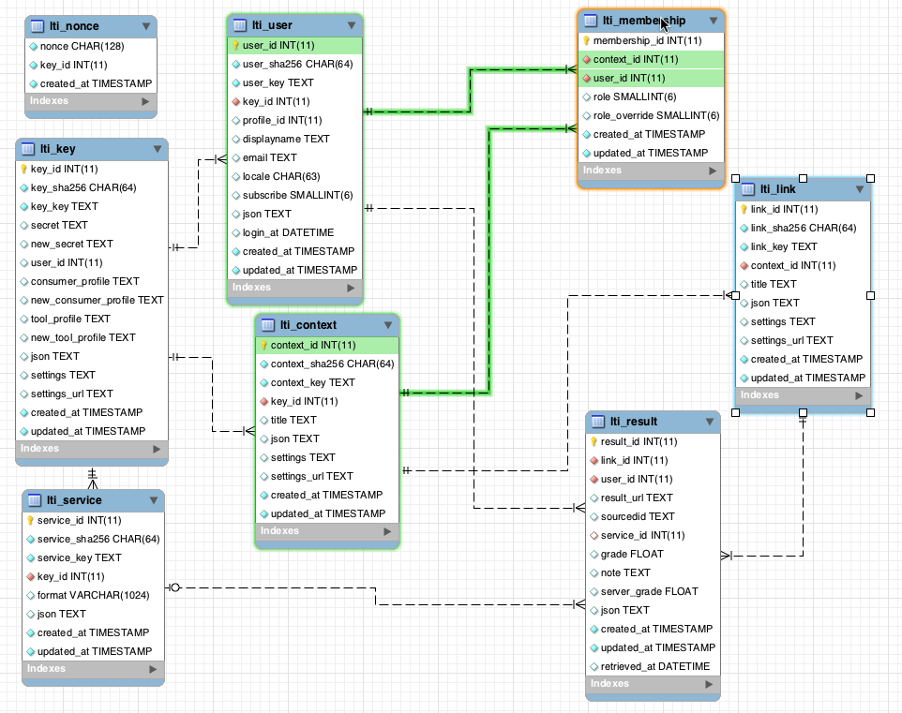
www.tsugi.org

Slide 7
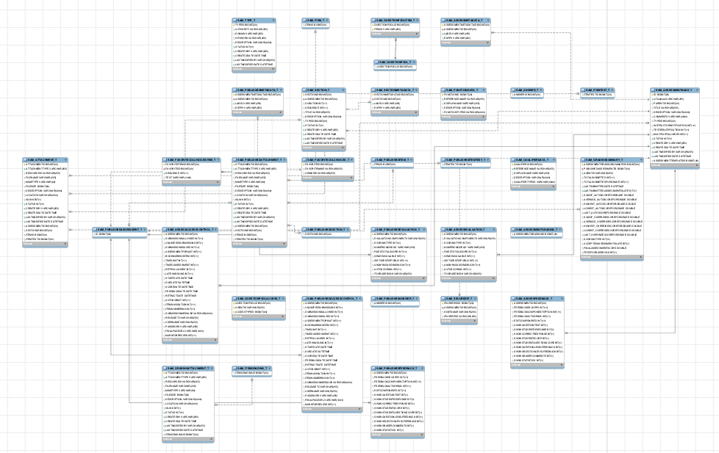
www.sakaiproject.org

Slide 8
Database Normalization (3NF)
There is *tons* of database theory / math – we simplify this to a few rules…
Do not replicate data - reference data - point at data
Add a special “unique key” column to each table which we will make references to. By convention, many programmers and frameworks call this column “id”
Use integers for to make links between tables – integers are fast and small
http://en.wikipedia.org/wiki/Database_normalization

Slide 9
Drawing a Data Model Picture

Slide 10
Sketching a Data Model
Drawing a picture of the data objects for our application and then figuring out how to represent the objects and their relationships
Basic Rule: Don’t put the same string data in twice - use a relationship instead
When there is one thing in the “real world” there should only be one copy of that thing in the database

Slide 11
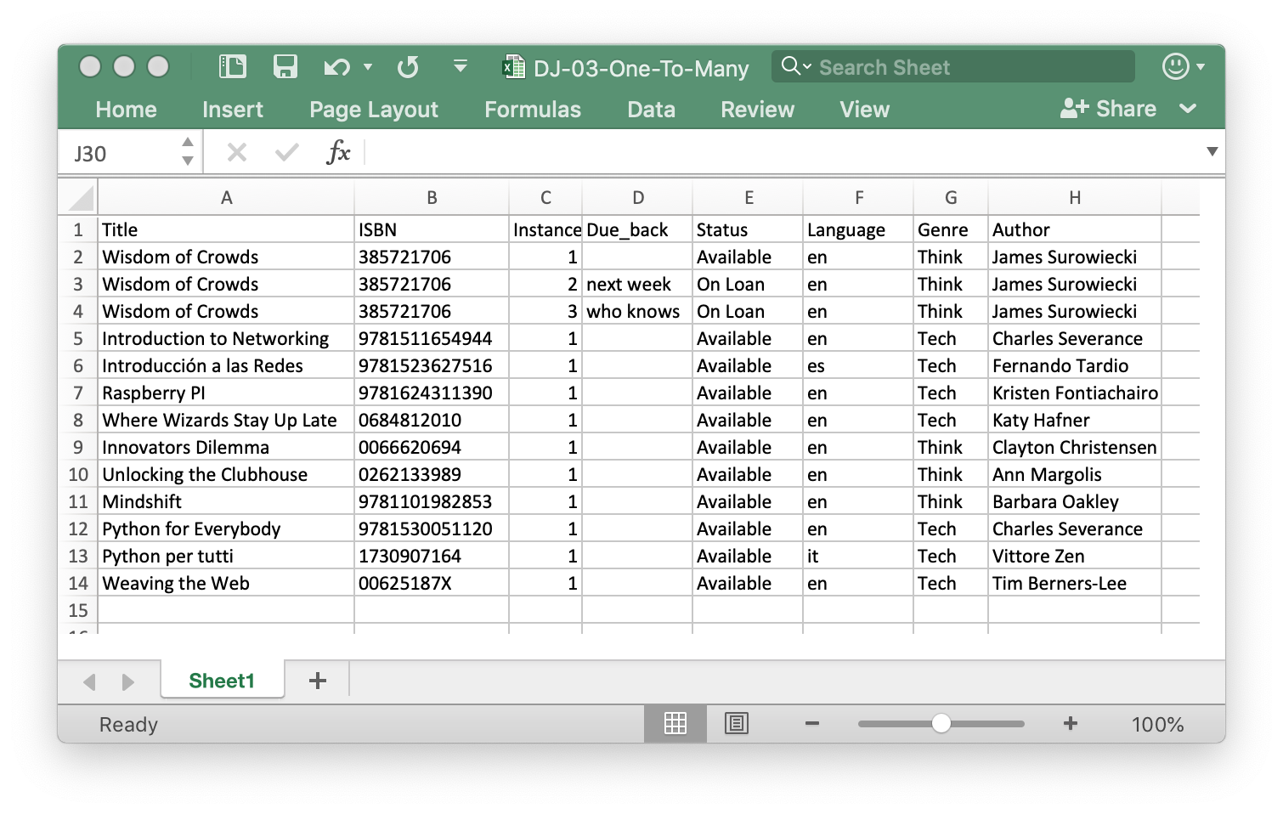

Slide 12
www.tsugi.org

Slide 13
For each “piece of info”...
Is the column an object or an attribute of another object?
Once we define objects, we need to define the relationships between objects.
Title
ISBN
Instance
Language
Status
Genre
Author

Slide 14
Where to start?
1
1
What is this application about?
Books
Physical books (Instances)
If you get it wrong you just redraw
0..N
1..N
??
1..N
1..N
1
1

Slide 15
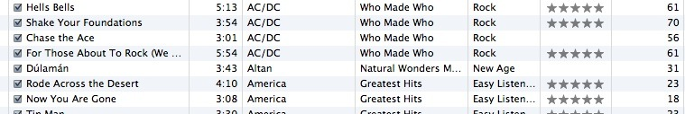

Slide 16
Track
Artist
belongs-to
Rating
Len
Album
Count
belongs-to
belongs-to
Genre

Slide 17
belongs-to
Track
Album
Title
Rating
Len
Track
Count
id
title
Album
rating
Table
Primary key
Logical key
Foreign key
id
len
title
count
album_id

Slide 18
Designing a Data Model

Slide 20
Title | ISBN | Instance | Due_back | Status | Language | Genre | Author
Wisdom of Crowds | 385721706 | 1 |  | Available | en | Think | James Surowiecki
Wisdom of Crowds | 385721706 | 2 | next week | On Loan | en | Think | James Surowiecki
Wisdom of Crowds | 385721706 | 3 | who knows | On Loan | en | Think | James Surowiecki
Introduction to Networking | 9781511654944 | 1 |  | Available | en | Tech | Charles Severance
Introducción a las Redes | 9781523627516 | 1 |  | Available | es | Tech | Fernando Tardio
Raspberry PI | 9781624311390 | 1 |  | Available | en | Tech | Kristen Fontichiaro
Where Wizards Stay Up Late | 0684812010 | 1 |  | Available | en | Tech | Katy Hafner
Innovators Dilemma | 0066620694 | 1 |  | Available | en | Think | Clayton Christensen
Unlocking the Clubhouse | 0262133989 | 1 |  | Available | en | Think | Ann Margolis
Mindshift | 9781101982853 | 1 |  | Available | en | Think | Barbara Oakley
Python for Everybody | 9781530051120 | 1 |  | Available | en | Tech | Charles Severance
Python per tutti | 1730907164 | 1 |  | Available | it | Tech | Vittore Zen
Weaving the Web | 00625187X | 1 |  | Available | en | Tech | Tim Berners-Lee

Slide 21
Title | ISBN | Instance | Due_back | Status | Language | Genre | Author
Wisdom of Crowds | 385721706 | 1 |  | Available | en | Think | James Surowiecki
Wisdom of Crowds | 385721706 | 2 | next week | On Loan | en | Think | James Surowiecki
Wisdom of Crowds | 385721706 | 3 | who knows | On Loan | en | Think | James Surowiecki
Introduction to Networking | 9781511654944 | 1 |  | Available | en | Tech | Charles Severance
Introducción a las Redes | 9781523627516 | 1 |  | Available | es | Tech | Fernando Tardio
Raspberry PI | 9781624311390 | 1 |  | Available | en | Tech | Kristen Fontichiaro
Where Wizards Stay Up Late | 0684812010 | 1 |  | Available | en | Tech | Katy Hafner
Innovators Dilemma | 0066620694 | 1 |  | Available | en | Think | Clayton Christensen
Unlocking the Clubhouse | 0262133989 | 1 |  | Available | en | Think | Ann Margolis
Mindshift | 9781101982853 | 1 |  | Available | en | Think | Barbara Oakley
Python for Everybody | 9781530051120 | 1 |  | Available | en | Tech | Charles Severance
Python per tutti | 1730907164 | 1 |  | Available | it | Tech | Vittore Zen
Weaving the Web | 00625187X | 1 |  | Available | en | Tech | Tim Berners-Lee

Slide 22
Removing Duplication
Title | ISBN | Instance | Due_back | Status | Language
Wisdom of Crowds | 385721706 | 1 |  | Available | en
Wisdom of Crowds | 385721706 | 2 | next week | On Loan | en
Wisdom of Crowds | 385721706 | 3 | who knows | On Loan | en
Introduction to Networking | 9781511654944 | 1 |  | Available | en
Introducción a las Redes | 9781523627516 | 1 |  | Available | es
Instance | Due_back
1
2 | next week
3 | who knows
1
1
Title | ISBN
Wisdom of Crowds | 385721706
Introduction to Networking | 9781511654944
Introducción a las Redes | 9781523627516
Language
en
es

Slide 23
Adding Links
Title | ISBN | Instance | Due_back | Status | Language
Wisdom of Crowds | 385721706 | 1 |  | Available | en
Wisdom of Crowds | 385721706 | 2 | next week | On Loan | en
Wisdom of Crowds | 385721706 | 3 | who knows | On Loan | en
Introduction to Networking | 9781511654944 | 1 |  | Available | en
Introducción a las Redes | 9781523627516 | 1 |  | Available | es
Instance | Due_back | Status
1 |  | Available
2 | next week | On Loan
3 | who knows | On Loan
1 |  | Available
1 |  | Available
Title | ISBN
Wisdom of Crowds | 385721706
Introduction to Networking | 9781511654944
Introducción a las Redes | 9781523627516
Language
en
es
To
One
To
One
Many
Many

Slide 24
Title | ISBN
Wisdom of Crowds | 385721706
Introduction to Networking | 9781511654944
Introducción a las Redes | 9781523627516
Language
en
es
To
One
Many
Legend:
1 One
1..* Many with a minimum of 1
0..* Many with a minimum of 0
https://developer.mozilla.org/en-US/docs/Learn/Server-side/Django/Models

Slide 25
Instance | Due_back | Status
1 |  | Available
2 | next week | On Loan
3 | who knows | On Loan
1 |  | Available
1 |  | Available
Title | ISBN
Wisdom of Crowds | 385721706
Introduction to Networking | 9781511654944
Introducción a las Redes | 9781523627516
To
One
Many
Legend:
1 One
1..* Many with a minimum of 1
0..* Many with a minimum of 0
https://developer.mozilla.org/en-US/docs/Learn/Server-side/Django/Models

Slide 26
Representing Links (Relationships) in a Database
Lets get physical…

Slide 27
Links in a Logical Model
Title | ISBN | Instance | Due_back | Status | Language
Wisdom of Crowds | 385721706 | 1 |  | Available | en
Wisdom of Crowds | 385721706 | 2 | next week | On Loan | en
Wisdom of Crowds | 385721706 | 3 | who knows | On Loan | en
Introduction to Networking | 9781511654944 | 1 |  | Available | en
Introducción a las Redes | 9781523627516 | 1 |  | Available | es
Instance | Due_back | Status
1 |  | Available
2 | next week | On Loan
3 | who knows | On Loan
1 |  | Available
1 |  | Available
Title | ISBN
Wisdom of Crowds | 385721706
Introduction to Networking | 9781511654944
Introducción a las Redes | 9781523627516
Language
en
es
To
One
To
One
Many
Many

Slide 28
Links in a Physical Model
Title | ISBN | Instance | Due_back | Status | Language
Wisdom of Crowds | 385721706 | 1 |  | Available | en
Wisdom of Crowds | 385721706 | 2 | next week | On Loan | en
Wisdom of Crowds | 385721706 | 3 | who knows | On Loan | en
Introduction to Networking | 9781511654944 | 1 |  | Available | en
Introducción a las Redes | 9781523627516 | 1 |  | Available | es
id | Instance | Due_back | book_id
1 | 1 |  | 1
2 | 2 | next week | 1
3 | 3 | who knows | 1
4 | 1 |  | 2
5 | 1 |  | 3
id | Title | ISBN | lang_id
1 | Wisdom of Crowds | 385721706 | 1
2 | Introduction to Networking | 9781511654944 | 1
3 | Introducción a las Redes | 9781523627516 | 2
id | Lang
1 | en
2 | es

Slide 29
Links in a Physical Model
Title | ISBN | Instance | Due_back | Status | Language
Wisdom of Crowds | 385721706 | 1 |  | Available | en
Wisdom of Crowds | 385721706 | 2 | next week | On Loan | en
Wisdom of Crowds | 385721706 | 3 | who knows | On Loan | en
Introduction to Networking | 9781511654944 | 1 |  | Available | en
Introducción a las Redes | 9781523627516 | 1 |  | Available | es
id | Instance | Due_back | book_id
1 | 1 |  | 1
2 | 2 | next week | 1
3 | 3 | who knows | 1
4 | 1 |  | 2
5 | 1 |  | 2
id | Title | ISBN | lang_id
1 | Wisdom of Crowds | 385721706 | 1
2 | Introduction to Networking | 9781511654944 | 1
3 | Introducción a las Redes | 9781523627516 | 2
id | Lang
1 | en
2 | es

Slide 30
Key Terminology
We add an automatically incrementing column to every row which we call the "Primary Key" for that row. We often name the column "id" to indicate that it is the "identifier" for that row.
When we add a column to a table that "points to" a row in another table we call it a "Foreign Key" and often include the name of the destination table in the column name like "lang_id"
id | Title | ISBN | lang_id
1 | Wisdom of Crowds | 385721706 | 1
2 | Introduction to Networking | 9781511654944 | 1
3 | Introducción a las Redes | 9781523627516 | 2
id | Lang
1 | en
2 | es

Slide 31
Physical / Logical
id | Instance | Due_back | book_id
1 | 1 |  | 1
2 | 2 | next week | 1
3 | 3 | who knows | 1
4 | 1 |  | 2
5 | 1 |  | 2
id | Lang
1 | en
2 | es
id | Title | ISBN | lang_id
1 | Wisdom of Crowds | 385721706 | 1
2 | Introduction to Networking | 9781511654944 | 1
3 | Introducción a las Redes | 9781523627516 | 2

Slide 32
Representing Links (Relationships) in Django
Lets get our ORM on…

Slide 33
Model Field Types
AutoField
BigAutoField
BigIntegerField
BinaryField
BooleanField
CharField
DateField
DateTimeField
DecimalField
DurationField
EmailField
FileField
FilePathField
FloatField
ImageField
IntegerField
GenericIPAddressField
NullBooleanField
PositiveIntegerField
PositiveSmallIntegerField
SlugField
SmallIntegerField
TextFIeld
TimeField
URLField
ForeignKey
ManyToManyField
OneToOneField
https://docs.djangoproject.com/en/4.0/ref/models/fields/#field-types

Slide 34
Instance | Due_back | Status
1 |  | Available
2 | next week | On Loan
3 | who knows | On Loan
Title | ISBN
Wisdom of Crowds | 385721706
Introduction to Networking | 9781511654944
Introducción a las Redes | 9781523627516
Lang
en
es
from django.db import models
class Lang(models.Model):
name = models.CharField(max_length=200)
class Book(models.Model):
title = models.CharField(max_length=200)
isbn = models.CharField(max_length=13)
lang = models.ForeignKey('Lang', on_delete=models.SET_NULL, null=True)
class Instance(models.Model):
book = models.ForeignKey('Book', on_delete=models.CASCADE)
due_back = models.DateField(null=True, blank=True)

Slide 35
from django.db import models
class Lang(models.Model):
name = models.CharField(max_length=200)
class Book(models.Model):
title = models.CharField(max_length=200)
isbn = models.CharField(max_length=13)
lang = models.ForeignKey('Lang',
on_delete=models.SET_NULL, null=True)
class Instance(models.Model):
due_back = models.DateField(null=True, blank=True)
book = models.ForeignKey('Book',
on_delete=models.CASCADE)
https://github.com/csev/dj4e-samples/blob/master/bookone/models.py

Slide 36
From Model to Database
$ python3 manage.py makemigrations
Migrations for 'bookone':
bookone/migrations/0001_initial.py
- Create model Book
- Create model Instance
- Create model Lang
- Add field lang to book
$ python3 manage.py migrate
Operations to perform:
Apply all migrations: admin,...
Running migrations:
Applying bookone.0001_initial... OK
Note that makemigrations only "does something" when you create or alter a models.py file. The migrate only "does something" when there are migrations that are not yet applied to the database. Also an application must be added to settings.py before these commands see the models.py file for an application.

Slide 37
dj4e-samples$ sqlite3 db.sqlite3
SQLite version 3.24.0 2018-06-04 14:10:15
Enter ".help" for usage hints.
sqlite> .tables 'bookone%'
bookone_book bookone_instance bookone_lang
sqlite> .schema bookone_book
CREATE TABLE IF NOT EXISTS "bookone_book" (
"id" integer NOT NULL PRIMARY KEY AUTOINCREMENT,
"title" varchar(200) NOT NULL,
"isbn" varchar(13) NOT NULL,
"lang_id" integer NULL REFERENCES "bookone_lang" ("id")
DEFERRABLE INITIALLY DEFERRED
);
CREATE INDEX "bookone_book_lang_id_24ba3759"
ON "bookone_book" ("lang_id");
sqlite> .schema bookone_lang
CREATE TABLE IF NOT EXISTS "bookone_lang" (
"id" integer NOT NULL PRIMARY KEY AUTOINCREMENT,
"name" varchar(200) NOT NULL
);
sqlite> .schema bookone_instance
CREATE TABLE IF NOT EXISTS "bookone_instance" (
"id" integer NOT NULL PRIMARY KEY AUTOINCREMENT,
"due_back" date NULL,
"book_id" integer NOT NULL REFERENCES "bookone_book" ("id")
DEFERRABLE INITIALLY DEFERRED
);
CREATE INDEX "bookone_instance_book_id_1fa5e2e7"
ON "bookone_instance" ("book_id");
sqlite> .quit
dj4e-samples$

Slide 38
About on_delete
What do we do when a row in one table points to a row in a "foreign" table via a foreign key and the "destination row" is deleted
on_delete = set_null – Keep the row but set foreign key to null
on_delete = cascade - Delete the row
id | Title | ISBN | lang_id
1 | Wisdom of Crowds | 385721706 | 1
2 | Introduction to Networking | 9781511654944 | 1
3 | Introducción a las Redes | 9781523627516 | 2
id | Lang
1 | en
2 | es
https://docs.djangoproject.com/en/4.0/ref/models/fields/#django.db.models.ForeignKey.on_delete

Slide 39
Instance | Due_back | Status
1 |  | Available
2 | next week | On Loan
3 | who knows | On Loan
Title | ISBN
Wisdom of Crowds | 385721706
Introduction to Networking | 9781511654944
Introducción a las Redes | 9781523627516
Language
en
es
from django.db import models
class Lang(models.Model):
name = models.CharField(max_length=200)
class Book(models.Model):
title = models.CharField(max_length=200)
isbn = models.CharField(max_length=13)
lang = models.ForeignKey('Lang', on_delete=models.SET_NULL, null=True)
class Instance(models.Model):
book = models.ForeignKey('Book', on_delete=models.CASCADE)
due_back = models.DateField(null=True, blank=True)

Slide 40
Using Models in the Django Shell

Slide 41
$ cd ~/dj4e-samples
$ python3 manage.py shell
>>> from bookone.models import Book, Lang, Instance
>>> z = Lang(name='en')
>>> z.save()
>>> z.id
1
>>> x = Book(title='PY4E', isbn='42', lang=z)
>>> x.save()
>>> x.id
1
>>> a = Instance(due_back="2020-07-06", book=x)
>>> a.save()
>>> a.id
1
>>> quit()
$

Slide 42
$ cd ~/dj4e-samples
$ python3 manage.py shell
>>> from bookone.models import Book, Lang, Instance
>>> x = Book.objects.get(pk=1)
>>> x
<Book: Book object (1)>
>>> x.title
'PY4E'
>>> x.lang.name
'en'
>>> y = Instance.objects.get(pk=1)
>>> y.due_back
datetime.date(2020, 7, 6)
>>> y.book.title
'PY4E'
>>> y.book.lang.name
'en'
>>> quit()
$

Slide 43
Demo Batch Loading from CSV
https://github.com/csev/dj4e-samples/tree/master/samples/scripts
https://django-extensions.readthedocs.io/en/latest/runscript.html

Slide 44
Loading Data From A File
Sometimes we need to pre-load data into our Django database
This data might come from an API or file
We need to write a Python program to function like the Django shell
cats/meow.csv
Name,Breed,Weight
Abby,Sphinx,6.4
Annie,Burmese,7.6
Ash,Manx,7.8
Athena,Manx,8.9
scripts/cats_load.py
db.sqlite
cats/models.py
https://github.com/csev/dj4e-samples

Slide 45
Installing django-extensions
dj4e-samples$ pip3 install django-extensions
Requirement already satisfied: django-extensions in /Library/Frameworks/Python.framework/Versions/3.6/lib/python3.6/site-packages
Requirement already satisfied: six>=1.2 in /Library/Frameworks/Python.framework/Versions/3.6/lib/python3.6/site-packages
dj4e-samples$
Note that this is installed already in dj4e-samples but for a new project you will need to install it yourself and edit settings.py
https://django-extensions.readthedocs.io/en/latest/runscript.html

Slide 46
Include Extensions in Project Settings
INSTALLED_APPS = [
'django.contrib.admin',
'django.contrib.auth',
[ ... ]
# Extensions - see requirements.txt
'django_extensions',
'crispy_forms',
[ ... ]
'home.apps.HomeConfig',
# Sample Applications - don't copy
'hello.apps.HelloConfig',
'getpost.apps.GetpostConfig',
'users.apps.UsersConfig',
[ ... ]
]
dj4e-samples/settings.py

Slide 47
Make a scripts folder
dj4e-samples$ mkdir scripts
dj4e-samples$ touch scripts/__init__.py
We place empty __init__.py files in folders to indicate to Python that they contain files that hold modules and as such are suitable for importing into a Python application.
http://effbot.org/pyfaq/what-is-init-py-used-for.htm

Slide 48
The Data File
dj4e-samples$ cat cats/meow.csv
Name,Breed,Weight
Abby,Sphinx,6.4
Annie,Burmese,7.6
Ash,Manx,7.8
Athena,Manx,8.9
dj4e-samples$
https://en.wikipedia.org/wiki/Cat_(Unix)

Slide 49
import csv
from cats.models import Cat, Breed
def run():
fhand = open('cats/meow.csv')
reader = csv.reader(fhand)
next(reader) # Advance past the header
Cat.objects.all().delete()
Breed.objects.all().delete()
# Name,Breed,Weight
# Abby,Sphinx,6.4
# Annie,Burmese,7.6
# Ash,Manx,7.8
for row in reader:
print(row)
b, created = Breed.objects.get_or_create(name=row[1])
c = Cat(nickname=row[0], breed=b, weight=row[2])
c.save()
scripts/cats_load.py

Slide 50
from django.db import models
class Breed(models.Model):
name = models.CharField(max_length=200)
class Cat(models.Model):
nickname = models.CharField(max_length=200)
breed = models.ForeignKey('Breed', on_delete=models.CASCADE, null=False)
weight = models.FloatField()

Slide 51
dj4e-samples$ python3 manage.py runscript cats_load
['Abby', 'Sphinx', '6.4']
['Annie', 'Burmese', '7.6']
['Ash', 'Manx', '7.8']
['Athena', 'Manx', '8.9']
['Baby', 'Tabby', '6.9']
['Bagheera', 'Sphinx', '6.3']
dj4e-samples$
for row in reader:
print(row)
b, created = Breed.objects.get_or_create(name=row[1])
c = Cat(nickname=row[0], breed=b, weight=row[2])
c.save()

Slide 52
Acknowledgements / Contributions
These slides are Copyright 2019- Charles R. Severance (www.dr-chuck.com) as part of www.dj4e.com and made available under a Creative Commons Attribution 4.0 License. Please maintain this last slide in all copies of the document to comply with the attribution requirements of the license. If you make a change, feel free to add your name and organization to the list of contributors on this page as you republish the materials.
Initial Development: Charles Severance, University of Michigan School of Information
Insert new Contributors and Translators here including names and dates
Continue new Contributors and Translators here

