Slide 1
Django for Everybody Removing jQuery Summer 2023
Dr. Charles Severance
University of Michigan
School of Information

Slide 2
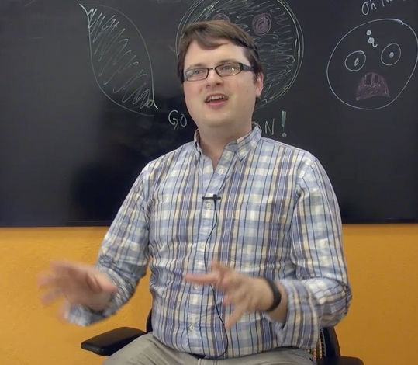
John Resig
Started jQuery in 2005 to make his web development projects easier
- Elegant way to select DOM elements
- Clean way to register events
Released in 2006
Works at Khan Academy as the “Dean of Computer Science”

Slide 3
Summer 2023 Updates
Django 4.0 -> Django 4.2 (LTS – through 2026)
Bootstrap 3 -> Bootstrap 5
jQuery -> Pure JavaScript

Slide 4
High Level
You can use either JavaScript *or* jQuery to do your assignments for a transition period
The auto graders do not check or look at your JavaScript code yet.
At least until June 2024
But the course lectures will be about JavaScript

Slide 5
JavaScript – Ads 1 through Ads 4
Course 3 – Django features and libraries – Week 5
Ads1 Assignment does not have any JavaScript
Ads1 *does* copy a bunch of code form the DJ4E-samples that includes navigation, etc.
Course 4 – Covers the JavaScript language and has assignments that use JavaScript
Ads + Pictures – Uses JavaScript to show / hide the overlay (Week 2)
Replacement material – JavaScript and the Browser (Week 3)
JSON / AJAX – Uses JavaScript for the requests from the browser (Week 4)

Slide 6
During the Transition
We can help if you fall into a crevasse between versions
Django 4.0 / Django 4.2
JavaScript / jQuery
The autograders will not be the problem
If your code works, it will pass the autograders

Slide 7
Conclusion
Thanks so much to jQuery and John Resig
From 2006 to present they made in-the-browser development portable
It gave JavaScript time to build enough portable features to achieve parity
I kept jQuery in Web Applications for Everybody (PHP) if you really want to learn it ☺
I already miss jQuery's simplicity – but having things built into the browser is "the way"

