Slide 1
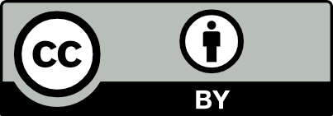
JavaScript and the Browser
Dr. Charles Severance
www.dj4e.com

Slide 2
JavaScript in a Browser
In a desktop or server, you have an operating system like Windows, Linux, or MacOS and languages like Python, PHP, and Java. JavaScript is both the programming language in a browser *and* some of the "operating system".
Document object Model (DOM)
Visible Window (Window)
Tabs
Events
Timers

Slide 3
When Does JavaScript Execute?
As the document is being parsed
As a result of some kind of UI Event
As a result of a timer expiring
As a result of an asynchronous activity finishing
First class functions and "code as data" are essential to this execution model.

Slide 4
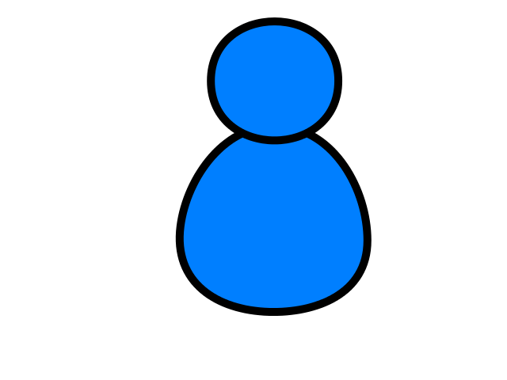
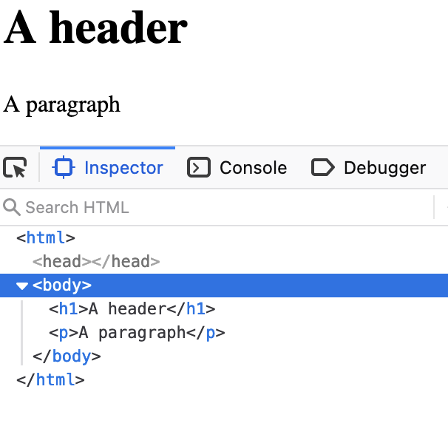
Browser
D
O
M
Server
Click
https://www.dj4e.com/code/browser/01-noscript.htm
Parse
Response
<h1>A header</h1>
<p>A paragraph</p>
JavaScript

Slide 5
Browser
D
O
M
Server
Click
https://www.dj4e.com/code/browser/02-script.htm
Parse
Response
<script>
document.write('<h1>A header</h1>\n');
document.write('<p>A paragraph</p>\n');
</script>
JavaScript

Slide 6
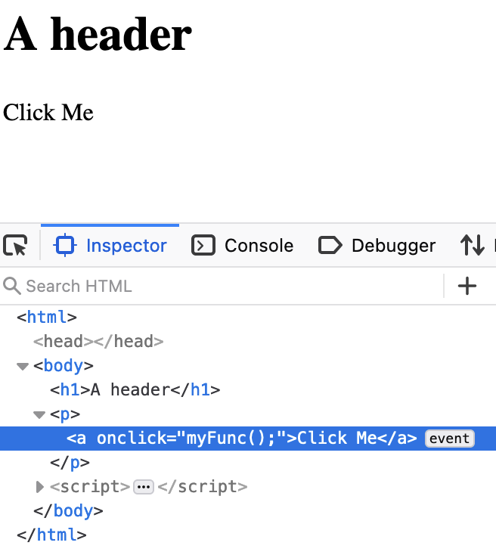
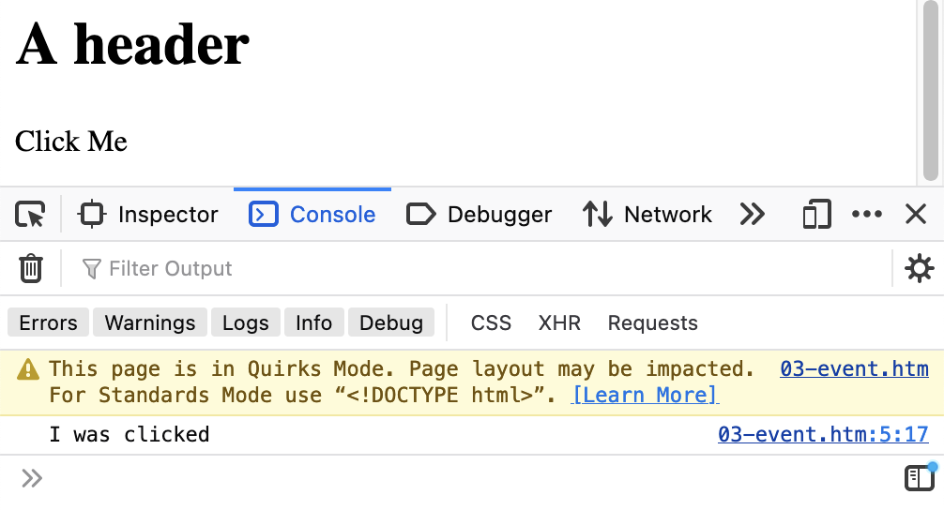
Browser
D
O
M
Server
Click
https://www.dj4e.com/code/browser/01-noscript.htm
<h1>A header</h1>
<p><a onclick="myFunc();">Click Me</a></p>
<script>
function myFunc() {
console.log("I was clicked");
}
</script>
Parse
Response
Click
JavaScript

Slide 7
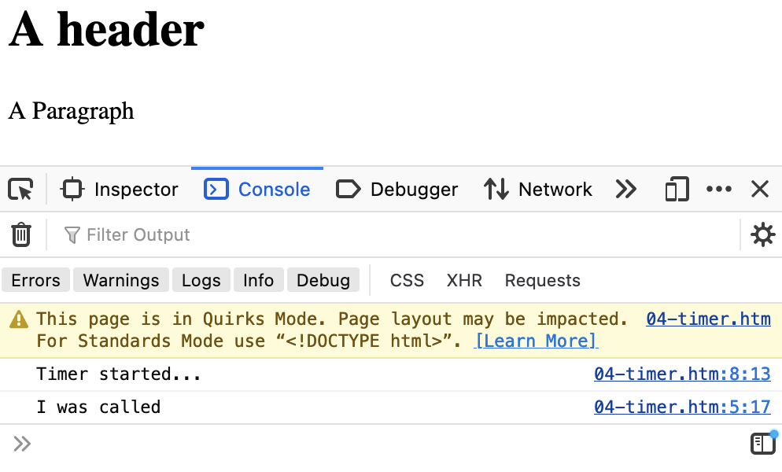
Browser
D
O
M
Server
Click
https://www.dj4e.com/code/browser/04-timer.htm
<h1>A header</h1>
<p>A Paragraph</a>
<script>
function myFunc() {
console.log("I was called");
}
setTimeout(myFunc, 5000);
console.log("Timer started...");
</script>
Parse
Response
Timer
JavaScript

Slide 8
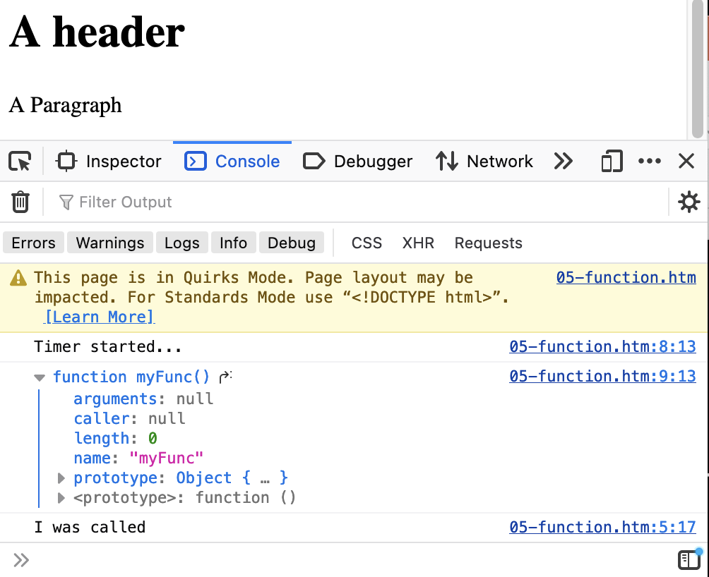
First Class Functions
https://www.dj4e.com/code/browser/05-function.htm
The first parameter to setTimeout() is a function reference – no ()
<h1>A header</h1>
<p>A Paragraph</a>
<script>
function myFunc() {
console.log("I was called");
}
setTimeout(myFunc, 5000);
console.log("Timer started...");
console.log(myFunc);
</script>

Slide 9
Document Object Model
(a.k.a. the "DOM")

Slide 10
Document Object Model
The browser (and sometimes our JavaScript) parses the HTML and produces a Document Object Model (DOM) which is then displayed to the user through a Window
In our event and/or timer code, we can read and manipulate the DOM
As the DOM is updated, the user sees the new UI through the Window
Using a debugger, we can directly manipulate the DOM

Slide 11
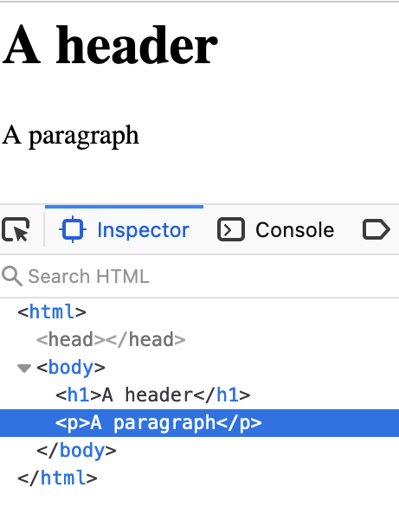
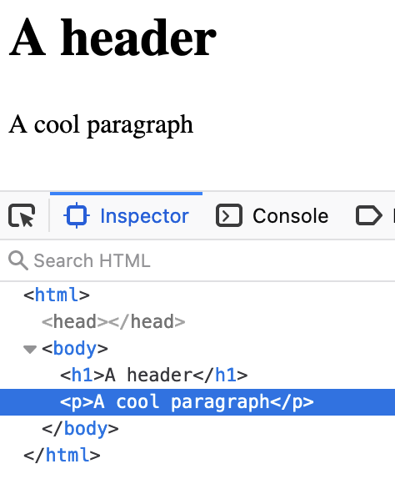
Inspect the DOM
https://www.dj4e.com/code/browser/01-noscript.htm
When you "inspect element" in the debugger, you are seeing the DOM and the Window
When you change the DOM in the debugger, the changes are reflected in the content that is displayed in the Window

Slide 12
Using getElementById()
In order not to have to traverse each unique DOM, we use a function call that all browsers support. This allows us to bypass the DOM structure and jump to a particular tag within the DOM and manipulate that tag.

Slide 13
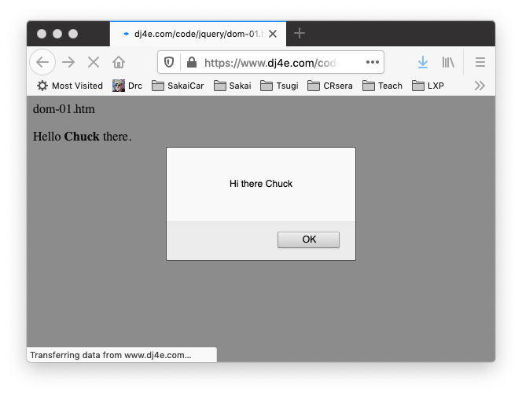
<p>
Hello <b><span id="person">Chuck</span></b> there.
</p>
<script type="text/javascript">
console.dir(document.getElementById('person'));
var st = document.getElementById('person').innerHTML;
console.log("ST = "+st);
alert('Hi there ' + st);
document.getElementById('person').innerHTML = 'Joseph';
</script>
dom-01.htm

Slide 14
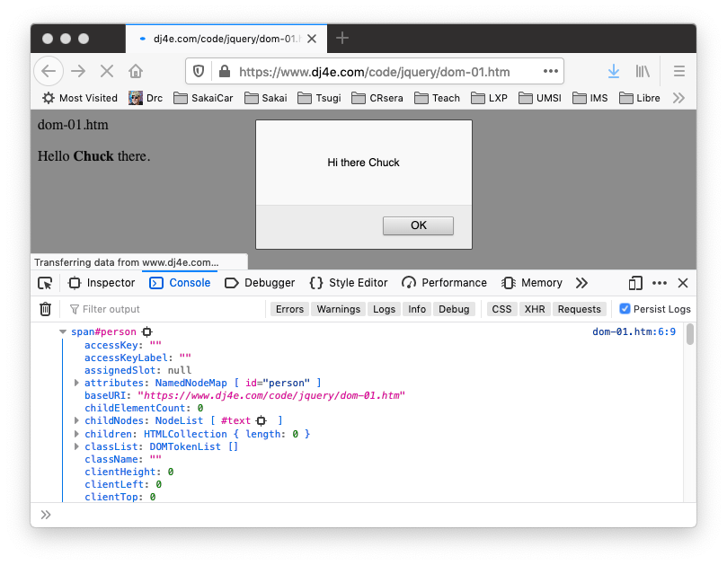
dom-01.htm
console.dir(document.getElementById('person'));

Slide 15
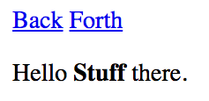
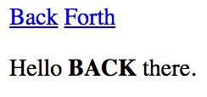
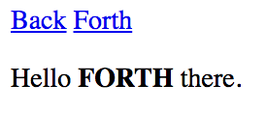
Updating the Browser Document
<a href="#"
onclick="document.getElementById('stuff').innerHTML='BACK';return false;">
Back</a>
<a href="#"
onclick="document.getElementById('stuff').innerHTML='FORTH';return false;">
Forth</a>
</p>
<p>
Hello <b><span id="stuff">Stuff</span></b> there.
dom-02.htm
This is one reason why you can only have one id per document.

Slide 16
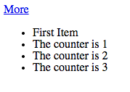
<p>
<a href="#" onclick="add();return false;">More</a>
</p>
<ul id="the-list">
<li>First Item</li>
</ul>
<script>
counter = 1;
console.log(document.getElementById('the-list'))
function add() {
var x = document.createElement('li');
x.className = "list-item";
x.innerHTML = "The counter is "+counter;
document.getElementById('the-list').appendChild(x);
counter++;
}
</script>
dom-03.htm

Slide 18
Threading

Slide 19
Multi-Tasking Types
Pre-Emptive Multi-Tasking (Operating systems / web servers)
If a tasks runs a long loop, they suspended after their "time slice" to share the processor with other tasks
It limits the impact on the performance of the system or other tasks if one task does a lot of computation in the "foreground" or pauses to wait for something
Cooperative Multi-Tasking (JavaScript)
A greedy task can hang or crash the entire system
A responsible task breaks long "loops" into a set of separate tasks, giving up the processor at each step
https://en.wikipedia.org/wiki/Computer_multitasking

Slide 20
Python / Django Server is Multi Threaded
When a Django view is running, any model retrieval may require a "long" pause while the objects are retrieved from a database
If the server were single threaded, no other browsers could make requests while one request was in progress and waiting for data
class MainView(LoginRequiredMixin, View):
def get(self, request):
mc = Make.objects.all().count()
al = Auto.objects.all()
ctx = {'make_count': mc, 'auto_list': al}
return render(request, 'autos/auto_list.html', ctx)

Slide 21
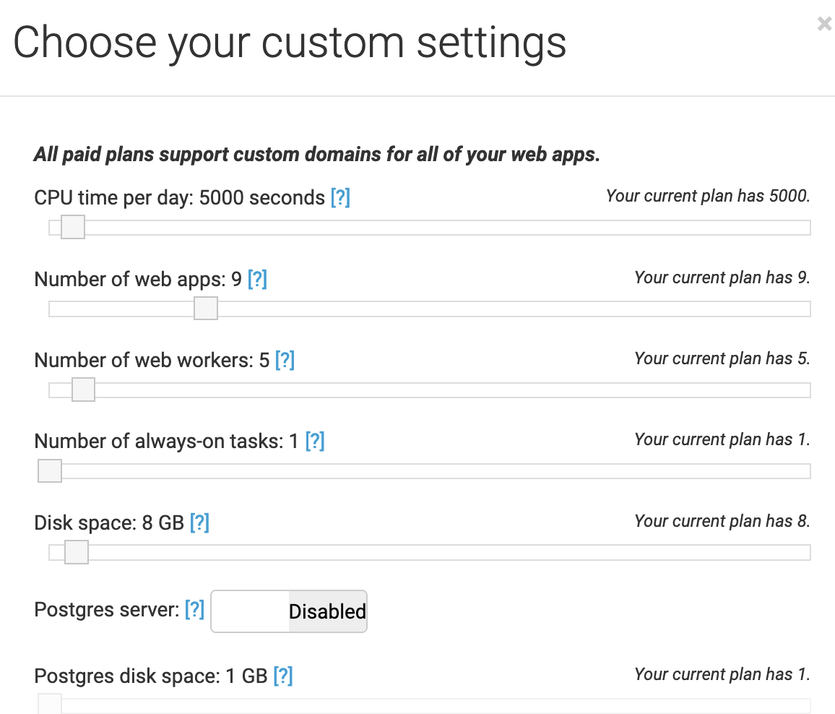
www.pythonanywhere.com
Free accounts have 1 web worker and one webapp

Slide 22
Browser
Linux
N
G
I
N X
WGSIConfig
settings.py
Django – dj4e.pythonanywhere.com
urls.py
views.py
model.py
WGSIConfig
settings.py
Django – dj4e.pythonanywhere.com
urls.py
views.py
model.py
… 5 …
WGSIConfig
settings.py
Django – dj4e.pythonanywhere.com
urls.py
views.py
model.py

Slide 23
History of Cooperative Multitasking in Operating Systems

Slide 24
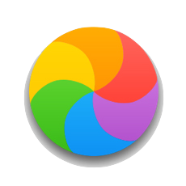

A Long Time Ago
Windows 3.1 used cooperative multi tasking
Mac OS 8 used cooperative multi tasking
Each application was responsible for "not keeping the processor too long"
When an application failed and could not respond to events or mi-behaved, the user would see the "Spinning Beach Ball of Death" or the dreaded Windows hourglass cursor and usually have to rebooth their computer

Slide 25
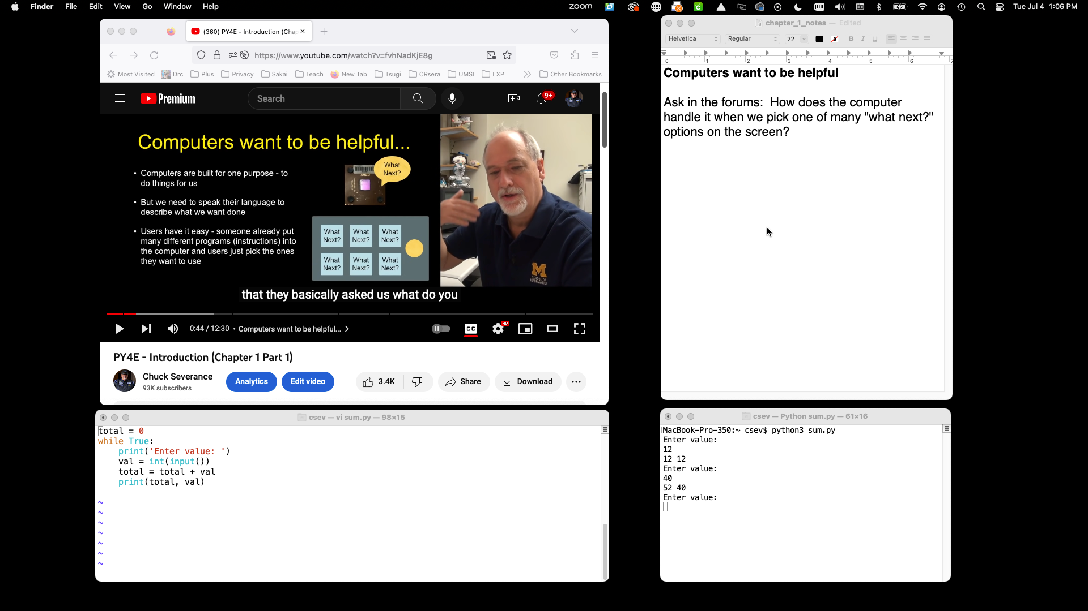

Slide 26
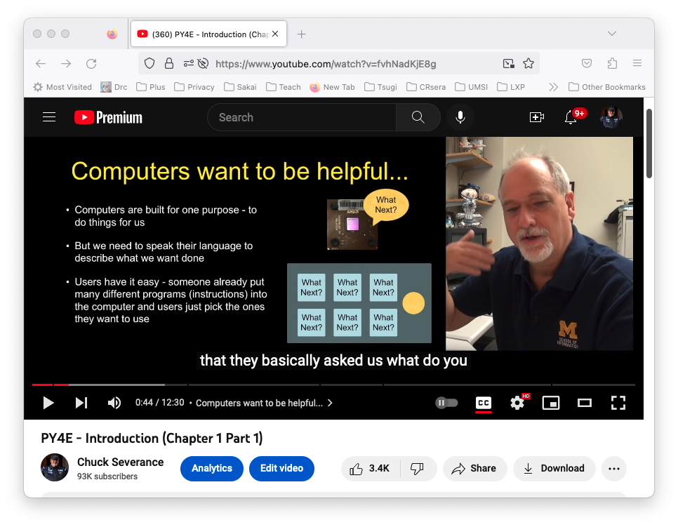
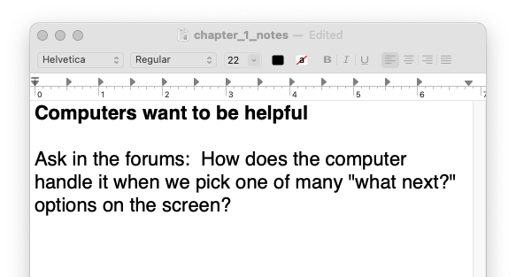

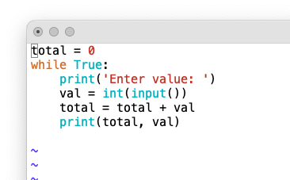
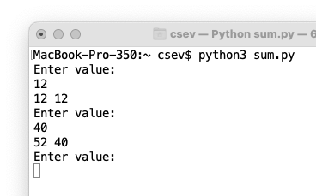
Hardware
MacOS
App: Firefox
Waiting: Click
Background thread:
Retrieve and play
App: TextEdit
Waiting: Click
App: Terminal and vim
Waiting: Click
App: Terminal and python3
Waiting: Character press

Slide 27
Hardware
MacOS
App: Firefox
Waiting: Click
Background thread:
Retrieve and play
App: TextEdit
Waiting: Click
App: Terminal and vim
Waiting: Click
App: Terminal and python3
Waiting: Character press

Slide 28
Hardware
MacOS
App: Firefox
Waiting: Click
Background thread:
Retrieve and play
App: TextEdit
Waiting: Click
App: Terminal and vim
Waiting: Click
App: Terminal and python3
Waiting: Character press

Slide 29
Hardware
MacOS
App: Firefox
Waiting: Click
Background thread:
Retrieve and play
App: TextEdit
Waiting: Click
App: Terminal and vim
Waiting: Click
App: Terminal and python3
Waiting: Character press

Slide 30
Why Do Cooperative MultiTasking at all?
It keeps things much simpler and smaller when building an operating system
Windows 3.1 / Mac OS 8
It uses less memory and does not require virtual memory
Windows 3.1 / Mac OS 8
In 1994, JavaScript handled asynchronous activity programming without requiring a virtual memory system inside the browser on operating systems that did not have virtual memory support

Slide 31
Cooperative Multi Tasking in JavaScript

Slide 32
JavaScript Threads
In JavaScript, there is one thread
When your JavaScript code is running, it is the only thing running so whatever you do must finish quickly.
This is why using alert() in your code can temporarily hang all or part of your web page – you have "paused" the one thread waiting for the user to press the alert button
Long computations or long delays must make provisions to "release" the thread so the browser can use the thread to do the things that need done.
When your thread is running – it *is* the browser

Slide 33
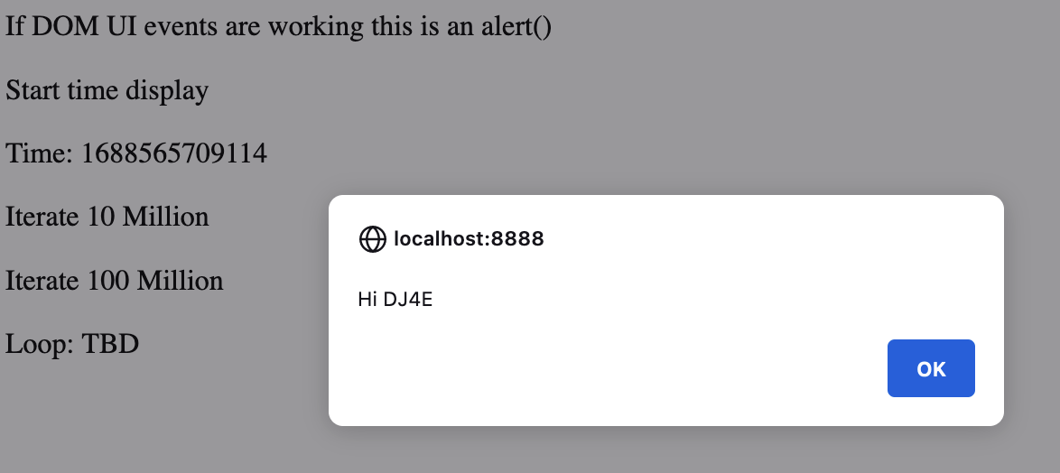
Responsible and Irresponsible Code
Press "Start Time Display"
Time Updates continuously
The alert box pops up when the link is pressed
Time updating pauses until the alert box is closed
https://www.dj4e.com/freeze.htm

Slide 34
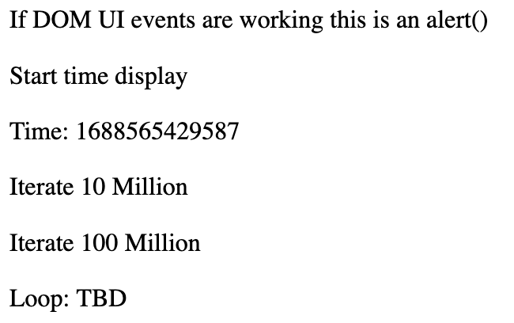
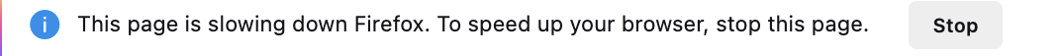
Responsible and Irresponsible Code
Press Here – Time updates continuously
Press Here – Browser hangs for about 30 seconds
Time updating stops. Pressing on "DOM UI" does nothing.
Sometimes the browser notices that things are amiss
If you stop the code, you can see how far the loop proceeded.
https://www.dj4e.com/freeze.htm

Slide 35
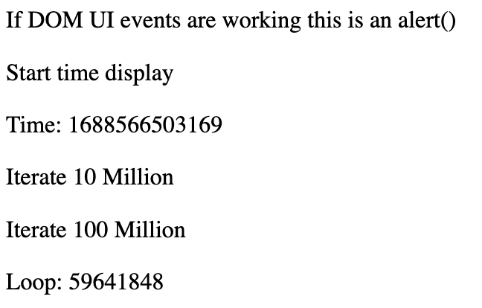
Responsible and Irresponsible Code
If you stop the JavaScript mid loop,
Eventually things will calm down and the UI will update
But the browser will have disabled JavaScript on the page
So "Start time display" and "DOM UI" will not work until
the page is refreshed.
https://www.dj4e.com/freeze.htm

Slide 36
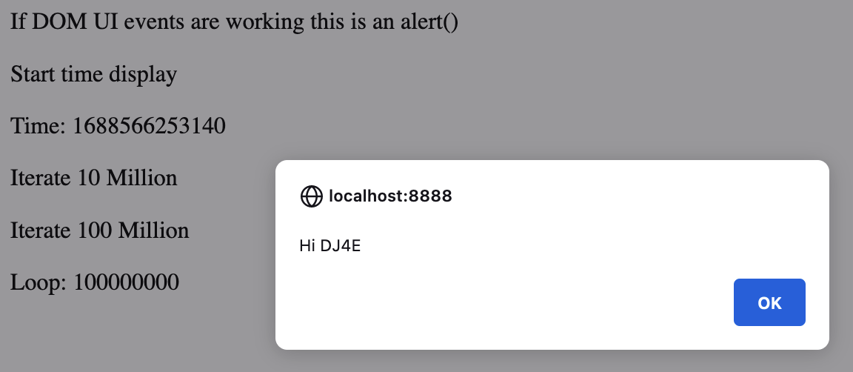
Responsible and Irresponsible Code
If you wait long enough, the loop will finish, and the screen will update and if you pressed the "DOM UI" button, the alert box will pop up. If you dismiss the alert box, the time will once again start updating.
Your browser was busy for about 30 seconds, but during that time click events and the setTimeout() event were being held to be executed as soon as your code finished and released the CPU back to the browser.
https://www.dj4e.com/freeze.htm

Slide 37
<p><a onclick="alert('Hi DJ4E');">If DOM UI events are working
this is an alert()</a></p>
<p><a onclick="setTimeout(updateTime, 100);">Start time display</a></p>
<p>Time: <span id="time">TBD</span></p>
<p><a onclick="updateTimeLoop(10000000);">Iterate 10 Million</a></p>
<p><a onclick="updateTimeLoop(100000000);">Iterate 100 Million</a></p>
<p>Loop: <span id="loop">TBD</span></p>
<script>
function updateTimeLoop(iterations) {
for(let i=0;i<=iterations; i++) {
document.getElementById("loop").innerHTML = i;
}
}
function updateTime() {
document.getElementById("time").innerHTML = Date.now();
setTimeout(updateTime, 100);
}
</script>
https://www.dj4e.com/freeze.htm

Slide 38
Threading Summary
There are two ways our JavaScript code can hang the browser
Do too much computation on the main thread (this example)
Wait for an external event – like retrieving web data in JavaScript (coming soon)
Programming in JavaScript is dramatically different than most other languages because we must deal with all the issues that are our responsibility due to cooperative multi-tasking
Initially it seems quite annoying – but once you understand it – it is kind of cool to be writing code like an operating system

Slide 39
Browser
Linux
D
O
M
Django
settings.py
Routing
Click
urls.py
views.py
Parse
Response
Views
Templates
forms.py
JavaScript
Database
Shell
Models
model.py
/admin
admin.py

Slide 40
Browser
Linux
D
O
M
Django
settings.py
Routing
urls.py
views.py
Parse
Response
Views
Templates
forms.py
AJAX
JavaScript
Database
Shell
Models
model.py
/admin
admin.py

Slide 41
Vanilla JavaScript (1995)
<script type="text/javascript">
document.write("<p>Hello World</p>")
</script>
https://www.dj4e.com/code/javascript/js-01.htm
http://en.wikipedia.org/wiki/Document_Object_Model

Slide 42
Document Object Model
JavaScript can manipulate the current HTML document.
The “Document Object Model” is how we access various “bits” of the current screen to read and/or manipulate.
We can even find pieces of the model by id attribute and change them.
We can read and write the DOM from (Vanilla) JavaScript.

Slide 43
Using getElementById()
In order not to have to hard-code tree-paths to each part of the DOM, we use function calls to query the DOM and retrieve a particular tag within the DOM and manipulate that tag.

Slide 44
<p>
Hello <b><span id="person">Chuck</span></b> there.
</p>
<script type="text/javascript">
console.dir(document.getElementById('person'));
var st = document.getElementById('person').innerHTML;
console.log("ST = "+st);
alert('Hi there ' + st);
document.getElementById('person').innerHTML = 'Joseph';
</script>
dom-01.htm

Slide 45
dom-01.htm
console.dir(document.getElementById('person'));

Slide 46
Updating the Browser Document
<a href="#"
onclick="document.getElementById('stuff').innerHTML='BACK';return false;">
Back</a>
<a href="#"
onclick="document.getElementById('stuff').innerHTML='FORTH';return false;">
Forth</a>
</p>
<p>
Hello <b><span id="stuff">Stuff</span></b> there.
dom-02.htm
This is one reason why you can only have one id per document.

Slide 47
<p>
<a href="#" onclick="add();return false;">More</a>
</p>
<ul id="the-list">
<li>First Item</li>
</ul>
<script>
counter = 1;
console.log(document.getElementById('the-list'))
function add() {
var x = document.createElement('li');
x.className = "list-item";
x.innerHTML = "The counter is "+counter;
document.getElementById('the-list').appendChild(x);
counter++;
}
</script>
dom-03.htm

Slide 48
Summary
This focused on the mechanics of low-level jQuery.
- Initialization setup
- Event handling
- DOM selection
- DOM manipulation
Vanilla JavaScript is catching up…

Slide 49
Acknowledgements / Contributions
These slides are Copyright 2010- Charles R. Severance (www.dr-chuck.com) as part of www.dj4e.com and made available under a Creative Commons Attribution 4.0 License. Please maintain this last slide in all copies of the document to comply with the attribution requirements of the license. If you make a change, feel free to add your name and organization to the list of contributors on this page as you republish the materials.
Initial Development: Charles Severance, University of Michigan School of Information
Insert new Contributors and Translators here including names and dates
Continue new Contributors and Translators here
Notes:
Note from Chuck. Please retain and maintain this page as you remix and republish these materials. Please add any of your own improvements or contributions.

Slide 50
Additional Source Information
https://commons.wikimedia.org/wiki/File:Mouse_pointer_or_cursor.png
https://en.wikipedia.org/wiki/Spinning_pinwheel#/media/File:OS_X_10.11_Beta_Beach_Ball.jpg

