Slide 1
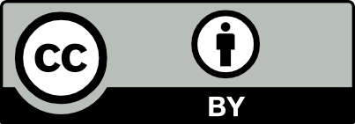
JavaScript and the Browser
Dr. Charles Severance
www.dj4e.com

Slide 2
JavaScript in a Browser
In a desktop or server, you have an operating system like Windows, Linux, or MacOS and languages like Python, PHP, and Java. JavaScript is both the programming language in a browser *and* some of the "operating system".
Document object Model (DOM)
Visible Window (Window)
Tabs
Events
Timers

Slide 3
When Does JavaScript Execute?
As the document is being parsed
As a result of some kind of UI Event
As a result of a timer expiring
As a result of an asynchronous activity finishing
First class functions and "code as data" are essential to this execution model.

Slide 4
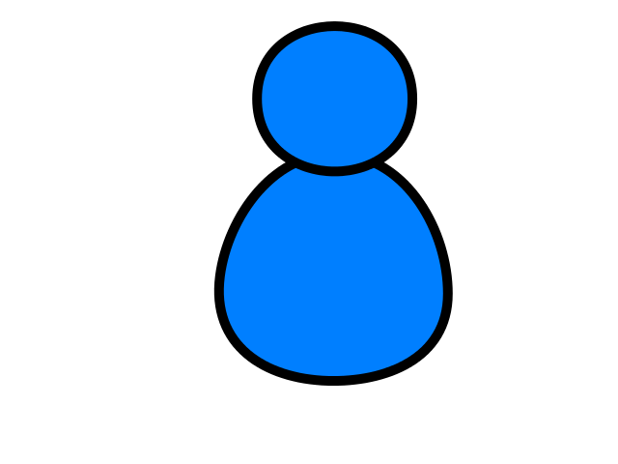
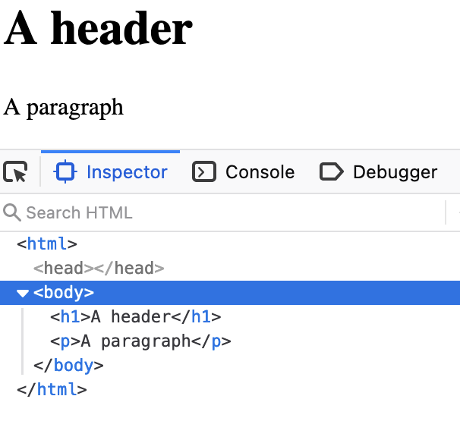
Browser
D
O
M
Server
Click
https://www.dj4e.com/code/browser/01-noscript.htm
Parse
Response
<h1>A header</h1>
<p>A paragraph</p>
JavaScript

Slide 5
Browser
D
O
M
Server
Click
https://www.dj4e.com/code/browser/02-script.htm
Parse
Response
<script>
document.write('<h1>A header</h1>\n');
document.write('<p>A paragraph</p>\n');
</script>
JavaScript

Slide 6
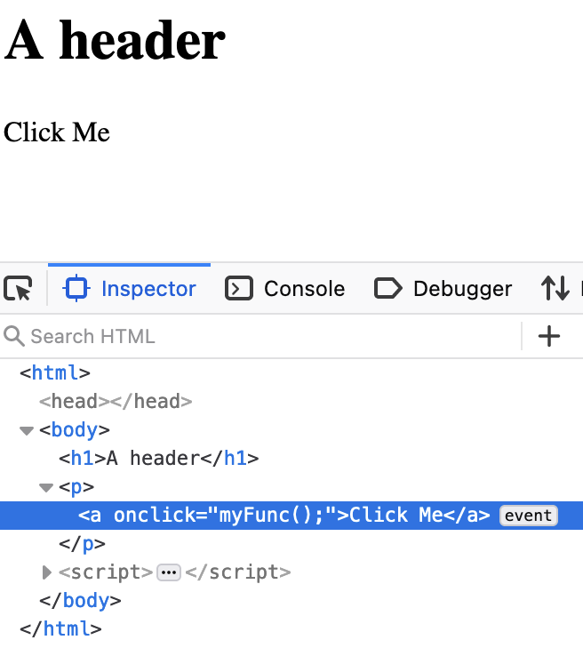
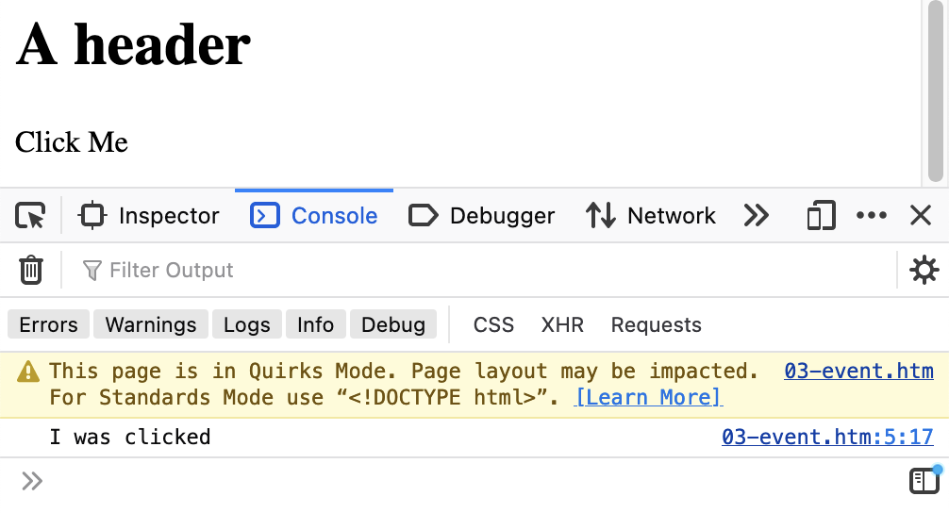
Browser
D
O
M
Server
Click
https://www.dj4e.com/code/browser/03-event.htm
<h1>A header</h1>
<p><a onclick="myFunc();">Click Me</a></p>
<script>
function myFunc() {
console.log("I was clicked");
}
</script>
Parse
Response
Click
JavaScript

Slide 7
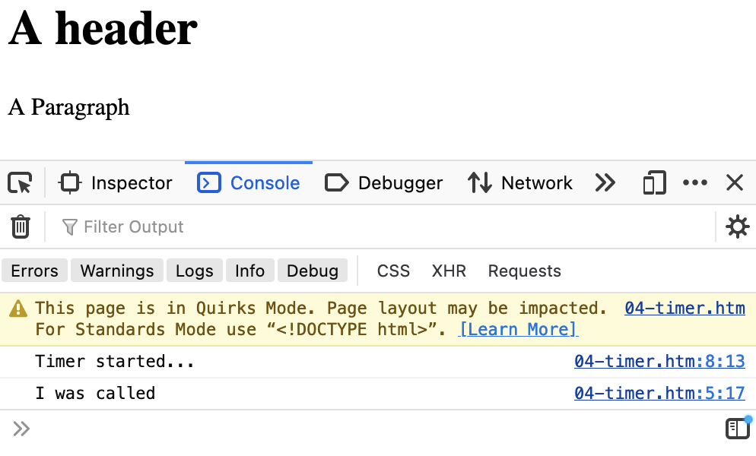
Browser
D
O
M
Server
Click
https://www.dj4e.com/code/browser/04-timer.htm
<h1>A header</h1>
<p>A Paragraph</a>
<script>
function myFunc() {
console.log("I was called");
}
setTimeout(myFunc, 5000);
console.log("Timer started...");
</script>
Parse
Response
Timer
JavaScript

Slide 8
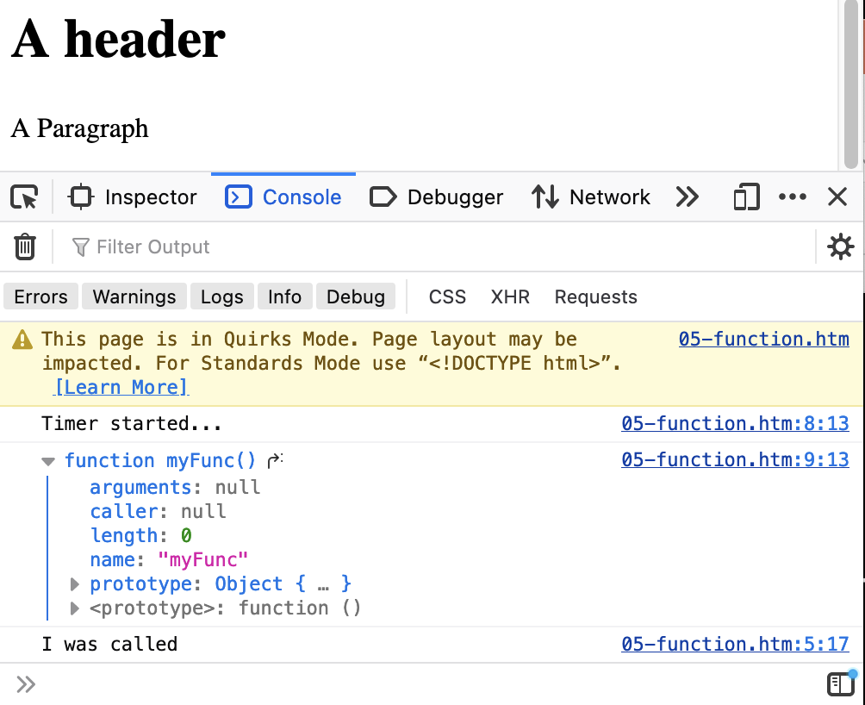
First Class Functions
https://www.dj4e.com/code/browser/05-function.htm
The first parameter to setTimeout() is a function reference – no ()
<h1>A header</h1>
<p>A Paragraph</a>
<script>
function myFunc() {
console.log("I was called");
}
setTimeout(myFunc, 5000);
console.log("Timer started...");
console.log(myFunc);
</script>

Slide 9
Document Object Model
(a.k.a. the "DOM")

Slide 10
Document Object Model
The browser (and sometimes our JavaScript) parses the HTML and produces a Document Object Model (DOM) which is then displayed to the user through a Window
In our event and/or timer code, we can read and manipulate the DOM
As the DOM is updated, the user sees the new UI through the Window
Using a debugger, we can directly manipulate the DOM

Slide 11
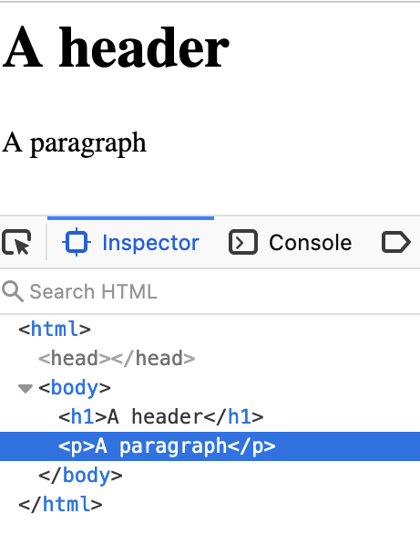
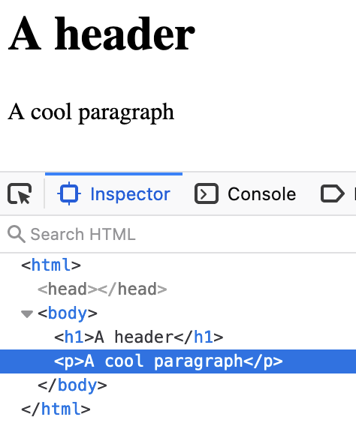
Inspect the DOM
https://www.dj4e.com/code/browser/01-noscript.htm
When you "inspect element" in the debugger, you are seeing the DOM and the Window
When you change the DOM in the debugger, the changes are reflected in the content that is displayed in the Window

Slide 12
The "Window"
We see the DOM "through" the Window

Slide 13
Browser
Browser
D
O
M
D
O
M
W I N D O W
Parse
Response
Parse
Response
JavaScript
JavaScript

Slide 14
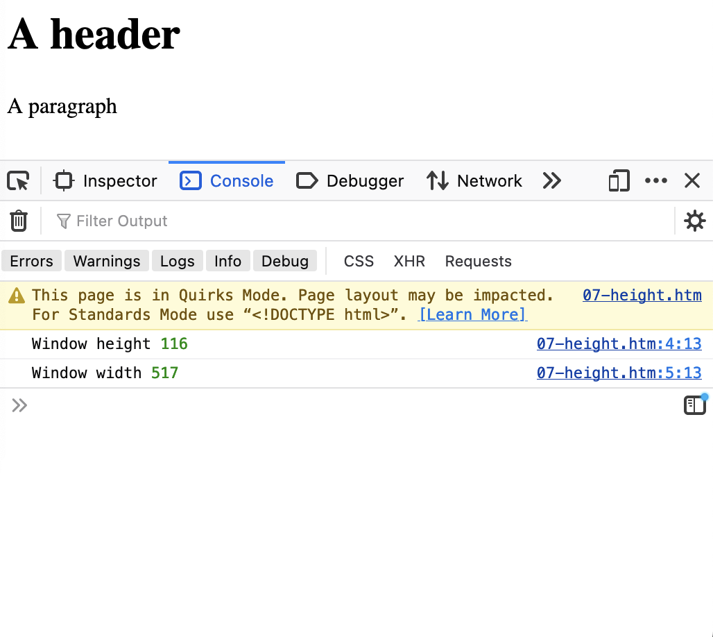
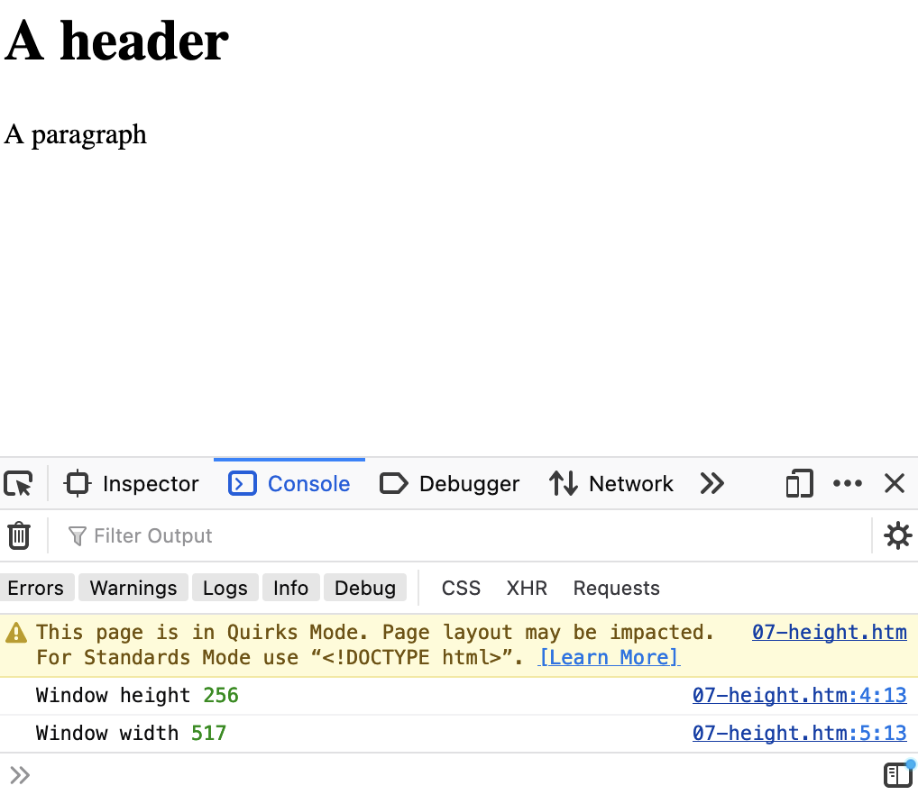
https://www.dj4e.com/code/browser/06-height.htm
<h1>A header</h1>
<p>A paragraph</p>
<script>
console.log("Window height", window.innerHeight);
console.log("Window width", window.innerWidth);
</script>
Window Height
Window Height

Slide 15
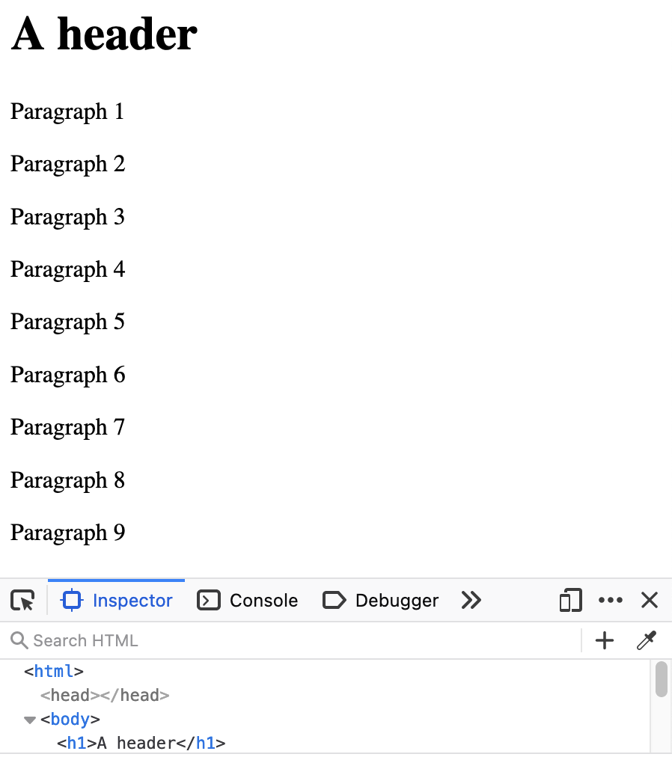
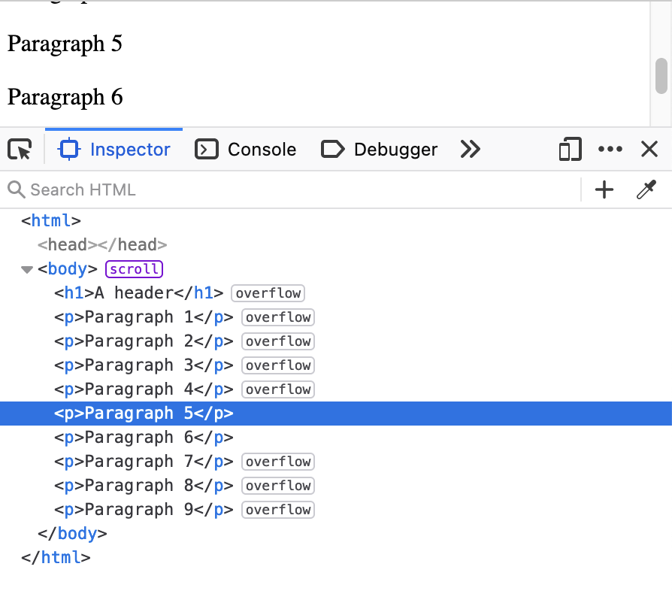
https://www.dj4e.com/code/browser/07-scroll.htm
Window Height
Window Height

Slide 16
Modifying the DOM in JavaScript
Lets not just console.log()

Slide 17
Modify the DOM
https://www.dj4e.com/code/browser/01-noscript.htm
When the DOM is modified and that portion of the DOM is viewable through the Window the user sees the change in their UI
We need to trigger some bit of our JavaScript to make these changes
We need a "handle" to find things in the DOM

Slide 18
Browser
D
O
M
Server
Click
https://www.dj4e.com/code/browser/03-event.htm
<h1>A header</h1>
<p><a onclick="myFunc();">Click Me</a></p>
<script>
function myFunc() {
console.log("I was clicked");
}
</script>
Parse
Response
Click
JavaScript
Recall…

Slide 19
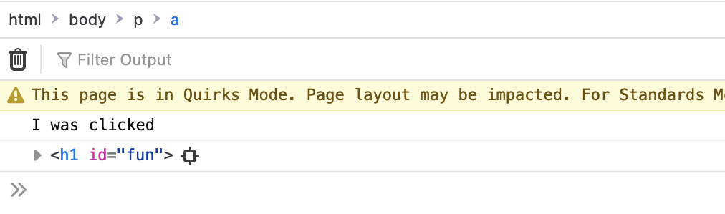
Browser
D
O
M
Server
Click
https://www.dj4e.com/code/browser/08-dom.htm
<h1 id="fun">A header</h1>
<p><a onclick="myFunc();">Click Me</a></p>
<script>
function myFunc() {
console.log("I was clicked");
let elem = document.getElementById("fun");
console.log(elem)
elem.innerHTML = "A cool header";
}
</script>
Parse
Response
JavaScript
Click

Slide 20
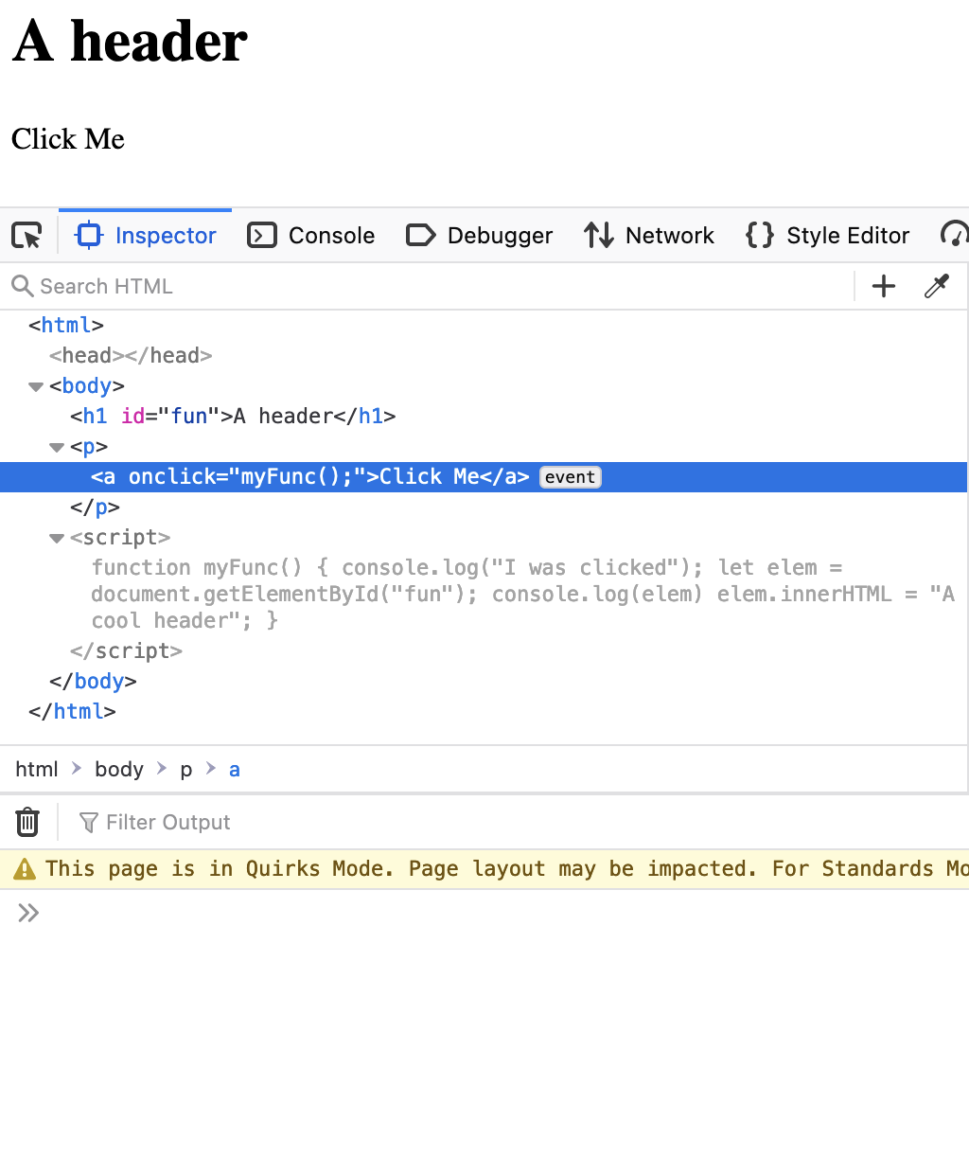
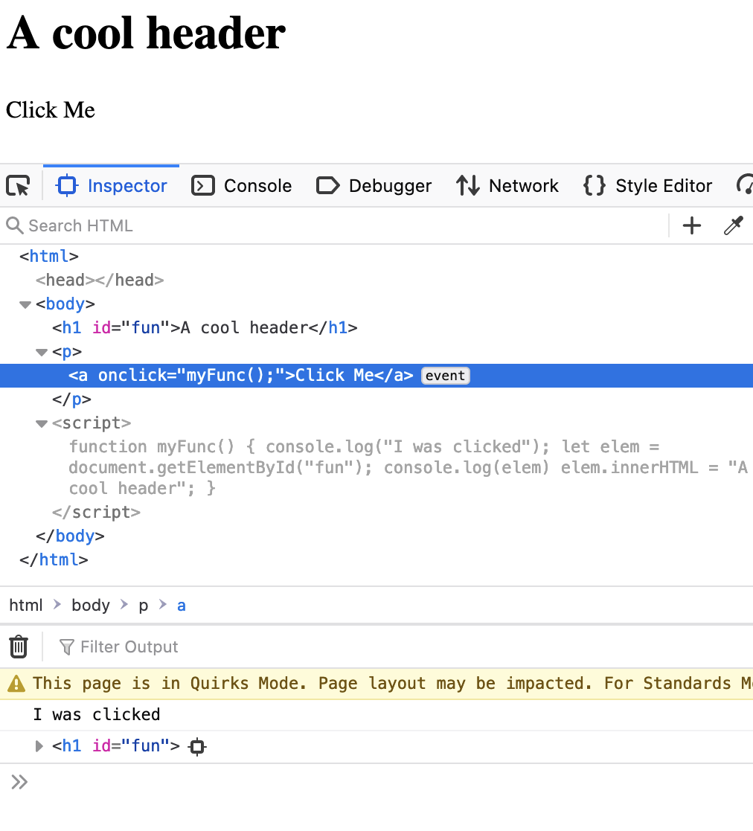
https://www.dj4e.com/code/browser/08-dom.htm

Slide 21
Adding to the DOM
We can build tags and add them to the DOM in JavaScript

Slide 22
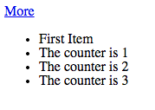
https://www.dj4e.com/code/browser/09-append.htm
<p>
<a href="#" onclick="add();return false;">More</a>
</p>
<ul id="zap">
<li>First Item</li>
</ul>
<script>
var counter = 1;
function add() {
var x = document.createElement('li');
x.className = "list-item";
x.innerHTML = "The counter is "+counter;
document.getElementById('zap').appendChild(x);
counter++;
}
</script>

Slide 23
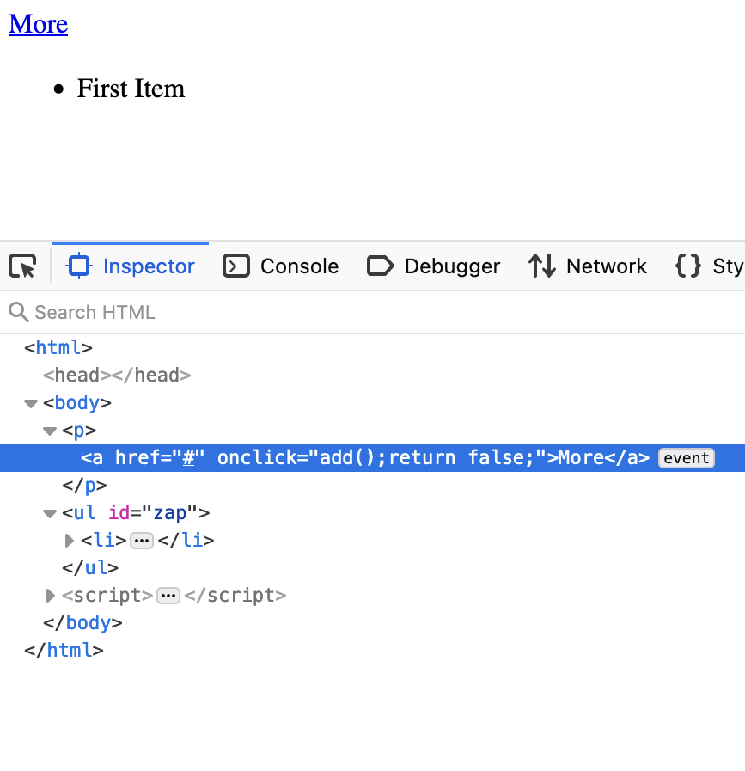
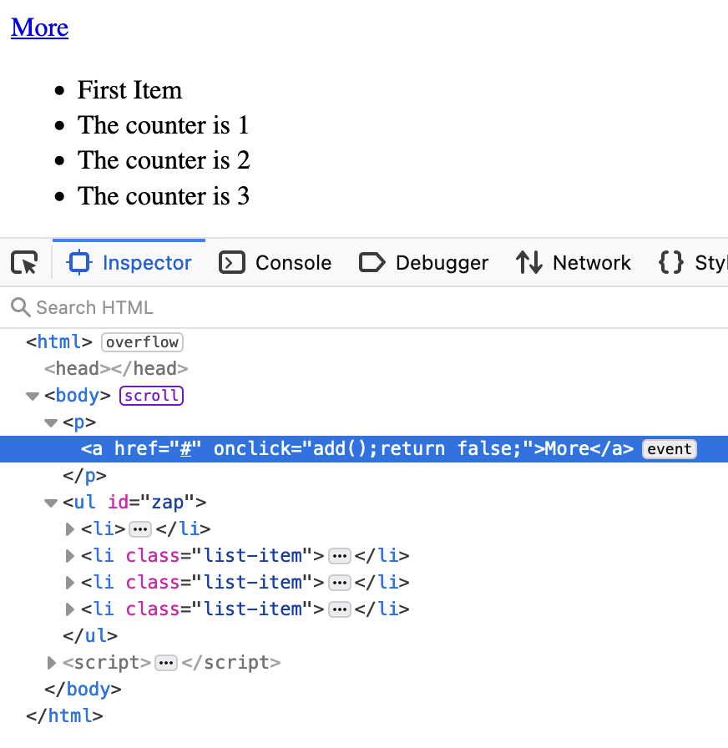

Slide 24
Browser Events

Slide 25
We have been using events all along
Register a Click Event handler via an onclick attribute
Setting a timer to run some of our code at some point in the future
<h1>A header</h1>
<p>A Paragraph</a>
<script>
function myFunc() {
console.log("I was called");
}
setTimeout(myFunc, 5000);
console.log("Timer started...");
</script>
<h1>A header</h1>
<p><a onclick="myFunc();">Click Me</a></p>
<script>
function myFunc() {
console.log("I was clicked");
}
</script>

Slide 26
Event Registration System
We can directly interact with the event registration system
Add an event to an element (tag)
Add an event to the DOM/Window to know when something happens

Slide 27
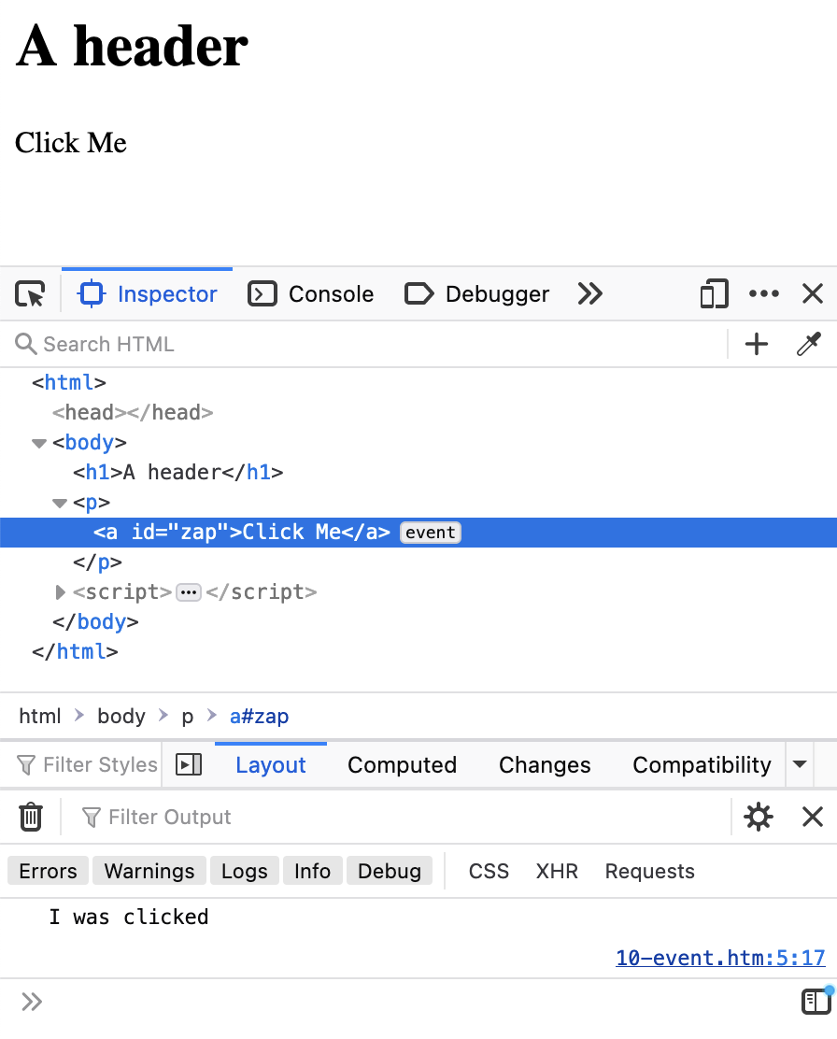
https://www.dj4e.com/code/browser/03-event.htm
<h1>A header</h1>
<p><a onclick="myFunc();">Click Me</a></p>
<script>
function myFunc() {
console.log("I was clicked");
}
</script>
https://www.dj4e.com/code/browser/10-event.htm
<h1>A header</h1>
<p><a id="zap">Click Me</a></p>
<script>
function myFunc() {
console.log("I was clicked");
}
document.getElementById('zap')
.addEventListener('click', myFunc);
</script>

Slide 28
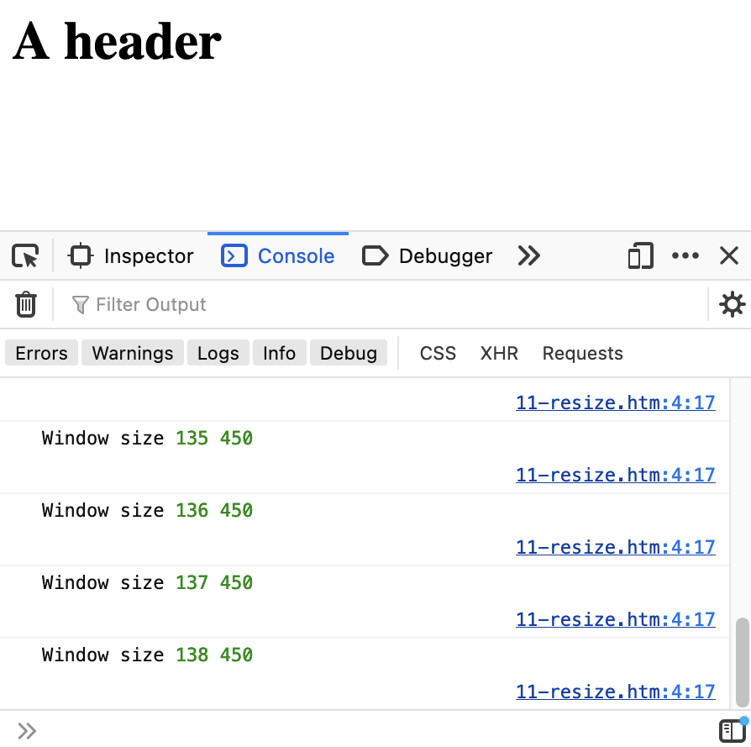
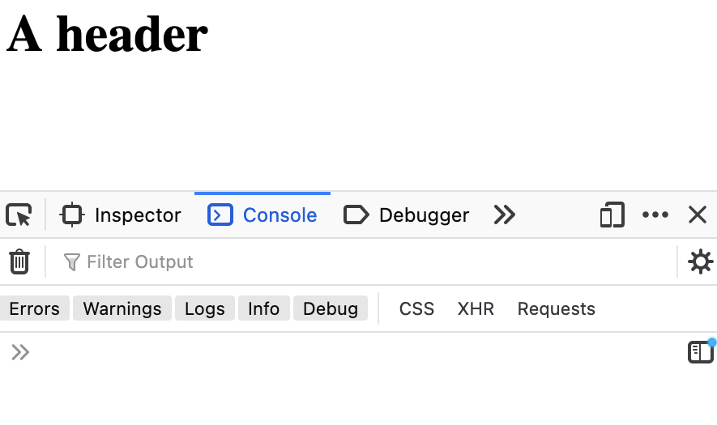
https://www.dj4e.com/code/browser/11-resize.htm
<h1>A header</h1>
<script>
function myFunc() {
console.log("Window size",
window.innerHeight,
window.innerWidth);
}
window.addEventListener('resize', myFunc);
</script>

Slide 29
Threading

Slide 30
Multi-Tasking Types
Pre-Emptive Multi-Tasking (Operating systems / web servers)
If a tasks runs a long loop, they suspended after their "time slice" to share the processor with other tasks
It limits the impact on the performance of the system or other tasks if one task does a lot of computation in the "foreground" or pauses to wait for something
Cooperative Multi-Tasking (JavaScript)
A greedy task can hang or crash the entire system
A responsible task breaks long "loops" into a set of separate tasks, giving up the processor at each step
https://en.wikipedia.org/wiki/Computer_multitasking

Slide 31
Python / Django Server is Multi Threaded
When a Django view is running, any model retrieval may require a "long" pause while the objects are retrieved from a database
If the server were single threaded, no other browsers could make requests while one request was in progress and waiting for data
class MainView(LoginRequiredMixin, View):
def get(self, request):
mc = Make.objects.all().count()
al = Auto.objects.all()
ctx = {'make_count': mc, 'auto_list': al}
return render(request, 'autos/auto_list.html', ctx)

Slide 32
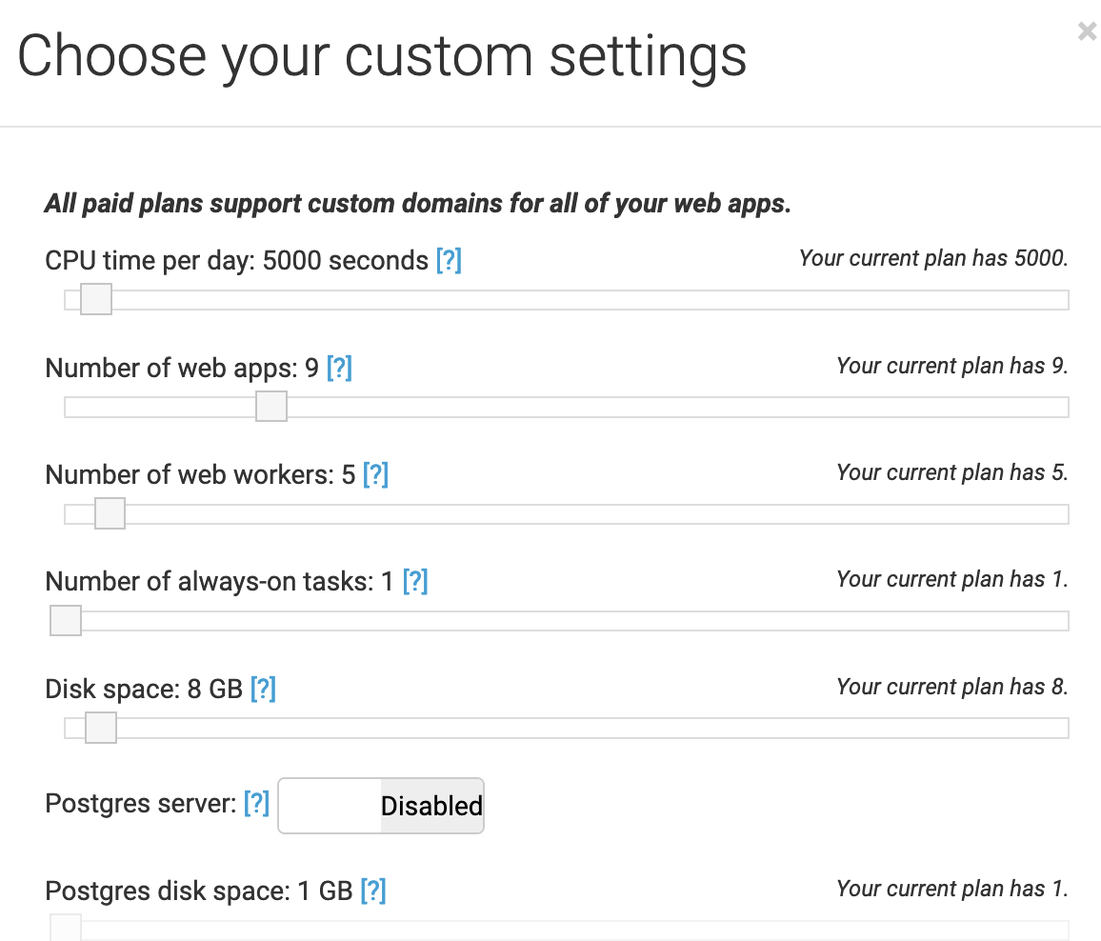
www.pythonanywhere.com
Free accounts have 1 web worker and one webapp

Slide 33
Browser
Linux
N
G
I
N X
WGSIConfig
settings.py
Django – dj4e.pythonanywhere.com
urls.py
views.py
model.py
WGSIConfig
settings.py
Django – dj4e.pythonanywhere.com
urls.py
views.py
model.py
… 5 …
WGSIConfig
settings.py
Django – dj4e.pythonanywhere.com
urls.py
views.py
model.py

Slide 34
History of Cooperative Multitasking in Operating Systems

Slide 35
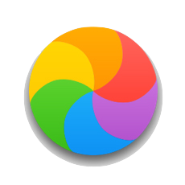
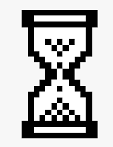
A Long Time Ago
Windows 3.1 used cooperative multi tasking
Mac OS 8 used cooperative multi tasking
Each application was responsible for "not keeping the processor too long"
When an application failed and could not respond to events or mi-behaved, the user would see the "Spinning Beach Ball of Death" or the dreaded Windows hourglass cursor and usually have to rebooth their computer

Slide 36
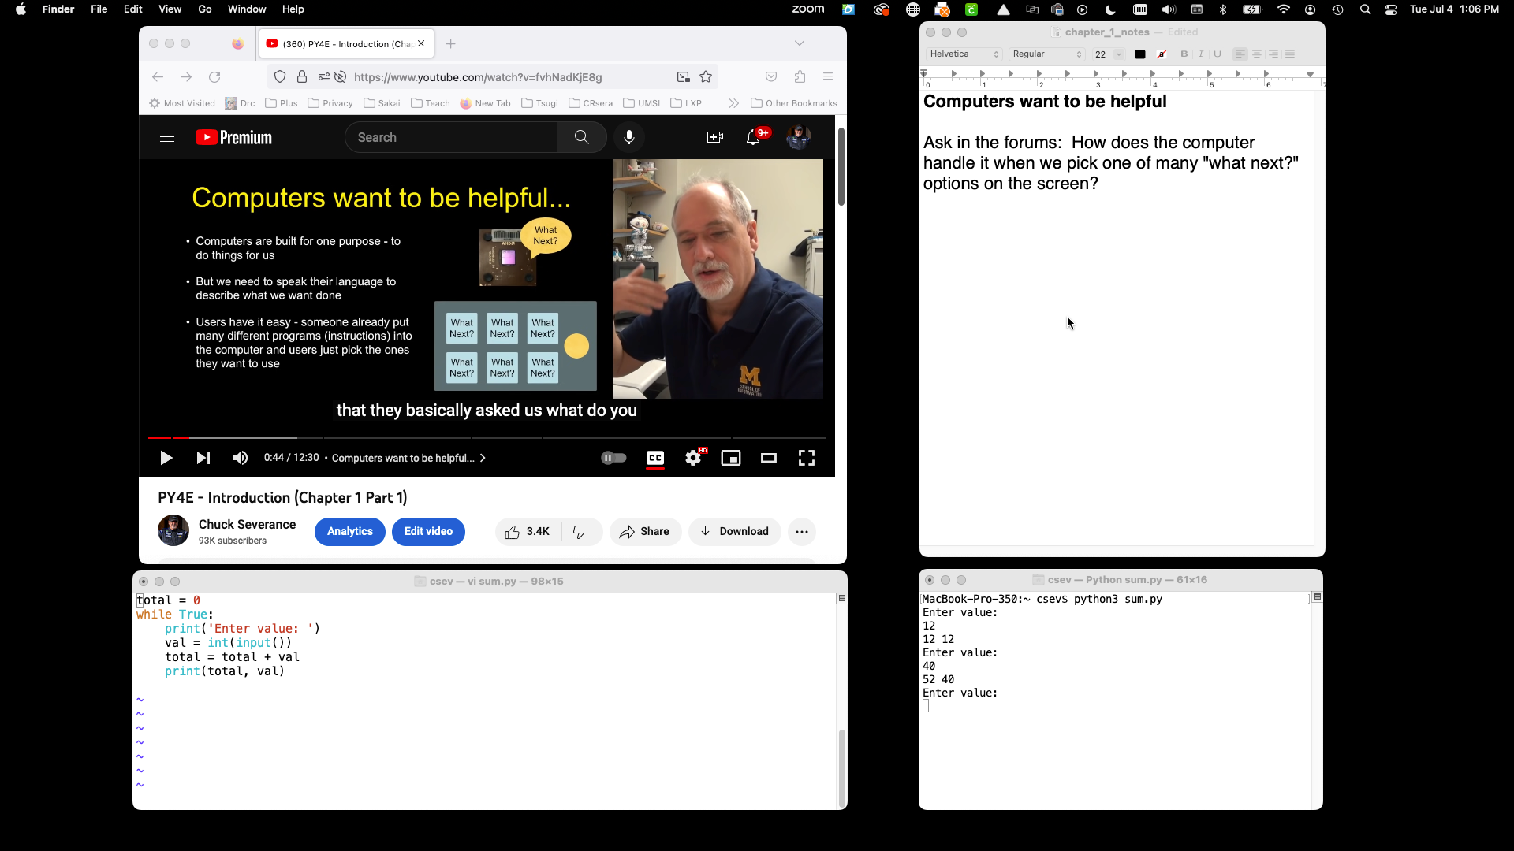

Slide 37
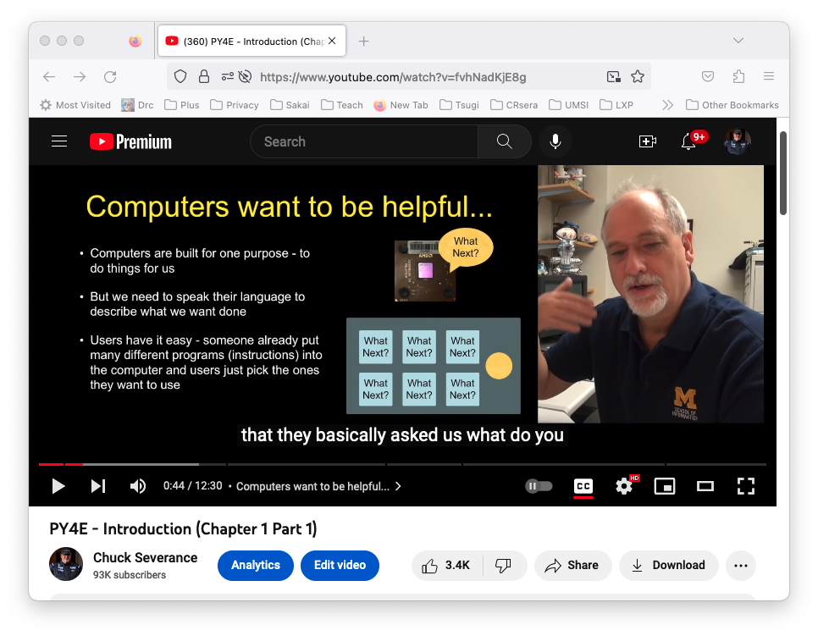
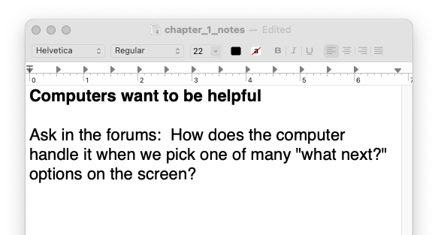

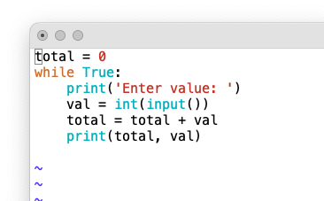
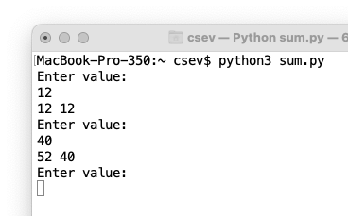
Hardware
MacOS
App: Firefox
Waiting: Click
Background thread:
Retrieve and play
App: TextEdit
Waiting: Click
App: Terminal and vim
Waiting: Click
App: Terminal and python3
Waiting: Character press

Slide 38
Hardware
MacOS
App: Firefox
Waiting: Click
Background thread:
Retrieve and play
App: TextEdit
Waiting: Click
App: Terminal and vim
Waiting: Click
App: Terminal and python3
Waiting: Character press

Slide 39
Hardware
MacOS
App: Firefox
Waiting: Click
Background thread:
Retrieve and play
App: TextEdit
Waiting: Click
App: Terminal and vim
Waiting: Click
App: Terminal and python3
Waiting: Character press

Slide 40
Hardware
MacOS
App: Firefox
Waiting: Click
Background thread:
Retrieve and play
App: TextEdit
Waiting: Click
App: Terminal and vim
Waiting: Click
App: Terminal and python3
Waiting: Character press

Slide 41
Why Do Cooperative MultiTasking at all?
It keeps things much simpler and smaller when building an operating system
Windows 3.1 / Mac OS 8
It uses less memory and does not require virtual memory
Windows 3.1 / Mac OS 8
In 1994, JavaScript handled asynchronous activity programming without requiring a virtual memory system inside the browser on operating systems that did not have virtual memory support

Slide 42
Cooperative Multi Tasking in JavaScript

Slide 43
JavaScript Threads
In JavaScript, there is one thread
When your JavaScript code is running, it is the only thing running so whatever you do must finish quickly.
This is why using alert() in your code can temporarily hang all or part of your web page – you have "paused" the one thread waiting for the user to press the alert button
Long computations or long delays must make provisions to "release" the thread so the browser can use the thread to do the things that need done.
When your thread is running – it *is* the browser

Slide 44
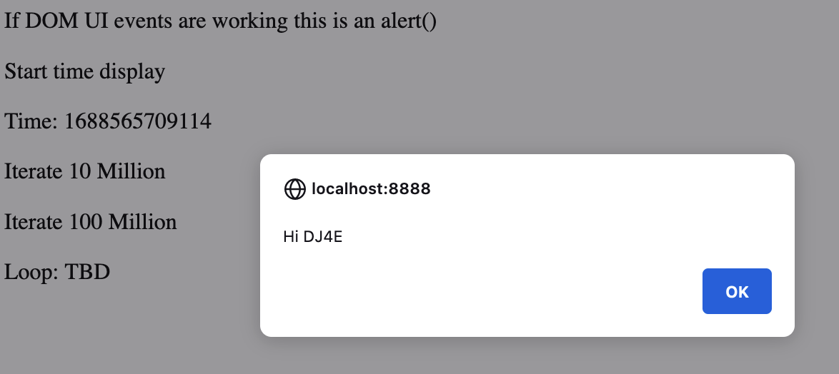
Responsible and Irresponsible Code
Press "Start Time Display"
Time Updates continuously
The alert box pops up when the link is pressed
Time updating pauses until the alert box is closed
https://www.dj4e.com/freeze.htm

Slide 45
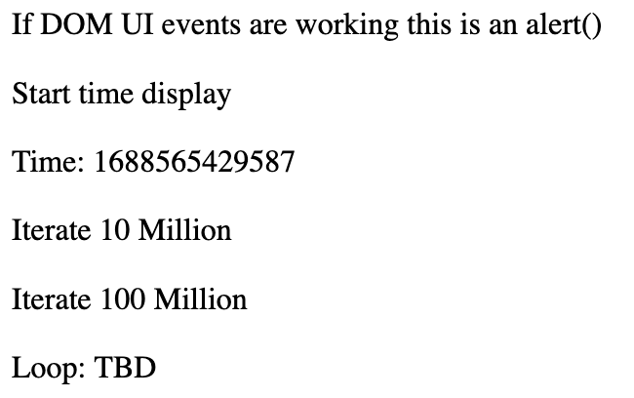
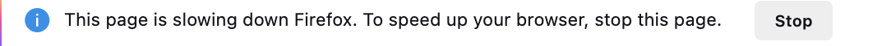
Responsible and Irresponsible Code
Press Here – Time updates continuously
Press Here – Browser hangs for about 30 seconds
Time updating stops. Pressing on "DOM UI" does nothing.
Sometimes the browser notices that things are amiss
If you stop the code, you can see how far the loop proceeded.
https://www.dj4e.com/freeze.htm

Slide 46
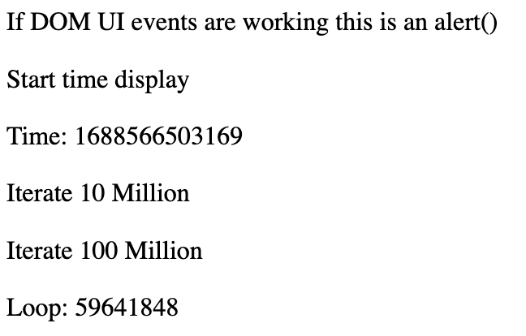
Responsible and Irresponsible Code
If you stop the JavaScript mid loop,
Eventually things will calm down and the UI will update
But the browser will have disabled JavaScript on the page
So "Start time display" and "DOM UI" will not work until
the page is refreshed.
https://www.dj4e.com/freeze.htm

Slide 47
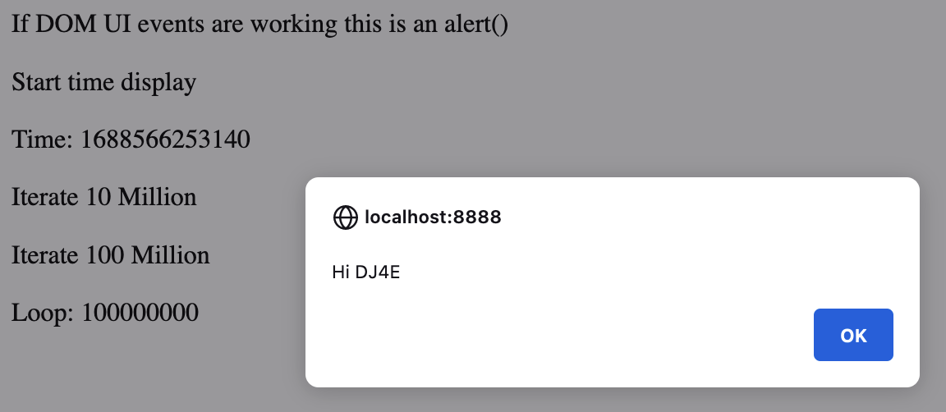
Responsible and Irresponsible Code
If you wait long enough, the loop will finish, and the screen will update and if you pressed the "DOM UI" button, the alert box will pop up. If you dismiss the alert box, the time will once again start updating.
Your browser was busy for about 30 seconds, but during that time click events and the setTimeout() event were being held to be executed as soon as your code finished and released the CPU back to the browser.
https://www.dj4e.com/freeze.htm

Slide 48
<p><a onclick="alert('Hi DJ4E');">If DOM UI events are working
this is an alert()</a></p>
<p><a onclick="setTimeout(updateTime, 100);">Start time display</a></p>
<p>Time: <span id="time">TBD</span></p>
<p><a onclick="updateTimeLoop(10000000);">Iterate 10 Million</a></p>
<p><a onclick="updateTimeLoop(100000000);">Iterate 100 Million</a></p>
<p>Loop: <span id="loop">TBD</span></p>
<script>
function updateTimeLoop(iterations) {
for(let i=0;i<=iterations; i++) {
document.getElementById("loop").innerHTML = i;
}
}
function updateTime() {
document.getElementById("time").innerHTML = Date.now();
setTimeout(updateTime, 100);
}
</script>
https://www.dj4e.com/freeze.htm

Slide 49
Threading Summary
There are two ways our JavaScript code can hang the browser
Do too much computation on the main thread (this example)
Wait for an external event – like retrieving web data in JavaScript (coming soon)
Programming in JavaScript is dramatically different than most other languages because we must deal with all the issues that are our responsibility due to cooperative multi-tasking
Initially it seems quite annoying – but once you understand it – it is kind of cool to be writing code like an operating system

Slide 50
Browser
Linux
D
O
M
Django
settings.py
Routing
Click
urls.py
views.py
Parse
Response
Views
Templates
forms.py
JavaScript
Database
Shell
Models
model.py
/admin
admin.py

Slide 51
Browser
Linux
D
O
M
Django
settings.py
Routing
urls.py
views.py
Parse
Response
Views
Templates
forms.py
AJAX
JavaScript
Database
Shell
Models
model.py
/admin
admin.py

Slide 52
Additional Source Information
https://commons.wikimedia.org/wiki/File:Mouse_pointer_or_cursor.png
https://en.wikipedia.org/wiki/Spinning_pinwheel#/media/File:OS_X_10.11_Beta_Beach_Ball.jpg

