Slide 1

JavaScript and the Browser
Dr. Charles Severance
www.dj4e.com

Slide 2
JavaScript in a Browser
In a desktop or server, you have an operating system like Windows, Linux, or MacOS and languages like Python, PHP, and Java. JavaScript is both the programming language in a browser *and* some of the "operating system".
Document object Model (DOM)
Visible Window (Window)
Tabs
Events
Timers
User-created tags (Web Components)

Slide 3
When Does JavaScript Execute?
Inline as the document is being parsed
As a result of some kind of UI Event
As a result of a timer expiring
As a result of an asynchronous activity finishing
First class functions and "code as data" are essential to this execution model.

Slide 4
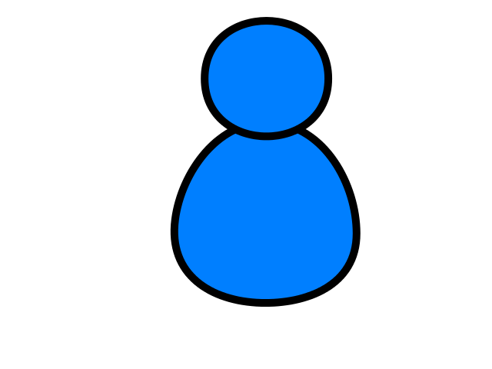
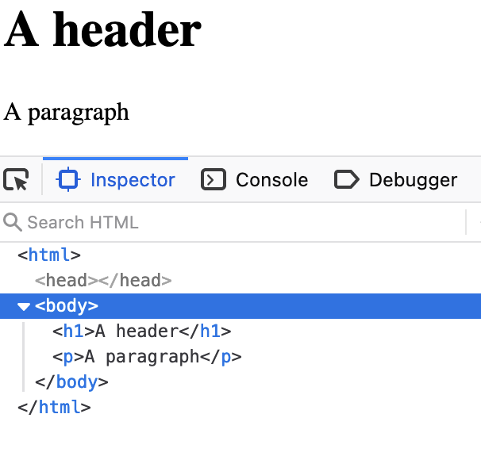
Browser
D
O
M
Server
Click
https://www.dj4e.com/code/browser/01-noscript.htm
Parse
Response
<h1>A header</h1>
<p>A paragraph</p>
JavaScript

Slide 5
Browser
D
O
M
Server
Click
https://www.dj4e.com/code/browser/02-script.htm
Parse
Response
<script>
document.write('<h1>A header</h1>\n');
document.write('<p>A paragraph</p>\n');
</script>
JavaScript

Slide 6
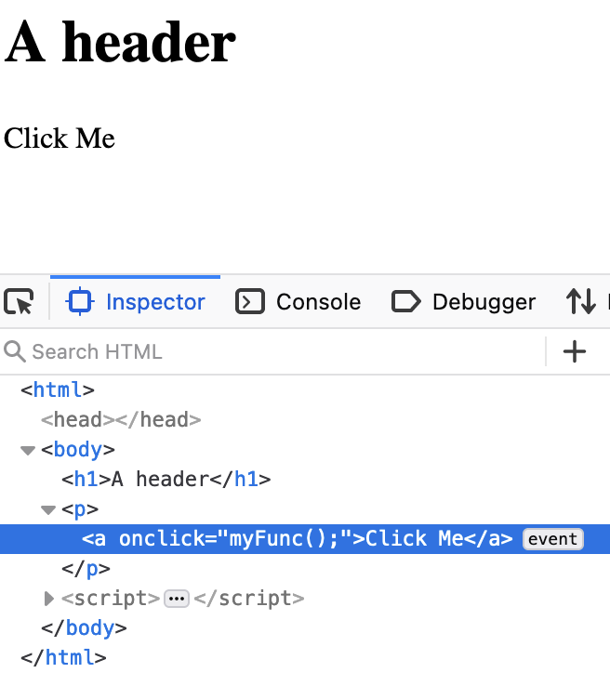
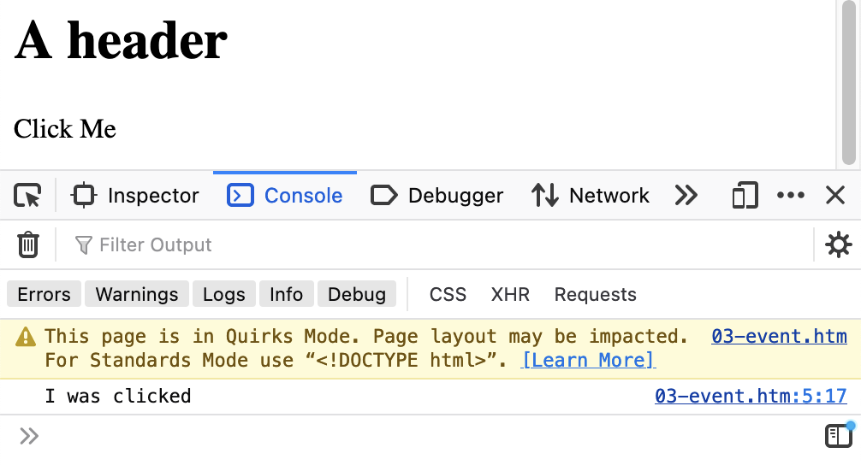
Browser
D
O
M
Server
Click
https://www.dj4e.com/code/browser/03-event.htm
<h1>A header</h1>
<p><a onclick="myFunc();">Click Me</a></p>
<script>
function myFunc() {
console.log("I was clicked");
}
</script>
Parse
Response
Click
JavaScript

Slide 7
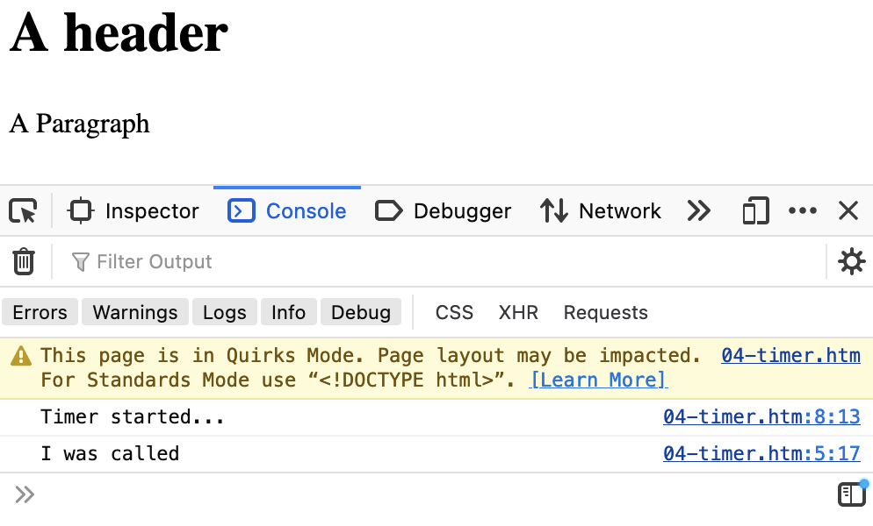
Browser
D
O
M
Server
Click
https://www.dj4e.com/code/browser/04-timer.htm
<h1>A header</h1>
<p>A Paragraph</a>
<script>
function myFunc() {
console.log("I was called");
}
setTimeout(myFunc, 5000);
console.log("Timer started...");
</script>
Parse
Response
JavaScript
Timer

Slide 8
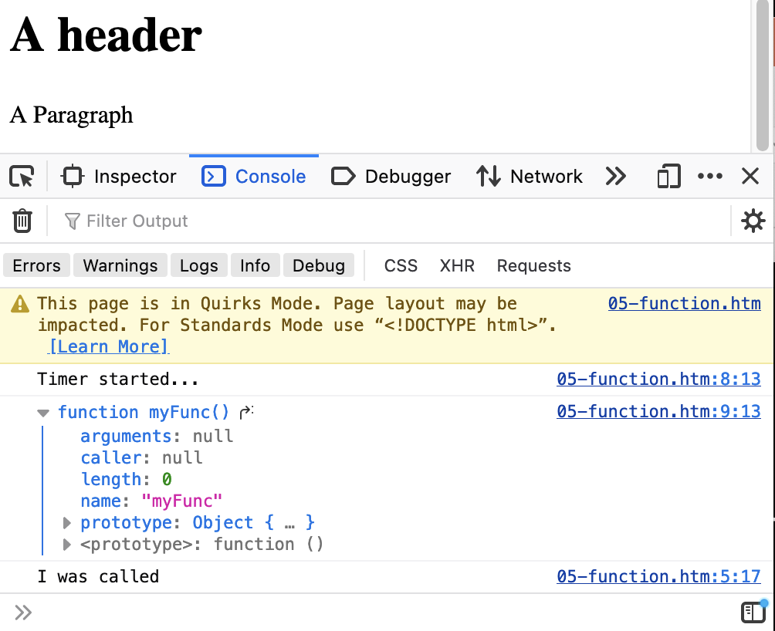
First Class Functions
https://www.dj4e.com/code/browser/05-function.htm
The first parameter to setTimeout() is a function reference – no ()
<h1>A header</h1>
<p>A Paragraph</a>
<script>
function myFunc() {
console.log("I was called");
}
setTimeout(myFunc, 5000);
console.log("Timer started...");
console.log(myFunc);
</script>

Slide 9
Document Object Model
(a.k.a. the "DOM")

Slide 10
Document Object Model
The browser (and sometimes our JavaScript) parses the HTML and produces a Document Object Model (DOM) which is then displayed to the user through a Window
In our event and/or timer code, we can read and manipulate the DOM
As the DOM is updated, the user sees the new UI through the Window
Using a debugger, we can directly manipulate the DOM

Slide 11
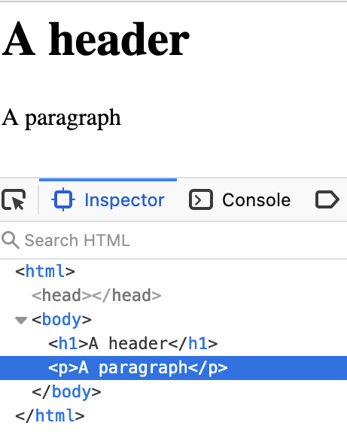
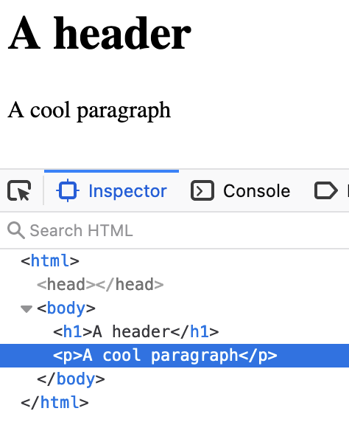
Inspect the DOM
https://www.dj4e.com/code/browser/01-noscript.htm
When you "inspect element" in the debugger, you are seeing the DOM and the Window
When you change the DOM in the debugger, the changes are reflected in the content that is displayed in the Window

Slide 12
The "Window"
We view the DOM "through" the Window

Slide 13
Browser
Browser
D
O
M
D
O
M
W I N D O W
Parse
Response
Parse
Response
JavaScript
JavaScript

Slide 14
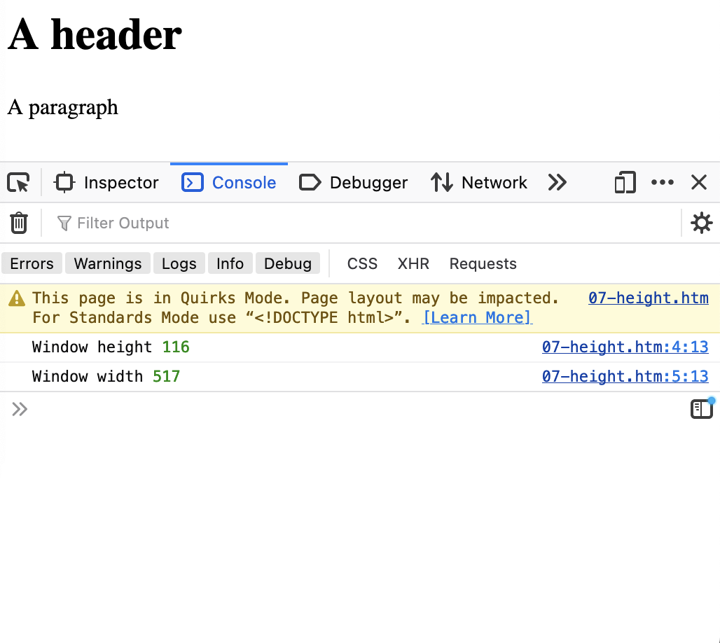
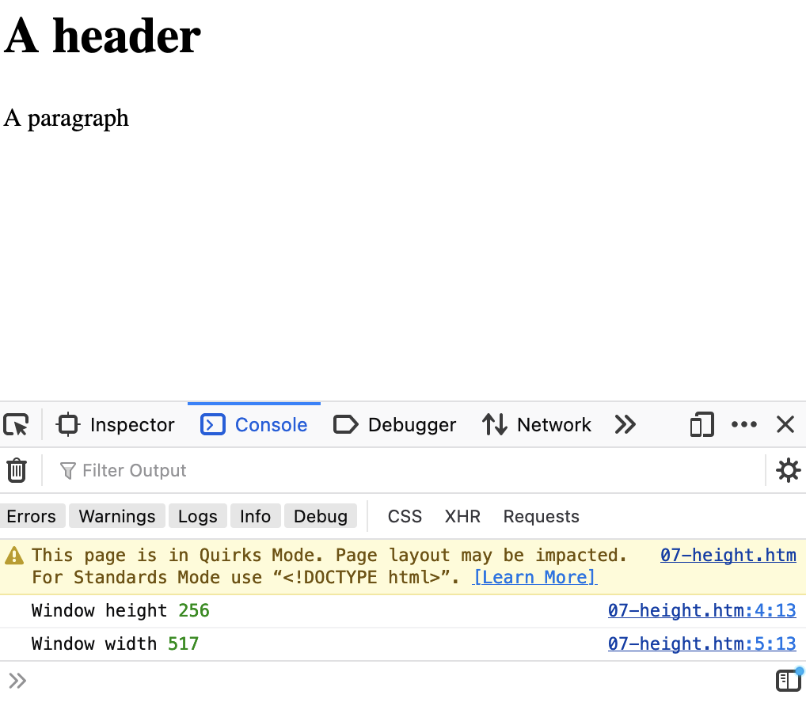
https://www.dj4e.com/code/browser/06-height.htm
<h1>A header</h1>
<p>A paragraph</p>
<script>
console.log("Window height", window.innerHeight);
console.log("Window width", window.innerWidth);
</script>
Window Height
Window Height

Slide 15
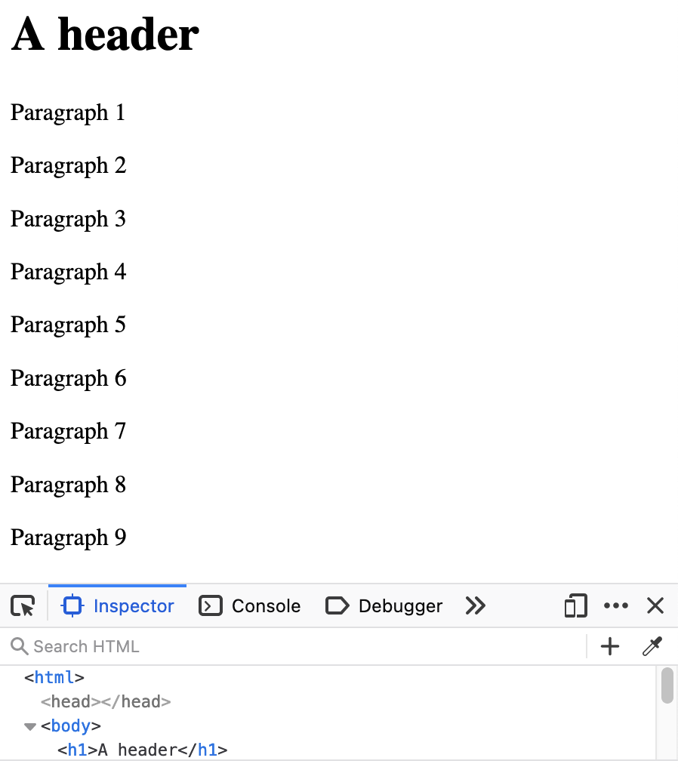
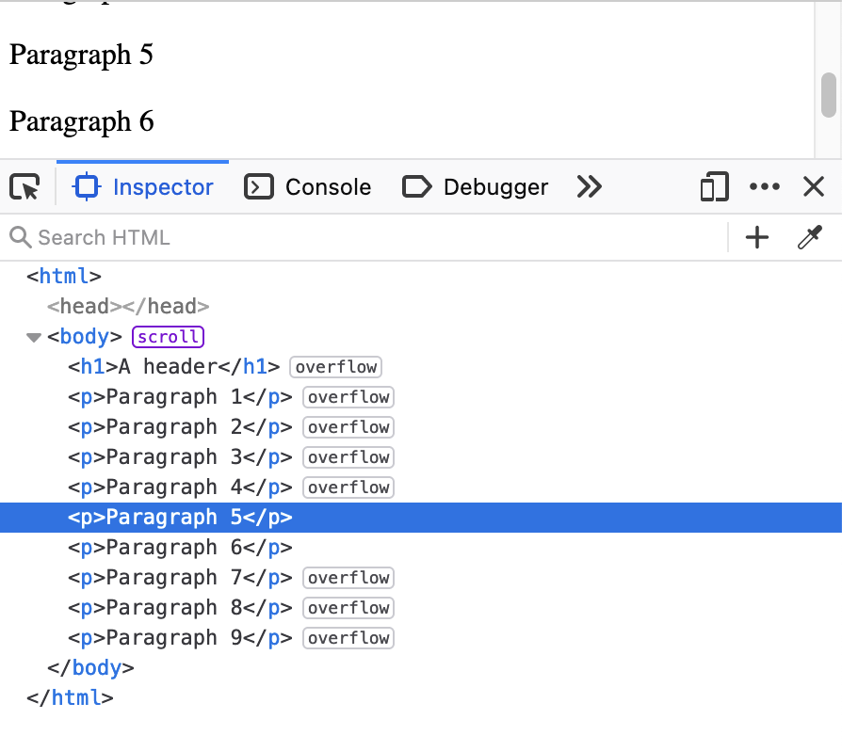
https://www.dj4e.com/code/browser/07-scroll.htm
Window Height
Window Height

Slide 16
Modifying the DOM in JavaScript
Let's not just console.log()

Slide 17
Modify the DOM
https://www.dj4e.com/code/browser/01-noscript.htm
When the DOM is modified and that portion of the DOM is viewable through the Window the user sees the change in their UI
We need to trigger some bit of our JavaScript to make these changes
We need a "handle" to find things in the DOM

Slide 18
Browser
D
O
M
Server
Click
https://www.dj4e.com/code/browser/03-event.htm
<h1>A header</h1>
<p><a onclick="myFunc();">Click Me</a></p>
<script>
function myFunc() {
console.log("I was clicked");
}
</script>
Parse
Response
Click
JavaScript
Recall…

Slide 19
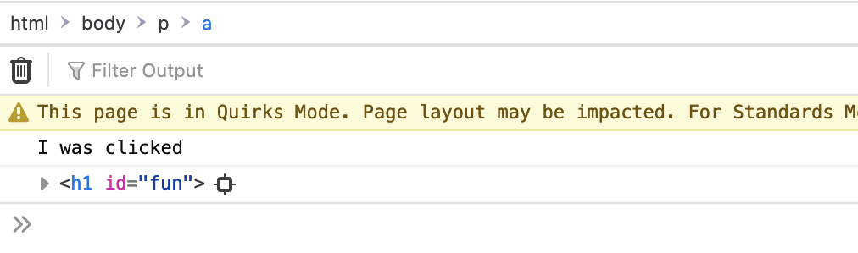
Browser
D
O
M
Server
Click
https://www.dj4e.com/code/browser/08-dom.htm
<h1 id="fun">A header</h1>
<p><a onclick="myFunc();">Click Me</a></p>
<script>
function myFunc() {
console.log("I was clicked");
let elem = document.getElementById("fun");
console.log(elem)
elem.innerHTML = "A cool header";
}
</script>
Parse
Response
JavaScript
Click

Slide 20
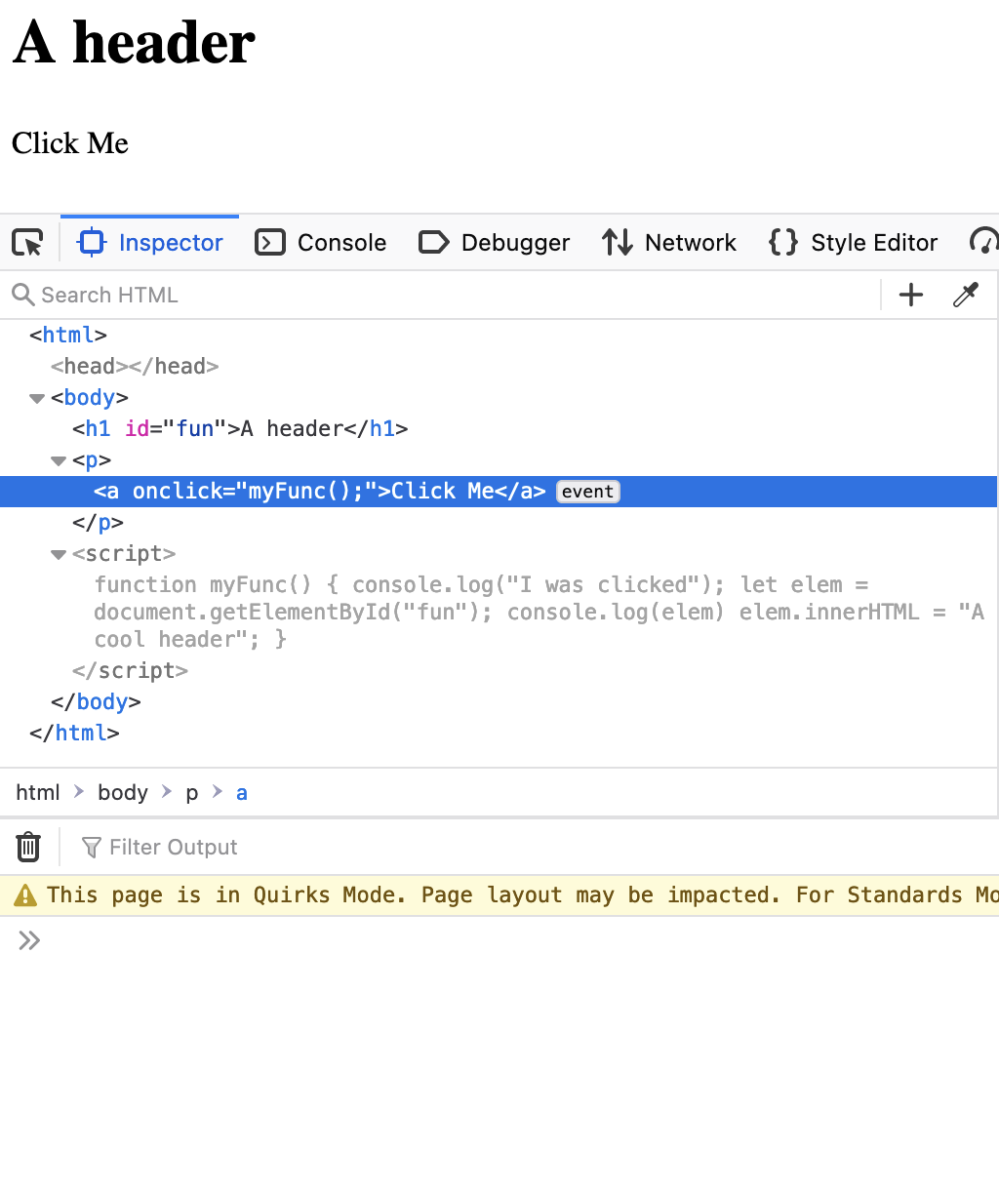
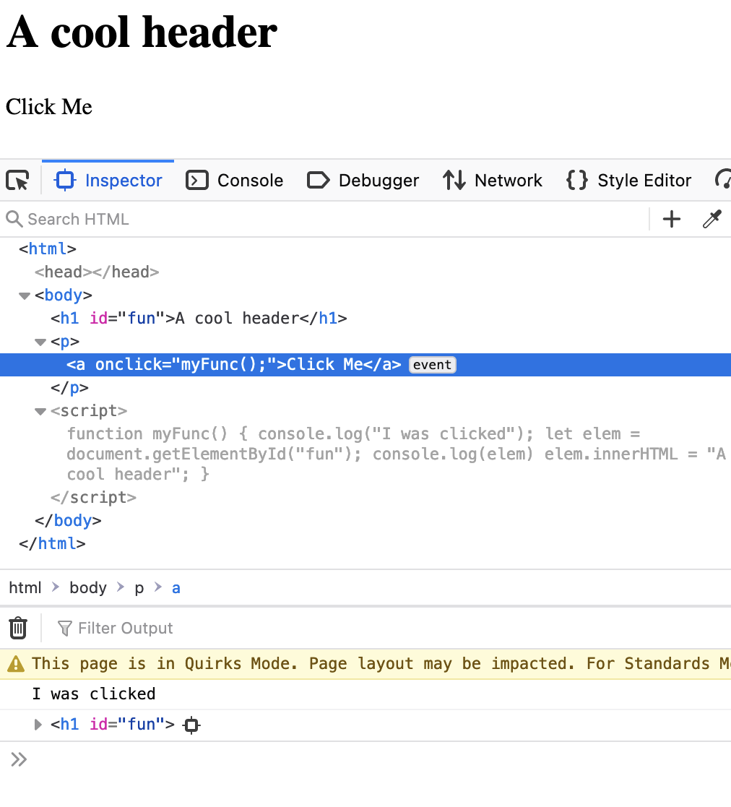
https://www.dj4e.com/code/browser/08-dom.htm

Slide 21
Adding to the DOM
We can build tags and add them to the DOM in JavaScript

Slide 22
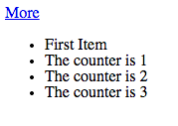
https://www.dj4e.com/code/browser/09-append.htm
<p>
<a href="#" onclick="add();return false;">More</a>
</p>
<ul id="zap">
<li>First Item</li>
</ul>
<script>
var counter = 1;
function add() {
var x = document.createElement('li');
x.className = "list-item";
x.innerHTML = "The counter is "+counter;
document.getElementById('zap').appendChild(x);
counter++;
}
</script>

Slide 23
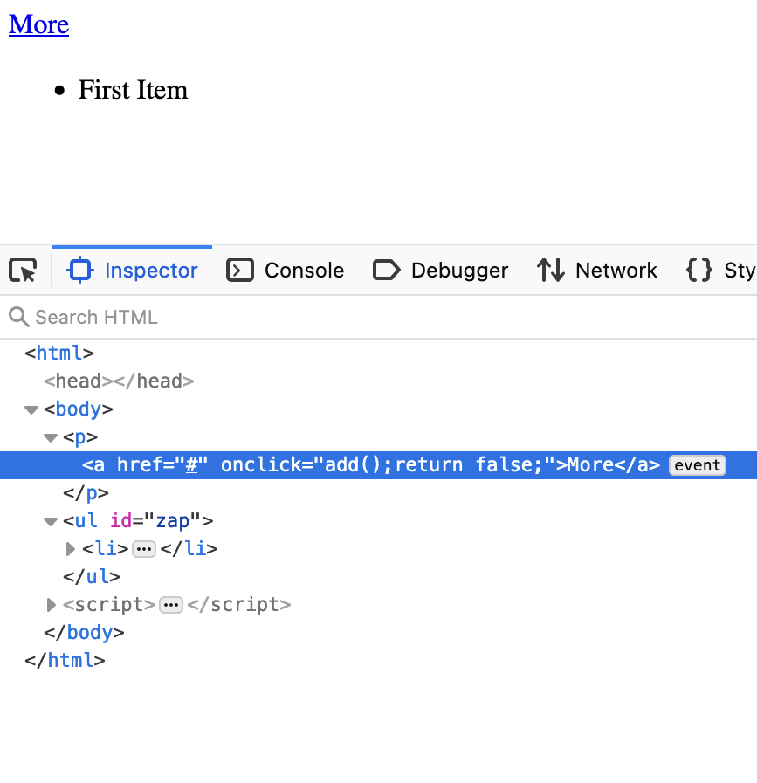
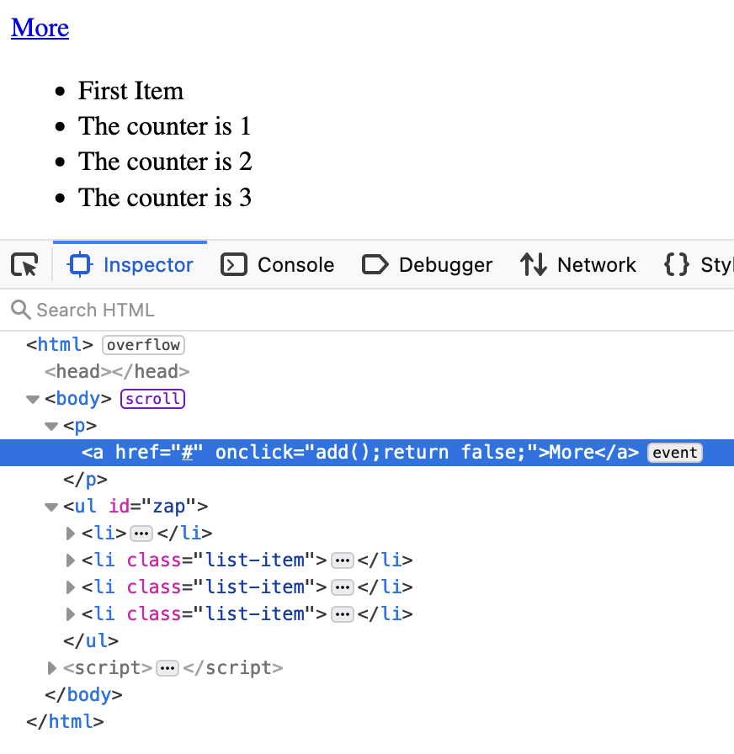

Slide 24
Changing CSS in the DOM

Slide 25
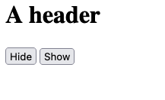
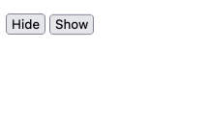
<h1 id="fun">A header</h1>
<p>
<button id="poof">Hide</button>
<button id="show">Show</button>
</p>
<script>
document.getElementById('show').addEventListener('click',
function (event) {
document.getElementById('fun').style.display = 'block';
}
);
document.getElementById('poof').addEventListener('click',
(event) => document.getElementById('fun').style.display = 'none'
);
</script>
https://www.dj4e.com/code/browser/13-css.htm

Slide 26
Browser Events

Slide 27
We have been using events all along
Register a Click Event handler via an onclick attribute
Setting a timer to run some of our code at some point in the future
<h1>A header</h1>
<p>A Paragraph</a>
<script>
function myFunc() {
console.log("I was called");
}
setTimeout(myFunc, 5000);
console.log("Timer started...");
</script>
<h1>A header</h1>
<p><a onclick="myFunc();">Click Me</a></p>
<script>
function myFunc() {
console.log("I was clicked");
}
</script>

Slide 28
Event Registration System
We can directly interact with the event registration system
Add an event to an element (tag)
Add an event to the DOM/Window to know when something happens

Slide 29
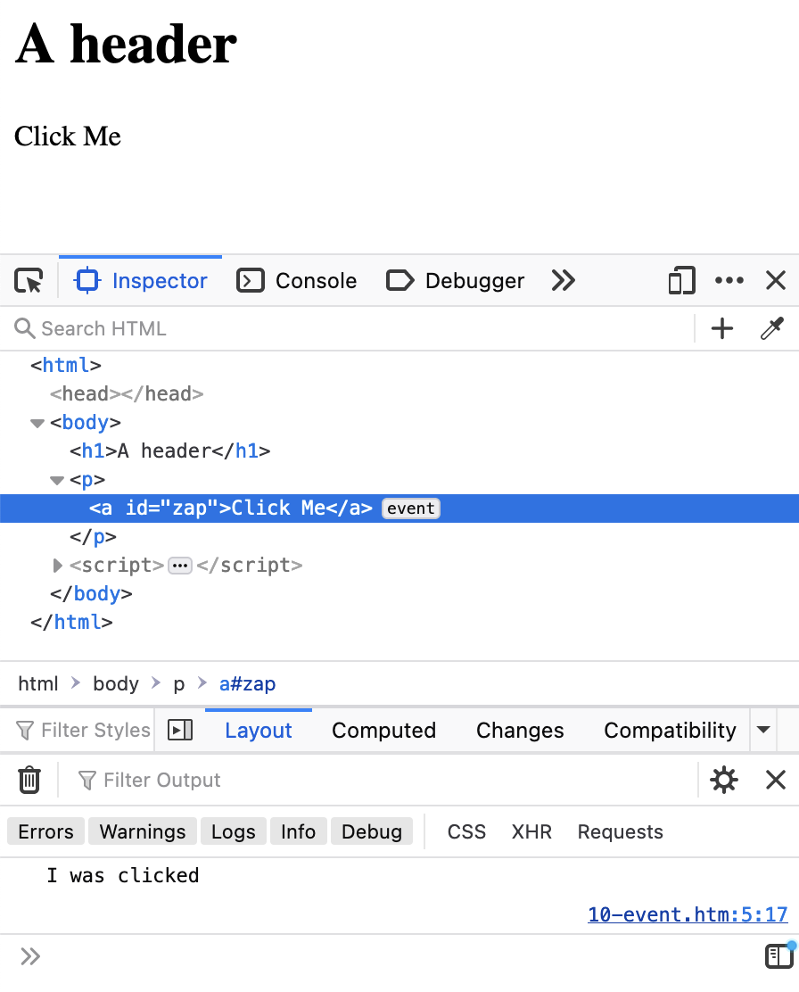
https://www.dj4e.com/code/browser/03-event.htm
<h1>A header</h1>
<p><a onclick="myFunc();">Click Me</a></p>
<script>
function myFunc() {
console.log("I was clicked");
}
</script>
https://www.dj4e.com/code/browser/10-event.htm
<h1>A header</h1>
<p><a id="zap">Click Me</a></p>
<script>
function myFunc() {
console.log("I was clicked");
}
document.getElementById('zap')
.addEventListener('click', myFunc);
</script>

Slide 30
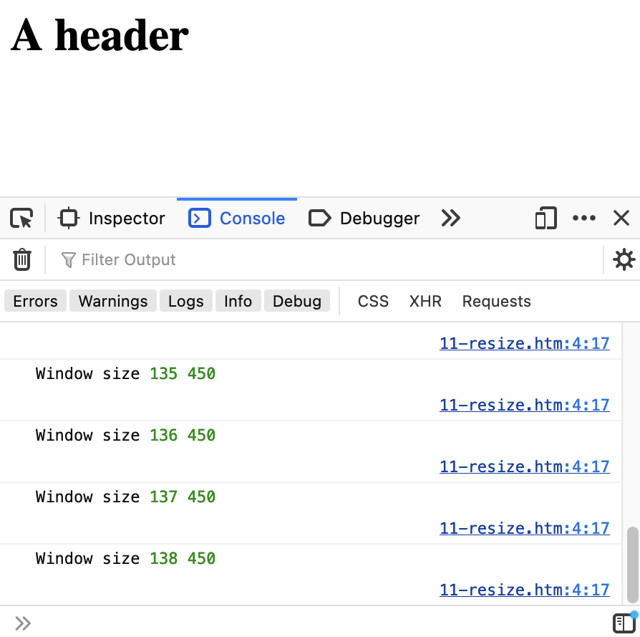
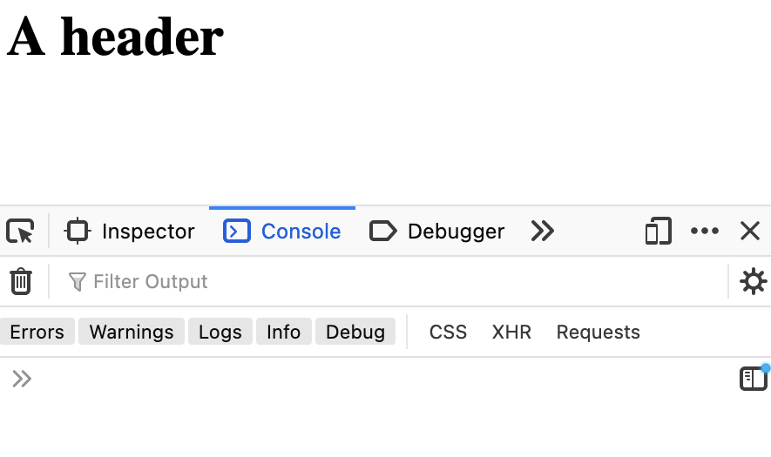
https://www.dj4e.com/code/browser/11-resize.htm
<h1>A header</h1>
<script>
function myFunc() {
console.log("Window size",
window.innerHeight,
window.innerWidth);
}
window.addEventListener('resize', myFunc);
</script>

Slide 31
Content Load Complete Event
Modern web pages are complex
HTML
CSS
Images
JavaScript libraries
To display a page, sometimes > 100 assets are downloaded
There is a special DOM event that triggers when the browser is done

Slide 32
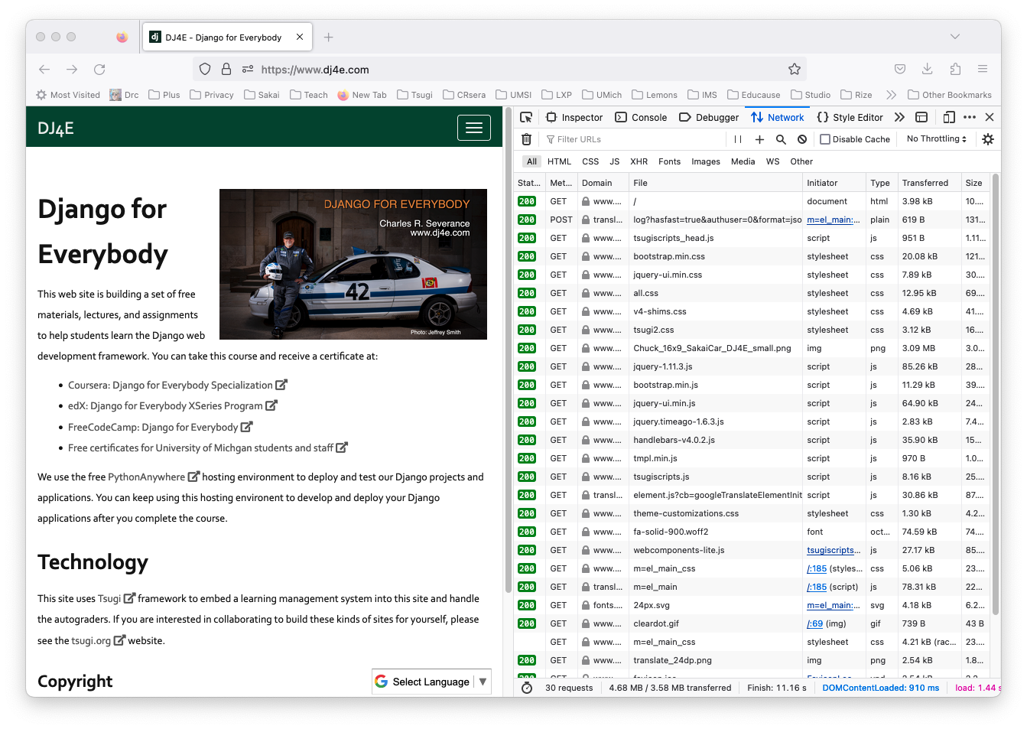

Slide 33
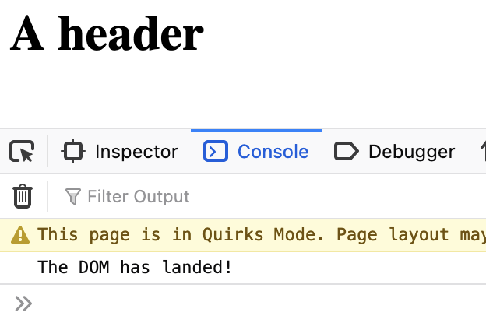
https://www.dj4e.com/code/browser/12-loaded.htm
<h1>A header</h1>
<script>
function myFunc() {
console.log("The DOM has landed!");
}
document.addEventListener('DOMContentLoaded', myFunc);
</script>

Slide 34
Network Events

Slide 35
Network Operations in JavaScript
JavaScript can make network requests, receive those requests, and use the response data to alter the DOM
Since network requests take time, we must use events
Start the request
Receive the request
Process the request
Each step is separate and completing one step starts the next

Slide 36
Browser
Server
D
O
M
https://www.dj4e.com/code/browser/14-fetch.htm
Click
<p>A Paragraph</p>
<script>
fetch('secret.txt')
.then(response => {
console.log(response);
return response.text()
})
.then(textString => {
console.log(textString);
});
</script>
Parse
Response
JavaScript
Console
https://www.dj4e.com/code/browser/secret.txt
The secret (of course) is 42

Slide 37
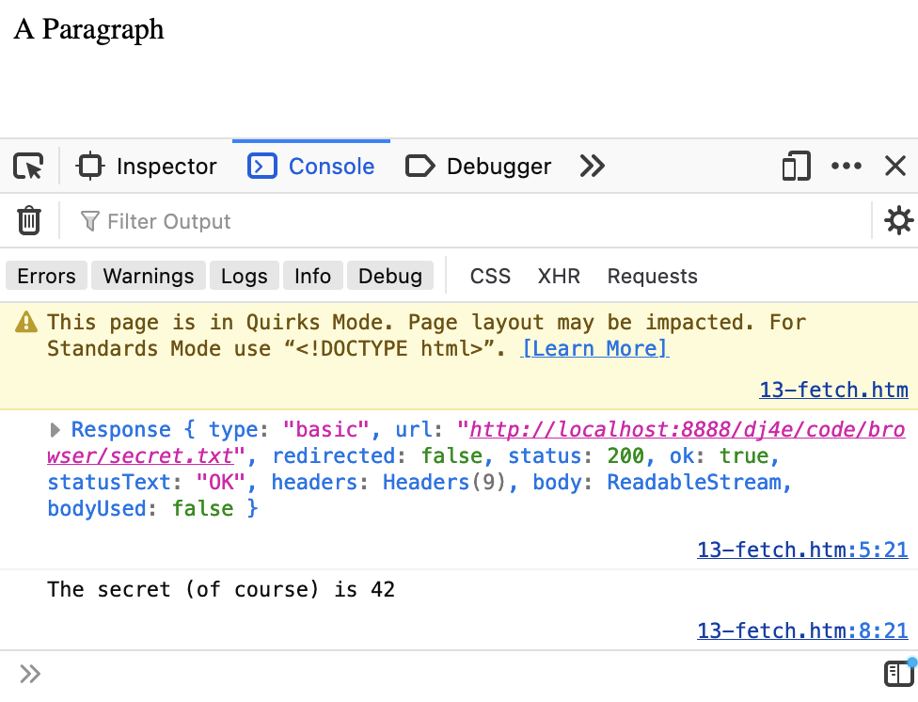
Server
https://www.dj4e.com/code/browser/14-fetch.htm
<p>A Paragraph</p>
<script>
fetch('secret.txt')
.then(response => {
console.log(response);
return response.text()
})
.then(textString => {
console.log(textString);
});
</script>
https://www.dj4e.com/code/browser/secret.txt
The secret (of course) is 42

Slide 38
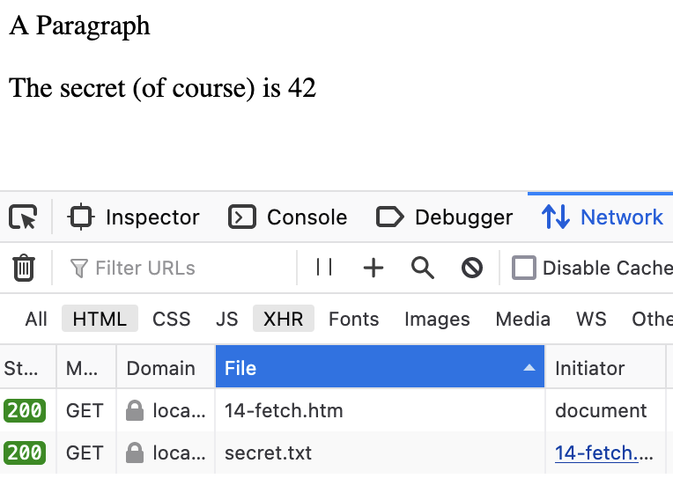
Server
https://www.dj4e.com/code/browser/15-fetch.htm
<p>A Paragraph</p>
<p id="zap"></p>
<script>
fetch('secret.txt')
.then(response => response.text() )
.then(textString => {
document.getElementById("zap")
.innerText = textString;
});
</script>
https://www.dj4e.com/code/browser/secret.txt
The secret (of course) is 42

Slide 39
User-Created Tags
(a.k.a. web components)

Slide 40
Programmers hate to repeat themselves
Repetition causes errors
Cut-paste-change only gets us so far – especially when there is a bug the the code we started with
This leads to lots of ways to "D.R.Y" – Don't Repeat Yourself
Functions and Parameters
Object Oriented Approach with Base Classes
Class based views
Base and extended templates {% extends base_bootstrap.html %}
{% url .. allows us to change urls in urls.py and not edit templates
…

Slide 41
Templates in the Server (review)
from django.shortcuts import render
def guess(request) :
context = {'zap' : '42' }
return render(request, 'tmpl/guess.html', context)
dj4e-samples/tmpl/views.py
<html>
<head>
<title>A simple page</title>
</head>
<body>
<p>Your guess was {{ zap }}</p>
</body>
</html>
dj4e-samples/tmpl/templates/tmpl/guess.html

Slide 42
Browser
Linux
D
O
M
N
G
I
N X
WGSIConfig
settings.py
Django
Routing
Click
urls.py
views.py
Parse
Response
Views
Templates
forms.py
Javascript
Database
Shell
Models
models.py
/admin
admin.py

Slide 43
Browser
Linux
D
O
M
N
G
I
N X
WGSIConfig
settings.py
Django
Routing
Click
urls.py
views.py
Parse
Response
Views
Templates
forms.py
Javascript
Database
Templates
Shell
Models
models.py
/admin
admin.py

Slide 44
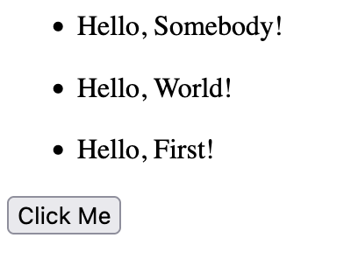
Templates in the Browser
<ul>
<li><dj4e-greeting></dj4e-greeting></li>
<li><dj4e-greeting name="World"></dj4e-greeting></li>
<li><dj4e-greeting name="First" id="1234"></dj4e-greeting></li>
</ul>
<button onclick="doChange();">Click Me</button>
<script type="module" src="./16-dj4e-greet.js"></script>
<script>
function doChange() {
document.getElementById('1234').setAttribute('name', 'Second');
}
</script>
https://www.dj4e.com/code/browser/16-greet.htm

Slide 45
Templates in the Browser
import { html, LitElement } from "https://cdn.jsdelivr.net/npm/lit@3.2.1/+esm";
export class SimpleGreeting extends LitElement {
static properties = {
name: { type: String }
};
constructor() {
super();
this.name = 'Somebody';
}
// Inherit CSS from enclosing document
createRenderRoot() { return this;}
render() {
return html`<p>Hello, ${this.name}!</p>`;
}
}
customElements.define('dj4e-greeting', SimpleGreeting);
https://www.dj4e.com/code/browser/16-dj4e-greet.js

Slide 46
Custom Component Ecosystems
There are many frameworks that lets us create virtual html tags and use them throughout our markup
React
Vue
Svelte
…
LIT is one of the smaller/simpler of these "tag" frameworks
import React from 'react';
function MyButton() {
const handleClick = () => {
alert('Button clicked!');
};
return (
<button onClick={handleClick}>
Click Me
</button>
);
}
export default MyButton;

Slide 47
Evolving Architecture of Web Applications
As the capabilities in the browser become increasingly powerful and easier to use, there is a trend towards moving portions of MVC into the browser
At the extreme the Controller and View move into the browser and the Model is written from the View code running in the browser using JSON and web services
Which is the next topic in this class ☺

Slide 48
Browser
Linux
D
O
M
N
G
I
N X
WGSIConfig
settings.py
Django
Routing
Click
urls.py
Parse
Response
Views
views.py
REST
Javascript
Database
Router
Models
Shell
Views
models.py
/admin
Templates
admin.py

Slide 49
Summary
Document Object Model (DOM)
Browser Window
UI Event Handlers
DOM Event Handlers
Window Event Handlers
Selecting and changing an element / tag
Adding an element/tag to the DOM
Changing the CSS of an element
Making network requests from JavaScript
Web Components

Slide 50
Additional Source Information
https://commons.wikimedia.org/wiki/File:Mouse_pointer_or_cursor.png
https://en.wikipedia.org/wiki/Spinning_pinwheel#/media/File:OS_X_10.11_Beta_Beach_Ball.jpg

