Slide 1
Debugging Django Applications on Python Anywhere
Dr. Charles R. Severance
www.dj4e.com

Slide 2

Startup Failure

Slide 3
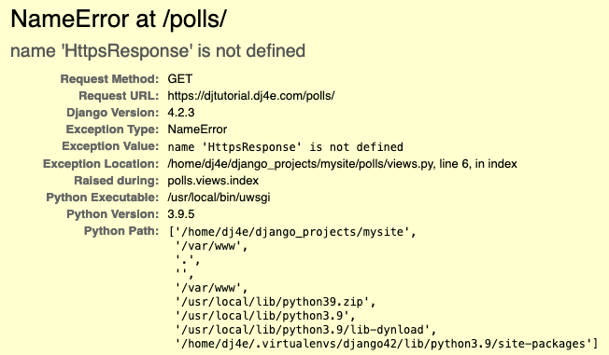

Traceback
screen

Slide 4
Outline
Your Django applications won't reload
Something went wrong :(
Missing includes in files and other little yellow triangle problems
Database missing or migrations not yet run
Missing Template File
Cut and paste mistakes one tutorial to another
Adding when you should be replacing / updating

Slide 5
Startup – Most Common Case
If you have made changes in ~/django_projects/mysite and your application won't start, it is usually in your application and can be diagnosed with
python manage.py check

Slide 6
Startup – All the steps
Note once you are past the first assignment, these settings should never be changed.
If you start experimenting with changing things under the Web tab, you will generally break your application in a way that it is almost impossible to fix – sometimes you just need to make a new PythonAnywhere account and start from the beginning
Mostly we look at these things and don't change them unless they look very wrong – and usually with help from someone else.

Slide 7
Startup Steps – Starts at the Web Tab
DON'T CHANGE THESE FILES / SETTINGS
Source code: /home/dj4e/django_projects/mysite
Working directory: /home/dj4e/django_projects/mysite
Virtual Environment: /home/dj4e/.virtualenvs/django42
WGSI Configuration (PythonAnywhere's "python manage.py runserver)
Project settings /home/dj4e/django_projects/mysite/mysite/settings.py
Project URLs /home/dj4e/django_projects/mysite/mysite/urls.py
Each application /home/dj4e/django_projects/mysite/polls/urls.py

