Slide 1

Browser
Linux
D
O
M
WSGIConfig
settings.py
Django
Routing
MiddleWare
Click
urls.py
HTML
CSS
urls.py
Templates
Parse
Response
Views
views.py
forms.py
Database
JavaScript
Shell
Models
Migrations
/admin
admin.py
models.py

Slide 2
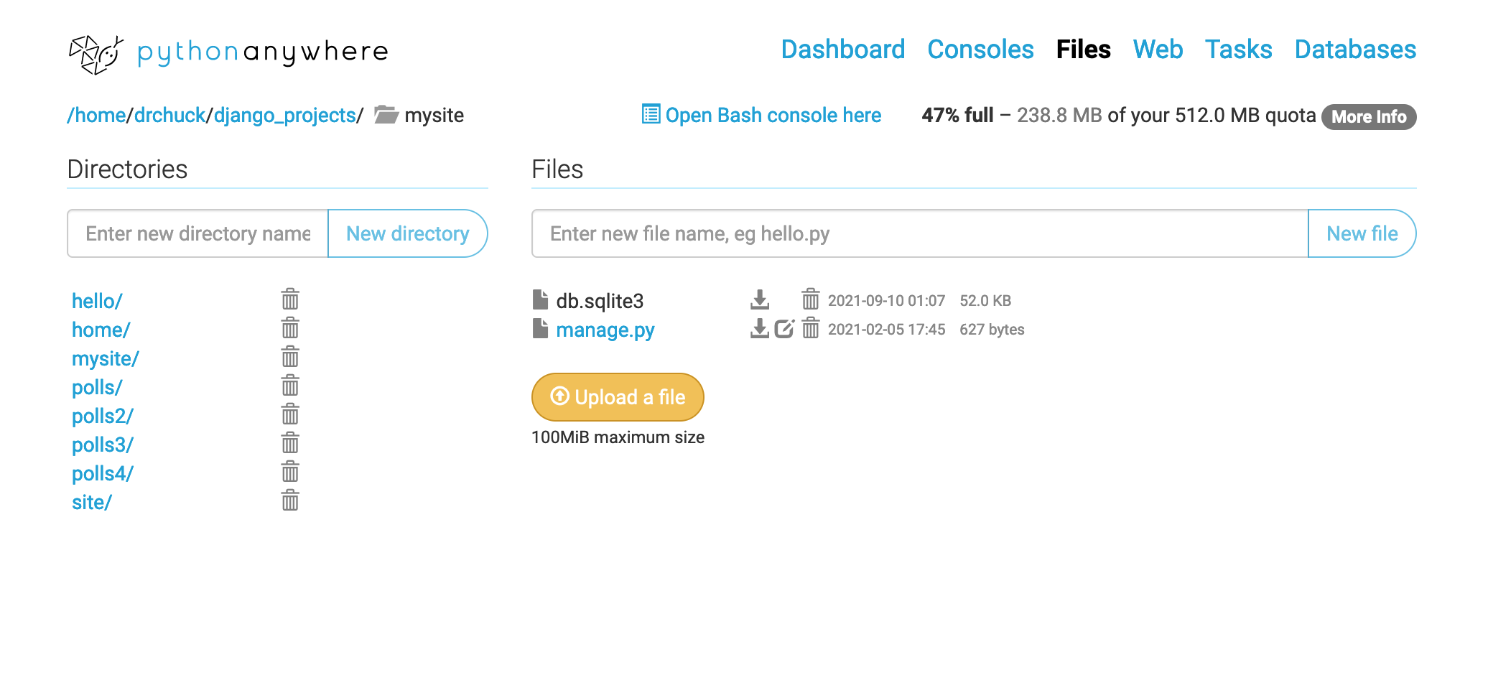

Slide 3
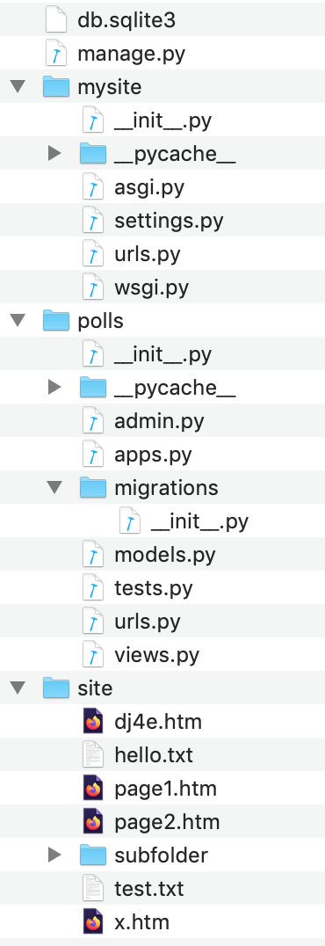
Linux
WSGIConfig
settings.py
Django
Routing
+Middle
Ware
urls.py
urls.py
Templates
App
views.py
forms.py
Database
Shell
Models
Migrations
/admin
admin.py
models.py

