Slide 1

JavaScript and the Browser
Dr. Charles Severance
www.dj4e.com

Slide 2
JavaScript in a Browser
In a desktop or server, you have an operating system like Windows, Linux, or MacOS and languages like Python, PHP, and Java. JavaScript is both the programming language in a browser *and* some of the "operating system".
Document object Model (DOM)
Visible Window (Window)
Tabs
Events
Timers

Slide 3
Threading

Slide 4
Multi-Tasking Types
Pre-Emptive Multi-Tasking
If a tasks runs a long loop, they suspended after their "time slice" to share the processor with other tasks
It limits the impact on the performance of the system or other tasks if one task decided to be "greedy"
Cooperative Multi-Tasking
A greedy task can hang or crash the entire system
A responsible task breaks long "loops" into a set of separate tasks, giving up the processor at each step
https://en.wikipedia.org/wiki/Computer_multitasking

Slide 5
Python / Django is Multi Threaded
When a Django view is running, any model retrieval may require a "long" delay while the objects are retrieved from a separate server
If the server were single threaded, no other browsers could make requests while one request was in progress and waiting for data
class MainView(LoginRequiredMixin, View):
def get(self, request):
mc = Make.objects.all().count()
al = Auto.objects.all()
ctx = {'make_count': mc, 'auto_list': al}
return render(request, 'autos/auto_list.html', ctx)

Slide 6
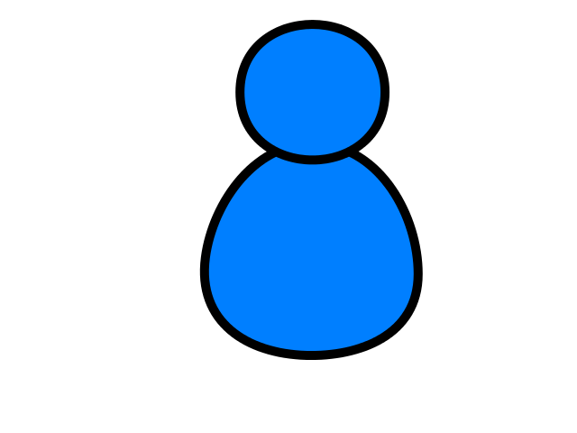
Browser
Linux
N
G
I
N X
WGSIConfig
settings.py
Django – dj4e.pythonanywhere.com
urls.py
views.py
model.py
WGSIConfig
settings.py
Django – dj4e.pythonanywhere.com
urls.py
views.py
model.py
……
WGSIConfig
Flask – flaskfun.pythonanywhere.com

Slide 7
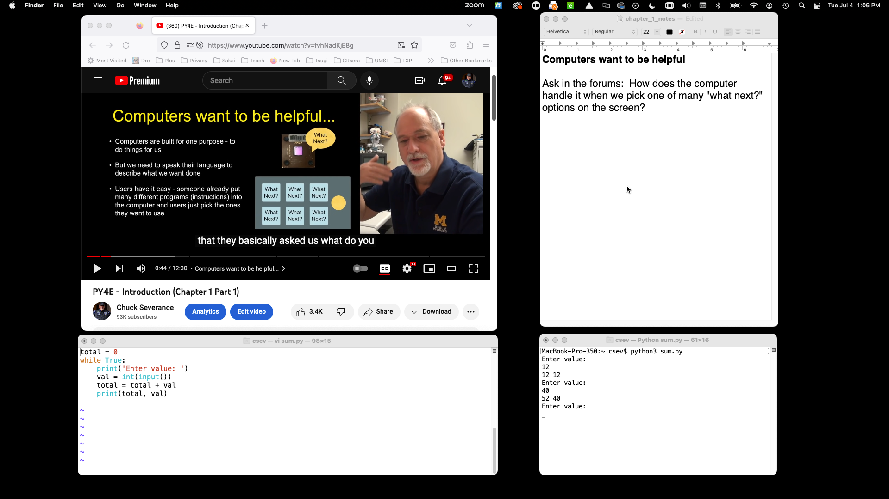

Slide 8
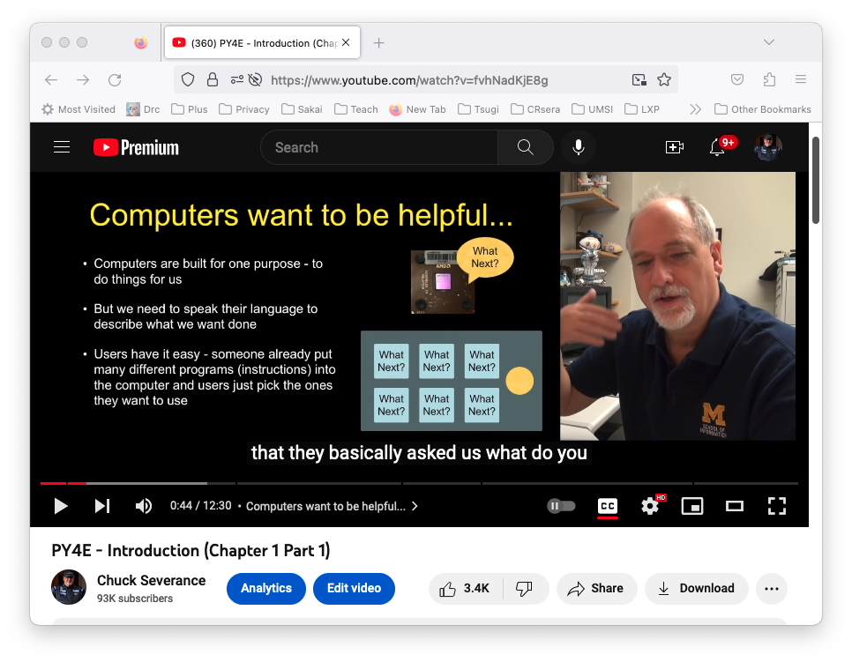
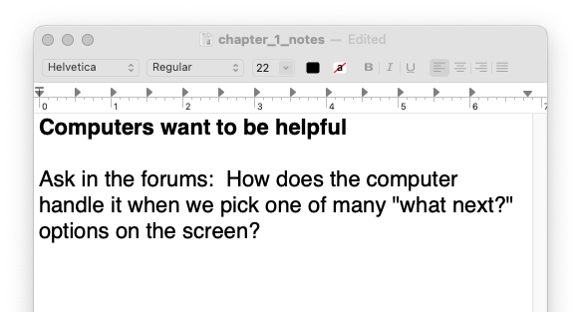

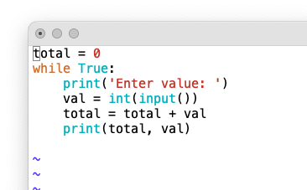
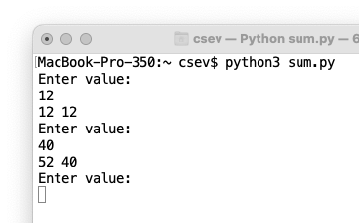
Hardware
MacOS
App: Firefox
Waiting: Click
Background thread:
Retrieve and play
App: TextEdit
Waiting: Click
App: Terminal and vim
Waiting: Click
App: Terminal and python3
Waiting: Character press

Slide 9
Hardware
MacOS
App: Firefox
Waiting: Click
Background thread:
Retrieve and play
App: TextEdit
Waiting: Click
App: Terminal and vim
Waiting: Click
App: Terminal and python3
Waiting: Character press

Slide 10

Hardware
MacOS
App: Firefox
Waiting: Click
Background thread:
Retrieve and play
App: TextEdit
Waiting: Click
App: Terminal and vim
Waiting: Click
App: Terminal and python3
Waiting: Character press

Slide 11
Hardware
MacOS
App: Firefox
Waiting: Click
Background thread:
Retrieve and play
App: TextEdit
Waiting: Click
App: Terminal and vim
Waiting: Click
App: Terminal and python3
Waiting: Character press

Slide 12
Browser
Linux
D
O
M
Django
settings.py
Routing
Click
urls.py
views.py
Parse
Response
Views
Templates
forms.py
JavaScript
Database
Shell
Models
model.py
/admin
admin.py

Slide 13
Browser
Linux
D
O
M
Django
settings.py
Routing
urls.py
views.py
Parse
Response
Views
Templates
forms.py
AJAX
JavaScript
Database
Shell
Models
model.py
/admin
admin.py

Slide 14
Vanilla JavaScript (1995)
<script type="text/javascript">
document.write("<p>Hello World</p>")
</script>
https://www.dj4e.com/code/javascript/js-01.htm
http://en.wikipedia.org/wiki/Document_Object_Model

Slide 15
Document Object Model
JavaScript can manipulate the current HTML document.
The “Document Object Model” is how we access various “bits” of the current screen to read and/or manipulate.
We can even find pieces of the model by id attribute and change them.
We can read and write the DOM from (Vanilla) JavaScript.

Slide 16
Using getElementById()
In order not to have to hard-code tree-paths to each part of the DOM, we use function calls to query the DOM and retrieve a particular tag within the DOM and manipulate that tag.

Slide 17
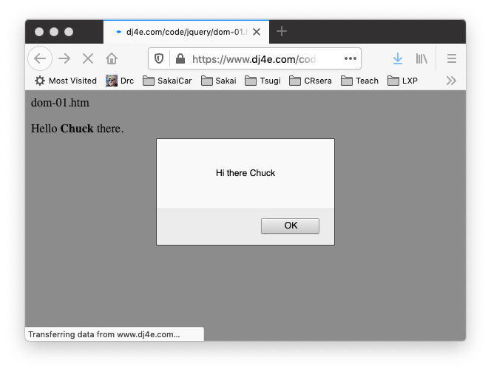
<p>
Hello <b><span id="person">Chuck</span></b> there.
</p>
<script type="text/javascript">
console.dir(document.getElementById('person'));
var st = document.getElementById('person').innerHTML;
console.log("ST = "+st);
alert('Hi there ' + st);
document.getElementById('person').innerHTML = 'Joseph';
</script>
dom-01.htm

Slide 18
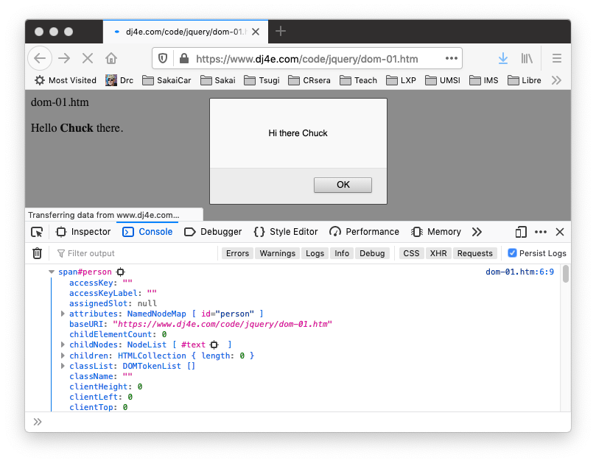
dom-01.htm
console.dir(document.getElementById('person'));

Slide 19
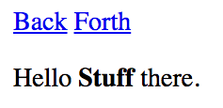
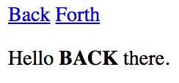
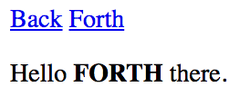
Updating the Browser Document
<a href="#"
onclick="document.getElementById('stuff').innerHTML='BACK';return false;">
Back</a>
<a href="#"
onclick="document.getElementById('stuff').innerHTML='FORTH';return false;">
Forth</a>
</p>
<p>
Hello <b><span id="stuff">Stuff</span></b> there.
dom-02.htm
This is one reason why you can only have one id per document.

Slide 20
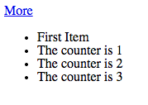
<p>
<a href="#" onclick="add();return false;">More</a>
</p>
<ul id="the-list">
<li>First Item</li>
</ul>
<script>
counter = 1;
console.log(document.getElementById('the-list'))
function add() {
var x = document.createElement('li');
x.className = "list-item";
x.innerHTML = "The counter is "+counter;
document.getElementById('the-list').appendChild(x);
counter++;
}
</script>
dom-03.htm

Slide 21
Summary
This focused on the mechanics of low-level jQuery.
- Initialization setup
- Event handling
- DOM selection
- DOM manipulation
Vanilla JavaScript is catching up…

Slide 22
Acknowledgements / Contributions
These slides are Copyright 2010- Charles R. Severance (www.dr-chuck.com) as part of www.dj4e.com and made available under a Creative Commons Attribution 4.0 License. Please maintain this last slide in all copies of the document to comply with the attribution requirements of the license. If you make a change, feel free to add your name and organization to the list of contributors on this page as you republish the materials.
Initial Development: Charles Severance, University of Michigan School of Information
Insert new Contributors and Translators here including names and dates
Continue new Contributors and Translators here
Notes:
Note from Chuck. Please retain and maintain this page as you remix and republish these materials. Please add any of your own improvements or contributions.

Slide 23
Additional Source Information
https://commons.wikimedia.org/wiki/File:Mouse_pointer_or_cursor.png
https://en.wikipedia.org/wiki/Spinning_pinwheel#/media/File:OS_X_10.11_Beta_Beach_Ball.jpg

