Slide 1
Deno Key-Value (KV) Charles Severance University of Michigan School of Information www.pg4e.com

Slide 2
History
Emerged from the NodeJS server project
JavaScript server for web applications
Node was founded in 2009 by Ryan Dahl
Ryan Dahl founded Deno (Node spelled backwards) in 2018
Fresh Start with a decade of experience
Some Node things just "happened" and became required / core and that limited innovation

Slide 3
Node Pain Points
JavaScript / TypeScript battle
Hope was that TypeScript as pre-processor would be temporary and JavaScript would be TS
Node started as a technology base
Not opinionated
Extended with a series of modules that were maintained independently
Dependency Management / npm
Maintaining / Improving Node was difficult

Slide 4
Evolving Distributed Architectures
Why serve static assets from one server in Ohio in the USA?
Slow and bandwidth is expensive
Edge caching of static assets
Akami (1998), Amazon CloudFront (2010), CloudFlare (2010), Fastly(2011), Netlify(2014)

Slide 5
CloudFlare is great for Content
Free / Inexpensive edge caching / serving of static assets
No cost Distributed Denial of Service (DDOS) protection
The actual www.py4e.com application runs on one EC2 server in Amazon backed by an Amazon Auto-scale MySQL Aurora Database
The PY4E server only accepts network connections from CloudFlare servers

Slide 6
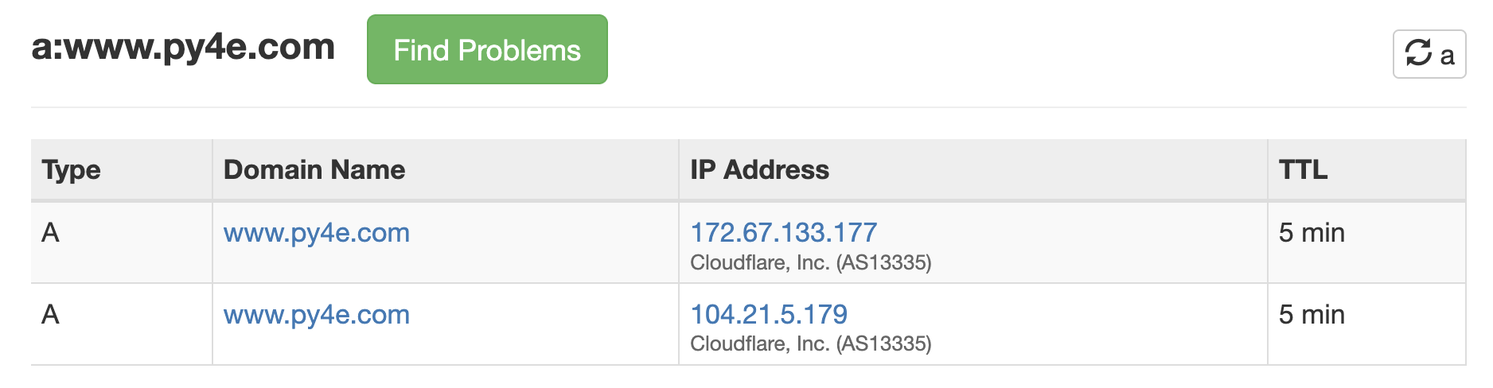
$ traceroute www.py4e.com
traceroute: Warning: www.py4e.com has multiple addresses; using 104.21.5.179
traceroute to www.py4e.com (104.21.5.179), 64 hops max, 40 byte packets
1 192.168.0.1 (192.168.0.1) 1.222 ms 1.063 ms 0.603 ms
2 * * *
3 * * *
4 10.192.208.213 (10.192.208.213) 9.174 ms 8.404 ms 7.673 ms
5 172.70.164.198 (172.70.164.198) 8.946 ms 8.604 ms 17.716 ms
6 141.101.73.212 (141.101.73.212) 9.009 ms
7 104.21.5.179 (104.21.5.179) 9.203 ms 8.930 ms 8.601 ms

Slide 7
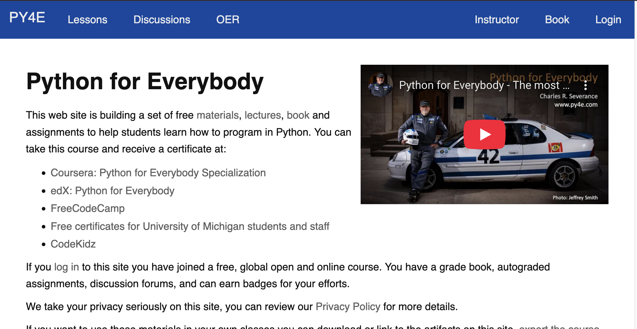
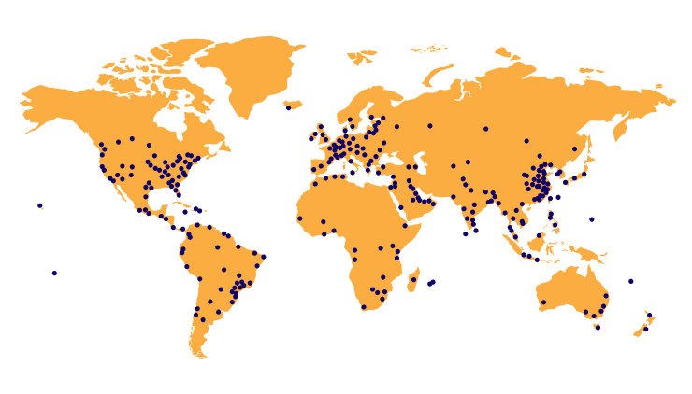
My Current Architecture
Cloudflare
Amazon
Security Group
Amazon EC2
Linux
PHP
Ohio, USA
Amazon
Aurora
MySQL
Cloudflare
Cloudflare
Cloudflare
Cloudflare
Cloudflare
Cloudflare
Cloudflare
… >100
Cloudflare

Slide 8
My Current Architecture
Cloudflare
Cache Static Assets
Distributed DNS
https termination
DDOS
Mitigation
Amazon
Security Group
Amazon EC2
Linux
PHP
Ohio, USA
Amazon
Aurora
MySQL
SQL
HTML
HTML
3-5
Hops
The UI
is rendered
in PHP
100+ data centers
1000s of servers

Slide 9
2018: CloudFlare Adds "Workers"
Cloudflare
Cache Static Assets
Distributed DNS
https termination
DDOS
Mitigation
Amazon
Security Group
Amazon EC2
Linux
PHP
Ohio, USA
Amazon
Aurora
MySQL
SQL
HTML
HTML
3-5
Hops
The UI
is rendered
in PHP
100+ data centers
1000s of servers
JavaScript
Workers

Slide 10
CloudFlare Workers - my concerns
It feels "emergent" – I don't have time to rewrite my app every year
I have no experience how costs might scale for a system like www.py4e.com
First, I would experiment with a small part of a production application

Slide 11
Enter Deno - Modern NodeJS
Deno is a JavaScript based web server
Standard library – lots of dependencies for basic JavaScript capabilities (like Cryptography) are part of each Deno release
Deno gives a choice of JavaScript and TypeScript out of the box
Kind of like "Django" (versus Flask) – "with batteries included" and "opinionated"
Still emerging (Deno 2.0 – October 2024)

Slide 12
Deno – More than a server
Deno Deploy – Distributed Hosting
Commercial service from deno.com
Free for low volume developer sites (***)
Open source if you want to use your own resources
Deno KV (Key Value) a built-in distributed JSON database with every Deploy instance
Deno KV Watch – Publish / Subscribe / Notifications worldwide – Like Redis

Slide 13
Deno KV Peer Products
Cloudflare Workers KV
Upstash Redis
Amazon DynamoDB
Google Firestore / Firebase
Folks I know who use these at scale say, "Deep Pockets"

Slide 14
My Current Architecture (review)
Cloudflare
Cache Static Assets
Distributed DNS
https termination
DDOS
Mitigation
Amazon
Security Group
Amazon EC2
Linux
PHP
Ohio, USA
Amazon
Aurora
MySQL
SQL
HTML
HTML
3-5
Hops
The UI
Is rendered
in PHP
100+ data centers
1000s of servers

Slide 15
My Deno Architecture??
Deno
DNS/DDOS
Static
Assets
JavaScript
Workers
KV
Web
Services
Web
Services
Amazon
Security Group
Amazon EC2
Linux
??
Ohio, USA
Amazon
Aurora
MySQL
SQL
The UI
is rendered
using web components
In browser

Slide 16
Why Deno has Potential (for me)
So much built in
Deno + Standard JS library
Deno KV
Deno KV Watch
Free Deno Deploy – great for teaching
Distributed Deno KV and KV Watch built in
Low cost distributed notifications are important in educational applications

Slide 17
Deno KV Database Architecture (high level) https://docs.deno.com/deploy/kv/manual/

Slide 18
Deno Actual Architecture Low Level
Foundation DB
https://github.com/apple/foundationdb
Ai: "Foundation DB technical overview"
SQLite
https://sqlite.org/

Slide 19
Deno KV Overview
Organizes Schemaless JSON documents
No explicit tables
Keys
Hierarchical logical key
No Integer, Guid, or SERIAL primary keys
Logical keys are JavaScript Arrays
Data can be stored (set) or retrieved (get) by key
Data can be scanned by logical key prefix (list)
Only sort order is logical key order
Similar to a PostgreSQL B-Tree index

Slide 20
Some book data to model (later)
Title | ISBN | Language | Author
Wisdom of Crowds | 385721706 | en | James Surowiecki
Introduction to Networking | 9781511654944 | en | Charles Severance
Introducción a las Redes | 9781523627516 | es | Fernando Tardio
Raspberry PI | 9781624311390 | en | Kristen Fontichiaro
Where Wizards Stay Up Late | 0684812010 | en | Katy Hafner
Innovators Dilemma | 0066620694 | en | Clayton Christensen
Unlocking the Clubhouse | 0262133989 | en | Ann Margolis
Mindshift | 9781101982853 | en | Barbara Oakley
Python for Everybody | 9781530051120 | en | Charles Severance
Python per tutti | 1730907164 | it | Vittore Zen
Weaving the Web | 00625187X | en | Tim Berners-Lee

Slide 21
Python Sorted Dictionaries (if only)
deno = dict()
deno[('books', 'Wizards up Late')] = {'author': 'Katie', 'title': 'Wizards', 'isbn': '6848', 'lang': 'en'}
deno[('authors', 'Katie Hafner')] = {'author': 'Katie', 'title': 'Wizards', 'isbn': '6848', 'lang': 'en'}
deno[('books', 'Python')] = {'author': 'Chuck', 'title': 'PY4E', 'isbn': '8513', 'lang': 'en'}
deno[('authors', 'Charles Severance')] = {'author': 'Chuck', 'title': 'PY4E', 'isbn': '8513', 'lang': 'en'}
deno[('books', 'Raspberry PI')] = {'author': 'Kristen', 'title': 'PI', 'isbn': '8162', 'lang': 'en'}
deno[('authors', 'Kristen Fontichairo')] = {'author': 'Kristen', 'title': 'PI', 'isbn': '8162', 'lang': 'en'}
deno[('books', 'Wisdom of Crowds')] = {'author': 'James', 'title': 'Wisdom', 'isbn': '3857', 'lang': 'en'}
deno[('authors', 'James Surowiecki')] = {'author': 'James', 'title': 'Wisdom', 'isbn': '3857', 'lang': 'en'}
deno[('books', 'Mindshift')] = {'author': 'Barb', 'title': 'Mind', 'isbn': '8110', 'lang': 'en'}
deno[('authors', 'Barb Oakley')] = {'author': 'Barb', 'title': 'Mind', 'isbn': '8110', 'lang': 'en'}
deno[('books', 'Python per tutti')] = {'author': 'Vittore', 'title': 'Tutti', 'isbn': '1730', 'lang': 'es'}
deno[('authors', 'Vittori Zen')] = {'author': 'Vittore', 'title': 'Tutti', 'isbn': '1730', 'lang': 'es'}
deno[('authors', 'Charles Severance')] = {'author': 'Chuck', 'title': 'Net', 'isbn': '8151', 'lang': 'en'}
deno[('books', 'Networking Intro')] = {'author': 'Chuck', 'title': 'Net', 'isbn': '8151', 'lang': 'en'}
for key in deno:
print(key, '=>', deno[key])
print()
# Sorted – At the moment of printing
for key in sorted(deno):
print(key, '=>', deno[key])
https://www.py4e.com/code/deno_in_python.py

Slide 22
Python Sorted Dictionaries (if only)
('authors', 'Barb Oakley') => {'author': 'Barb', 'title': 'Mind', 'isbn': '8110', 'lang': 'en'}
('authors', 'Charles Severance') => {'author': 'Chuck', 'title': 'Net', 'isbn': '8151', 'lang': 'en'}
('authors', 'James Surowiecki') => {'author': 'James', 'title': 'Wisdom', 'isbn': '3857', 'lang': 'en'}
('authors', 'Katie Hafner') => {'author': 'Katie', 'title': 'Wizards', 'isbn': '6848', 'lang': 'en'}
('authors', 'Kristen Fontichairo') => {'author': 'Kristen', 'title': 'PI', 'isbn': '8162', 'lang': 'en'}
('authors', 'Vittori Zen') => {'author': 'Vittore', 'title': 'Tutti', 'isbn': '1730', 'lang': 'es'}
('books', 'Mindshift') => {'author': 'Barb', 'title': 'Mind', 'isbn': '8110', 'lang': 'en'}
('books', 'Networking Intro') => {'author': 'Chuck', 'title': 'Net', 'isbn': '8151', 'lang': 'en'}
('books', 'Python') => {'author': 'Chuck', 'title': 'PY4E', 'isbn': '8513', 'lang': 'en'}
('books', 'Python per tutti') => {'author': 'Vittore', 'title': 'Tutti', 'isbn': '1730', 'lang': 'es'}
('books', 'Raspberry PI') => {'author': 'Kristen', 'title': 'PI', 'isbn': '8162', 'lang': 'en'}
('books', 'Wisdom of Crowds') => {'author': 'James', 'title': 'Wisdom', 'isbn': '3857', 'lang': 'en'}
('books', 'Wizards up Late') => {'author': 'Katie', 'title': 'Wizards', 'isbn': '6848', 'lang': 'en'}
/authors/Barb Oakley => {'author': 'Barb', 'title': 'Mind', 'isbn': '8110', 'lang': 'en'}
/authors/Charles Severance => {'author': 'Chuck', 'title': 'Net', 'isbn': '8151', 'lang': 'en'}
/authors/James Surowiecki => {'author': 'James', 'title': 'Wisdom', 'isbn': '3857', 'lang': 'en'}
/authors/Katie Hafner => {'author': 'Katie', 'title': 'Wizards', 'isbn': '6848', 'lang': 'en'}
/authors/Kristen Fontichairo => {'author': 'Kristen', 'title': 'PI', 'isbn': '8162', 'lang': 'en'}
/authors/Vittori Zen => {'author': 'Vittore', 'title': 'Tutti', 'isbn': '1730', 'lang': 'es'}
/books/Mindshift => {'author': 'Barb', 'title': 'Mind', 'isbn': '8110', 'lang': 'en'}
/books/Networking Intro => {'author': 'Chuck', 'title': 'Net', 'isbn': '8151', 'lang': 'en'}
/books/Python => {'author': 'Chuck', 'title': 'PY4E', 'isbn': '8513', 'lang': 'en'}
/books/Python per tutti => {'author': 'Vittore', 'title': 'Tutti', 'isbn': '1730', 'lang': 'es'}
/books/Raspberry PI => {'author': 'Kristen', 'title': 'PI', 'isbn': '8162', 'lang': 'en'}
/books/Wisdom of Crowds => {'author': 'James', 'title': 'Wisdom', 'isbn': '3857', 'lang': 'en'}
/books/Wizards up Late => {'author': 'Katie', 'title': 'Wizards', 'isbn': '6848', 'lang': 'en'}

Slide 23
Why B-Trees
A B-tree is a tree data structure that keeps data sorted and allows searches, sequential access, insertions, and deletions in logarithmic amortized time. The B-tree is optimized for systems that read and write large blocks of data. It is commonly used in databases and file systems.
07
16
01
02
05
6
09
12
18
21
http://en.wikipedia.org/wiki/B-tree

Slide 24
Distributed B-Trees
Deno KV is likely some variation of a single large B-Tree structure spread across the Deno Deploy nodes at data centers around the world. The nodes are connected via a low-latency network to coordinate with each other.
07
16
01
02
05
6
09
12
18
21
http://en.wikipedia.org/wiki/B-tree

Slide 25
$ python kvadmin.py
Enter command: get /01
$ python kvadmin.py
Enter command: get /06
$ python kvadmin.py
Enter command: get /12
Deploy 01
Deploy 02
Deploy 100
07
16
07
16
07
16
01
02
05
06
09
12
18
21
…

Slide 26
$ python kvadmin.py
Enter command: set /04
Deploy 01
Deploy 02
Deploy 100
07
16
07
16
07
16
01
02
05
06
09
12
18
21
04
…

Slide 27
$ python kvadmin.py
Enter command: set /04
We are part way through adding 04, only 1 node knows for sure (a) that 04 exists and (b) where it is.
Deploy 01
Deploy 02
Deploy 100
04
07
16
07
16
07
16
01
02
05
06
09
12
18
21
01
02
05
06
…

Slide 28
$ python kvadmin.py
Enter command: get /04
$ python kvadmin.py
Enter command: set /04
$ python kvadmin.py
Enter command: get /04
Deploy 01
Deploy 02
Deploy 100
04
07
16
07
16
07
16
01
02
05
06
09
12
18
21
01
02
05
06
…

Slide 29
$ python kvadmin.py
Enter command: set /04
Eventually, all nodes know (a) 04 exists and (b) where to find it. The system is again consistent.
Deploy 01
Deploy 02
Deploy 100
04
07
16
04
07
16
04
07
16
04
07
16
09
12
18
21
01
02
05
06
…

Slide 30
$ python kvadmin.py
Enter command: get /04
$ python kvadmin.py
Enter command: get /04
$ python kvadmin.py
Enter command: get /04
Deploy 01
Deploy 02
Deploy 100
04
07
16
04
07
16
04
07
16
04
07
16
09
12
18
21
01
02
05
06
…

Slide 31
Summary
B-Trees are a natural starting point for distributed eventual consistency database
Logical key only – no integer autoincrement
Incrementing integers is not reliable in a distributed system
The ULID (Universally Unique Lexicographically Sortable Identifier) is a special B-Tree friendly GUID

Slide 32
JavaScript in Three Slides

Slide 33
Python and JavaScript
Created in 1991
Interpreted
Unique Syntax
White space is essential
Data structures
list / tuple
dict
Created in 1995
Interpreted
Syntax derived from C
Whitespace ignored
Data structures
array
object

Slide 34
# Python: rosetta.py
x = {'key': 'value', 'lines': 25}
print(x)
y = ['bob', 'alice']
print(y)
a = 17
if a < 20 :
print('Below 20')
else :
print('20 or higher')
for a in range(5) :
print(a)
print('/a/b/c/'.split('/'))
c = 'hello' + '\n' + 'world'
print(c)
// JavaScript: rosetta.js
const x = {key : 'value', lines: 25 }
console.log(x)
const y = ['bob', 'alice']
console.log(y)
const a = 17;
if ( a < 20 ) {
console.log('Below 20')
} else {
console.log('20 or higher')
}
for(var i=0; i<5; i++) {
console.log(i);
}
console.log('/a/b/c'.split('/'))
const c = 'hello' + '\n' + 'world'
console.log(c)

Slide 35
// JavaScript: rosetta.js
const x = {key : 'value', lines: 25 }
console.log(x)
const y = ['bob', 'alice']
console.log(y)
const a = 17;
if ( a < 20 ) {
console.log('Below 20')
} else {
console.log('20 or higher')
}
for(var i=0; i<5; i++) {
console.log(i);
}
console.log('/a/b/c'.split('/'))
const c = 'hello' + '\n' + 'world'
console.log(c)
{ key: 'value', lines: 25 }
[ 'bob', 'alice' ]
Below 20
0
1
2
3
4
[ '', 'a', 'b', 'c' ]
hello
world

Slide 36
Deno kvadmin.py https://www.pg4e.com/code/kvadmin.py https://github.com/csev/deno-first/blob/main/main.ts https://docs.deno.com/deploy/kv/manual/operations/

Slide 37
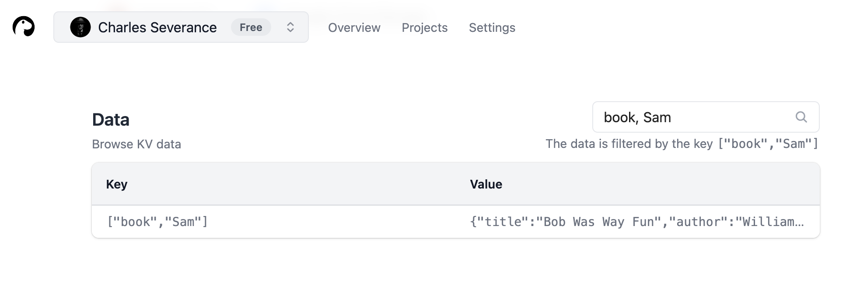
Deno has no admin tool (for now)
No PGAdmin, no DBeaver, no PHPMyAdmin
Not even a command line pg or mysql
All you get is a way to view KV data in the dashboard (for now)

Slide 38
Experiment: Simple kvadmin.py
Deno
KV
$ python kvadmin.py
Enter command: get /book/Hamlet
{ "title":"Hamlet",
"author":"Bill",
"isbn": "42", "lang": "ang"}
Deno
KV
Deno
KV
Web
Services
Deno
KV
Deno
KV
…
Deno
KV

Slide 39
A Simple Deno+Hono Web Server
import { Hono } from "https://deno.land/x/hono@v3.4.1/mod.ts";
const app = new Hono();
app.get("/hello", async (c) => {
const result = {answer: 'world'}
return c.json(result);
});
Deno.serve(app.fetch);
DEPLOY
Deno
https://hono.pg4e.com/hello
{"answer":"world"}
Deno
Deno

Slide 40
kvadmin.py
python kvadmin.py
Enter command: samples
{"author": "Bill", "title": "Hamlet", "isbn": "42", "lang": "ang"}
{"author": "Katie", "title": "Wizards", "isbn": "6848", "lang": "en"}
Enter command: set /books/Hamlet
Enter json (finish with a blank line:
{"author": "Bill", "title": "Hamlet", "isbn": "42", "lang": "ang"}
https://kv-admin-api.pg4e.com/kv/set/books/Hamlet?token=123
{
"ok": true,
"versionstamp": "0100000003612c600000"
}

Slide 41
kvadmin.py
Enter command: get /books/Hamlet
https://kv-admin-api.pg4e.com/kv/get/books/Hamlet?token=123
200
{
"key": [
"books",
"Hamlet"
],
"value": {
"author": "Bill",
"title": "Hamlet",
"isbn": "42",
"lang": "ang"
},
"versionstamp": "0100000003612c600000"
}

Slide 42
https://www.pg4e.com/code/kvadmin.py
# get /books/Hamlet
# https://kv-admin-api.pg4e.com/kv/get/books/Hamlet?token=123
if len(pieces) == 2 and pieces[0] == 'get' :
url = ( secrets['url'] + '/kv/get' + pieces[1] +
'?token=' + secrets['token'] )
with urllib.request.urlopen(url, timeout=30) as response:
text = response.read().decode('utf-8')
status = response.status
print(status)
try:
data = json.loads(text)
pretty_json_string = json.dumps(data, indent=4)
print(pretty_json_string)
except Exception as e:
print(text)

Slide 43
https://github.com/csev/deno-kv-admin
import { Hono } from "https://deno.land/x/hono@v3.4.1/mod.ts";
const app = new Hono();
const kv = await Deno.openKv();
// Get a record by key
// https://kv-admin-api.pg4e.com/kv/get/books/Hamlet?token=42
app.get("/kv/get/:key{.*}", async (c) => {
checkToken(c);
const key = c.req.param("key");
const result = await kv.get(key.split('/')); # ['books', 'Hamlet']
return c.json(result);
});
# ...
Deno.serve(app.fetch);

Slide 44
kvadmin.py
Enter command: list /books
https://kv-admin-api.pg4e.com/kv/list/books?token=42
200
{
"records": [
{
"key": [
"books",
"Hamlet"
],
"value": {
"author": "Bill",
"title": "Hamlet",
"isbn": "42",
"lang": "ang"
},
"versionstamp": "0100000003612c600000"
}
],
"cursor": ""
}

Slide 45
kvadmin.py
Enter command: delete /books/Hamlet
https://kv-admin-api.pg4e.com/kv/delete/books/Hamlet?token=42
Status: 200
Enter command: list /books
https://kv-admin-api.pg4e.com/kv/list/books
200
{
"records": [],
"cursor": ""
}
Enter command: quit

Slide 46
We will explore all four CRUD use cases in client and server code in the walk though…

Slide 47
Data Model Design in Deno KV https://docs.deno.com/deploy/kv/manual/operations/

Slide 48
Some book data to model
Title | ISBN | Language | Author
Wisdom of Crowds | 385721706 | en | James Surowiecki
Introduction to Networking | 9781511654944 | en | Charles Severance
Introducción a las Redes | 9781523627516 | es | Fernando Tardio
Raspberry PI | 9781624311390 | en | Kristen Fontichiaro
Where Wizards Stay Up Late | 0684812010 | en | Katy Hafner
Innovators Dilemma | 0066620694 | en | Clayton Christensen
Unlocking the Clubhouse | 0262133989 | en | Ann Margolis
Mindshift | 9781101982853 | en | Barbara Oakley
Python for Everybody | 9781530051120 | en | Charles Severance
Python per tutti | 1730907164 | it | Vittore Zen
Weaving the Web | 00625187X | en | Tim Berners-Lee

Slide 49
Deno KV Overview (Review)
Stores Schemaless JSON documents
No explicit tables
Keys
Hierarchical logical key
No Integer, Guid, or SERIAL primary keys
Logical keys are JavaScript Arrays
Data can be stored (set) or retrieved (get) by key
Data can be scanned by key prefix (list)
Only order is logical key order
Similar to a PostgreSQL B-Tree index

Slide 50
Deno Keys are Arrays
const kv = await Deno.openKv();
const prefs = {
username: "ada",
theme: "dark",
language: "en-US",
};
const result = await kv.set(["preferences", "ada"], prefs);
const entry = await kv.get(["preferences", "ada"]);
console.log(entry.key);
console.log(entry.value.theme);
const entries = kv.list({ prefix: ["preferences"] });
for await (const entry of entries) {
console.log(entry.key);
console.log(entry.value.language);
}
await kv.delete(["preferences", "ada"]);

Slide 51
Python Sorted Dictionaries (if only)
deno = dict()
deno[('books', 'Wizards up Late')] = {'author': 'Katie', 'title': 'Wizards', 'isbn': '6848', 'lang': 'en'}
deno[('authors', 'Katie Hafner')] = {'author': 'Katie', 'title': 'Wizards', 'isbn': '6848', 'lang': 'en'}
deno[('books', 'Python')] = {'author': 'Chuck', 'title': 'PY4E', 'isbn': '8513', 'lang': 'en'}
deno[('authors', 'Charles Severance')] = {'author': 'Chuck', 'title': 'PY4E', 'isbn': '8513', 'lang': 'en'}
deno[('books', 'Raspberry PI')] = {'author': 'Kristen', 'title': 'PI', 'isbn': '8162', 'lang': 'en'}
deno[('authors', 'Kristen Fontichairo')] = {'author': 'Kristen', 'title': 'PI', 'isbn': '8162', 'lang': 'en'}
deno[('books', 'Wisdom of Crowds')] = {'author': 'James', 'title': 'Wisdom', 'isbn': '3857', 'lang': 'en'}
deno[('authors', 'James Surowiecki')] = {'author': 'James', 'title': 'Wisdom', 'isbn': '3857', 'lang': 'en'}
deno[('books', 'Mindshift')] = {'author': 'Barb', 'title': 'Mind', 'isbn': '8110', 'lang': 'en'}
deno[('authors', 'Barb Oakley')] = {'author': 'Barb', 'title': 'Mind', 'isbn': '8110', 'lang': 'en'}
deno[('books', 'Python per tutti')] = {'author': 'Vittore', 'title': 'Tutti', 'isbn': '1730', 'lang': 'es'}
deno[('authors', 'Vittori Zen')] = {'author': 'Vittore', 'title': 'Tutti', 'isbn': '1730', 'lang': 'es'}
deno[('authors', 'Charles Severance')] = {'author': 'Chuck', 'title': 'Net', 'isbn': '8151', 'lang': 'en'}
deno[('books', 'Networking Intro')] = {'author': 'Chuck', 'title': 'Net', 'isbn': '8151', 'lang': 'en'}
for key in deno:
print(key, '=>', deno[key])
print()
# Sorted – At the moment of printing
for key in sorted(deno):
print(key, '=>', deno[key])
https://www.py4e.com/code/deno_in_python.py

Slide 52
Python Sorted Dictionaries (if only)
('authors', 'Barb Oakley') => {'author': 'Barb', 'title': 'Mind', 'isbn': '8110', 'lang': 'en'}
('authors', 'Charles Severance') => {'author': 'Chuck', 'title': 'Net', 'isbn': '8151', 'lang': 'en'}
('authors', 'James Surowiecki') => {'author': 'James', 'title': 'Wisdom', 'isbn': '3857', 'lang': 'en'}
('authors', 'Katie Hafner') => {'author': 'Katie', 'title': 'Wizards', 'isbn': '6848', 'lang': 'en'}
('authors', 'Kristen Fontichairo') => {'author': 'Kristen', 'title': 'PI', 'isbn': '8162', 'lang': 'en'}
('authors', 'Vittori Zen') => {'author': 'Vittore', 'title': 'Tutti', 'isbn': '1730', 'lang': 'es'}
('books', 'Mindshift') => {'author': 'Barb', 'title': 'Mind', 'isbn': '8110', 'lang': 'en'}
('books', 'Networking Intro') => {'author': 'Chuck', 'title': 'Net', 'isbn': '8151', 'lang': 'en'}
('books', 'Python') => {'author': 'Chuck', 'title': 'PY4E', 'isbn': '8513', 'lang': 'en'}
('books', 'Python per tutti') => {'author': 'Vittore', 'title': 'Tutti', 'isbn': '1730', 'lang': 'es'}
('books', 'Raspberry PI') => {'author': 'Kristen', 'title': 'PI', 'isbn': '8162', 'lang': 'en'}
('books', 'Wisdom of Crowds') => {'author': 'James', 'title': 'Wisdom', 'isbn': '3857', 'lang': 'en'}
('books', 'Wizards up Late') => {'author': 'Katie', 'title': 'Wizards', 'isbn': '6848', 'lang': 'en'}
/authors/Barb Oakley => {'author': 'Barb', 'title': 'Mind', 'isbn': '8110', 'lang': 'en'}
/authors/Charles Severance => {'author': 'Chuck', 'title': 'Net', 'isbn': '8151', 'lang': 'en'}
/authors/James Surowiecki => {'author': 'James', 'title': 'Wisdom', 'isbn': '3857', 'lang': 'en'}
/authors/Katie Hafner => {'author': 'Katie', 'title': 'Wizards', 'isbn': '6848', 'lang': 'en'}
/authors/Kristen Fontichairo => {'author': 'Kristen', 'title': 'PI', 'isbn': '8162', 'lang': 'en'}
/authors/Vittori Zen => {'author': 'Vittore', 'title': 'Tutti', 'isbn': '1730', 'lang': 'es'}
/books/Mindshift => {'author': 'Barb', 'title': 'Mind', 'isbn': '8110', 'lang': 'en'}
/books/Networking Intro => {'author': 'Chuck', 'title': 'Net', 'isbn': '8151', 'lang': 'en'}
/books/Python => {'author': 'Chuck', 'title': 'PY4E', 'isbn': '8513', 'lang': 'en'}
/books/Python per tutti => {'author': 'Vittore', 'title': 'Tutti', 'isbn': '1730', 'lang': 'es'}
/books/Raspberry PI => {'author': 'Kristen', 'title': 'PI', 'isbn': '8162', 'lang': 'en'}
/books/Wisdom of Crowds => {'author': 'James', 'title': 'Wisdom', 'isbn': '3857', 'lang': 'en'}
/books/Wizards up Late => {'author': 'Katie', 'title': 'Wizards', 'isbn': '6848', 'lang': 'en'}

Slide 53
A classic SQL Model
Title | ISBN | Language | Author
Introduction to Networking | 9781511654944 | en | Charles Severance
Introducción a las Redes | 9781523627516 | es | Fernando Tardio
Mindshift | 9781101982853 | en | Barbara Oakley
Python for Everybody | 9781530051120 | en | Charles Severance
Python per tutti | 1730907164 | it | Vittore Zen
Language
en
es
it
Title | ISBN
Introduction to Networking | 9781511654944
Introducción a las Redes | 9781523627516
Mindshift | 9781101982853
Python for Everybody | 9781530051120
Python per tutti | 1730907164
Author
Charles Severance
Fernando Tardio
Barbara Oakley
Vittore Zen
One
To
To
One
Many
Many

Slide 54
Translating to Deno KV
Efficient / indexed SQL queries
Book by ISBN
All books in a language
All books by an author
With a secondary index, exact title matches could be fast too
In Deno
No foreign keys
No primary keys
No secondary indexes

Slide 55
Deno Secondary Indexes
In Deno, for each query that we want to be efficient we use a different initial prefix
Let's assume that ISBN is the truly unique key, and secondary keys can have duplicates
We can create a "foreign logical key" by adding the unique logical key to all the secondary keys
kv.set(["books", "isbn", "9781511654944"], content);
kv.set(["books", "title", "Introduction to Networking", "9781511654944"], {});
kv.set(["books", "author", "Charles Severance", "9781511654944"], {} );
kv.set(["books", "language", "en", "9781511654944", {});
kv.list({ prefix: ["books", "author", "Charles Severance"]});

Slide 56
In kvadmin.py
set /books/isbn/9781511654944
{"author": "Chuck", "title": "Net", "isbn": "8151", "lang": "en"}
set /books/title/Introduction_to_Networking/9781511654944 {}
set /books/author/Charles_Severance/9781511654944 {}
set /books/language/en/9781511654944 {}
list /books/author/Charles_Severance
{
"key": [
"books",
"author",
"Charles_Severance",
"9781511654944"
],
"value": {},
"versionstamp": "0100000003d153510000"
}

Slide 57
We will explore all of CRUD client and server code in the walk though…

Slide 58
Acknowledgements / Contributions
These slides are Copyright 2025- Charles R. Severance (www.dr-chuck.com) as part of www.pg4e.com and made available under a Creative Commons Attribution 4.0 License. Please maintain this last slide in all copies of the document to comply with the attribution requirements of the license. If you make a change, feel free to add your name and organization to the list of contributors on this page as you republish the materials.
Initial Development: Charles R. Severance, University of Michigan School of Information
Insert new Contributors and Translators here including names and dates
Continue new Contributors and Translators here

