Slide 1
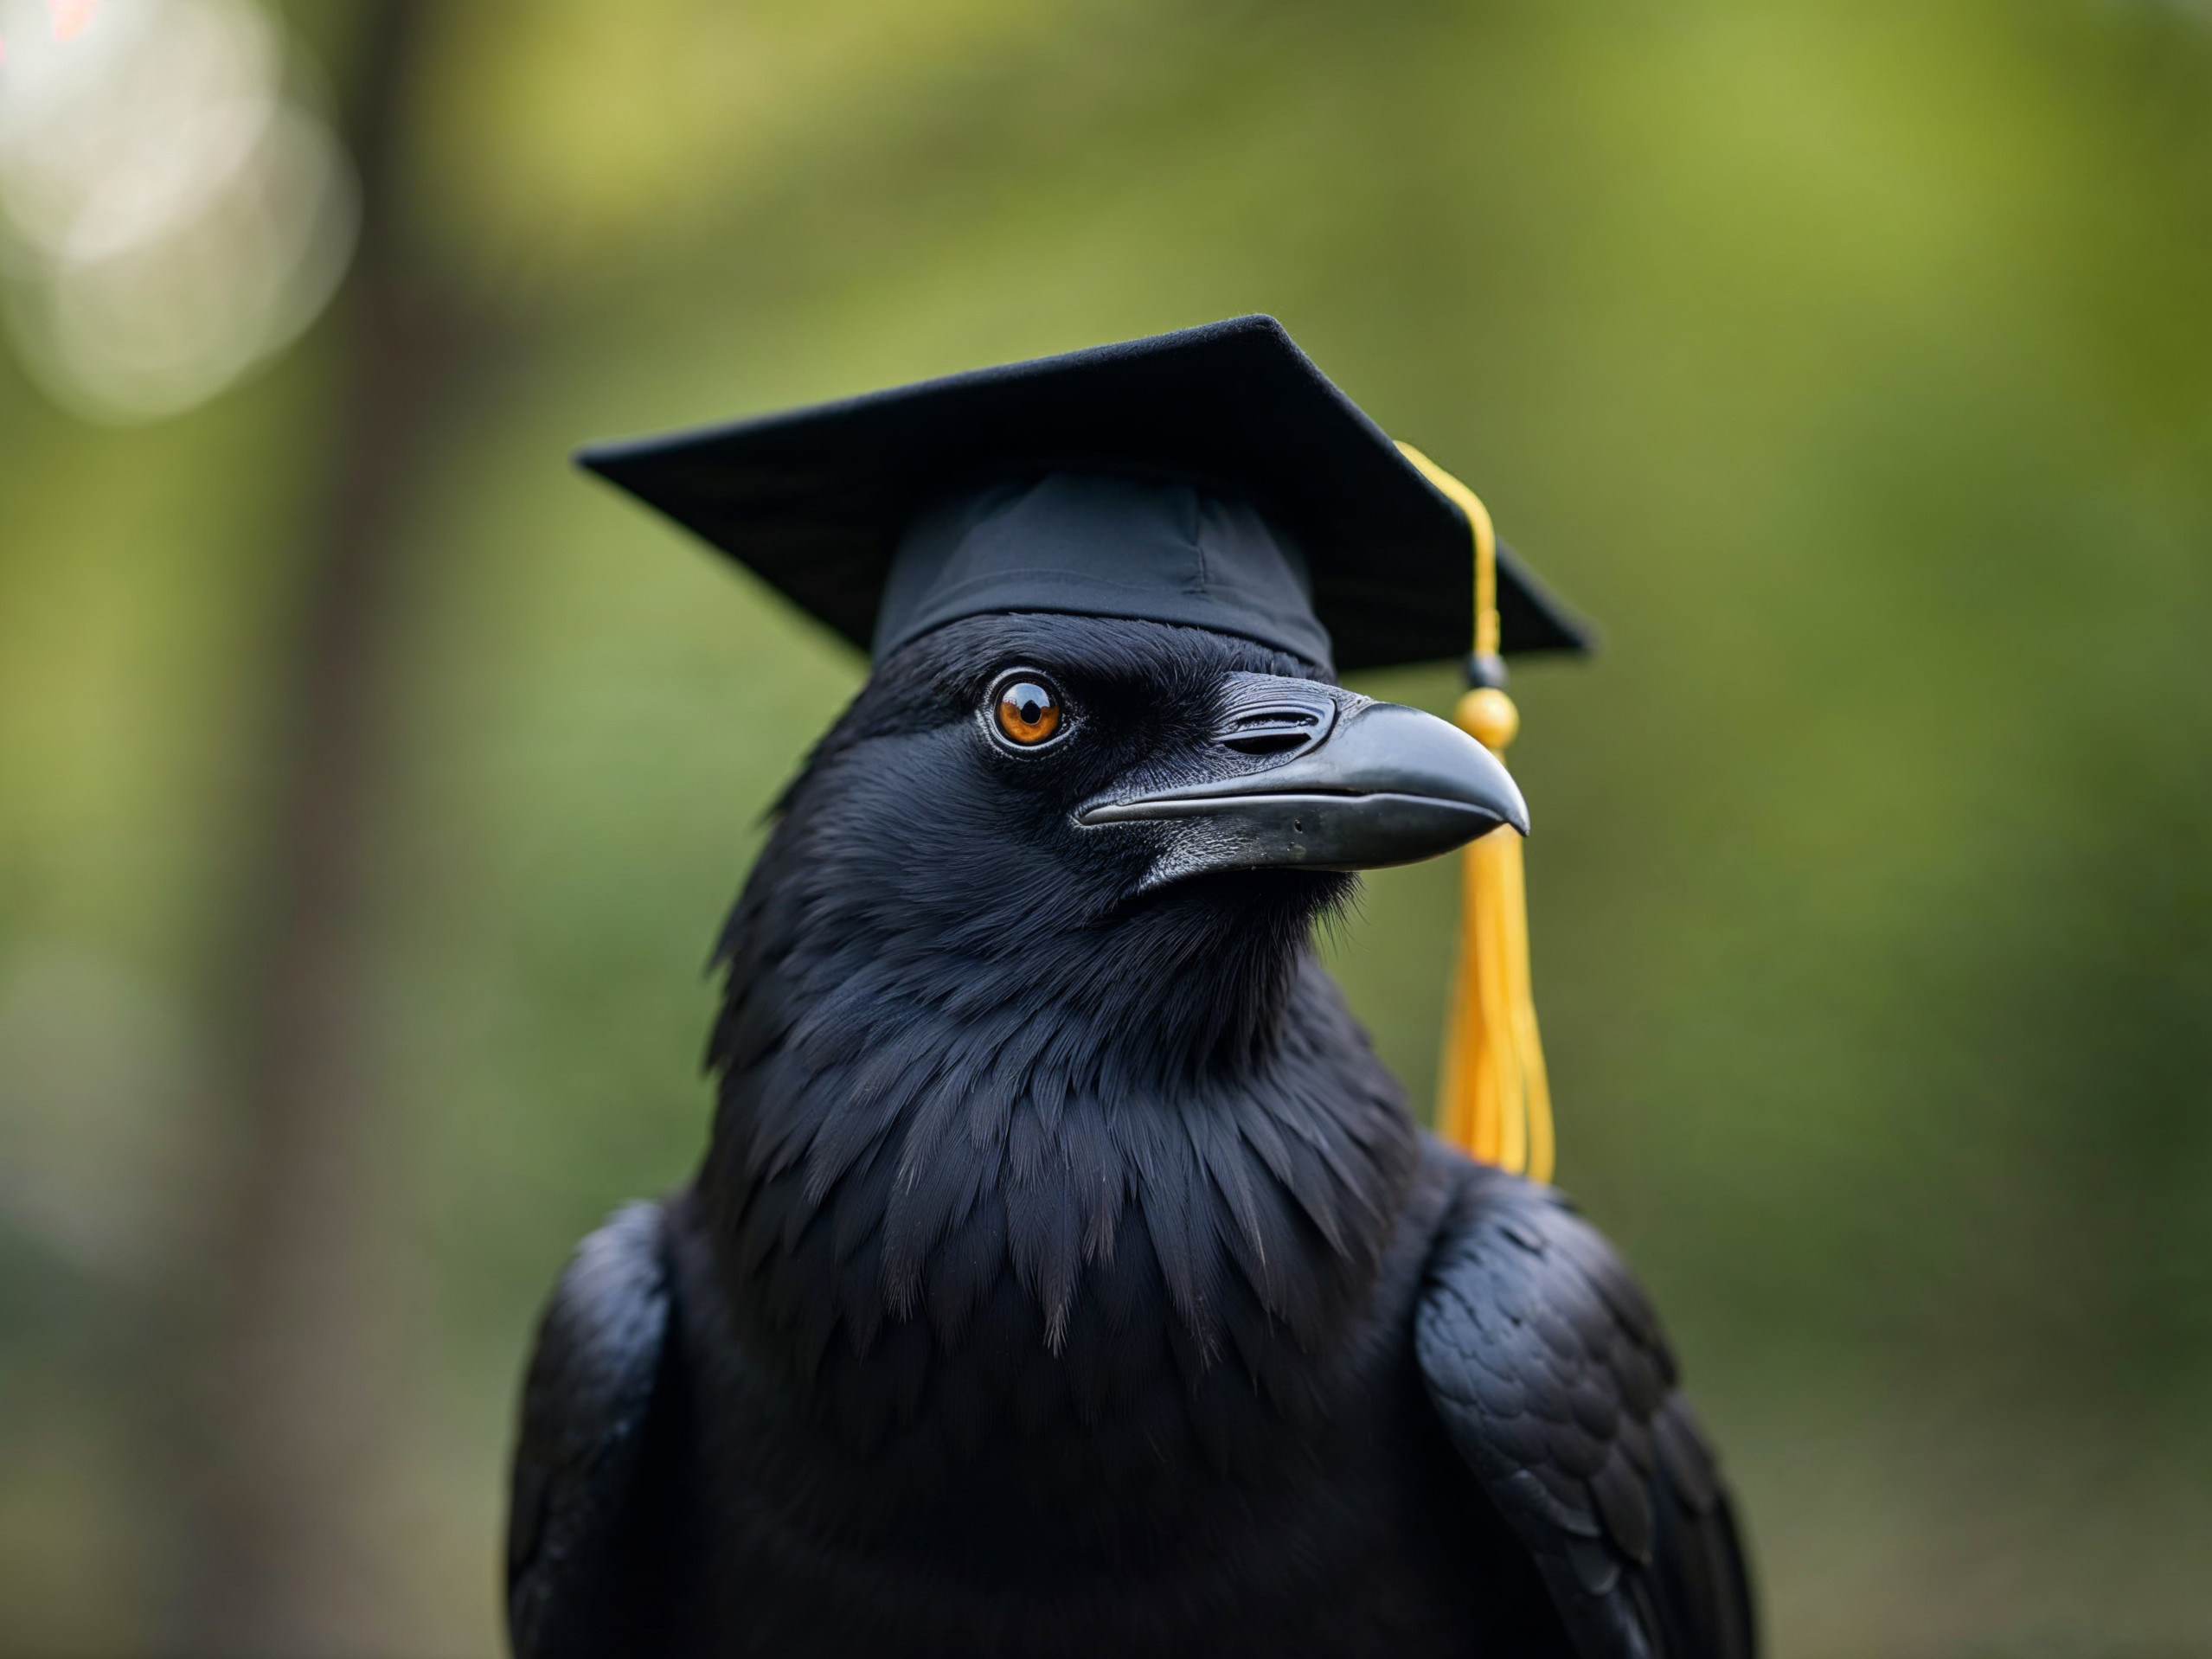
Remarkable Intelligence of the Corvid Birds

Slide 2
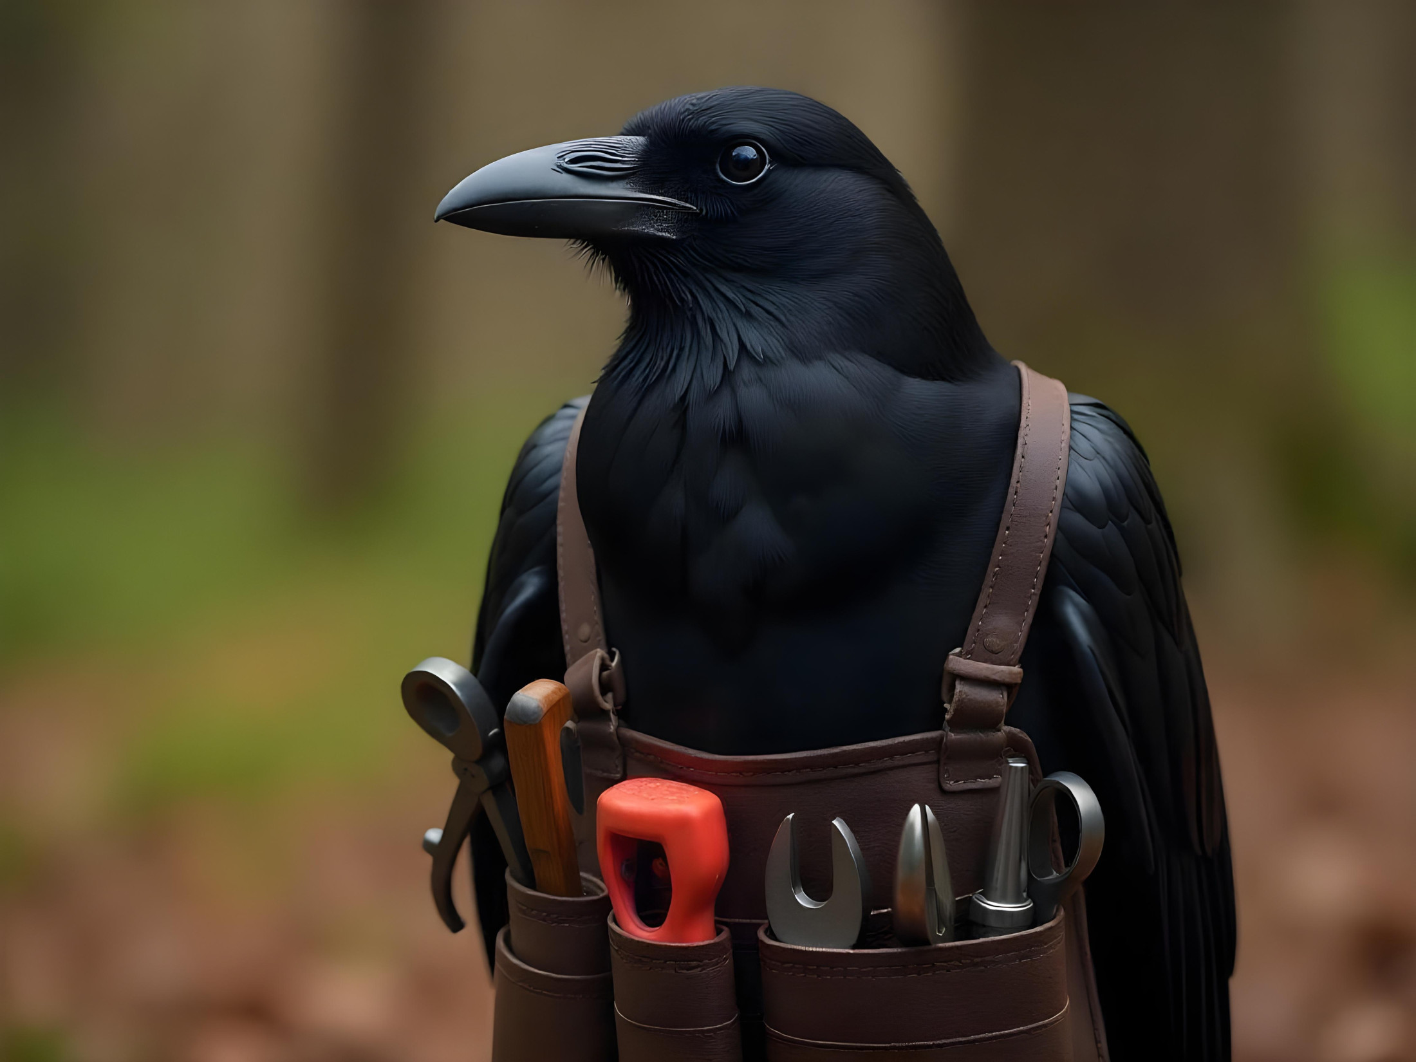
Tool Making

Slide 3
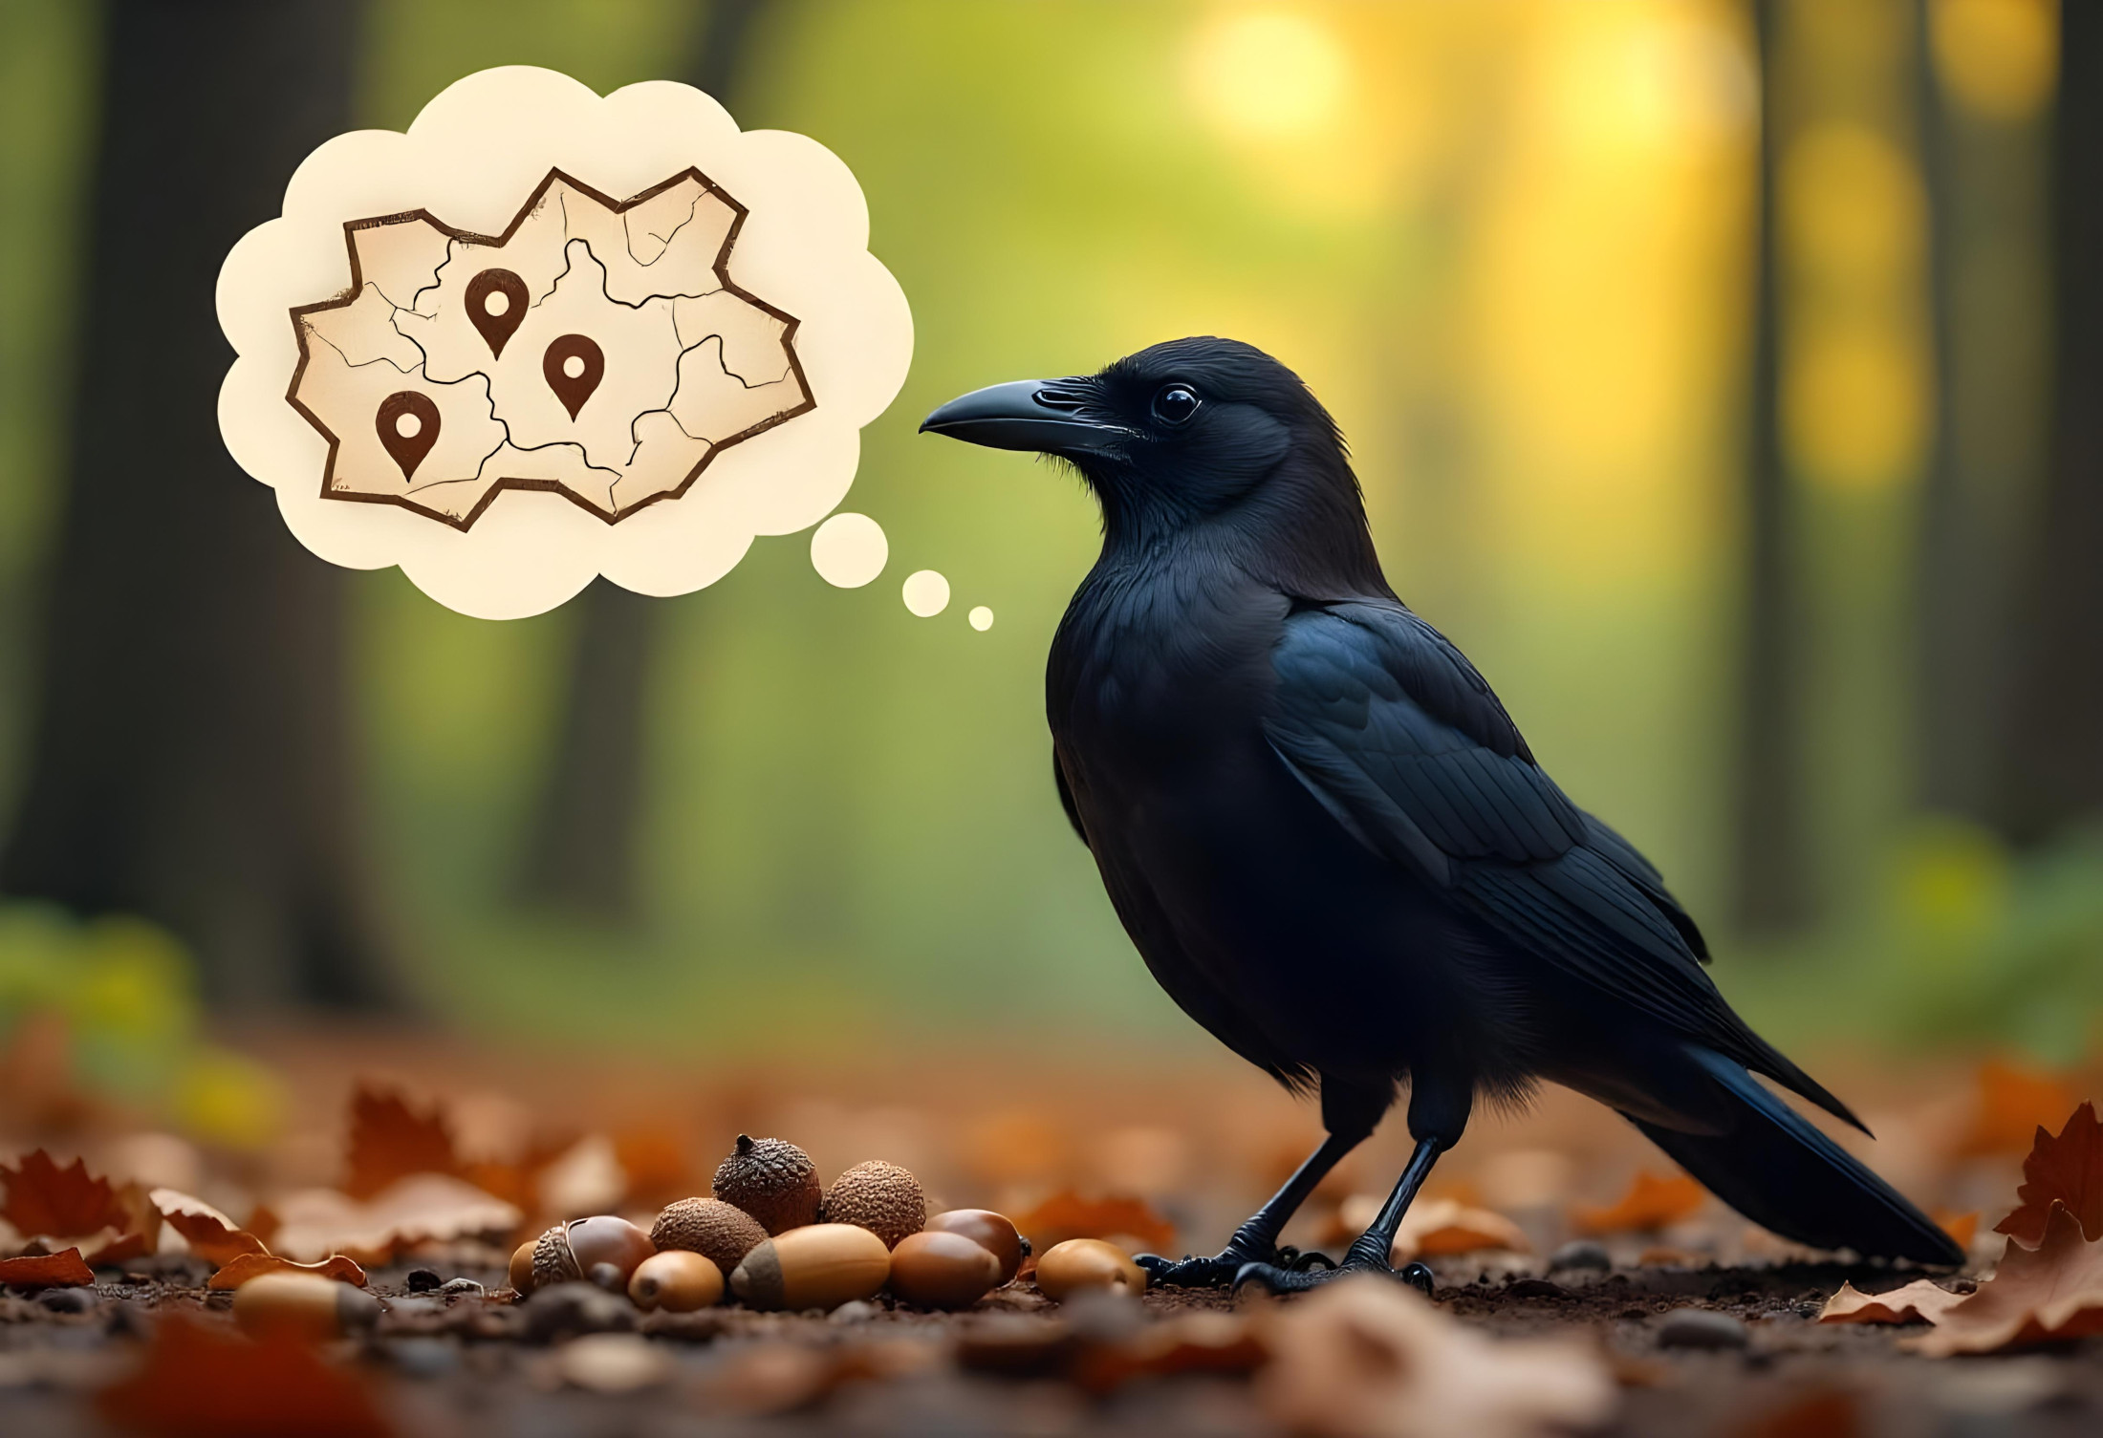
Amazing Memories

Slide 4
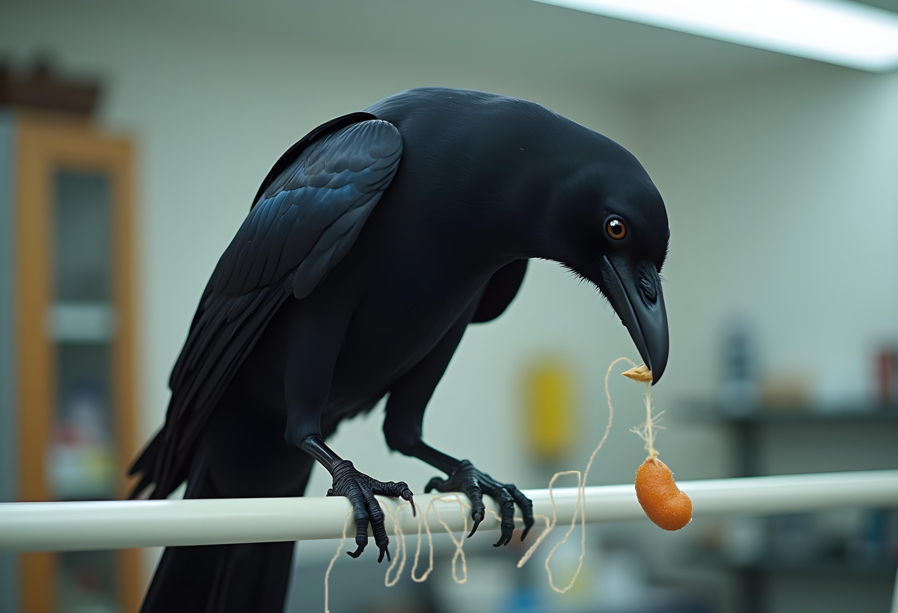
Problem Solvers

Slide 5
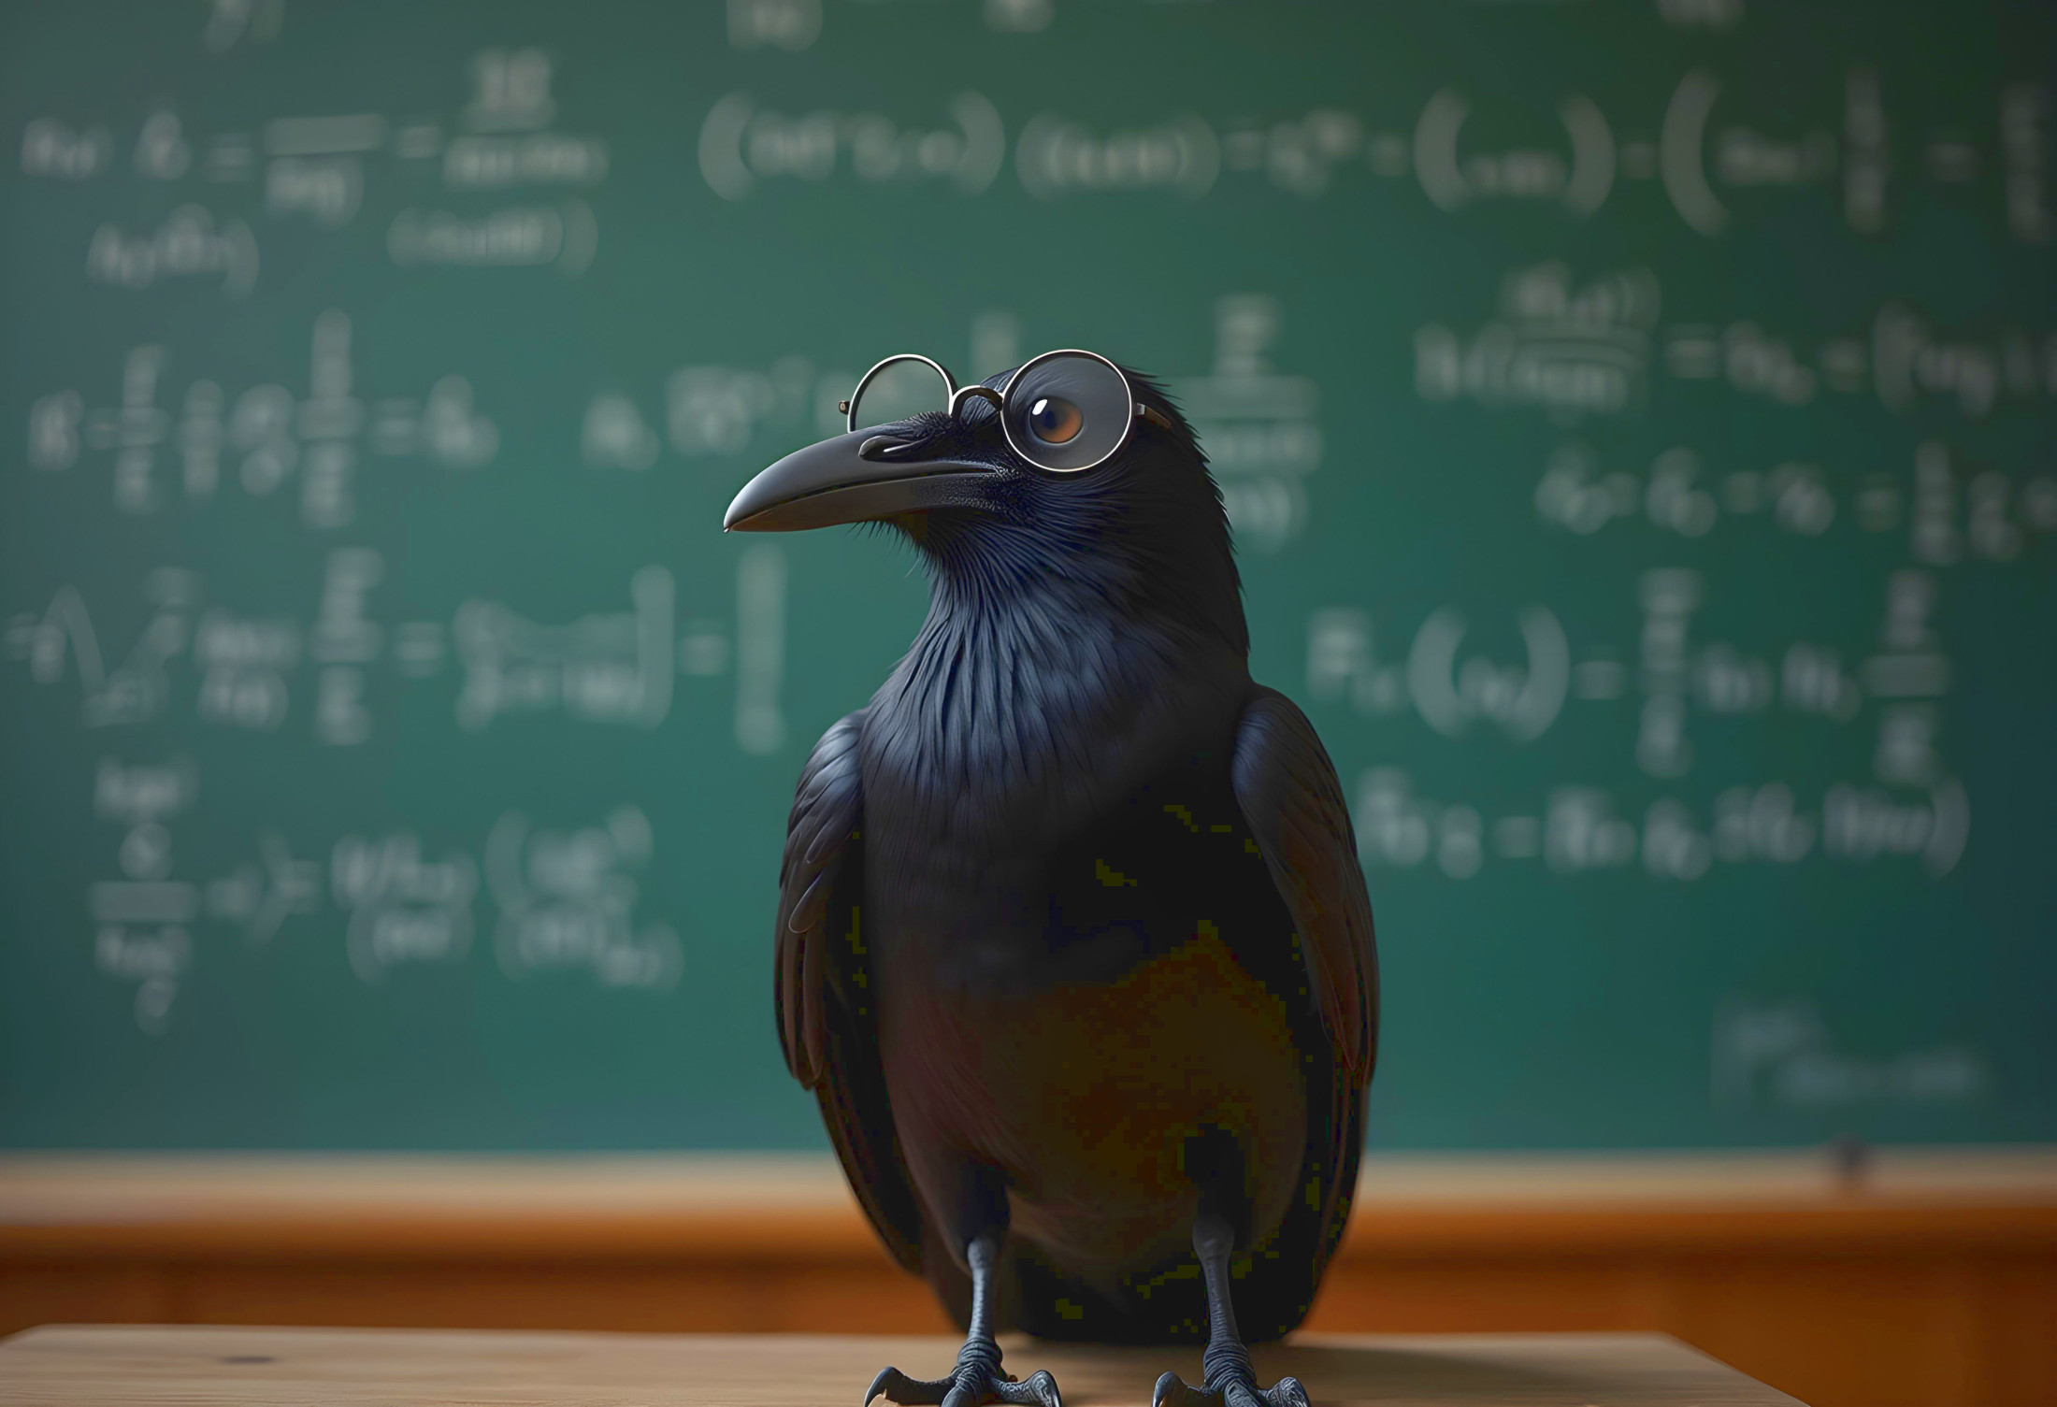
Smart Corvids
Tool Making
Great Memory
Problem Solving

