Slide 1
Quantum Computing
SHREYASH BHATKAR 41

Slide 2
Overview
^ Introduction & History
^ Classical Computer Vs Quantum Computer
^ Representation of Quantum bit
^ Operations on Qubits
^ Applications of Quantum Computing
^ Obstacles in Quantum Computing

Slide 3
Introduction & History:

Slide 4

What is Quantum computing ?
^Quantum Computing is an area of computing focused on developing computer technology based on the principles of quantum theory which explains the behaviour of energy and material on the atomic and sub-atomic levels.
^Quantum computing is the use of quantum-mechanical phenomena such as superposition and entanglement to perform computation.
^Entanglement: Entanglement is an extremely strong correlation that exists between quantum particles. The particles remain perfectly correlated even if separated by great distances. Two qubits are entangled through the action of laser. Once they have entangled, they are in an indeterminate state. The qubits can then be separated by any distance, they will remain linked. When one of the qubits is manipulated, the manipulation happens instantly to its entangled twin as well

Slide 5
Superposition: Quantum superposition is a fundamental principle of quantum mechanics. It states that, much like waves in classical physics, any two (or more) quantum states can be added together ("superposed") and the result will be another valid quantum state; and conversely, that every quantum state can be represented as a sum of two or more other distinct states.
In classical computing bits has two possible states either zero or one. In quantum computing, a qubit is a unit of quantum information. Qubits have special properties that help them solve complex problems much faster than classical bits. One of these properties is superposition, which states that instead of holding one binary value (“0” or “1”) like a classical bit, a qubit can hold a combination of “0” and “1” simultaneously.

Slide 6
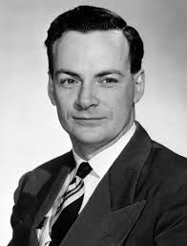
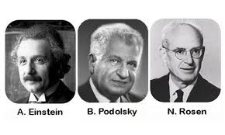
History of Quantum Computing :
1935 : The ERP Paradox
Albert Einstein, Robert Podolsky and Nathan Rosen
Proposed an experiment in which they stated the
quantum wave function as the complete description of
physical reality.
1981 :
Feynman proposed the idea of creating machines based on the laws of quantum mechanics instead of the laws of classical physics.

Slide 7
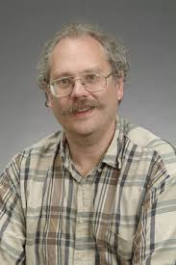
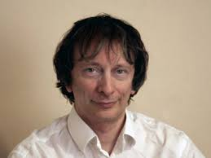
History of Quantum Computing :
1985 : David Deutsch developed the first universalbquantum computer.
1985 : Peter Shor came up with a quantum algorithm to factor very large numbers in polynomial time.
1997 : Lov Grover developed a quantum search algorithm with
O(√N) complexity.

Slide 8
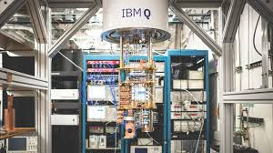
History of Quantum Computing :
2012 : The coherence Time was improved.
2016 :
IBM made quantum computing available on
IBM cloud to accelerate innovation.
IBM's quantum processors are made up of
superconducting transmon qubits, located in a dilution refrigerator at the IBM Research headquarters at the Thomas J. Watson Research Center.

Slide 9
Classical Computer Vs Quantum Computer

Slide 10
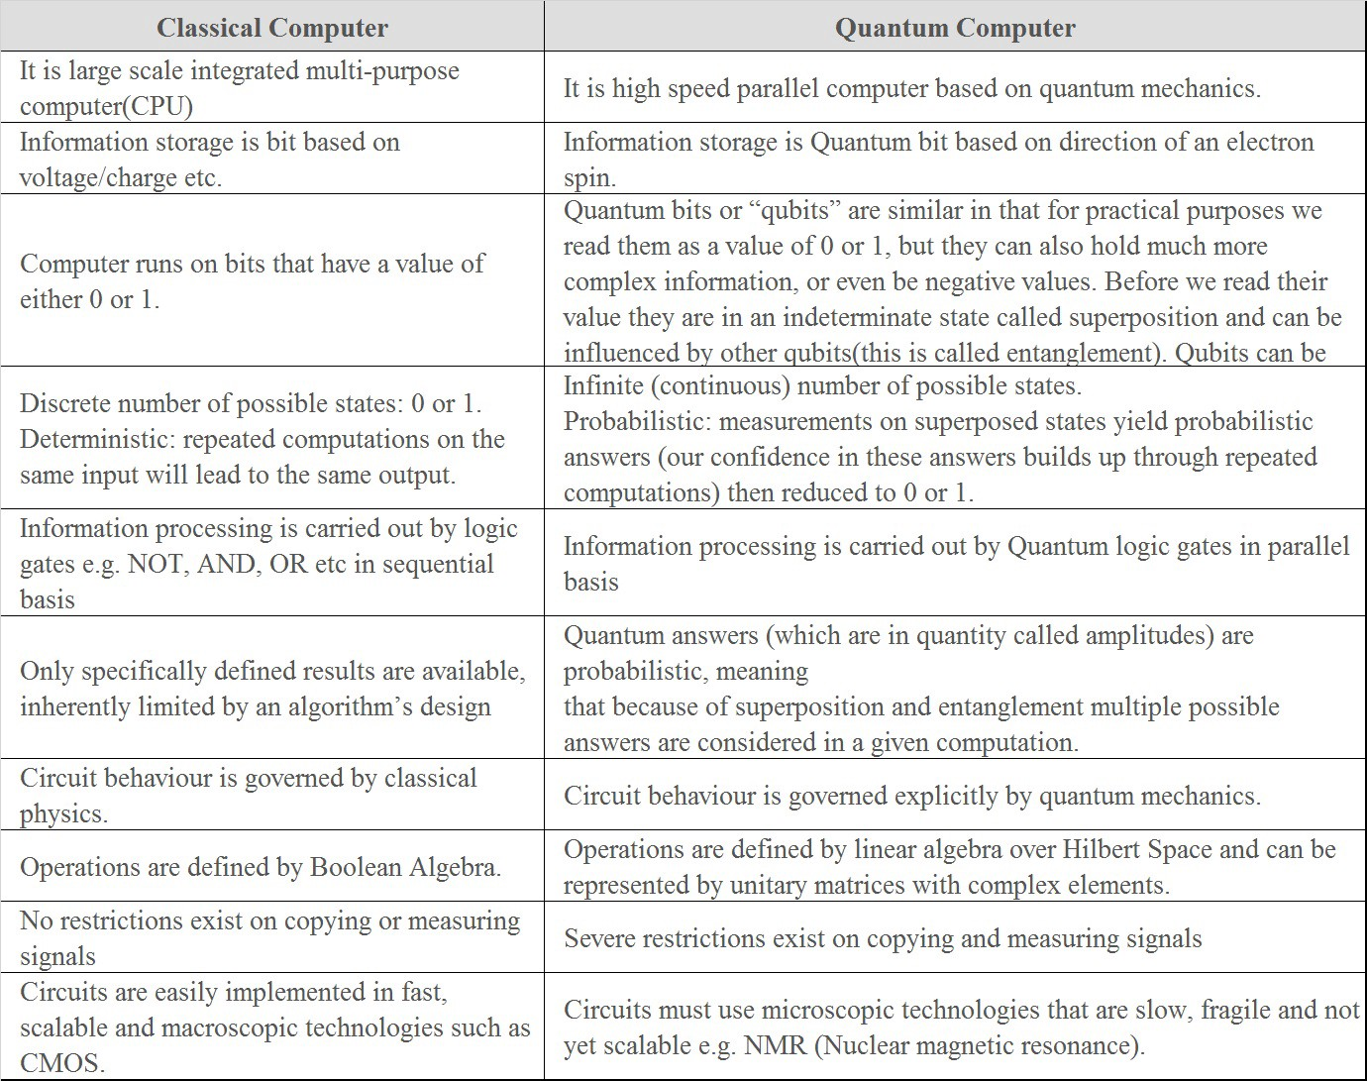

Slide 11
Representation of Qubit:

Slide 12
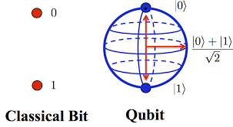
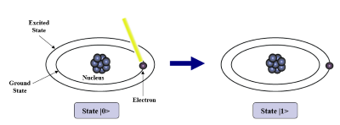
Quantum bits : Qubits
A Qubit is a logical concept that can be implemented on a wide range of different systems with quantum behaviour.
A classical bit can only represent either one of two states 0 and 1, but qubit manages to represent all possible combinations between 0 and 1.
A physical implementation of a qubit could use the two energy levels of an atom. An excited state representing |1> and a ground state representing |0>.

Slide 13
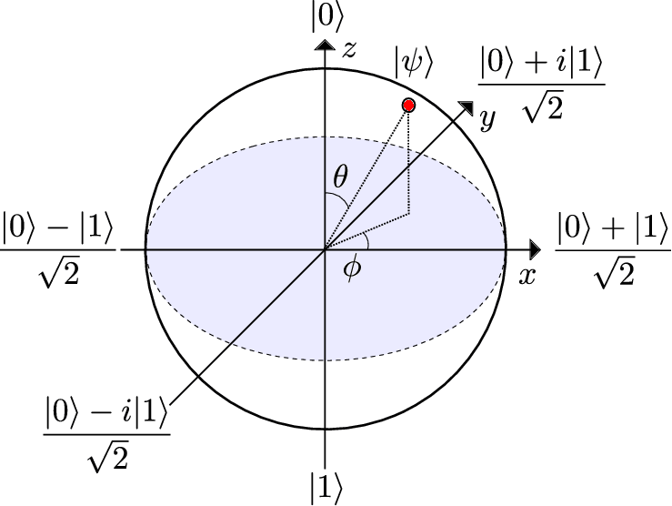

Vector representation of a Qubit
Vector Representation of classical 0: $\begin{matrix}0 \\ 1\end{matrix}$
Vector Representation of classical 1: 1
0
Vector Representation of Qubit ψ : α
β
|ψ> = α |0> + β |1>

Slide 14
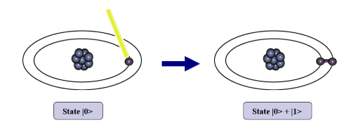
A single qubit can be forced into a superposition of the two states denoted by the addition of the state vectors:
|ψ> = α |0> + β |1>
Where α and β are complex numbers and |α |² + | β |² = 1
A qubit in superposition is in both of the states |1> and |0> at the same time.
We can also entangle the two qubits such that the measurement of one qubit is always correlated to the measurement of the other qubit.

Slide 15
“Operations on Qubit”

Slide 16
Operations on Qubits : Quantum Gates
In quantum computing and specifically in the quantum circuit model of computation, a Quantum Gate is a basic quantum circuit operating on a small number of Qubits.
They are the building blocks of quantum circuits, like classical Logic Gates
which are for conventional digital circuits.
Unlike many logic gates, Quantum Gates are reversible. Given output and gate type, it is always possible to find out input.
They are represented using ‘Unitary Matrices’. Every gate can be represented as matrix and every gate operation is matrix multiplication of qubit and gate matrices.
A gate which acts on n qubits is represented by a 2^{n} × 2^{n} unitary matrix.

Slide 17


Hadamard (H) gate
This gate operates on a single qubit. It maps the basis state $\left.|0\right\rangle$ to $\frac{\left.|0\right\rangle +\left.|1\right\rangle }{\sqrt{2}}$ and $\left.|1\right\rangle$ to $\frac{\left.|0\right\rangle −\left.|1\right\rangle }{\sqrt{2}}$ , which means that a measurement will have equal probabilities to become 1 or 0 (i.e. creates a superposition). It is represented by the Hadamard matrix
H = $\frac{1}{\sqrt{2}}\left[\begin{matrix}1 & 1 \\ 1 & −1\end{matrix}\right]$
Note: Two Hadamard gates used in succession can be used as a NOT gate
H
H
State |0>
State |0> + |1>
State |1>

Slide 18


Pauli-X gate
The Pauli-X gate acts on a single qubit.
It equates to a rotation around the X-axis of the Bloch sphere by π radians. It maps $\left.|0\right\rangle$ to $\left.|1\right\rangle$ and $\left.|1\right\rangle$ to $\left.|0\right\rangle$.
Due to this nature, it is sometimes called bit-flip.
It is represented by the Pauli X matrix:
X = $\left[\begin{matrix}0 & 1 \\ 1 & 0\end{matrix}\right]$

Slide 19


Pauli-Y gate
The Pauli-Y gate acts on a single qubit.
It equates to a rotation around the Y-axis of the Bloch sphere by π radians. It maps $\left.|0\right\rangle$ to $i \left.|1\right\rangle$ and $\left.|1\right\rangle$ to $\left.−i|0\right\rangle$.
It is represented by the Pauli Y matrix:
Y=$\left[\begin{matrix}0 & −i \\ i & 0\end{matrix}\right]$

Slide 20



Pauli-Z gate ($R_{π}$)
The Pauli-Z gate acts on a single qubit.
It equates to a rotation around the Z-axis of the Bloch sphere by π radians. It leaves basic state $\left.|0\right\rangle$ unchanged and maps $\left.|1\right\rangle$ to $−\left.|1\right\rangle$ .
Thus, it is a special case of a phase shift gate with φ = π.
Due to this nature, it is sometimes called phase-flip.
It is represented by the Pauli Z matrix:
Z=$\left[\begin{matrix}1 & 0 \\ 0 & −1\end{matrix}\right]$

Slide 21



SWAP Gate
The swap gate swaps two qubits.
Truth Table of SWAP is:-
Matrix representation of swap gate is
SWAP = $\left[\begin{matrix}1 & 0 & 0 & 0 \\ 0 & 0 & 1 & 0 \\ 0 & 1 & 0 & 0 \\ 0 & 0 & 0 & 1\end{matrix}\right]$
a | b | a´ | b´
0 | 0 | 0 | 0
0 | 1 | 1 | 0
1 | 0 | 0 | 1
1 | 1 | 1 | 1

Slide 22
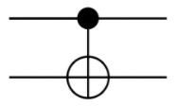

Controlled NOT
A gate which operates on two qubits is called a Controlled-NOT (CN or CNOT) Gate. If the bit on the control line is 1, invert the bit on the target line.
It performs the NOT operation on the second qubit only when the first qubit is $\left.|1\right\rangle$ , and otherwise leaves it unchanged.
Input
Output
A | B | A’ | B’
0 | 0 | 0 | 0
0 | 1 | 1 | 1
1 | 0 | 1 | 0
1 | 1 | 0 | 1
A - Target
A’
B - Control
B’

Slide 23
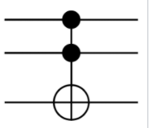
Toffoli (CCNOT) Gate
A gate which operates on three qubits is called a Controlled Controlled NOT (CCN) Gate. If the bits on both of the control lines is 1,then the target bit is inverted.
Input
Output
A | B | C | A’ | B’ | C’
0 | 0 | 0 | 0 | 0 | 0
0 | 0 | 1 | 0 | 0 | 1
0 | 1 | 0 | 0 | 1 | 0
0 | 1 | 1 | 1 | 1 | 1
1 | 0 | 0 | 1 | 0 | 0
1 | 0 | 1 | 1 | 0 | 1
1 | 1 | 0 | 1 | 1 | 0
1 | 1 | 1 | 0 | 1 | 1
A - Target
A’
B - Control 1
B’
C - Control 2
C’

Slide 24
Universal quantum gates
There are mainly two universal reversible gates:-
Toffoli gate:- (CCN)
The Toffoli gate has been shown to be a universal reversible logic gate as it can be used as a NAND gate(Universal Logic Gate).
Fredkin:- (Controlled-SWAP)
The Fredkin gate can also be seen as a controlled-SWAP gate in that it swaps the values of the second and third bits, if, and only if, the first bit is set to 1.

Slide 25
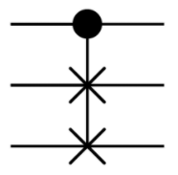
Circuit representation for the Fredkin Gate:-
Truth table of Fredkin Gate is:-
Input
Output
A | B | C | A’ | B’ | C’
0 | 0 | 0 | 0 | 0 | 0
0 | 0 | 1 | 0 | 0 | 1
0 | 1 | 0 | 0 | 1 | 0
0 | 1 | 1 | 0 | 1 | 1
1 | 0 | 0 | 1 | 0 | 0
1 | 0 | 1 | 1 | 1 | 0
1 | 1 | 0 | 1 | 0 | 1
1 | 1 | 1 | 1 | 1 | 1

Slide 26
“Applications of Quantum Computing”

Slide 27
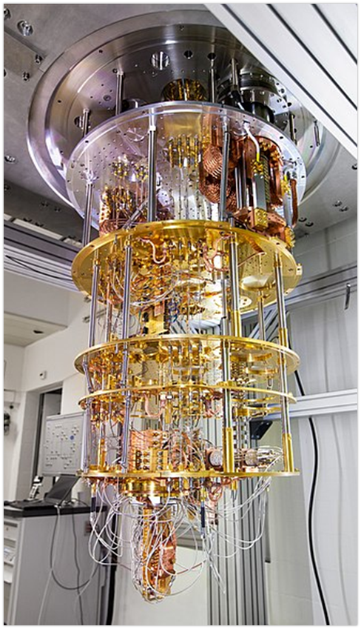
Universal Quantum Computer
A quantum Turing machine or universal quantum computer is an abstract machine used to model the effects of a quantum computer.
A universal quantum computer has secure computing,
machine learning, material science, quantum chemistry,
etc. and a very high computing power.
Quantum computer based on superconducting qubits
developed by IBM Research in Zurich, Switzerland.

Slide 28
Quantum Mechanics Simulations
Simulation can be done in physics, chemistry, materials science, nanotechnology, biology and medicine.
Computer can compute millions of variables at once.
All are limited today by the slow speed of quantum mechanical simulations.
Cryptoanalysis
Quantum computer is capable for cracking extremely complicated codes.

Slide 29
“Obstacles in Quantum Computing”

Slide 30
The technology required to implement a quantum computer is not yet available. The reason is that electron (Essential element of quantum computing) is damaged as soon as it is affected by the environment.
Quantum computers need a lot of cooling to work properly. For example, 460 degrees F.
According to theoretical research with quantum computing every computer on this planet will become vulnerable even nuclear codes can be hacked with quantum computing. What will happen if it gets in the wrong hands?
Many companies claim they have built quantum computers including IBM and D-wave etc. Even if they have built a quantum computer, we don’t have enough experience with Quantum computer. For example, D-wave solved Sudoku and many other puzzles using a quantum computer, even a classical computer can do that.

Slide 31
“Conclusion”

Slide 32
The quantum computers are the future of computing.
Quantum computing is a great prospect and it will solve many problems which cannot be solved by classical computing. It will also decrease the time of problem solving for the problems which are now solvable by classical computing.
The hardware and programs related to Quantum computing are not yet built completely. These are evolving but soon it will become a reality and will change the technology worldwide.
Every field of life including research, education, engineering, aero-space, medical, technology, media, nuclear technology, space travel, armed forces and sports, in fact every field of life will be affected by the quantum computers.

Slide 33
Thank you

