Slide 1
ROLE OF DATA SCIENCE IN ECONOMICS.
SHREYASH BHATKAR - 41

Slide 2
OVERVIEW:
OBJECTIVES
REDEFINING THE CONCEPT OF DATA SCIENCE
WHAT EXACTLY IS DATA SCIENCE
DATA SCIENTISTS AND ECONOMISTS
ROLE OF DS IN ECONOMICS
REAL LIFE EXAMPLES
METHODS AND TECHNIQUES
ADVANTAGES
CONCLUSION
REFERENCES

Slide 3
OBJECTIVES:
1) UNDERSTAND WHAT EXACTLY IS DATA SCIENCE.
2) UNDERSTAND ECONOMICS' RELATION WITH DATA SCIENCE.
3) THINGS WE CAN GET BENIFITTED WITH IF WE USE DS ALONG WITH ECONOMICS.

Slide 4

DATA ALL AROUND!
Lots of data is being collected
and warehoused
Scientific Experiments
– Internet of Things
– Web data, e-commerce
– Financial transactions, bank/credit transactions
– Online trading and purchasing
– Social Network
– ……many more!
FIGURE IS JUST FOR SIMPLIFICATION, THESE ARE MAINLY THE RESOURCES FROM WHICH DATA IS EXTRACTED.

Slide 5


What To Do With These Data?
#Aggregation and Statistics
– Data warehousing and OLAP
#Indexing, Searching, and Querying
– Keyword based search
– Pattern matching (XML/RDF)
# Knowledge discovery
– Data Mining
– Statistical Modeling
# Data Driven
– Predictive Analytics
– Deep Learning

Slide 6




What exactly is Data Science?
Some definitions link computational, statistical, and
substantive expertise:
A
MATHS AND STATISTICAL KNOWLEDGE.
SUBSTANTIVE EXPERTISE
HACKING SKILLS
B
Other definitions focus more on technical skills alone.
0
DATA BOOTHS
STATS NERDS
GRAPHIC DESIGNERS

Slide 7
WHAT EXACTLY IS DATA SCIENCE THEN?
An area that manages, manipulates,
extracts, and interprets knowledge from
tremendous amount of data
• Data science (DS) is a multidisciplinary field
of study with goal to address the challenges
in big data
• Data science principles apply to all data –
big and small

Slide 8
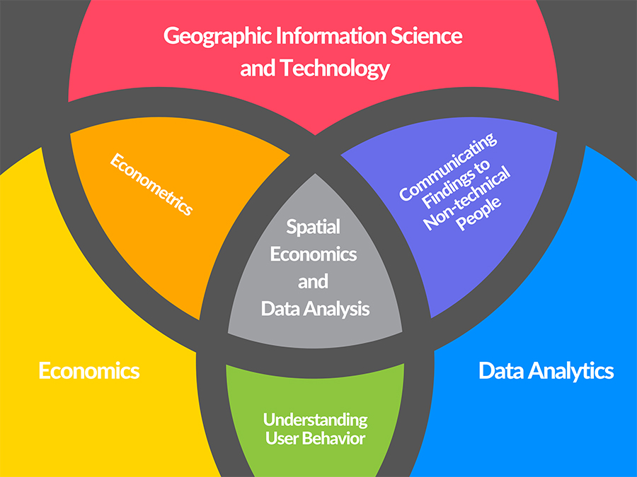
Economics & Data Science
Roughly 13% of current data scientists have an Economics degree. For comparison, the most well-represented discipline is data science and analysis, which takes up 21% of the pie. Therefore, Economics is indeed a competitive discipline when it comes to data science

Slide 9
SOME REASONS WHY D.S. GO HAND IN HAND WITH ECONOMICS:
THE FACTS ARE QUITE OBVIOUS, DATA SCIENTISTS CAN POSSIBILY BE GOOD ECONOMISTS AS WELL AS GOOD ECONOMIST MAY HAVE WHAT IT TAKES TO BE A DATA SCIENTIST.
BECAUSE,
Economics frequently intertwines with Mathematics, Finance, Psychology, and Politics.
An economist’s approach is always meant to be interdisciplinary.
The technical capabilities of an economist are often quite impressive.

Slide 10
MAJOR ROLE OF DATA SCIENCE IN ECONOMICS:
GATHERING DATA
ANALYSING DATA
STORING RECORDS
RETRIEVING AND CLASSIFICATION
THEREBY WE NEED TO COLLLECT THE DATA RELATED TO THE ECONOMY FOR OUR USE .
WE'LL FURTHER ANALYSE THE DATA AND MORE PRECISELY, COMPARE IT.
THUS FURTHER WE'LL SAVE OUR ANALYSIS O THE COMPARISON IN SOME OTHER TERMS.
THEN RETRIEVING AND CLASSIFYING THE STORED DATA AND REACHING TO A PROPER CONCLUSION WITH IT IN FRAME
YOUR TEXT

Slide 11
REAL LIFE EXAMPLES OF DATA SCIENCE BEING USED WITH ECONOMICS:
-Behavioral economists can quantify consumer response & attitude in response to marketing campaigns, price reduction and addition of new features
-Agricultural economists help decide how to set the right insurance policy for farmers against natural disasters.
-Industrial economists determine the level of commodity production and pricing mechanism for a given market demand
-Sports economists are already making a huge influence on “ the way players are drafted or how much they are paid, through to individual coaching decisions, and even strategic shifts across entire leagues”

Slide 12
METHODS AND TECHNIQUES:
If not all, a large part of economics is data-driven and quantitative.
-Descriptive statistics and hypothesis testing
-Correlation and regression analysis
-Time series analysis and visualization
-Predictive analytics and forecasting
-Panel data modeling: OLS, fixed & random-effects models

Slide 13
ECONOMETRICS, TERM TO PONDER UPON
Econometrics is the application of statistical modeling in understanding complex social and environmental issues. That’s really a big area of applied economics.

Slide 14
ADVANTAGES:
THUS THE ANALYSIS WE DO WITH DS FOR ECONOMICS HELPS TO GET A BETTER PERSPECTIVE OF THINGS.
THEN WE CAN ARRANGE THE DATA IN THE WAY WE WANT IT TO BE.
PROVIDING THE DATA IN A MORE EFFICIENT WAY TO SPECTATORS.
OVERALL DEVELOPMENT AND MORE EFFICIENT WAY OF ANALYSING SCIO-ECONOMIC PERSPECTIVES.

Slide 15
CONCLUSIONS:
THUS WITH THE MAJOR ROLE OF DS IN ECONOMICS WE CAN SHOWCASE THE DATA WITH IN A MORE EFFICIENT WAY.
WHEN THE THINGS ARE WELL ARRANGED AND SYSTEMATIC IT'LL OBVIOUSLY INCREASE THE PRODUCTIVITY.
AND AT LAST BUT THE MOST IMPORTANT ASPECT WE CAN MAKE BETTER REVENUE WITH THE HELP OF DATA SCIENCE BEING USED IN ECONOMICS.

Slide 16
REFERENCES:
- https://sdsi.stanford.edu/about/data-science-economics (2oth Sept. 2020)
- https://towardsdatascience.com/
(12th Sept. 2020)
- https://info.cambridgespark.com/
(18th Sept. 2020)
- https://www.masterstudies.com/Master-of-Science-in-Data-Science-and-Economics/Italy/University-of-Milan/
(2oth Sept. 2020)

Slide 17
THANKS FOR YOUR TIME, HOPE YOU LEARNT SOMETHING OF VALUE TODAY!

