Slide 1
Asymptotic Notations in Data Structures
Group 3
SHREYASH BHATKAR 41

Slide 2
Overview
Basics of Asymptotic Notation
Asymptotic Notations
Examples of Asymptotic Notations using different sorting techniques
Properties of Asymptotic Notations
Strategies for Big-O, Big-Omega and Big-Theta
Summary

Slide 3
Basics of Asymptotic Notation

Slide 4
What is Asymptotic Analysis?
Asymptotic analysis of an algorithm refers to defining the mathematical framing of its run-time performance.
Using asymptotic analysis, we can conclude the best case, average case, and worst case scenario of an algorithm.
Asymptotic analysis refers to computing the running time of any operation in mathematical units of computation.
For example, the running time of one operation is computed as f(n) and may be for another operation it is computed as g(n²). This means the first operation running time will increase linearly with the increase in n and the running time of the second operation will increase exponentially when n increases. Similarly, the running time of both operations will be nearly the same if n is significantly small.

Slide 5
It is represented using “Asymptotic Notations”.
Asymptotic Notations describe different rate-of-growth relations between the defining function and the defined set of functions.
Commonly used asymptotic notations to calculate the running time complexity of an algorithm are
Big-Oh
Big-Omega
Big-Theta
Small-o
Small-omega

Slide 6
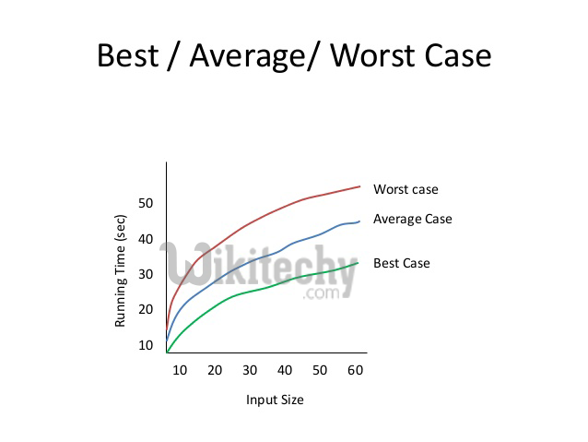
Usually, the time required by an algorithm falls under three types −
Best Case − Minimum time required for program execution.
Average Case − Average time required for program execution.
Worst Case − Maximum time required for program execution.
Performance analysis is calculated based on two factors –
Time Complexity
Space Complexity

Slide 7
What is Time & Space Complexity?
Time Complexity :-
Time complexity of an algorithm quantifies the amount of time taken by an algorithm to run as a function of the length of the input.
Time taken = Run time + Compile time.
It is used to compare algorithm to check the efficient one.
Space Complexity :-
Space complexity of an algorithm quantifies the amount of space or memory taken by an algorithm to run as a function of the length of the input.
An efficient algorithm takes space as small as possible.

Slide 8
Asymptotic Notations

Slide 9
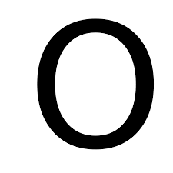
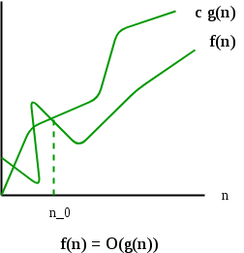

Big-Oh Notation - “ ”
The notation Ο($n$) is the formal way to express the upper bound of an algorithm's running time.
It measures the worst case time complexity or the longest amount of time an algorithm can possibly take to complete.
O(g($n$)) = { f($n$) : there exist positive constants c
and $n_{0}$ such that
0 <= f($n$) <= c*g($n$)
for all $n$ >= $n_{0}$ }

Slide 10
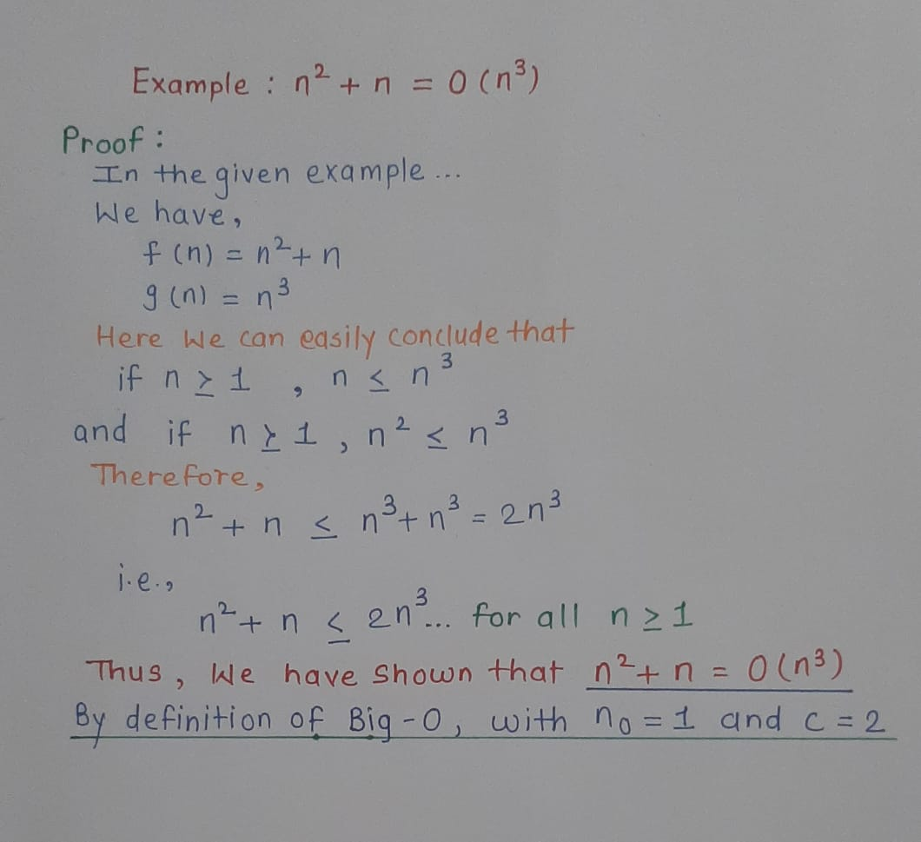

Slide 11

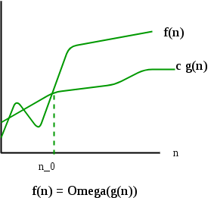

Big-Omega Notation – “ ”
The notation Ω ($n$) is the formal way to explain the lower bound of an algorithm’s running time.
It measures the best case time complexity of an algorithm.
The best case performance of an algorithm is generally not useful, the Omega notation is the least used notation among all three.
Ω (g($n$)) = {f($n$): there exist positive constants c
and $n_{0}$ such that
0 <= c*g($n$) <= f($n$)
for all $n$ >= $n_{0}$ }

Slide 12
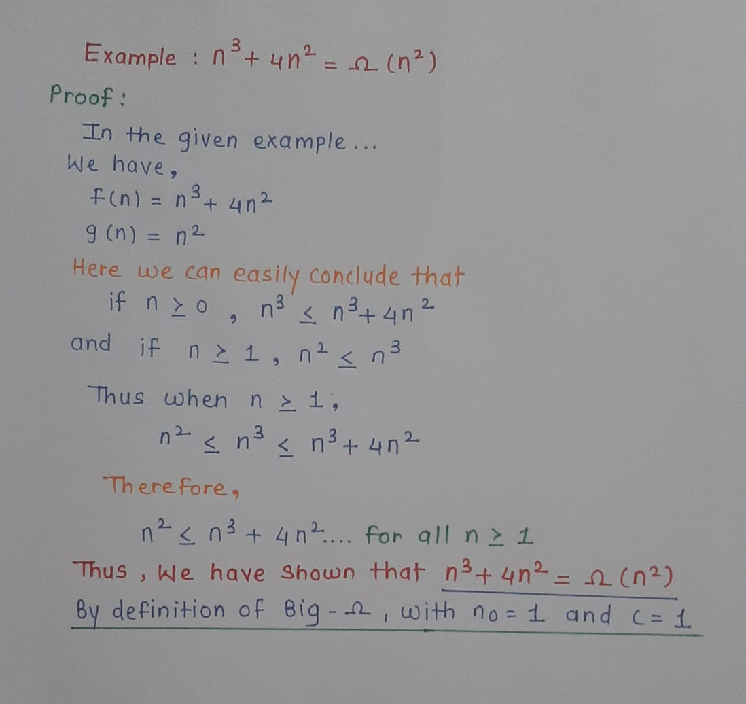

Slide 13
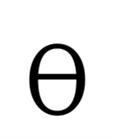
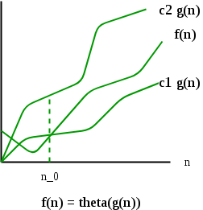

Big-Theta Notation – “ ”
The notation θ($n$) is the formal way to express both the lower bound and the upper bound of an algorithm's running time.
It measures the average case time complexity of an algorithm.
Θ(g($n$)) = {f($n$): there exist positive
constants c1, c2 and $n_{0}$ such that
0 <= c1*g($n$) <= f($n$) <= c2*g($n$)
for all $n$ >= $n_{0}$
}

Slide 14
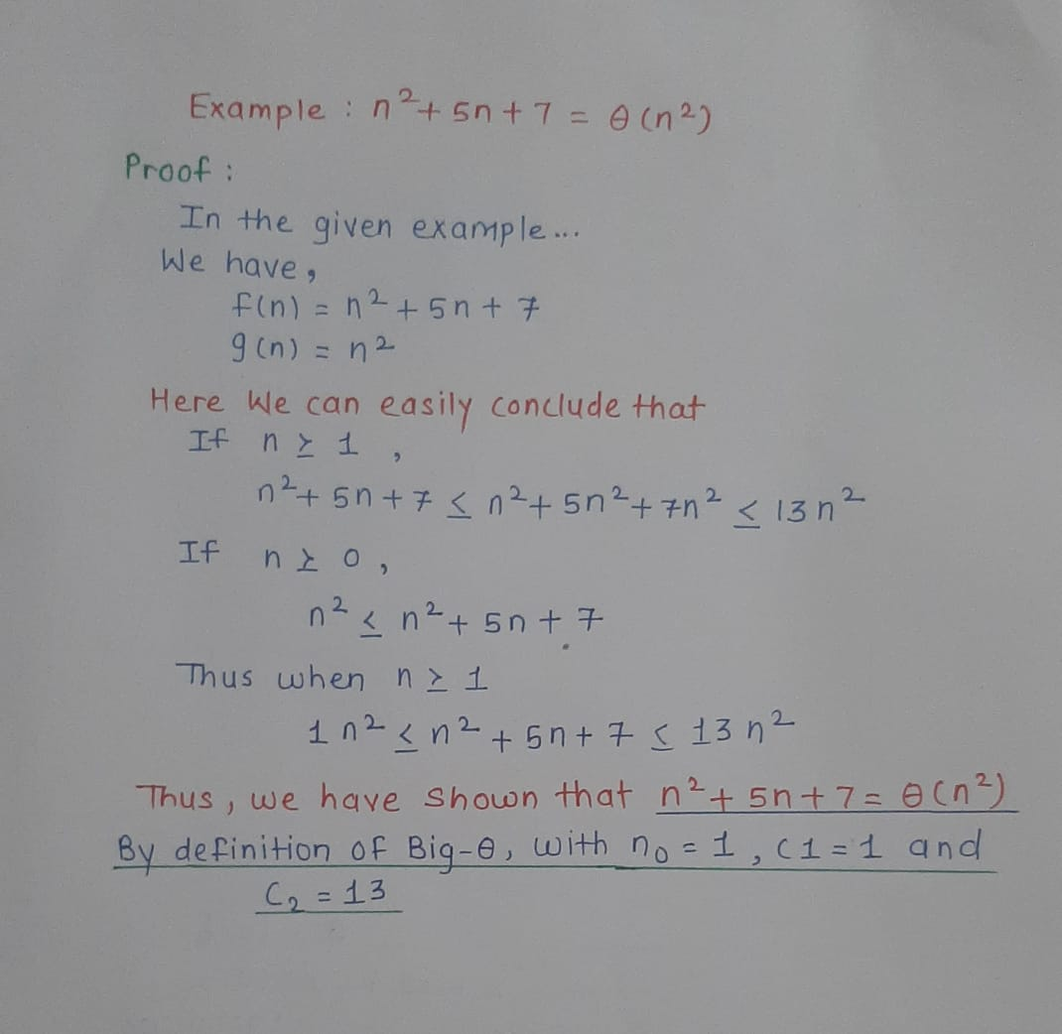

Slide 15
Difference Between Big Oh, Big Omega and Big Theta :
S.NO. | BIG OH | BIG OMEGA | BIG THETA
1. | It is like <= rate of growth of an algorithm is less than or equal to a specific value | It is like >= rate of growth is greater than or equal to a specified value | It is like == meaning the rate of growth is equal to a specified value
2. | The upper bound of algorithm is represented by Big O notation. Only the above function is bounded by Big O. asymptotic upper bond is it given by Big O notation. | The algorithm’s lower bound is represented by Omega notation. The asymptotic lower bond is given by Omega notation | The bonding of function from above and below is represented by theta notation. The exact asymptotic behavior is done by this theta notation.
3. | Big oh (O) – Worst case | Big Omega (Ω) – Best case | Big Theta (Θ) – Average case
4. | Big-O is a measure of the longest amount of time it could possibly take for the algorithm to complete. | Big- Ω is take a small amount of time as compare to Big-O it could possibly take for the algorithm to complete. | Big- Θ is take very short amount of time as compare to Big-O and Big-? it could possibly take for the algorithm to complete.
5. | Mathematically – Big Oh is 0 <=f(n) <= c g(n) for all n>=n0 | Mathematically – Big Omega is O<= C g(n) <= f(n) for all n>=n 0 | Mathematically – Big Theta is O<=C 2 g(n)<=f(n)<=C 1 g(n) for n>=n 0

Slide 16
Examples of Asymptotic Notations using different sorting techniques

Slide 17

Complexity
Worst Case: - O($n^{2}$)
Number of comparison in 1st pass : $n$-1
Number of comparison in 2nd pass : $n$-2
Number of comparison in last pass : 1
Total number of comparison:
($n$-1)+($n$-2)+……+1
=$n$($n$-1)/2 // Using sum of natural numbers
=($n^{2}$ - $n$)/2 = O($n^{2}$)
Best Case: - Ω($n$)
List already sorted, 1 pass of $n$-1 comparisons.
Average Case:- Θ($n^{2}$)

Slide 18

Bubble Sort
Algorithm bubble (a, $n$)
Unsorted array ‘a’ of length ‘$n$’. Sorted array in ascending order of length $n$
for i = 1 to ($n$ – 1) // $n$-1 passes
test = 0
for j = 0 to (($n$-1) – i ) //don’t compare sorted data
if ( a[j] > a[j+1] )
temp=a[j]
a[j]=a[j+1]
a[j+1]=temp
test = 1 //exchange happened
if (test = 0) // no exchange - list is now sorted
return

Slide 19

Selection Sort
Algorithm selection (a, length)
Unsorted array ‘a’ of length ‘$n$’. Sorted list in ascending order of length $n$
for i = 0 to ($n$ -2) // $n$-1 passes
min_index = i
for j = (i+1) to ($n$ -1)
if ( a[min_index] > a[j] )
min_index = j
if (min_index < > i) // place i^{th} smallest element at i^{th} place
temp= a[i]
a[i]=a[min_index]
a[min_index]=temp

Slide 20

Complexity
Worst & Best Case: - O($n^{2}$) and Ω($n^{2}$)
I pass ($n$-1) comparisons, II pass ($n$-2) comparisons & so on.
Thus, total comparisons:-
($n$-1) + ($n$-2) + ($n$-3) + …. + (1)
( $n$($n$-1))/2 // Using sum of natural numbers
O($n^{2}$ )
(Worst & best cases are same as an element has to be compared to all others to ensure that it is minimum.)

Slide 21

Insertion Sort
Algorithm insertion (a, length)
Unsorted list ‘a’ of length ‘$n$’. Sorted list a in ascending order of length $n$
for i = 1 to ($n$ -1) // $n$-1 passes
indata=a[i]
for j = (i-1)
if ( indata < a[j] )
a[j+1] = a[j] // shift elements
else
break
a[j+1] = indata // insert element at proper position

Slide 22

Complexity
Best Case: - Ω (𝑛)
List is already sorted. In each iteration, first element of unsorted list compared with last element of sorted list, thus ($n$-1) comparisons.
Worst Case: - O($n^{2}$)
List sorted in reverse order. First element of unsorted list compared with one element of sorted list, second compared with 2 elements. Last element to be inserted compared with all the n-1 elements.
1 + 2 + 3 + ………………… ($n$-2) + ($n$-1)
= ($n$ ($n$-1))/2
= O ($n^{2}$)
Average Case: - Θ($n^{2}$)

Slide 23
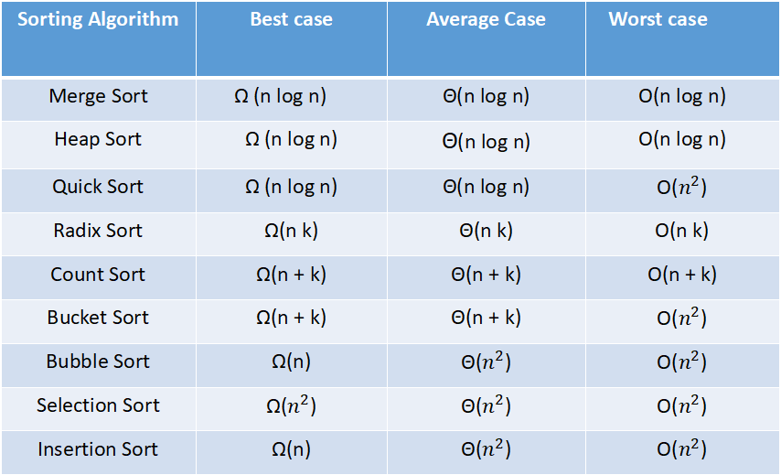
Time Complexity of different sorting techniques using asymptotic notations
Sorting Algorithm | Best case | Average Case | Worst case
Merge Sort | Ω (n log n) | Θ(n log n) | O(n log n)
Heap Sort | Ω (n log n) | Θ(n log n) | O(n log n)
Quick Sort | Ω (n log n) | Θ(n log n) | O($n^{2}$)
Radix Sort | Ω(n k) | Θ(n k) | O(n k)
Count Sort | Ω(n + k) | Θ(n + k) | O(n + k)
Bucket Sort | Ω(n + k) | Θ(n + k) | O($n^{2}$)
Bubble Sort | Ω(n) | Θ($n^{2}$) | O($n^{2}$)
Selection Sort | Ω($n^{2}$) | Θ($n^{2}$) | O($n^{2}$)
Insertion Sort | Ω(n) | Θ($n^{2}$) | O($n^{2}$)

Slide 24
Properties of Asymptotic Notations

Slide 25

1. General Properties
Example: f($n$) = 2$n$²+5 is O($n$²) then 7*f($n$) = 7*(2$n$²+5) = 14$n$²+35 is also O($n$²)
Similarly this property satisfies for both Θ and Ω notation.
If f($n$) is Θ(g($n$)) then a*f($n$) is also Θ(g($n$)); where a is a constant.
If f($n$) is Ω (g($n$)) then a*f($n$) is also Ω (g($n$)); where a is a constant.
2. Reflexive Properties
If f($n$) is given then f($n$) is O(f($n$)).
Example: f($n$) = $n$² ; O($n$²) i.e O(f($n$))
Similarly this property satisfies for both Θ and Ω notation.
If f($n$) is given then f($n$) is Θ(f($n$)).
If f($n$) is given then f($n$) is Ω (f($n$)).

Slide 26

3. Transitive Properties
If f($n$) is O(g($n$)) and g($n$) is O(h($n$)) then f($n$) = O(h($n$))
Example:
If f($n$) = $n$ , g($n$) = $n^{2}$ and h($n$)=n³ n is O($n^{2}$) and $n^{2}$ is O($n$³) then n is O($n$³)
Similarly this property satisfies for both Θ and Ω notation.
If f($n$) is Θ(g($n$)) and g($n$) is Θ(h($n$)) then f($n$) = Θ(h($n$))
If f($n$) is Ω (g($n$)) and g($n$) is Ω (h($n$)) then f($n$) = Ω (h($n$))
4. Symmetric Properties
If f($n$) is Θ(g($n$)) then g($n$) is Θ(f($n$))
Example:
f($n$) = $n^{2}$ and g($n$) = $n^{2}$ then f($n$) = Θ($n$²) and g($n$) = Θ($n$²)
This property only satisfies for Θ notation.

Slide 27

5 . Transpose Symmetric
Properties
If f($n$) is O(g($n$)) then g($n$) is Ω (f($n$)).
Example: f($n$) = $n$ , g($n$) = $n$² then n is O($n$²) and $n$² is Ω ($n$)
This property only satisfies for O and Ω notations.
Other Properties
If f($n$) = O(g($n$)) and f($n$) = Ω(g($n$)) then f($n$) = Θ(g($n$))
If f($n$) = O(g($n$)) and d($n$)=O(e($n$)) then f($n$) + d($n$) = O( max(g($n$),e($n$)))
Example: f($n$) = $n$ i.e O($n$) d($n$) = $n$² i.e O($n$²) then f($n$) + d($n$) = $n$ + $n$² i.e O($n$²)
If f($n$)=O(g($n$)) and d($n$)=O(e($n$)) then f($n$) * d($n$) = O( g($n$) * e($n$)) Example: f($n$) = $n$ i.e O($n$) d($n$) = $n$² i.e O($n$²) then f($n$) * d($n$) = $n$*$n$² = $n$³ i.e O($n$³)

Slide 28
STRATEGIES

Slide 29

Strategies for Big-O
Sometimes the easiest way to prove that f($n$) = O (g($n$)) is to take c to be the sum of the positive coefficients of f($n$).
We can usually ignore the negative coefficients. Why?
Example: To prove 5$n^{2}$ + 3$n$ + 20 = O($n^{2}$), we pick c = 5 + 3 + 20 = 28. Then if $n$ ≥ $n_{0}$= 1, 5$n^{2}$ + 3$n$+ 20 ≤ 28$n^{2}$, thus 5$n^{2}$ + 3$n$ + 20 = O($n^{2}$).
This is not always so easy. How would you show that (${\sqrt{2})}^{\log{n}}$+ $\log^{2}n$+ $n^{4}$ is O($2^{n}$)? After we have talked about the relative rates of growth of several functions, this will be easier.
In general, we simply (or, in some cases, with much effort) find values c and $n_{0}$ that work. This gets easier with practice.

Slide 30

Strategies for Ω and Θ
Proving that a f($n$) = Ω(g($n$)) often requires more thought.
Quite often, we have to pick c < 1.
A good strategy is to pick a value of c which you think will work, and determine which value of $n_{0}$is needed.
Being able to do a little algebra helps.
We can sometimes simplify by ignoring terms of f($n$) with the positive coefficients. Why?
The following theorem shows us that proving f ($n$) = Θ(g($n$)) is nothing new:
Theorem: f(n) = Θ(g($n$)) if and only if f(n) = O(g($n$)) and f($n$) = Ω(g($n$)).
Thus, we just apply the previous two strategies.

Slide 31
SUMMARY

Slide 32

Summary of the Notations
f ($n$) Є O (g($n$)) → f ≤ g
f ($n$) Є Ω (g($n$)) → f ≥ g
f ($n$) Є Θ (g($n$)) →f ≈ g
It is important to remember that a Big-O bound is only an upper bound. So an algorithm that is O($n^{2}$) might not ever take that much time. It may actually run in O($n$) time.
Conversely, an Ω bound is only a lower bound. So an algorithm that is Ω($n$ log $n$) might actually be Θ($2^{n}$).
Unlike the other bounds, a Θ-bound is precise. So, if an algorithm is Θ($n^{2}$), it runs in quadratic time.

Slide 33

Classification Summary
We have seen that when we analyze functions asymptotically:
Only the leading term is important.
Constants don't make a significant difference.
The following inequalities hold asymptotically:
c < log $n$ < $\log^{2}n$ < $\sqrt{n}$ < $n$ < $n$ log $n$
$n$ < $n$ log $n$ < $n^{(1.1)}$ < $n^{2}$ < $n^{3}$ < $n^{4}$ < $2^{n}$
In other words, an algorithm that is Θ(n log($n$)) is more efficient than an algorithm that is Θ($n^{3}$).

Slide 34
Thank You for tuning in!

