Slide 1
WIRELESS POWER TRANSFER
SHREYASH BHATKAR - 41

Slide 2
Overview
Introduction
History
Why is WPT?
Methods
Benefits of WPT
Advantages and disadvantages of WPT
Application of WPT
Conclusion

Slide 3
INTRODUCTION
Wireless power transfer (WPT) is the transmission of electrical energy from a power source to an electric load without wires.
This phenomenon is also called as WITRICITY
The main reason for power loss during transmission and distribution is the resistance of wires used in grid.
According to studies, most of the energy loss Is during transmission:
On an average, more than 30%
In India, it exceeds 40%

Slide 4
In 1899 Nikola Tesla was able to light lamps over 25 miles away without using wires. Also the high frequency current of tesla coil, could light lamps filled with gas (like Neon).
In 1964 William. C Brown demonstrated a Rectenna which would convert Microwaves Power to Electricity.
INNOVATIONS:

Slide 5
01
02
Sir NICOLA TESLA was the first person to propose and research the idea of wireless transmission in 1899, since many scholars are working to make his dream into reality.
1899: Tesla continuous wireless power transmission in Colorado in springs and writes “The inferiority of the induction method would appeared immense as compared as the disturbed charge of the ground and air method.”
03
2009: Sony shows wireless electrodynamics-induction powered TV set,60W over 50cm.
.
HISTORY

Slide 6
ADVANTAGES OF WIRELESS PT.
- Fast
- Reliable to use
- Efficient
- Low maintenance cost
- Can be used for short range as well as long range

Slide 7
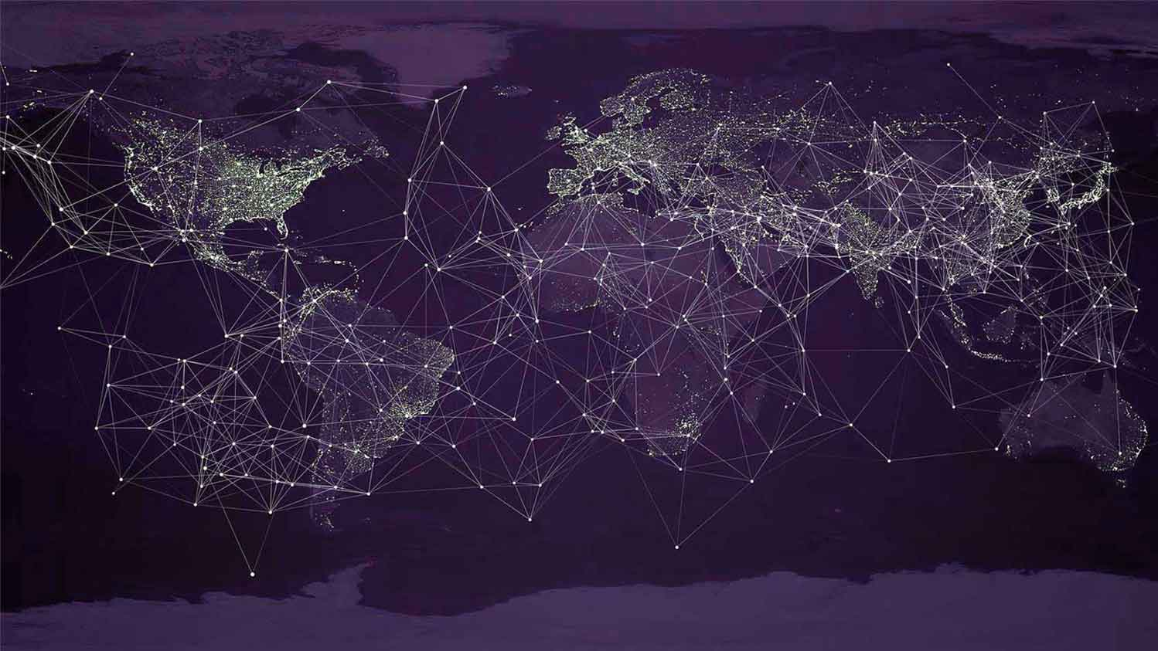
METHODS OF WIRELESS POWER TRASNMISSION:
Near field techniqueS :
Capacitive coupling
Inductive coupling
Magneto dynamic coupling
Far field techniqueS :
Microwave power transmission
Laser power transmission

Slide 8
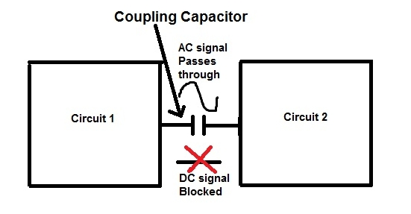
CAPACITIVE COUPLING:
Capacitive coupling also referred to as electric coupling.
It makes use of electric fields for the transmission of power between two electrodes (an anode and cathode) forming a capacitance for the transfer of power.
Capacitive coupling has a few advantages over inductive coupling. The field is largely confined between the capacitor plates, reducing interference, which in inductive coupling requires heavy ferrite "flux confinement" cores.

Slide 9
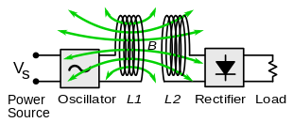
INDUCTIVE COUPLING:
In inductive coupling (electromagnetic induction or inductive power transfer, IPT), power is transferred between coils of wire by a magnetic field.
.
An alternating current (AC) through the transmitter coil (L1) creates an oscillating magnetic field (B) by Ampere's law. The magnetic field passes through the receiving coil (L2), where it induces an alternating EMF (voltage) by Faraday's law of induction, which creates an alternating current in the receiver.
.

Slide 10
MAGNETO DYNAMIC COUPLING:
In this method, power is transmitted between two rotating armatures, one in the transmitter and one in the receiver, which rotate synchronously, coupled together by a magnetic field generated by permanent magnets on the armatures.
.
.
The magnetic field acts like a mechanical coupling between the armatures.
It is claimed that this technique can transfer power over distances of 10 to 15 cm (4 to 6 inches) with high efficiency, over 90%.
.

Slide 11
Far - Field techniques Microwave power transmission:ssion
Power transmission via radio waves can be made more directional, allowing longer-distance power beaming, with shorter wavelengths of electromagnetic radiation, typically in the microwave range.
A rectenna may be used to convert the microwave energy back into electricity.
.
.
Rectenna conversion efficiencies exceeding 95% have been realized.
Power beaming using microwaves has been proposed for the transmission of energy from orbiting solar power satellites to Earth and the beaming of power to spacecraft leaving orbit has been considered.

Slide 12
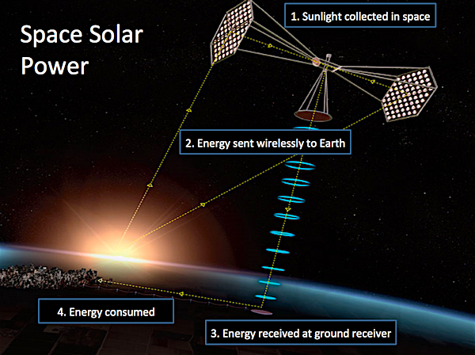

Slide 13
Lasers:ion
In the case of electromagnetic radiation closer to the visible region of the spectrum (tens of micrometers to tens of nanometers), power can be transmitted by converting electricity into a laser beam that is then pointed at a photovoltaic cell.
.
.
.
This mechanism is generally known as power beaming because the power is beamed at a receiver that can convert it to electrical energy. At the receiver, special photovoltaic laser power converters which are optimized for monochromatic light conversion are applied.
.

Slide 14
Benefits of WPT:
Allows for charging of multiple devices.
High charging speeds: though at the moment wireless charging offers a slower charging rate than the wired option, advances in resonance and induction technology
Wireless Power Transmission
Wireless power transfer allows for greater spatial freedom between the source and the device.
Eliminating charging cords enables engineers to make compact and watertight devices

Slide 15
Benefits of Wireless Power Transfer
The circuit become less complex because of the absence of resistance in cable .
Cable losses is reduced it is in form of heat which decreases the efficiency of devices.
.
Wireless Power Transmission
It will reduce the cost of electrical energy used by consumer.
The area is reduced and can be used for other purpose these areas are taken by tower ,long wire
etc.

Slide 16
DISADVANTAGES OF WIRELESS POWER TRANSFER
- The initial construction cost is high.
- Air ionization technique should not be feasible.
- Distance constraints .
- There must be high frequency supply .
- Field strength should be in safety level .
.

Slide 17
APPLICATIONS OF WIRELESS POWER TRANSFER
- The largest application of the WPT is the production of power by placing satellites with giant solar arrays in Geosynchronous Earth Orbit and transmitting the power as microwaves to the earth known as Solar Power Satellites (SPS).
- WPT is used in moving targets like fuel-free-electric vehicles, fuel- free airplanes, fuel-free rockets and moving robots.
- The other applications of WPT are Wireless power source or Ubiquitous Power Source, RF Power Adaptive Rectifying Circuits and Wireless sensors.
.

Slide 18
CONCLUSIONS
- Transmission without wires a reality.
- Efficient.
- Low maintenance cost. But, high initial cost.
- Better than conventional wired transfer.
- Energy crisis can be decreased.
- Low loss.
- ln near future, world will be completely wireless
.

Slide 19
REFERENCES:
1. https://ieeexplore.ieee.org/document/5596172
2. https://digital -library.theiet.org/content/books/po/pbpo112e
3. https://www.itu.int/dms_pub/itu-r/opb/rep/R-REP-SM.2392-2016-PDF
4. https://space.nss.org/wireless-power-transmission-video/
5. RESEARCH PAPER BY D. SENGUPTA ON WPT USING MICROWAVES.

Slide 20
THANK YOU!
HOPE YOU LEARNT SOMETHING OF VALUE TODAY!

