Slide 1
Title of the Project: ElectraWear
SHREYASH BHATKAR
FY-L-29

Slide 2
Introduction
THE DAY TO DAY HAPPENINGS IN THE SOCIETY, AREN'T MUCH FRIENDLY FOR WOMEN AND WOMEN'S SAFETY IS AT RISK. WE NEED TO STOP SUCH MALFUNCTIONS AND FIX THOSE LOOPHOLES IN OUR SOCIETY. THEREBY WE'RE CREATING A “STUN GUN” FUSED WITH FOOTWEAR. WHEN A PERSON WALKS PRESSURE IS EXERTED ON THE GROUND AND THIS PRESSURE CAN BE CONVERTED INTO ELECTRICAL ENERGY AND THIS ENERGY CAN BE USED TO ELECTROCUTE THE PERPETRATORS OF CRIME. MORE THE USER WALKS MORE ENERGY WILL BE CREATED AND STORED .
Concept:
Piezoelectricity was present ever since mid-18th century. Piezoelectricity is the electric charge that accumulates in certain solid materials (such as crystals, certain ceramics in response to applied mechanical stress.

Slide 3
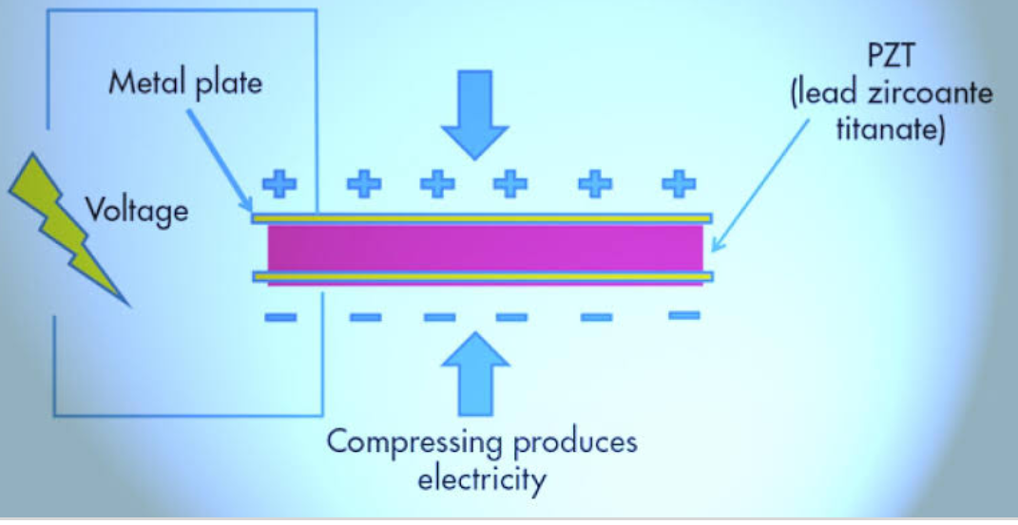
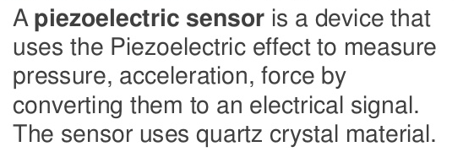
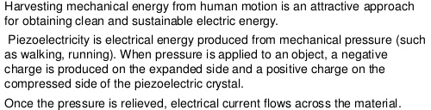
theory

Slide 4
Details of the materials used
Following components have been used :
Piezoelectric crystals(5 pieces in circular shape)
Connecting wires
Shoe
Led(For testing purpose)
Full wave bridge rectifier
Capacitor(3500 micro Farady)

Slide 5
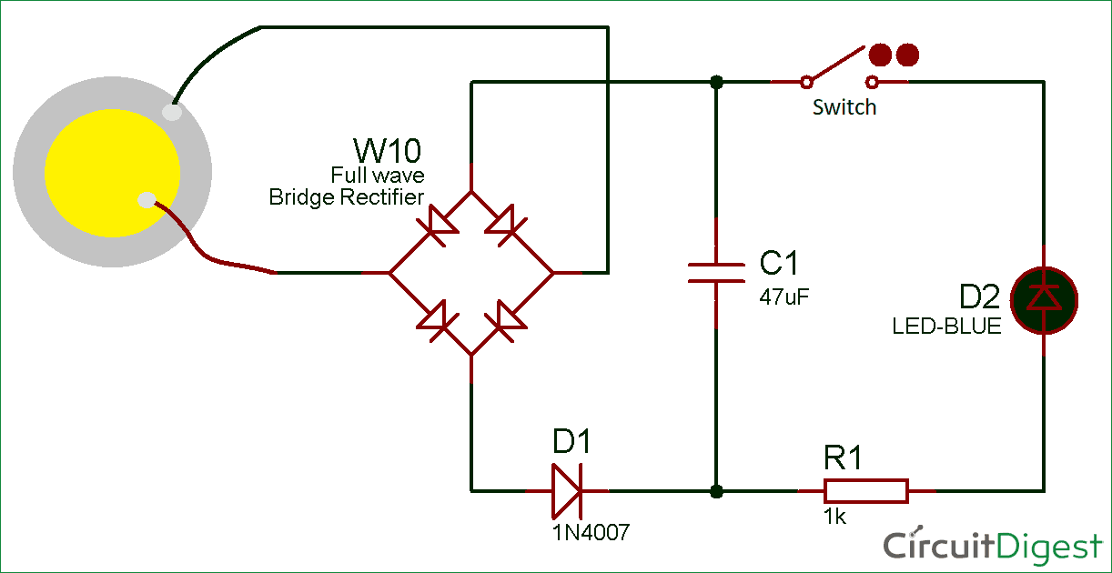
Methodology /designing
Piezoelectric crystal is classified under ferroelectric material.
When we give mechanical strain it will convert it in to elec-trical energy.
A tile made by piezoelectric material is made.
When we give mechanical pressure can be either from the weight of the moving vehicles or from the weight of the people walking over it, the tile due to piezoelectric material it will converted in to electrical energy in the form of AC.
The obtained AC is not in steady state so a bridge rectifier is used to convert variable AC to constant DC. And stored in battery.

Slide 6
Results and Discussions:
The main aim of this paper is to generate power in a noncon-ventional, nonpolluting form of energy can be harvested and maintain economically.
The electric power is produced from the mechanical strain to electrical energy by piezoelectric material (PZT).
The PZT (Lead Zirconate titanate) has used to generate electric power, because it is easily polarized and low field strength, high coupling factor.
The (PZT) is superior in all characteristics than other transducers. In future the piezoe-lectric is main source to generate electric energy.
With future development in the field of electronics better manufactured piezoelectric crystals and better selection of place of installa-tion to get more electricity can be generated.
Though this is just an idea of us. The work model implementation and conceptualization would require some effort and time on our part.

Slide 7
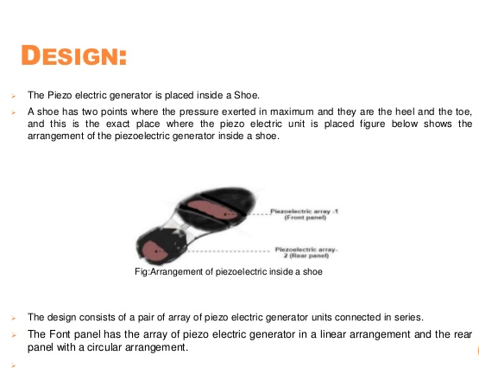
DESIGN

Slide 8
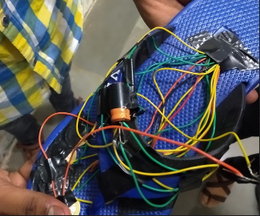
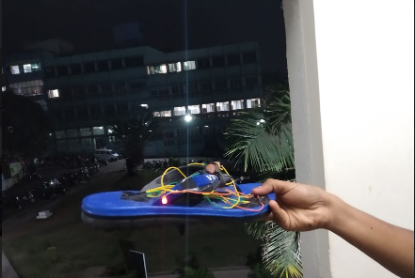
IMPLEMENTATIONS / FINAL PRODUCT

Slide 9
Problems Faced:
Due to the small size of the circuit the amount of electricity produced is very small.
Limitations of the projects
Can pick up stray voltages in connecting wires.
Crystal is prone to damage/crack if overstressed.
May get affected by long use at high temperatures.

Slide 10
FUTURE SCOPE
The piezoelectric better crystals have being start use with positive result.
In India, maximum public movement is observed in rail way stations, temples, and shopping malls; hence this places can be used for piezoelectric crystals for generation of electric power.
Apart from all the above places a attempts are made to develop energy from our daily life by initialing piezoelectric crystals in shoe thus in each step piezoelectric shoe can be used to electrocute the criminals.

Slide 11

REFERENCES
https://circuitdigest.com/electronic-circuits/foot-step-power-generation-circuit-using-piezoelectric-sensor
https://en.wikipedia.org/wiki/Piezoelectric_sensor
http://en.jkelec.com/index.php?c=content&a=show&id=405&gclid=CjwKCAiAlO7uBRANEiwA_vXQ-6RrFP5stNgDtWlx437E_Nq56qyaA9InnmZv6zU5Hos3mYTVX0N54xoC2GIQAvD_BwE
https://www.elprocus.com/what-is-a-piezoelectric-sensor-circuit-specifications-and-applications/
Youtube Links:https://youtu.be/4nbBAG-848c
https://www.youtube.com/watch?v=95igv1NXFDA

Slide 12
Thank you FOR YOUR TIME

