Slide 1
Introduction Service Oriented Architecture
Oxford University
Software Engineering Programme
Sep 2015

Slide 2
Introduction
Aims
Pre-requisites
Contents
Connections
Resources
Rules of Engagement
Introductions

Slide 3
Aims
Understanding of Principles
Exploration of de facto and de jure standards
Practical experience of different technologies
Architecture and Design
Wider context

Slide 4
Pre-requisites
Covered by the Pre-Study Guide!
XML including XML namespaces and XML schema
JSON JSON is dead simple but it would help if you have looked at it before
Java
Basic Java language skills
Unix Command Line / sh

Slide 5
Contents
Evolution of distributed computing
REST Architecture: HTTP, Resources, URIs, HATEOAS
JAX-RS
Web Services: WS-*, etc
Microservices
JAX-WS
REST and SOAP compared
SOA in Action – Amazon and Amazon EC2, Netflix, PEPPOL

Slide 6
Contents continued
Intermediation: ESBs and Enterprise Integration Patterns
Quality of Service: WS-Security, SAML2, XACML, OAuth, etc
Governance
API Management
Composition and Orchestration: BPEL and BPMN
Other Patterns: Thrift, Protocol Buffers, EDA, MQTT, AMQP, etc

Slide 7
Practicals
Creating a REST Service using JAX-RS
Creating a SOAP Service using JAX-WS
Security
Governance and Registry lookup at runtime
ESB intermediation and transformation
API Management and OAuth2
BPMN and process orchestration

Slide 8
Connections
Objects (OOR, OOD, OOP, DPA, SPL)
Formal techniques (SEM, SDE)
Concurrency (CDS, ACT, MOB)
Security (SPR, SRO, DES, NES)

Slide 9
Resources
Singh and Huhns, Service Oriented Computing (Wiley, 2005)
Josuttis, SOA in Practice (O’Reilly, 2007)
Erl, SOA (Prentice-Hall, 2005)
Szyperski, Component Software (Addison-Wesley, 2nd Ed, 2002)
Richardson and Ruby, RESTful Web Services (O’Reilly, 2007)
Weerawarana et al, Web Services Platform Architecture, (Pearson, 2005)
Fielding, Architectural Styles and the Design of Network-based Software Architectures, (University of California, 2000)
Various W3C, OASIS, IETF, OMG standards

Slide 10
Rules of Engagement
Ask questions as we go along
We will “park” any that are better answered later
Don’t wait till the end to ask or raise concerns
Timings are flexible
Please keep mobile phones silent or better still turned off
If you have improvements, please submit issues or pull requests:
https://github.com/pzfreo/ox-soa/issues/new

Slide 11
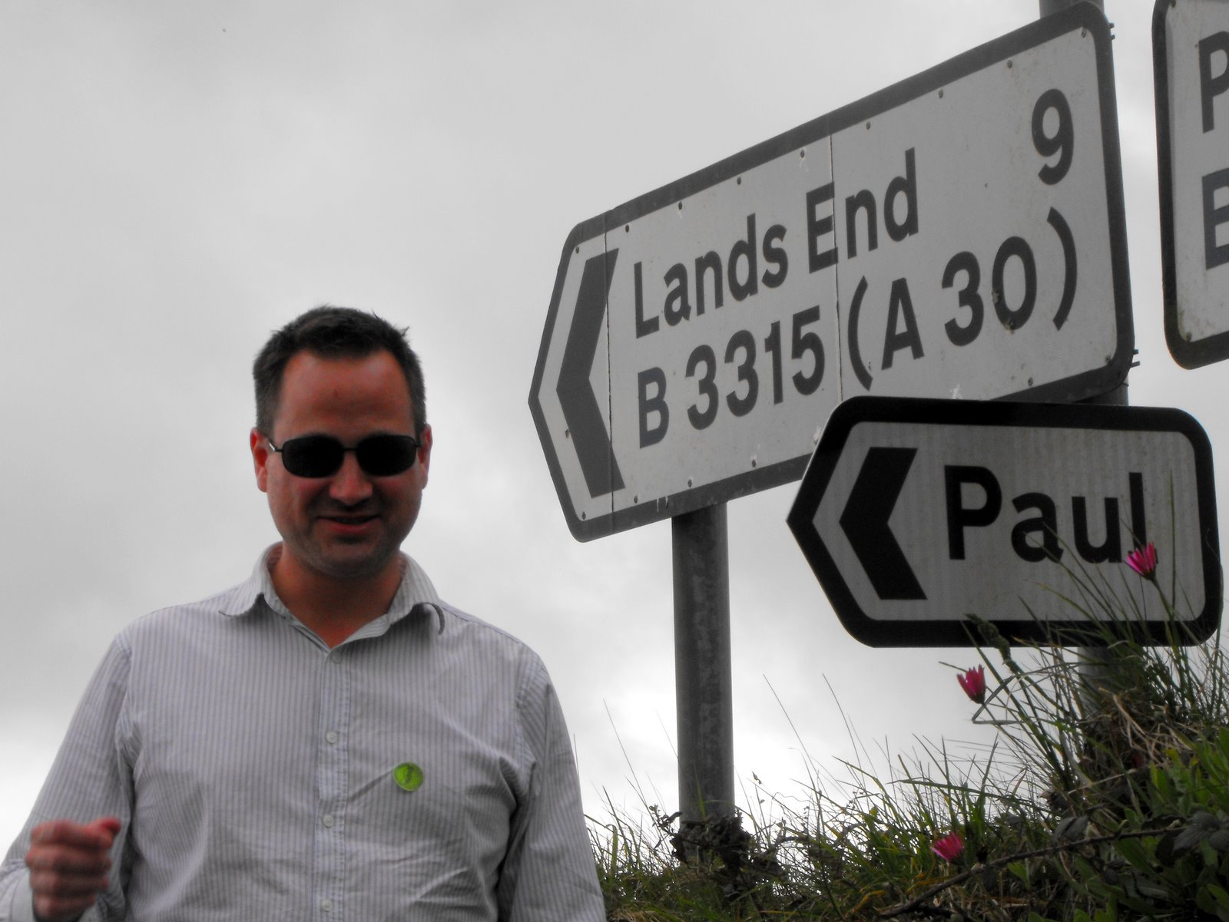
Paul Fremantle
CTO and Co-Founder of WSO2
Previously Senior Technical Staff Member, IBM WebSphere architecture
Co-Chair Web Services Reliable eXchange at OASIS (WSRM)
VP, Apache Synapse and Member of ASF
MA in Maths and Philosophy
MSc in Computation (1995)
Part time PhD student
Plays the tin whistle

Slide 12
You?

Slide 13
Approximate Schedule
Monday | Tuesday | Wednesday | Thursday | Friday
Introduction | SOAP and WS-* SOA in Action | ESB, Intermediation Architecture | Orchestration, Choreography | Other Models: Thrift, ProtoBuf, Avro Event Driven Architecture
Evolution of Distributed Computing | JAX-WS Practical | ESB Practical | Process Management Practical | Engineering Conclusion
REST/JAX-RS | QoS and WS-Security Other Security: SAML2, XACML, OAuth2 | Governance, Dependency Management | API Management APIs vs Services
JAXRS Practical | WS-Security Practical | Registry Practical | API Management Practical

Slide 14

Let’s get started

