Slide 1
Understanding HTTP and REST – part 2
Oxford University
Software Engineering Programme
Sep 2015

Slide 2
REST
Roy Fielding, a principal author of HTTP 1.1
PhD thesis Architectural Styles and the Design of Network-based
Subsequent article Principled Design of the Modern Web Architecture (ACM TOIT 2:2, 2002)
Richardson & Ruby, RESTful Web Services architectural patterns of the web
Software Architectures (2000) more about evaluation than a cookbook
Taking HTTP seriously as a distributed computing protocol: fixed few verbs, emphasis on the nouns

Slide 3
Client Server (CS)
Server offers services, listens for requests
Client sends request, waits for response
Transient, triggering client; persistent, reactive server
Separation of concerns: user interface from behaviour
Improves portability to a new user interface
Improves scalability by simplifying components
Improves evolvability by allowing independent evolution of components

Slide 4
Replicated Repository (RR) and Caching ($)
Replicated repository: multiple servers provide same service
Present the illusion of a single, centralized service
Improves performance: latency, redundancy
Maintaining consistency the primary challenge
Caching: caching responses for later reuse
Effectively a replication of a fragment (typically, potential data set is huge or infinite)
Responses explicitly or implicitly labelled cacheable or not
Lazy or active replication
Less effective than full replication, but cheaper and simpler

Slide 5
Stateless (S)
Each request from client must carry all necessary context
No session state stored on server — kept entirely on client
Resource state is a different matter
Improves visibility for monitoring
Improves reliability by simplifying recovery from partial failure
Improves scalability by allowing server to free resources quickly
Improves evolvability by simplifying server, cache
Decreases performance by increasing overhead

Slide 6
Layered Systems
Hierarchical arrangement
Layer provides services to layer above, uses services from layer below
Improves evolvability and reusability through abstraction
Decreases performance through overhead, latency
Layered-client-server (LCS) adds proxy and gateway components to CS
Proxy acts as shared server for one or more clients, forwarding (maybe translated) requests
Gateway appears as normal server, but forwards (maybe translated)
Requests to lower layers: load balancing, security

Slide 7
Uniform Interface
Improves simplicity and visibility
Decreases efficiency through possible data translations
For REST, optimized for large-grain hypermedia data transfer
Identification of resources
Manipulation of resources through representations
Self-descriptive messages
Hypermedia as the engine of application state (more later)

Slide 8
Virtual Machine (VM) and Code-on-Demand (COD)
Mobile code
Dynamically relocate processing between data source and destination
Improves performance by relocating code near data
Data element must be transformed into component
Extend client functionality by downloading applets/scripts
Virtual machine to provide controlled environment
Improves simplicity and extensibility of client
Reduces visibility
Not a big part of REST-based SOA (yet: cf AJAX)

Slide 9
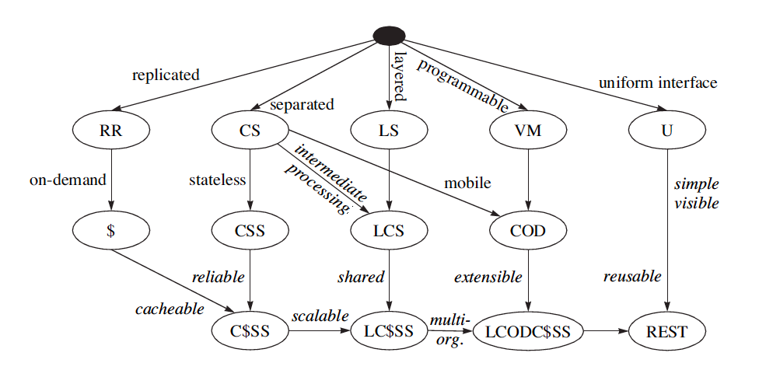
REST Derivation from Style Constraint

Slide 10
Principles of REST Architecture
REST isn't protocol specific, but in practice means the RESTful usage of HTTP
HTTP is actually a very rich application protocol which gives us features like content negotiation and distributed caching.
HTTP verbs nicely map to CRUD operations of data
RESTful web services try to leverage HTTP in its entirety using specific architectural principles.

Slide 11
Resources and Uniform Interface
Addressable Resources. Every “object” on your network should have a unique ID.
An important aspect is that each “object” or resource has its own specific URI where it can be addressed
Anything you wish to act upon, reference, annotate, etc
The URI should have a lifetime equivalent to the resource it represents (e.g. I’ve had the same bank account for 20+ years)

Slide 12
Representation
State of resource captured and transferred between components
Might be current or desired future state
Represented as data plus metadata (name–value pairs)
Metadata includes control data, media type
The Content-Type of the resource should be useful and meaningful (self-description)
One resource might have several representations
Selected via separate URIs, or via content negotiation

Slide 13
Stateless Interaction
Abstract interface for component communication
Stateless interactions:
connectors need not retain application state between requests
interactions can be processed in parallel, naively
intermediary may view and understand request in isolation
reusability of cached response can be determined from response itself
Request parameters: control data, target URI, optional representation
Response parameters: control data, optional resource metadata, optional representation

Slide 14
Uniform Interface
A Uniform, Constrained Interface. When applying REST over HTTP, stick to the methods provided by the protocol
GET, POST, PUT, and DELETE.
These should be used properly
GET should have no side effects or change on state
PUT should update the resource “in-place”

Slide 15
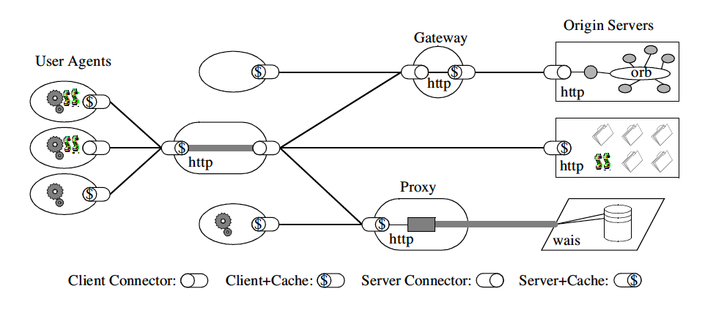
REST Architecture

Slide 16
REST Standards
HTTP 1.1
URI
URI Template
WebSockets
XML, JSON, etc
Atom/AtomPub
OData
OpenId
OAuth 1 / 2
SAML/SAML2
JSON Web Tokens
WADL
Swagger
Json Home
Json Web Encryption
Json Web Signature
Json Patch
SPDY
HTTPbis
HTTP Link Header
Microformats
RDDL
…

Slide 17
Async
HTTP is synchronous: request–response
What about long-running requests? deferred synchronous interaction
Client POSTs request (because not idempotent)
POST /queue HTTP/1.1
Host: jobservice.com
Please tell me whether 2ˆ43,112,609 - 1 is prime
server queues task, returns code 202 ‘Accepted’ with
URI Location: http://jobservice.com/queue/job11a4f9
202 Accepted
Client polls resource:
GET /queue/job11a4f9 HTTP/1.1
getting either status report or result
Of course WebSockets could be used to push the response
Also see new Push API from W3C

Slide 18
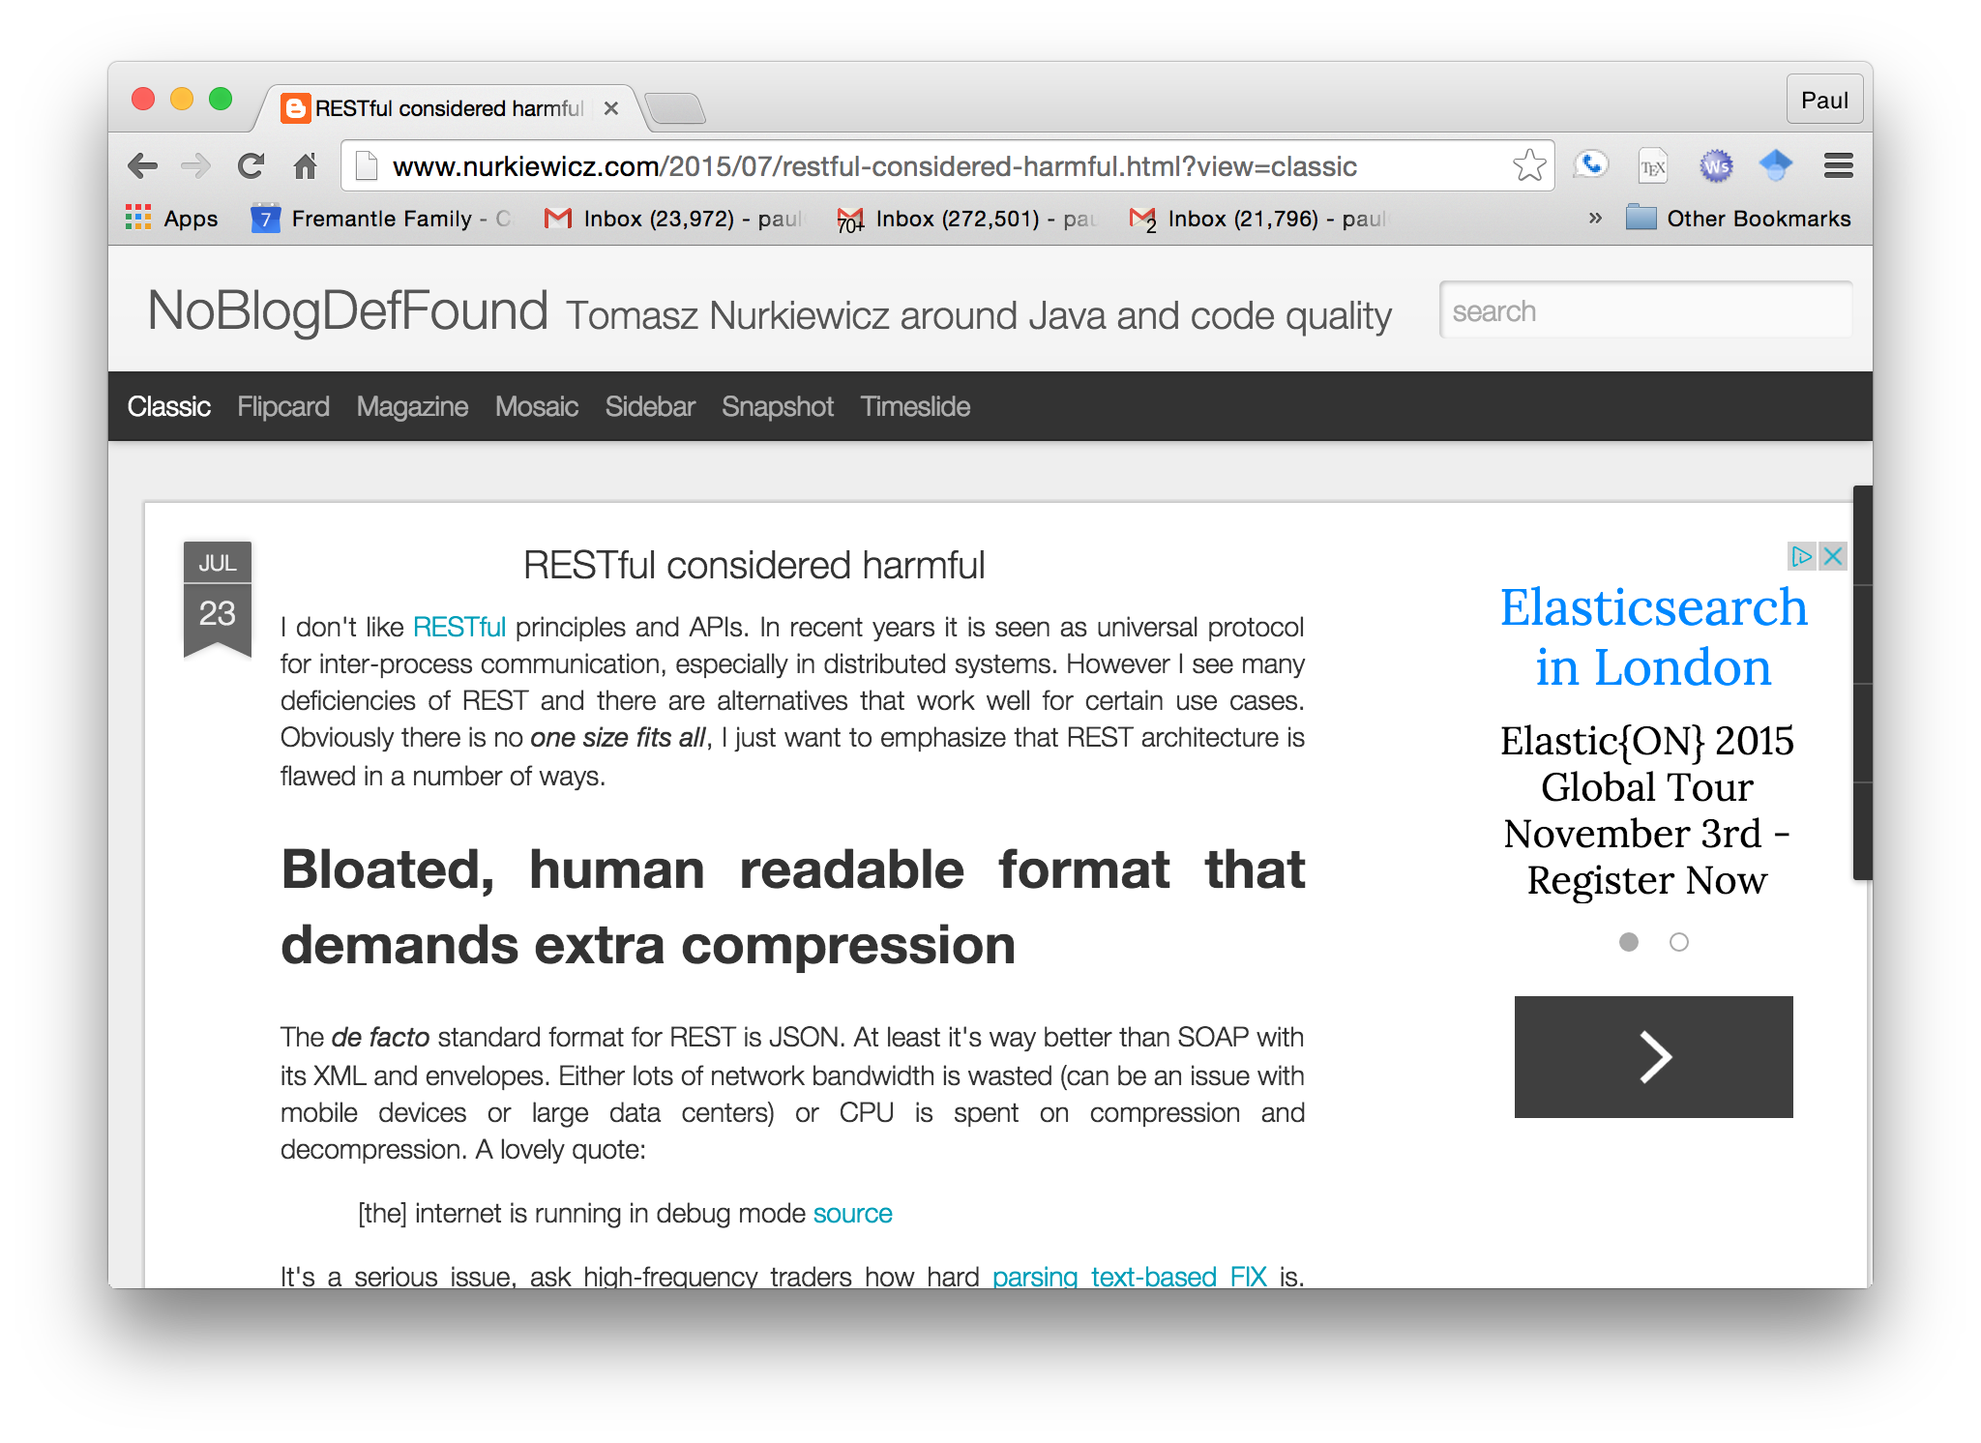
Not everyone agrees: http://www.nurkiewicz.com/2015/07/restful-considered-harmful.html

Slide 19
Anti-REST concerns
Bloated formats (equally applies to SOAP)
Neither Schema nor Contract
APIs and discovery instead of clear published machine-readable documentation
No inbuilt batching, paging, sorting, etc
CRUD only
HTTP Status codes mixed with business replies
Temporal Coupling
Not clear enough what is REST and what isn’t!
Backwards compatibility

Slide 20
Questions?

