Slide 1
Creating REST Clients
Oxford University
Software Engineering Programme
Sep 2015

Slide 2
Just do it?!

Slide 3
A good answer if you already know
HTTP Client code
XML
JSON
etc

Slide 4
First try it out
Chrome Advanced REST Client is a good start
SOAPUI also provides test capabilities
curl should be your friend too!

Slide 5
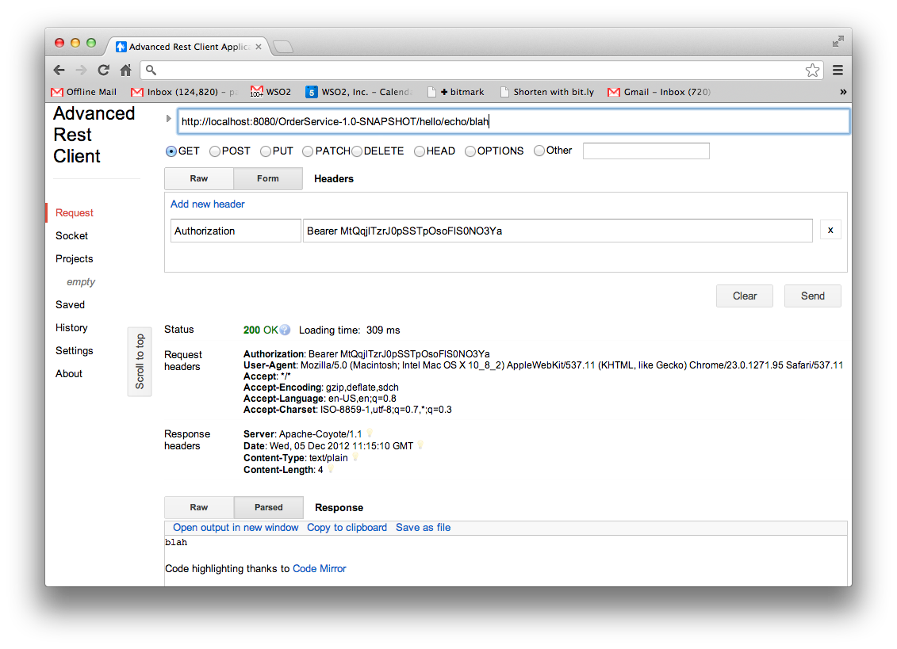

Slide 6
curl
curl -v http://localhost:8080/OrderService-1.0-SNAPSHOT/hello/echo/blah
* About to connect() to localhost port 8080 (#0)
* Trying ::1...
* connected
* Connected to localhost (::1) port 8080 (#0)
> GET /OrderService-1.0-SNAPSHOT/hello/echo/blah HTTP/1.1
> User-Agent: curl/7.24.0 (x86_64-apple-darwin12.0) libcurl/7.24.0 OpenSSL/0.9.8r zlib/1.2.5
> Host: localhost:8080
> Accept: */*
>
< HTTP/1.1 200 OK
< Server: Apache-Coyote/1.1
< Date: Wed, 05 Dec 2012 11:20:17 GMT
< Content-Type: text/plain
< Content-Length: 4
<
* Connection #0 to host localhost left intact
blah* Closing connection #0

Slide 7
Next choose your favourite HTTP library
JS: XMLHttpRequest
.NET: System.Net.Http.HttpClient
Java: Many! Built-in: java.net.URLConnection CXF: org.apache.cxf.jaxrs.client.WebClient Apache: org.apache.http.client.HttpClient
Google HTTP Client, etc, etc
Ruby
https://www.ruby-toolbox.com/categories/http_clients (too many to list)

Slide 8
JAX-RS 2.0
Includes support for clients
Available since CXF 3.0.0

Slide 9
JAX-RS 2.0 Features
Client API
Client-side and Server-side Asynchronous
Filters and Interceptors
Improved Connection Negotiation
Validation
Hypermedia
Alignment with JSR 330
Model-View-Controller

Slide 10
JAXRS 2.0 Client API
Similar to CXF client
Aiming to be much higher level than standard HTTP clients
Not a bad idea, but don’t give up on “loose coupling”
The client and the service are independent
Technology choice of one shouldn’t influence the technology choice of the other

Slide 11
Example JAX-RS Client Code
Client client = ClientBuilder.newBuilder().newClient();
WebTarget target = client.target("http://localhost:8080/rs");
target = target.path("service").queryParam("a", "avalue");
Invocation.Builder builder = target.request();
Response response = builder.get();
Book book = builder.get(Book.class);

Slide 12
Example HTTPClient code
HttpClient client = new DefaultHttpClient();
{
HttpGet request = new HttpGet(url);
HttpResponse response = client.execute(request);
System.out.println("Response status:" + response.getStatusLine());
System.out.println("Response data:");
HttpEntity entity = response.getEntity();
if (entity != null) {
BufferedReader br = new BufferedReader(new InputStreamReader(
(entity.getContent())));
String output;
while ((output = br.readLine()) != null) {
System.out.println(output);
}
}
}

Slide 13
Example Python Code
h = httplib2.Http();
resp, content = h.request("http://api.openweathermap.org/data/2.5/weather?q="+city)
try:
response=json.loads(content)
main = response['main']
temp = round(main['temp'] - 273.15,2)
humidity = main['humidity']
pressure = main['pressure']
wind = response['wind']
windspeed = wind['speed']
winddirection = wind['deg']
country = response['sys']['country']
city = response['name']

Slide 14
Example CXF Client code
WebClient client = WebClient.create(url); Response r = client.accept(MediaType.APPLICATION_JSON).get();
int status = r.getStatus();
String jsonString = IOUtils.toString((InputStream) r.getEntity());

Slide 15
Questions?

