Slide 1
Introduction to SOA Security
Oxford University
Software Engineering Programme
Dec 2013

Slide 2
Security Aims
Confidentiality
Integrity
Availability
Authenticity
Non-Repudiation
Authorization

Slide 3
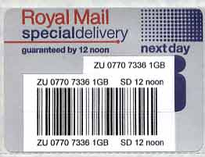
In Real Life
The opacity of the envelope provides confidentiality
The seal on the envelope provides integrity
Royal Mail hopefully provides availability
The signature provides authenticity
The proof of posting and “signed-for” provide non-repudiation
None of these match up to the standards of electronic security

Slide 4
Confidentiality
Provided by Encryption
On the web, 99% of the time using TLS
TLS is the successor to SSL
And often referred to as SSL!
If you want to understand TLS well, this is about the best resource I’ve seen:
http://www.moserware.com/2009/06/first-few-milliseconds-of-https.html

Slide 5
Encryption is pointless without authenticity/identity
If I encrypt the message aimed at the wrong person, I have failed
Encryption key distribution was the biggest issue until
1973: Ellis, Cocks and Williamson of GCHQ created first “non-secret crypto”
Only made public in 1997
1976: Diffie Helman key exchange
1977: Rivest Shamir Adleman (RSA) public key cryptography

Slide 6
A simple analogy
Padlocks which cannot be explored, re-engineered or re-used
Keys which cannot be reverse-engineered into a padlock

Slide 7
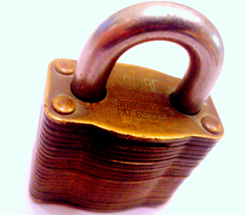
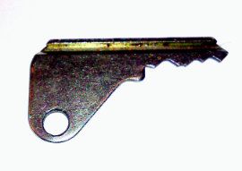
Public Key Encryption
You send out as many padlocks as you like, but you keep the key secret
2. I lock the message in a box with YOUR padlock and send it to you
3. Only you have the key, so only you can read the message

Slide 8
Authenticity
Need to Sign the message
Now I send out lots of keys but keep the padlocks secret
Anything I lock up in a box with my padlock must come from me
Anyone can unlock it and verify its from me

Slide 9
Authenticity
The actual implementation of this is different
Most interactions
only use PKI for one sided authenticity (do I trust the server?),
HTTP Basic Auth for the client
No direct trust of the server (I don’t want to store a key for every server I talk to)
Certificate Authority model
I trust the CA, the CA trusts the Website => I trust the website

Slide 10
HTTP Authorization
Mutual TLS/SSL
Hardly ever used. Requires managing certificates for every client
Have you tried to get your mum to install a client cert?!
Basic Auth
Easy, fast, effective
Completely insecure except over HTTPS – base64 encoding
Digest
Hash of the password

Slide 11
Basic vs Digest
Digest looks good on the wire
Secure hash of the password is passed over the wire
How does the server validate?
Needs to have the password stored using reversible encryption
Basic looks bad on the wire
Unencrypted password
Server can store the hash instead
Much more likely that a hacker will attack the server and steal 100m passwords, than break a TLS session and steal one!

Slide 12
Integrity
A Hash Function
Takes a large input (e.g. a message)
Creates a (hopefully) unique shortened hash
e.g. a 160-bit, 256-bit, 384-bit or 512-bit output
Exact inputs will always end with identical outputs
You cannot go from the output back to the input (that would be a wicked compression algorithm)
Except maybe by guessing?!

Slide 13
Integrity
Include a signed hash in with the message
Only the sender could do this
If the message is modified or manipulated the receiver will calculate a different hash to the sender
This is used for both integrity AND authenticity
The signed hash is equivalent to signing the message

Slide 14
Non-repudiation
This is done by passing back a signed hash of the signed hash!
The receiver can prove that the sender sent the message (log the signed hash)
The receiver then signs this and sends it back
The sender logs this to prove that the receiver received the message

Slide 15
Availability
Availability is an important aspect
Many attacks have been based on bringing down one system before spoofing it
e.g. famously Mitnick and Shimomura, Christmas Day 1994

Slide 16
Performance
Public Key Cryptography is based on mathematics of very large prime numbers
The aim is that to break it will take many many years
Though Quantum Computing may change that
Its slow
Usually PKC is only used for exchange of a secret key that is then used for a session

Slide 17
TLS
99% of time used with only Server-Side authenticity
Client validates the cert, and then authenticates via another model (e.g. Basic Auth, OAuth2, SAML2, etc)
Mutual SSL/TLS is where both sides authenticate
Most usually used in server-server communications

Slide 18
TLS pros and cons
Strongly encrypted two-way data channel
(+) standard and straightforward
(+) highly trustworthy
(–) entirely point-to-point
(–) no scope for processing by intermediaries (that includes firewalls and filters) (–) protocol-based; no scope for fine-grained authorization

Slide 19
OAuth/OAuth2
Designed to solve the problem of LinkedIn/Gmail
I don’t want to give LinkedIn my Gmail password so they can scan my contact list
I just want to give them 10 mins access to my contact list
OAuth 1.x requires clients to implement signature algorithms
OAuth 2.0 allows a vanilla client that implements HTTPS to work

Slide 20
Tokens
Security Tokens provide an effective way of managing sign-on, authenticity and identity across a network
I need to sign on to multiple systems
I go to the token server and prove who I am
The token server issues me with a token for a given period
I present that token to the other systems
They validate that the trusted token server has signed this token
Since they trust the token server, they now trust the claims made by that token
The only system that needs to validate my password or identity is the token server

Slide 21
Tokens
Kerberos (known as tickets)
Developed by MIT in the late 80’s onwards
Designed to allow lots of campus machines to be secured easily (without having local UNIX password files!)
SAML/SAML2
An XML version that has become a popular way of doing Single Sign On for the Web
Used by Google Apps
OAuth/OAuth2
Rapidly gaining popularity with Facebook/LinkedIn/Gmail/Github/etc

Slide 22
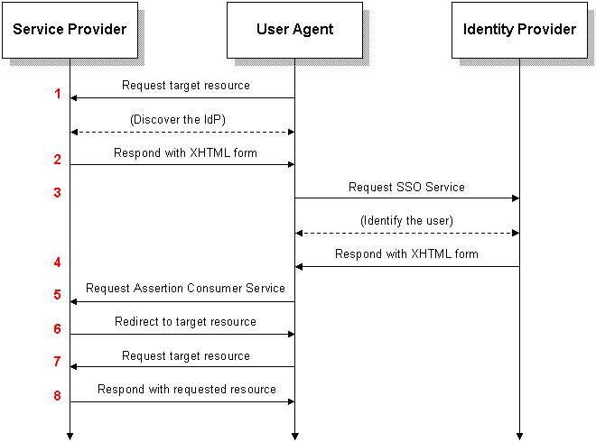
SAML2

Slide 23
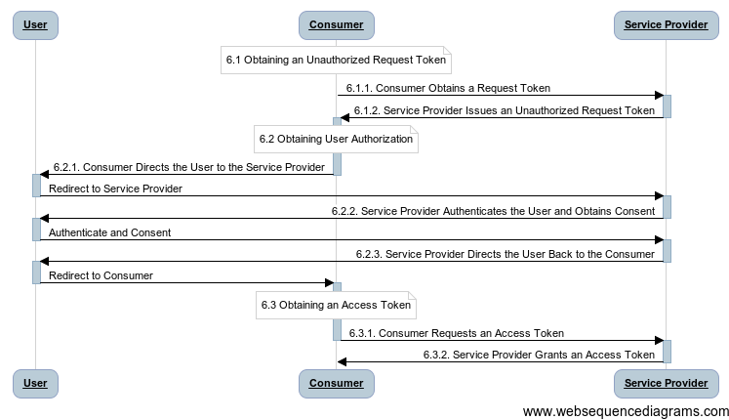
Three-legged OAuth

Slide 24
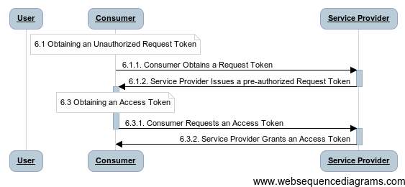
Two Legged OAuth

Slide 25
REST Security
HTTPS + Basic Auth
Rapidly moving to HTTPS+OAuth2
Does not support signatures, or message level encryption
New standards emerging
http://tools.ietf.org/html/draft-ietf-jose-json-web-encryption-07 (JWE)
http://tools.ietf.org/html/draft-jones-json-web-signature-07 (JWS)
http://tools.ietf.org/html/draft-ietf-oauth-json-web-token-05 (JWT)

Slide 26
Web Services Security Covered in detail in another chapter
WS-Security
Provides Message level encryption, signature and authentication
WS-SecurityPolicy
Allows services to publish their security requirements
WS-SecureConversation
Greater efficiency by bootstrapping fast cryptography for a session
WS-Trust
Token-based security (inc Kerberos and SAML)
WS-Federation
Federated security using WS-Trust

Slide 27
Authorization

Slide 28
Access Control
Traditionally Authorization has been
Role-based
If I am a manager then I can look at salaries
Based only on user
Hard-coded
Authorization rules encapsulated in code and applications

Slide 29
Problems with RBAC
Problems with this are:
Doesn’t correctly model the real world
I should only be able to see my team’s salaries, and only while participating in the salary review process
Hard to evolve
Hard to manage compliance
How do I find out who can make a trade of $30m?

Slide 30
Policy Based Access Control
Delegate access control decisions to a “Policy Decision Point”
Utilise more information in the decision
Externalise the decision from the code

Slide 31
XACML 3.0
An XML language for capturing authorization and entitlement
Together with a powerful model
Terminology
Policy Decision Point (PDP)
Policy Enforcement Point (PEP)
Policy Administration Point (PAP)
Policy Information Point (PIP)

Slide 32
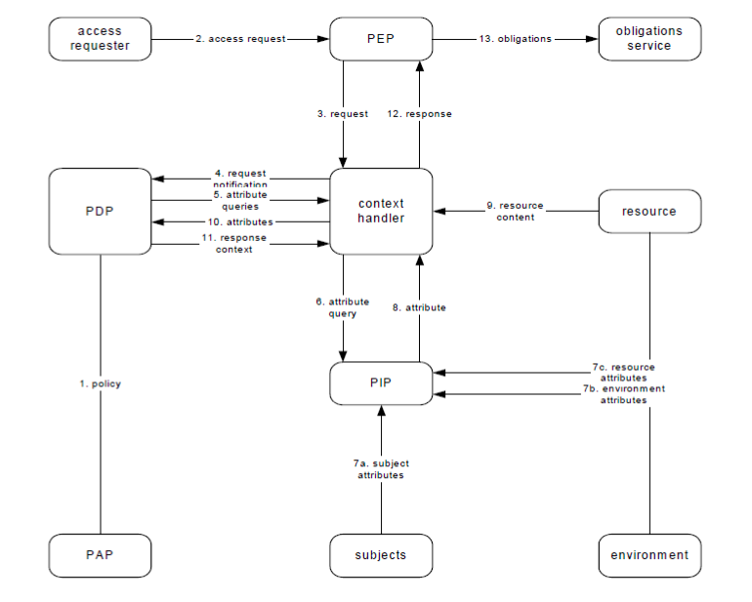

Slide 33
What can you do with XACML?
Encode rules such as:
X can access record Y if:
X is the patient for record Y
X is the doctor of the patient and working on the patients behalf
X is the guardian or parent of the patient
How does this data get to the decision point?
In claims (e.g. there may be a claim saying that the doctor is logged into the hospital records system)
In further information available to the PIP
LDAP lookup shows I am Z’s guardian

Slide 34
Resources
Applied Cryptography, Second Edition, Bruce Schneier, John Wiley & Sons, 1996, ISBN 0-471-11709-9
Web Services Security, Mark O’Neill, 2003, ISBN 0072224711
Google (sorry but there are too many links!)

