Slide 1
Understanding HTTP and REST
Oxford University
Software Engineering Programme
Dec 2014

Slide 2

World Wide Web
navigating document collections
multimedia documents
hypertext cross-references
hypertext markup language
(HTML)
hypertext transfer protocol
(HTTP)
Tim Berners-Lee at CERN, 1989–1992

Slide 3
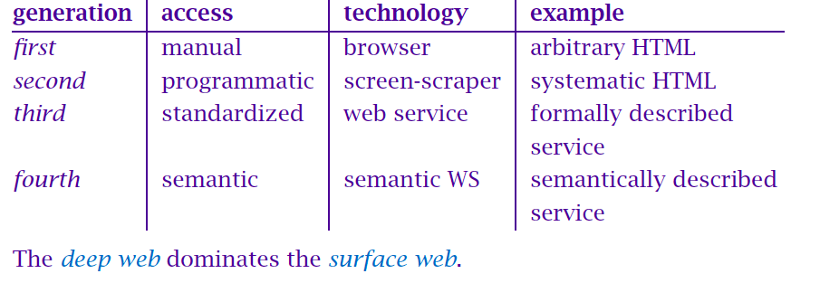
Evolving Web

Slide 4
HTTP
two-way transmission of requests and responses
layered over TCP
essentially stateless (but. . . )
standard extensions for security

Slide 5
HTTP “Verbs”
GET uri
read a document; should be “safe”
PUT uri, data
create or modify a resource; should be idempotent
POST uri, data
create a subordinate resource
DELETE uri
delete a resource; should be idempotent
(also HEAD, TRACE, OPTIONS, CONNECT and now PATCH)

Slide 6
UR*
uniform resource identifier (URI)
uniform resource locator (URL)
uniform resource name (URN)
For a large class of schemes, the syntax is
<scheme>://<authority><path>?<query>
The classical view is that URIs are partitioned into URLs (which describe a primary access mechanism, eg http:// and URNs (which do not, eg isbn:) and need a separate resolver).
The contemporary view is that URIs may define subspaces; http: is a URI scheme, and urn:isbn: is a URN namespace. ‘URL’ is somewhat deprecated.

Slide 7
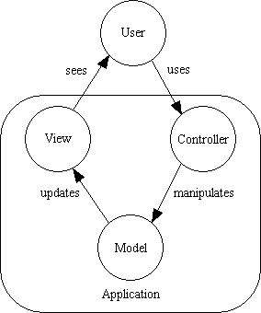
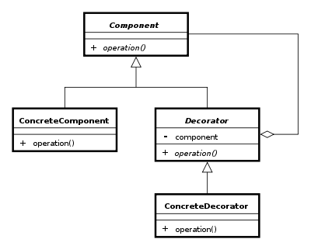
Design Patterns

Slide 8
REST is a design pattern
Also characterized as an Architectural Style (aka an architecture design pattern)

Slide 9
REST
Roy Fielding, a principal author of HTTP 1.1
PhD thesis Architectural Styles and the Design of Network-based
Subsequent article Principled Design of the Modern Web Architecture (ACM TOIT 2:2, 2002)
Richardson & Ruby, RESTful Web Services architectural patterns of the web
Software Architectures (2000) more about evaluation than a cookbook
Taking HTTP seriously as a distributed computing protocol: fixed few verbs, emphasis on the nouns

Slide 10
Client Server (CS)
Server offers services, listens for requests
Client sends request, waits for response
Transient, triggering client; persistent, reactive server
Separation of concerns: user interface from behaviour
Improves portability to a new user interface
Improves scalability by simplifying components
Improves evolvability by allowing independent evolution of components

Slide 11
Replicated Repository (RR) and Caching ($)
Replicated repository: multiple servers provide same service
Present the illusion of a single, centralized service
Improves performance: latency, redundancy
Maintaining consistency the primary challenge
Caching: caching responses for later reuse
Effectively a replication of a fragment (typically, potential data set is huge or infinite)
Responses explicitly or implicitly labelled cacheable or not
Lazy or active replication
Less effective than full replication, but cheaper and simpler

Slide 12
Stateless (S)
Each request from client must carry all necessary context
No session state stored on server — kept entirely on client
Resource state is a different matter
Improves visibility for monitoring
Improves reliability by simplifying recovery from partial failure
Improves scalability by allowing server to free resources quickly
Improves evolvability by simplifying server, cache
Decreases performance by increasing overhead

Slide 13
Layered Systems
Hierarchical arrangement
Layer provides services to layer above, uses services from layer below
Improves evolvability and reusability through abstraction
Decreases performance through overhead, latency
Layered-client-server (LCS) adds proxy and gateway components to CS
Proxy acts as shared server for one or more clients, forwarding (maybe translated) requests
Gateway appears as normal server, but forwards (maybe translated)
Requests to lower layers: load balancing, security

Slide 14
Uniform Interface
Improves simplicity and visibility
Decreases efficiency through possible data translations
For REST, optimized for large-grain hypermedia data transfer
Identification of resources
Manipulation of resources through representations
Self-descriptive messages
Hypermedia as the engine of application state (more later)

Slide 15
Virtual Machine (VM) and Code-on-Demand (COD)
Mobile code
Dynamically relocate processing between data source and destination
Improves performance by relocating code near data
Data element must be transformed into component
Extend client functionality by downloading applets/scripts
Virtual machine to provide controlled environment
Improves simplicity and extensibility of client
Reduces visibility
Not a big part of REST-based SOA (yet: cf AJAX)

Slide 16
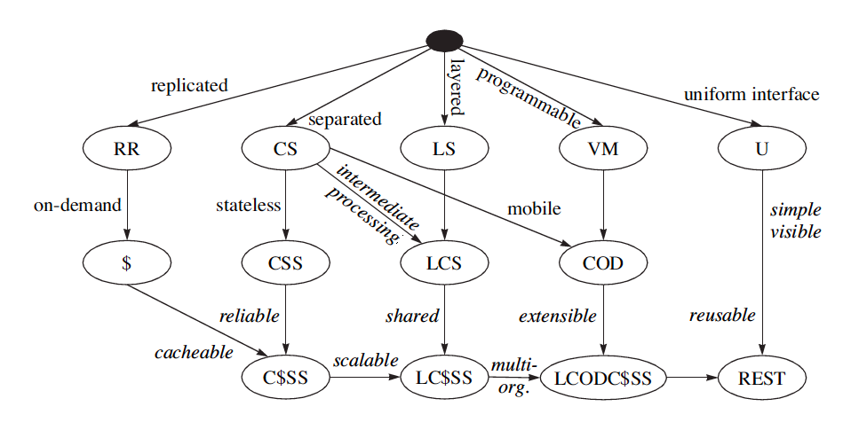
REST Derivation from Style Constraint

Slide 17
Principles of REST Architecture
REST isn't protocol specific, but in practice means the RESTful usage of HTTP
HTTP is actually a very rich application protocol which gives us features like content negotiation and distributed caching.
HTTP verbs nicely map to CRUD operations of data
RESTful web services try to leverage HTTP in its entirety using specific architectural principles.

Slide 18
Resources and Uniform Interface
Addressable Resources. Every “object” on your network should have a unique ID.
An important aspect is that each “object” or resource has its own specific URI where it can be addressed
Anything you wish to act upon, reference, annotate, etc
The URI should have a lifetime equivalent to the resource it represents (e.g. I’ve had the same bank account for 20+ years)

Slide 19
Representation
State of resource captured and transferred between components
Might be current or desired future state
Represented as data plus metadata (name–value pairs)
Metadata includes control data, media type
The Content-Type of the resource should be useful and meaningful (self-description)
One resource might have several representations
Selected via separate URIs, or via content negotiation

Slide 20
Stateless Interaction
Abstract interface for component communication
Stateless interactions:
connectors need not retain application state between requests
interactions can be processed in parallel, naively
intermediary may view and understand request in isolation
reusability of cached response can be determined from response itself
Request parameters: control data, target URI, optional representation
Response parameters: control data, optional resource metadata, optional representation

Slide 21
Uniform Interface
A Uniform, Constrained Interface. When applying REST over HTTP, stick to the methods provided by the protocol
GET, POST, PUT, and DELETE.
These should be used properly
GET should have no side effects or change on state
PUT should update the resource “in-place”

Slide 22
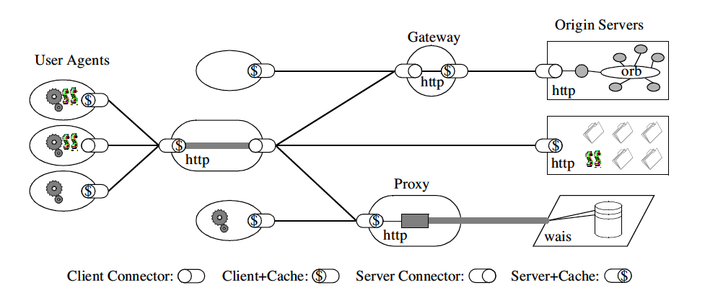
REST Architecture

Slide 23
Resource Oriented Architecture
Resource-oriented architecture
after Richardson & Ruby, RESTful WS
action identified in HTTP method, not in payload
scoping information in URI
GET reports/open-bugs HTTP/1.1
in contrast to RPC-style interaction
POST /rpc HTTP/1.1 Host: www.upcdatabase.com <?xml version="1.0”> <methodCall> <methodName>lookupUPC</methodName> … </methodCall>
. . . or hybrid
http://www.flickr.com/services/rest?method=search&tags=cat

Slide 24
PUT vs POST
PUT vs POST
creation by either PUT to new URI or POST to existing URI
typically, create a subordinate resource with a POST to its parent
use PUT when client chooses URI; use POST when server chooses
successful POST returns code 201 ‘Created’ with Location header
(POST also sometimes used for form submission, but this can be non-uniform)

Slide 25
Resource Representations and States
Interact with services using representations of resources.
An XML representation
A JSON representation
An object referenced by one URI can have different formats available. Different platforms need different formats.
A mobile application may need JSON
A Java application may need XML.
Utilize the Content-Type header
And the Accept: header
Communicate in a stateless manner
Stateless applications are far more scaleable

Slide 26
Hypertext as the Engine of Application State
Resources are identified by URIs
↓
Clients communicate with resources via requests using a
standard set of methods
↓
Requests and responses contain resource representations
in formats identified by media types
↓
Responses contain URIs that link to further resources
↓
Beginning

Slide 27
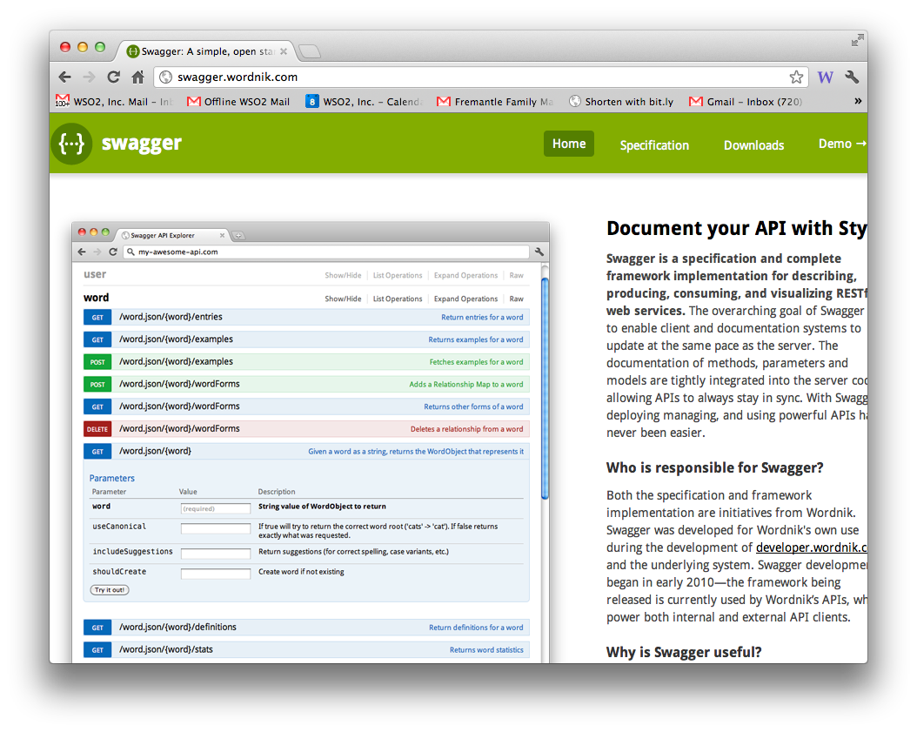
REST description

Slide 28
Async
HTTP is synchronous: request–response
What about long-running requests? deferred synchronous interaction
Client POSTs request (because not idempotent)
POST /queue HTTP/1.1
Host: jobservice.com
Please tell me whether 2ˆ43,112,609 - 1 is prime
server queues task, returns code 202 ‘Accepted’ with
URI Location: http://jobservice.com/queue/job11a4f9
202 Accepted
Client polls resource:
GET /queue/job11a4f9 HTTP/1.1
getting either status report or result
Of course WebSockets could be used to push the response
Also see new Push API from W3C

Slide 29
URI Design
URIs should be meaningful and well-structured
Some believe client should be able to construct URI to access a resource (increases surface area)
Others say URIs should be opaque!
Discuss?!
Use paths to separate elements of hierarchy, general to specific
use punctuation to separate items at same hierarchical level
commas when order matters (eg coordinates), semicolons otherwise
use query variables only for ‘arguments’
URIs denote resources, not operations (unless the operation is itself something you might CRUD)

Slide 30
REST Standards
HTTP 1.1
URI
URI Template
WebSockets
XML, JSON, etc
Atom/AtomPub
OData
OpenId
OAuth 1 / 2
SAML/SAML2
JSON Web Tokens
WADL
Swagger
Json Home
Json Web Encryption
Json Web Signature
Json Patch
SPDY
HTTPbis
HTTP Link Header
Microformats
RDDL
…

Slide 31
Quick look at the Sample Service

Slide 32
JSON
A simple notation that originated in JavaScript
var x = {a:1, b:2, c:3}
equivalent to:
x.a = 1; x.b = 2; x.c = 3
Can be done “dynamically”
var x = “{a:1, b:2, c:3}”
// imagine this actually
// comes from a webserver
var z = eval(‘(‘+x+’)’)
assert(z.a == 1)

Slide 33
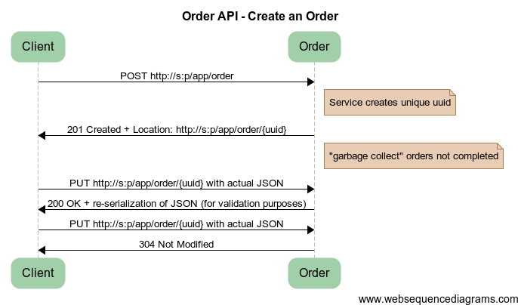
Create an Order
Notes:
title Order API - Create an Order
Client -> Order: POST http://s:p/app/order
note right of Order: Service creates unique uuid
Order -> Client: 201 Created + Location: http://s:p/app/order/{uuid}
note right of Order: "garbage collect" orders not completed
Client -> Order: PUT http://s:p/app/order/{uuid} with actual JSON
Order -> Client: 200 OK + re-serialization of JSON (for validation purposes)
Client -> Order: PUT http://s:p/app/order/{uuid} with actual JSON
Order -> Client: 304 Not Modified

Slide 34
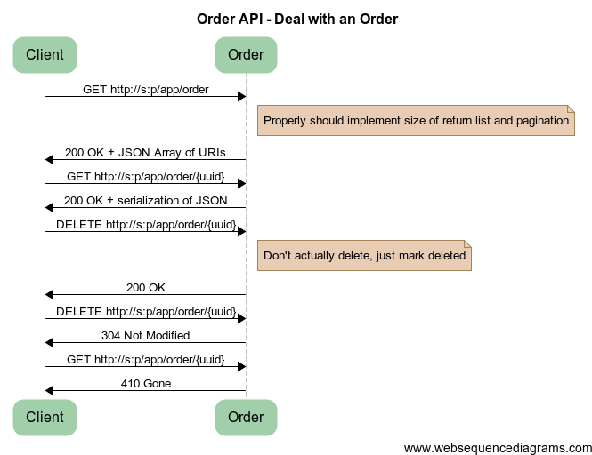
Notes:
title Order API - Deal with an Order
Client -> Order: GET http://s:p/app/order
note right of Order: Properly should implement size of return list and pagination
Order -> Client: 200 OK + JSON Array of URIs
Client -> Order: GET http://s:p/app/order/{uuid}
Order -> Client: 200 OK + serialization of JSON
Client -> Order: DELETE http://s:p/app/order/{uuid}
note right of Order: Don't actually delete, just mark deleted
Order -> Client: 200 OK
Client -> Order: DELETE http://s:p/app/order/{uuid}
Order -> Client: 304 Not Modified
Client -> Order: GET http://s:p/app/order/{uuid}
Order -> Client: 410 Gone

Slide 35
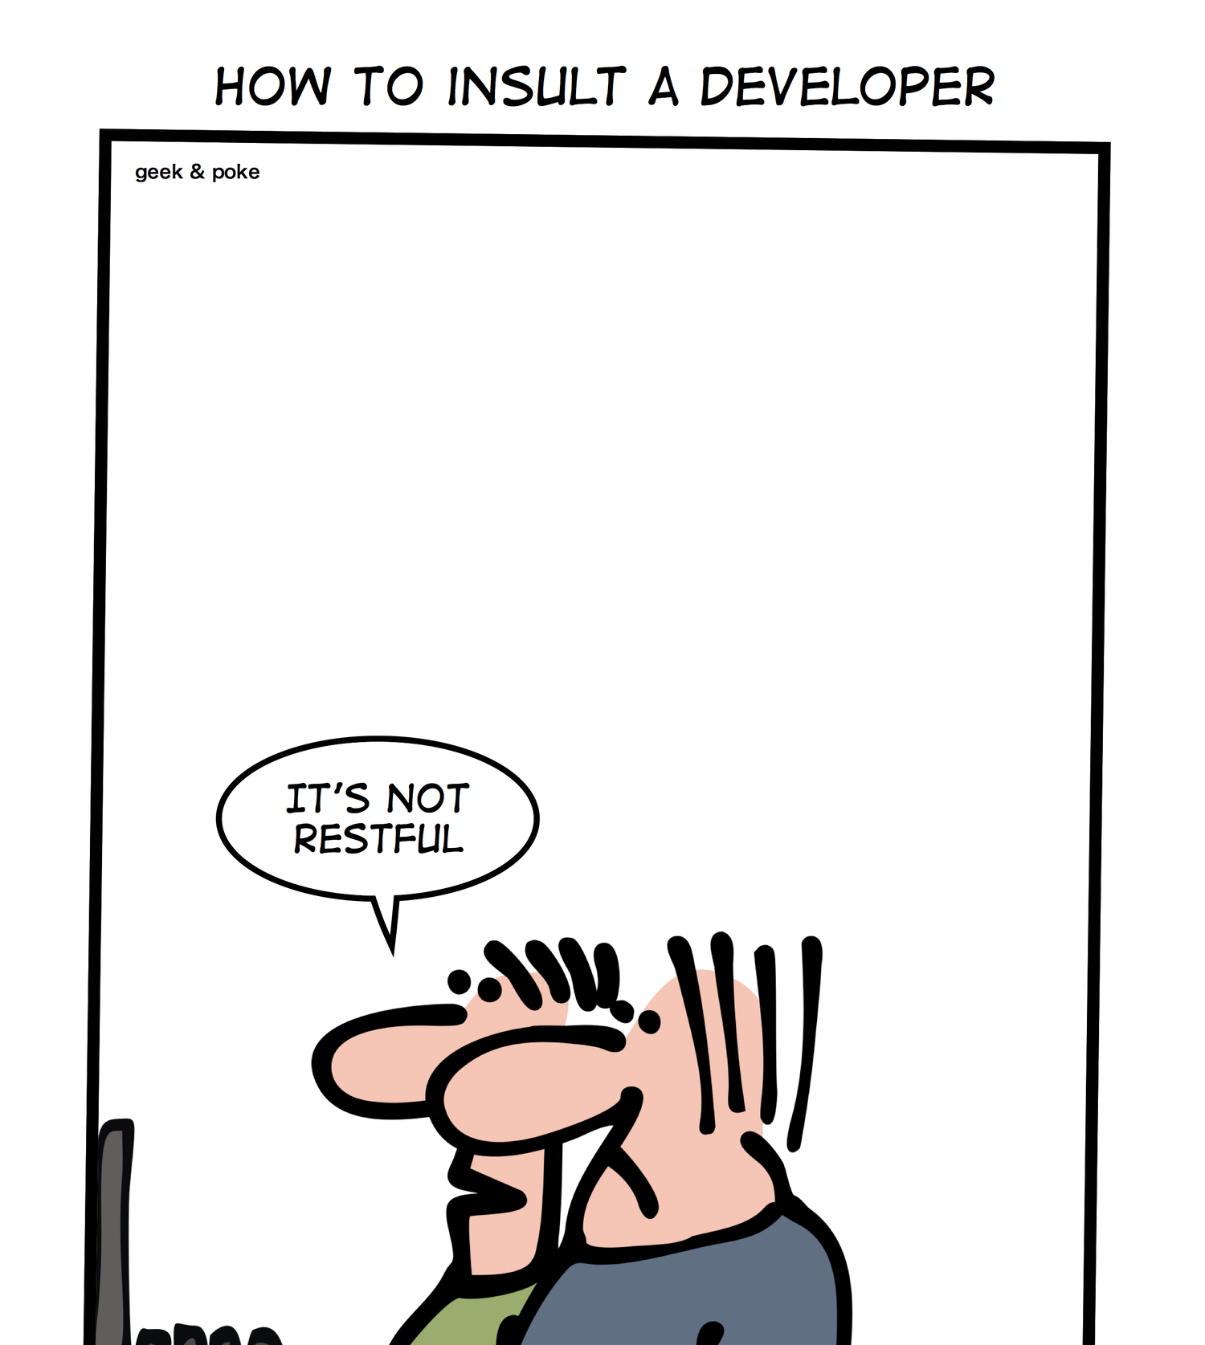

Slide 36
Questions?

