Slide 1
APIs and API Management
Oxford University
Software Engineering Programme
Dec 2014

Slide 2
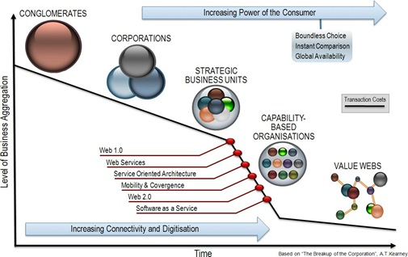
The Breakup of the Corporation

Slide 3
APIs
An API is a business capability delivered over the Internet to internal or external consumers
Network accessible function
Available using standard web protocols
With well-defined interfaces
Designed for access by third-parties
A Managed API is:
Actively advertised and subscribe-able
Available with SLAs
Secured, authenticated, authorized and protected
Monitored and monetized with analytics

Slide 4
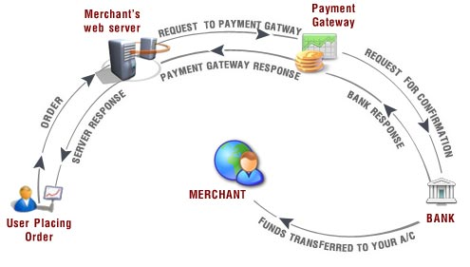
APIs All the Way…

Slide 5
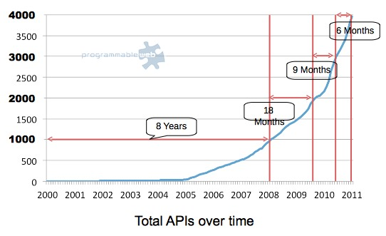
Don’t ignore API Proliferation
Source: http://blog.programmableweb.com/2011/10/03/4000-web-apis-whats-hot-and-whats-next/
Notes:
Source: http://blog.programmableweb.com/2011/10/03/4000-web-apis-whats-hot-and-whats-next/ downloaded on 18, October 2011
Significant proliferation of published APIs
4105 APIs and 6215 mashups on programmable web alone (as of 18 October 2011)
Top 5 Types of APIs in 2010
Social (149)
Internet (112)
Mapping (103)
Search (83)
Mobile (74)

Slide 6





Some Statistics
Twitter : More than 15 billion calls per day 75% through APIs
Netflix : More than 1 billion calls per day
Facebook : More than 5 billion calls per day
Amazon : More than 260 billion objects store in S3
eBay : More than 6 billion transactions per day

Slide 7
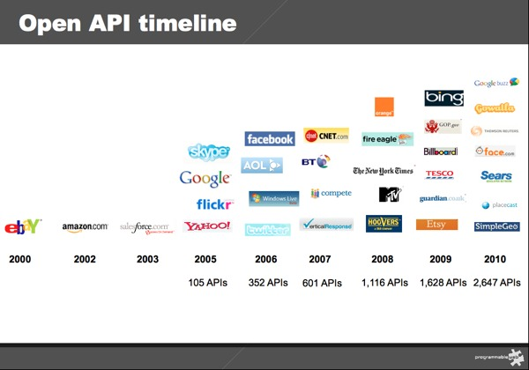
The New Web
Create an Architecture of Participation across multiple brand name properties
Source: http://blog.programmableweb.com/2011/01/03/api-growth-doubles-in-2010-social-and-mobile-are-trends/
Notes:
Source: http://blog.programmableweb.com/2011/01/03/api-growth-doubles-in-2010-social-and-mobile-are-trends/ downloaded on 18, October 2011
The New Web (Web 2.0+) relies on creating an ‘architecture of participation’ across multiple web properties
LinkedIn, Twitter, eBay
Facebook, Twitter,
APIs are used to interconnect the site experiences and share information
RSS Feeds, service calls,
Oauth, SAML
Mashups

Slide 8
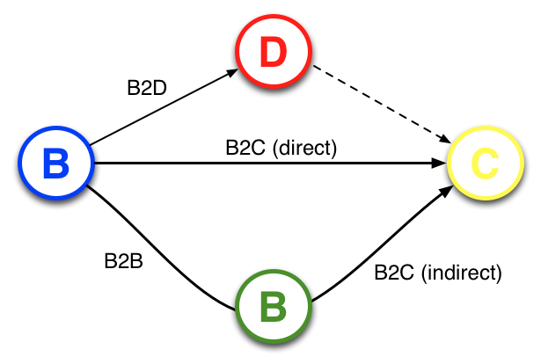
API Opportunities
“APIs create a new relationship opportunity –
B2D; Business to Developer, that creates
direct B2C, B2B and indirect B2C relations”

Slide 9
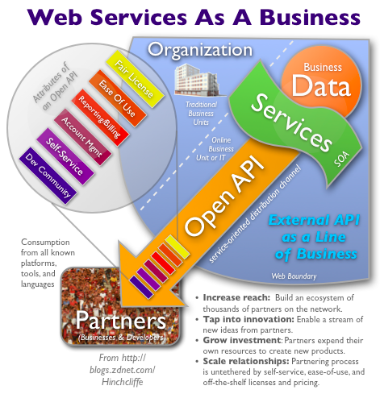
Running your SOA like a Web startup
http://www.zdnet.com/blog/hinchcliffe/running-your-soa-like-a-web-startup/525

Slide 10
API Ecosystem Model
From SOA lessons learned, best practices roles
API Creator
Builds, manages, and versions API
Understand business and technical requirements
Cares about usage and scaling
Seeks feedback, ratings, usage
API Publisher
Publishes, Promotes and encourages consumers to adopt APIs
Determines usage patterns and how to best monetize asset
Monitors and secures
API Consumer
Understands the interface definition
Subscribes and connects application to API
Monitors own usage and cost basis
Provides feedback and ratings

Slide 11
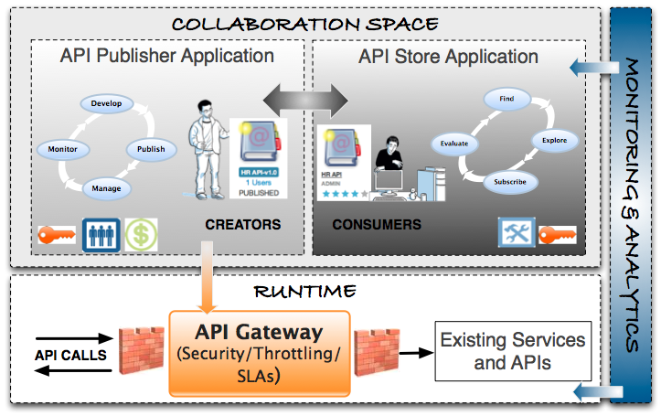
API Manager Components

Slide 12
Understanding the Flow
API Creator adds API into API Manager
[Optionally provides Sandbox endpoint]
API Publisher approves publish
API Consumer finds API
API Consumer subscribes to API and obtains a key
[Optional an approval process is started]
OAuth2-based Key issued
[Optionally issue both production and sandbox keys]
API Consumer application makes a call
API Key is validated
API Key metadata is used to identify:
Throttling / Rate limiting policy
Sandbox / Production endpoint
Event is metered/monitored against the API, Key, IP address, etc

Slide 13
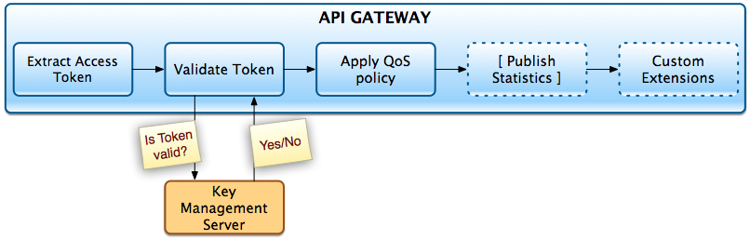
Using the API key to enable context

Slide 14
API Management market
Apigee
Layer7 / CA
3Scale
Mashery / Intel
IBM Castiron
WSO2 API Manager

Slide 15
Questions?

