Slide 1
WS-Policy and WS-SecurityPolicy

Slide 2
Overview
Introduction
Policy assertions
Main security bindings
RampartConfig Assertion

Slide 3
WS-Policy
General framework for endpoints to express requirements
Basic operators
wsp:All
wsp:ExactlyOne
Domain assertions
WS-SecurityPolicy Language
Just XML elements

Slide 4
Basic operators example
<wsp:Policy>
<wsp:ExactlyOne>
<wsp:All>
<A/>
<B/>
</wsp:All>
<wsp:All>
<A/>
<C/>
</wsp:All>
</wsp:ExactlyOne>
</wsp:Policy>

Slide 5
WS-SecurityPolicy
Based on WS-Policy
Various groups of policy assertions
Can be embedded into WSDL or referenced

Slide 6
WS-SecurityPolicy
To express security requirements of a Web service according to the WS-Policy spec
What needs to be protected
What tokens to use
Algorithms, reference types, etc..
Covers all WS-Sec* specifications

Slide 7
Assertion Types
Protection assertions
Token assertions
Binding assertions
Supporting token assertions
Protocol assertions

Slide 8
Protection Assertions
Specify what needs to be protected
Integrity
Confidentiality
Signed/EncryptedParts
Signed/EncryptedElements
RequiredElements

Slide 9
Signed/Encrypted Parts
Headers
name / namespace
namespace
Body
Protect when present

Slide 10
Example
<sp:SignedParts xmlns:sp="http://...securitypolicy">
<sp:Body/>
<sp:Header Name="To" Namespace="http://.../ws/2004/08/addressing"/>
<sp:Header Name="From" Namespace="http://.../ws/2004/08/addressing"/>
</sp:SignedParts>
<sp:EncryptedParts xmlns:sp="http://...securitypolicy">
<sp:Body/>
</sp:EncryptedParts>

Slide 11
Signed/Encrypted elements
arbitrary elements in the SOAP envelope
configured using XPATH

Slide 12
Example
<sp:EncryptedElements xmlns:sp="http://../securitypolicy">
<sp:XPath
xmlns:ns1="http://InteropBaseAddress/interop"
xmlns:ns2="http://xmlsoap.org/Ping">
/soapenv:Envelope/soapenv:Body/
ns1:PingResponse/ns2:scenario
</sp:XPath>
</sp:EncryptedElements>

Slide 13
Required Elements
arbitrary elements in the SOAP envelope
configured using XPATH

Slide 14
Example
<sp:RequiredElements xmlns:sp="http://../securitypolicy">
<sp:XPath
xmlns:a="http://xmlsoap.org/Ping">
/soapenv:Envelope/soapenv:Body/ ns1:PingResponse/ns2:scenario/a:scenario
</sp:XPath>
</sp:RequiredElements>

Slide 15
Token Assertions
Specifying token types to use
UsernameToken
X. 509
IssuedToken
SecureConversation
Kerberos
Token Inclusion
Never
Always
AlwaysToRecipient
Once

Slide 16
Token Assertion Examples
<sp:X509Token sp:IncludeToken="http://.../IncludeToken/Never">
<wsp:Policy>
<sp:WssX509V3Token10/>
</wsp:Policy>
</sp:X509Token>
<sp:UsernameToken sp:IncludeToken="http://.../AlwaysToRecipient" />

Slide 17
Bindings
Collections of security properties (values populated by assertions)‏
Tokens
Algorithms
Processing order
Inclusion of timestamp

Slide 18
Bindings
Three main types:
TransportBinding
AsymmetricBinding
SymmetricBinding
Security Binding properties

Slide 19
Algorithm Suite
Defines values algorithms to be used
[Sym Sig] Symmetric Key Signature
[Asym Sig] Signature with an asymmetric key
[Dig] Digest
[Enc] Encryption
[Sym KW] Symmetric Key Wrap
[Asym KW] Asymmetric Key Wrap
[Comp Key] Computed key
[Enc KD] Encryption key derivation
[Sig KD] Signature key derivation
[Min SKL] Minimum symmetric key length
[Max SKL] Maximum symmetric key length
[Min AKL] Minimum asymmetric key length
[Max AKL] Maximum asymmetric key length
Pre defined set of a algorithm suites
eg. Basic256, Basic192

Slide 20
Security Binding Properties
Timestamp
Default : false
sp:IncludeTimestamp sets property to true
Protection Order
Default : Sign before encryption
sp:EncryptBeforeSigning to change it

Slide 21
Security Binding Properties
Signature Protection
Default: false
sp:EncryptSignature sets property to true
signature should be encrypted
Token Protection
Default: false
sp:ProtectTokens sets property to true
Token used to generate the signature must aslo be covered by the signature

Slide 22
Security Binding Properties
Entire Header and Body Signatures
Default: false
sp:OnlySignEntireHeadersAndBody sets property to true.

Slide 23
Security Binding Properties
Security Header Layout
Strict
Lax
LaxTimestampFirst
LaxTimestampLast
Declare before use principle
Default: Lax

Slide 24
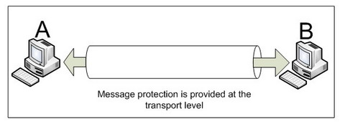
Transport Binding
Indicates that the transport layer is used to satisfy the security requirements

Slide 25
Transport Binding
Allows specification of :
Transport tokens
Security header layout
Timestamp presence
Supporting tokens

Slide 26
Transport Binding example
<sp:TransportBinding>
<wsp:Policy>
<sp:TransportToken>
<wsp:Policy>
<sp:HttpsToken />
</wsp:Policy>
</sp:TransportToken>
<sp:AlgorithmSuite>...</sp:AlgorithmSuite>
<sp:IncludeTimestamp />
</wsp:Policy>
</sp:TransportBinding>

Slide 27
Symmetric Binding
Indicates that the message layer is used to satisfy the security requirements
Defines "Encryption Token" and "Signature Token" properties
Where multiple messages are exchanged the tokens perform the same functions for all messages

Slide 28
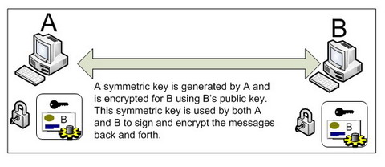
Symmetric Binding

Slide 29
SymmetricBinding Example
<sp:SymmetricBinding>
<wsp:Policy>
<sp:ProtectionToken>
<wsp:Policy>
<sp:X509Token
sp:IncludeToken="http://.../IncludeToken/Never"/>
</wsp:Policy>
</sp:ProtectionToken>
<sp:AlgorithmSuite><sp:Basic256/></sp:AlgorithmSuite>
<sp:EncryptBeforeSigning />
</wsp:Policy>
</sp:SymmetricBinding>

Slide 30
Asymmetric Binding
Indicates that the message layer is used to satisfy the security requirements
Defines “Initiator Token” and “Recipient Token” properties
Where multiple messages are exchanged the tokens perform different functions

Slide 31
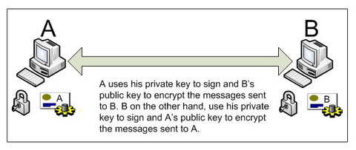
Asymmetric Binding

Slide 32
Asymmetric Binding Example
<sp:AsymmetricBinding>
<wsp:Policy>
<sp:InitiatorToken>
<wsp:Policy>
<wsp:X509Token sp:IncludeToken=‘.../IncludeToken/AlwaysToRecipient’ />
</wsp:Policy>
</sp:InitiatorToken>
<sp:RecipientToken>
<wsp:Policy>
<wsp:X509Token sp:IncludeToken=‘.../IncludeToken/Never’ />
</wsp:Policy>
</sp:RecipientToken>
<sp:AlgorithmSuite><sp:Basic128/></sp:AlgorithmSuite>
<sp:EncryptBeforeSigning />
</wsp:Policy>
</sp:AsymmetricBinding>

Slide 33
Supporting Tokens
Services may require multiple sets of claims to be presented
Corresponds to additional tokens in a message
eg. Symmetric binding + Username token

Slide 34
Supporting Tokens Example
<sp:SupportingTokens>
<wsp:Policy>
<sp:UsernameToken sp:IncludeToken=‘.../IncludeToken/Once’ />
</wsp:Policy>
</sp:SupportingTokens>

Slide 35
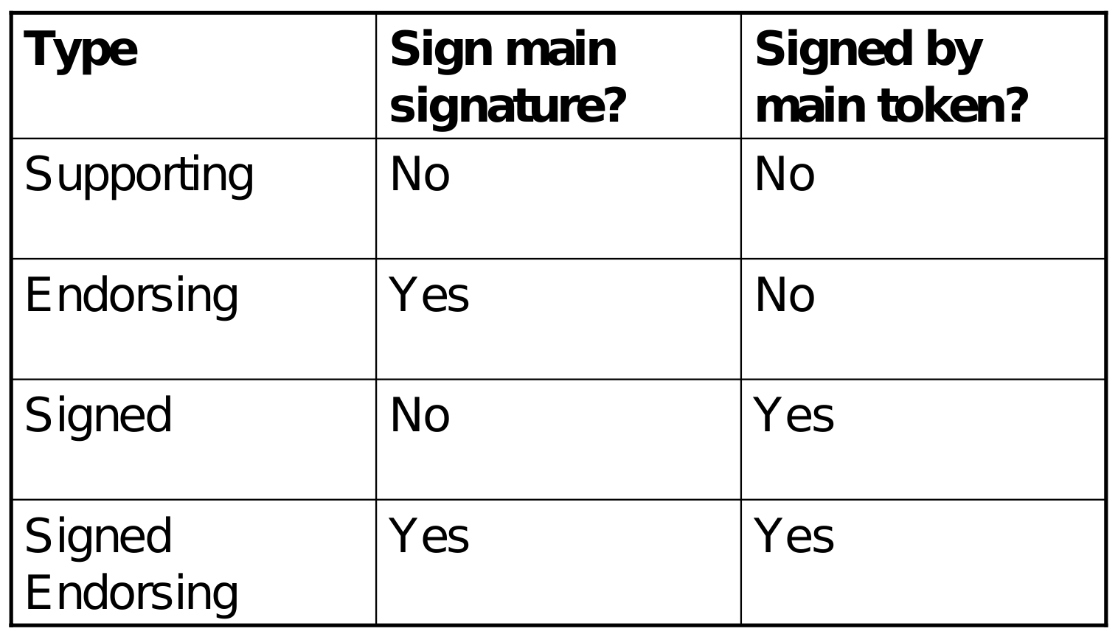
Supporting Token types

Slide 36
WSS Assertions
WSS10
<sp:MustSupportRefKeyIdentifier ... /> <sp:MustSupportRefIssuerSerial ... /> <sp:MustSupportRefExternalURI ... /> <sp:MustSupportRefEmbeddedToken ... />
WSS11
<sp:MustSupportRefKeyIdentifier ... /> <sp:MustSupportRefIssuerSerial ... /> <sp:MustSupportRefExternalURI ... /> <sp:MustSupportRefEmbeddedToken ... /> <sp:MustSupportRefThumbprint ... /> <sp:MustSupportRefEncryptedKey ... /> <sp:RequireSignatureConfirmation ... />

Slide 37
WSS Assertions
Should be able to process any of the key referencing mechanisms
<sp:X509Token sp:IncludeToken="http://../IncludeToken/Never">
<wsp:Policy>
<sp:RequireThumbprintReference/>
<sp:WssX509V3Token10/>
</wsp:Policy>
</sp:X509Token>

Slide 38
WSS Assertion Examples
<sp:Wss10>
<wsp:Policy>
<sp:MustSupportRefKeyIdentifier />
<sp:MustSupportRefExternalURI />
</wsp:Policy>
</sp:Wss10>
<sp:Wss11>
<wsp:Policy>
<sp:MustSupportRefExternalURI />
<sp:MustSupportRefThumbprint />
<sp:RequireSignatureConfirmation />
</wsp:Policy>
</sp:Wss11>

Slide 39
Trust Assertions
Specify supported version of WS-Trust and associated properties
sp:Trust10
Example :
<sp:Trust10>
<wsp:Policy>
<sp:RequireClientEntropy />
<sp:RequireServerEntropy />
</wsp:Policy>
</sp:Trust10>

Slide 40
Policy Subjects
Message Policy Subject
wsdl:binding/wsdl:operation/wsdl:input,
wsdl:binding/wsdl:operation/wsdl:output
Operation Policy Subject
wsdl:binding/wsdl:operation
Endpoint Policy Subject
wsdl:binding

Slide 41
Policy Subjects
MUST NOT attach to
Message Policy Subject
wsdl:message
wsdl:portType/wsdl:operation/wsdl:input
Operation Policy Subject
wsdl:portType/wsdl:operation
Endpoint Policy Subject
wsdl:portType

Slide 42
Applying Security Policies
services.xml
<service>
<wsp:Policy/>
<operation name="echo">
<wsp:Policy/>
<message label="In">
<wsp:Policy/>
</message>
<message label="Out">
<wsp:Policy/>
</message>
</operation>
<service>

Slide 43
Applying Security Policies
<service>
<wsp:PolicyAttachment
xmlns:wsp="http://../policy">
<wsp:AppliesTo>
<policy-subject identifier="binding:soap11" />
<policy-subject identifier="binding:soap12" />
</wsp:AppliesTo>
<wsp:Policy/>
</wsp:PolicyAttachment>
</service>

Slide 44
Applying Security Policies
<service>
<wsp:PolicyAttachment
xmlns:wsp="http://../policy">
<wsp:AppliesTo>
<policy-subject identifier="binding:soap11/operation:echo" />
<policy-subject identifier="binding:soap12/operation:echo" />
</wsp:AppliesTo>
<wsp:Policy/>
</wsp:PolicyAttachment>
</service>

Slide 45
Applying Security Policies
<service>
<wsp:PolicyAttachment
xmlns:wsp="http://../policy">
<wsp:AppliesTo>
<policy-subject identifier="binding:soap11/operation:echo/in" />
<policy-subject identifier="binding:soap12/operation:echo/in" />
</wsp:AppliesTo>
<wsp:Policy/>
</wsp:PolicyAttachment>
</service>

