Slide 1
Qualities of Service
Oxford University
Software Engineering Programme
Dec 2012

Slide 2
Qualities of Service
Transactions
Reliable Messaging
Security

Slide 3
Transactions
Idealized indivisible activities techniques for maintaining the illusion in the face of complexity,
Ideas arose from distributed databases
Concurrency, failures
Underlying finance, logistics, manufacturing. . .
Transaction Processing: Concepts and Techniques, Gray and Reuter, 1993
(http://books.google.co.uk/books?id=S_yHERPRZScC)

Slide 4
ACID
atomicity
all-or-nothing
consistency
integrity-preserving: invariants satisfied
isolation
hidden intermediate results: multi-user behaviour consistent with single-user mode
durability
permanent committed results

Slide 5
Problems Avoided with ACID
lost update
write committed and acknowledged but then discarded
inconsistent retrieval
reads of multiple fields at different times
non-serializability
loss of single-user abstraction
conflict
e.g. simultaneous bookings of the same room

Slide 6
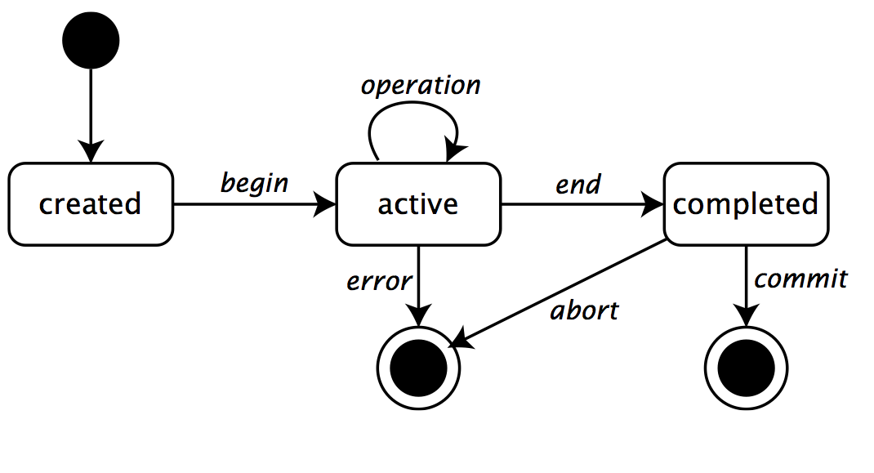
Transaction Lifecycle

Slide 7
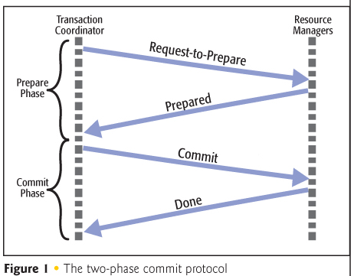
Two Phase Commit (2PC)

Slide 8
Locking
serialization mechanisms for resources, enforcing unique access
read locks (shareable) and write locks (exclusive)
may need to wait for locked resource to be released
may result in deadlock: two parties, each waiting for the other
lock resources in canonical order (requires foresight), or abort one party (requires rollback)

Slide 9
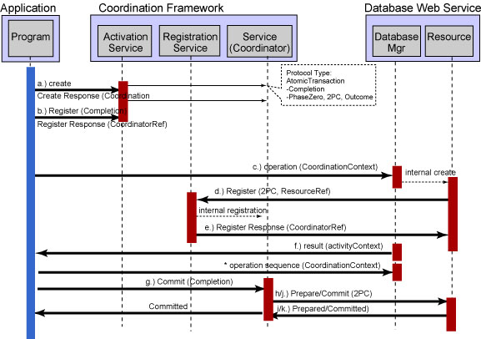
WS-Atomic Transactions

Slide 10
WS-AT
Relies on WS-Addressing and WS-Coordination
WS-Coordination is a generalized coordination protocol for multiple parties
Also used by WS-BusinessActivity
How does WS-AT fit with?
Loose Coupling
Service Oriented Architecture
Asynchronous calling

Slide 11
CAP Theorem Brewer’s Theorem
Consistency
ACID
Availability
High Available
Partition Tolerance
Can work at Internet scale across Datacenters
You can only guarantee two of these three
While this is true, its also misleading.
Recommend you read
http://www.infoq.com/articles/cap-twelve-years-later-how-the-rules-have-changed by Eric Brewer

Slide 12
Eventually Consistent
Despite the arguments, etc about CAP
Eventually Consistent / NoSQL databases are gaining huge mindshare (and a lot of marketshare of new greenfield apps too)
e.g. Cassandra vs MySQL w/50Gb
MySQL r/w 300ms/350ms
Cassandra r/w 15ms/0.15ms
Also scalability, elasticity, no master

Slide 13
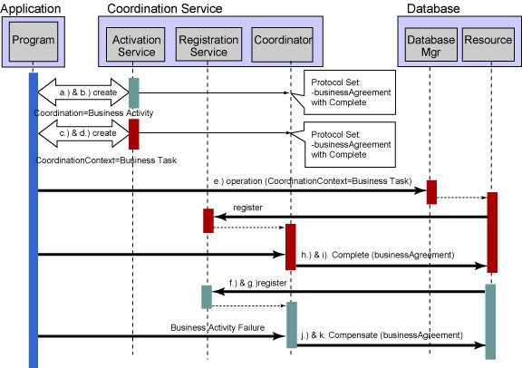
WS-BusinessActivity

Slide 14
WS-BusinessActivity
Suitable for long running loosely coupled scenarios
Can use WS-AT to handle system exceptions – WS-BA handles business exceptions
Business logic must support the cancel/compensate logic
Not ACID
For example, no clear isolation as locks are not held
Can take place even if not all participants are always available

Slide 15
REST Transactions
Transactions
Various ideas: RETRO
http://freo.me/TLnyWp
Patterns
Towards Distributed Atomic Transactions over RESTful Services, Pardon and Pautasso, REST From Research to Practice, ISBN: 978-1-4419-8302-2 (Print) 978-1-4419-8303-9 (Online)

Slide 16
Messaging concepts: queuing
S
R
Queue
R
S
S
R

Slide 17
Messaging concepts: pub/sub
S
R
Subs
Topic
S
R
R
R
S
R

Slide 18
Messaging concepts: message
Message
Properties
Properties
Key/value pairs exposed to the broker
Subscription rules can filter based on properties
Body
Opaque payload not exposed to the broker
Can be used for encrypted data
Key
Value
Key
Value
Key
Value
Key
Value
Body
Body

Slide 19
WS-ReliableMessaging
Provides an MQ-like model for Web Services
Redelivers missing messages
Numbers messages so they can be delivered InOrder and ExactlyOnce
createSequence
RM Agent
Application
Message 1
Message 2
Nack message 1
Message 1
Msg 1
Msg 2
Message 1

Slide 20
Other approaches to reliability
ebMS Reliable Messaging
AMQP 1.0
MQTT
STOMP
REST patterns
Some believe you don’t need RM
http://www.infoq.com/articles/no-reliable-messaging

Slide 21
Security
Dealt with at length in a separate lecture!

Slide 22

Composability

Slide 23
Composability
The whole architecture of WS-* has been designed around this model
Use what you need
And no more
Don’t replicate technology in different standards
All the standards should work together

Slide 24
Basic Composability
WS-Security
WS-ReliableMessaging
WS-AtomicTransactions
Transactional
Secure
Transactional
Secure
Reliable
Transactional
Secure
Reliable
Reliable

Slide 25
Composability
SOAP Headers that work together
Common usage of base components
SOAP
WS-Addressing
The right building blocks, e.g.
Reliable pub/sub
WSRM + WS-Eventing
Secure Single Sign-on
WS-Trust + WS-Security

Slide 26
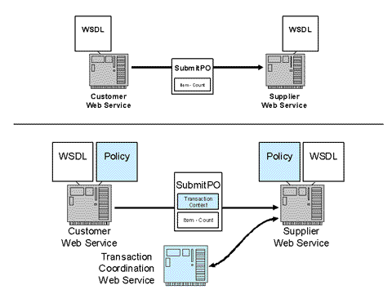
Composability example

Slide 27
Key Web Services Standards
Orchestration
Business Process Execution Language (BPEL)
SECURE
WS-Security
(encrypt, sign, auth)
WS-SecureConversation
(~SSL)
WS-Trust
(~Kerberos)
RELIABLE
WS-ReliableMessaging
(ExactlyOnce,
InOrder delivery, ~JMS)
TRANSACTIONAL
WS-AtomicTransaction
(2 Phase Commit ~XA)
WS-BusinessActivity
(Long running loosely coupled)
Quality
of
Service
WS-Policy
WS-MetadataExchange
WS-Addressing
Messaging
SOAP
WSDL
Transport
HTTP, TCP, SMTP, UDP
Wire interaction
Metadata
The Web services platform forms a complete framework for open standards enterprise middleware

Slide 28
WS-Policy Framework
A way of publishing requirements and capabilities for service endpoints
A simple language to specify combinations
Plus a way of attaching to WSDL, etc
Plus a set of Policy Assertion Languages
For example:
WS-SecurityPolicy
WS-ReliableMessagingPolicy
etc
More in later chapter

Slide 29
WS-MetadataExchange
How to query a service at runtime for its policy, WSDL, schema, etc

Slide 30
WS-Eventing
Guess what! There are two specs:
WS-Notification (IBM, HP, Oracle, Tibco and Globus)
WS-BaseNotification
WS-BrokeredNotification
WS-Topics
WS-Eventing (Microsoft, BEA, IBM, Tibco)
BaseNotification and Eventing are very similar

Slide 31
WS-Eventing
Publish-Subscribe in Web services/XML
Create, Delete, Renew and expire subscriptions
Subscriptions may have XPath-based filters
Specify how event messages should be delivered
Compose with other standards for secure, reliable transacted delivery

Slide 32
WS-Eventing Example
Subscriber
Event Source
Subscribe with EPR of subscriber
Respond with EPR of SubsMgr
Event Notifications (any message)
getStatus
SubsMgr
renew
unsubscribe

Slide 33
Event Driven Architecture in REST
Comet
Not considered good!
WebSockets
Not particularly RESTful, but W3C approved
EventSource https://developer.mozilla.org/en-US/docs/Server-sent_events/EventSource
WebHooks
Web Callbacks

Slide 34
Local / Remote Transparency
“The hard problems in distributed computing concern dealing with partial failure and the lack of a central resource manager. . . differences in memory access paradigms between local and distributed entities.
Many aspects of robustness can be reflected only at the protocol/interface level. . . An interface design issue has put an upper bound on the performance. . . Part of the definition of a class of objects will be the specification of whether those objects are meant to be used locally or remotely.
” Jim Waldo et al, ‘A Note on Distributed Computing’, 1994

Slide 35
One more thing to note
Service Level Agreements and active management have become much more important than RM and Transactions
Widespread APIs over the web
DoS attack prevention
Guaranteed availability
More when we look at API Management

Slide 36
Questions?

