Slide 1
Governance, Registries and Monitoring
Oxford University
Software Engineering Programme
Dec 2012

Slide 2
Contents
Software Development Lifecycle
Registries
Design Governance
Runtime Governance

Slide 3
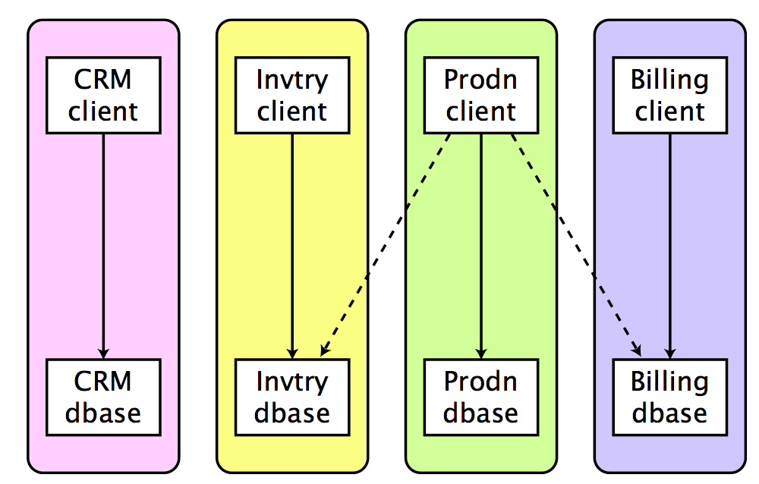
Before SOA

Slide 4
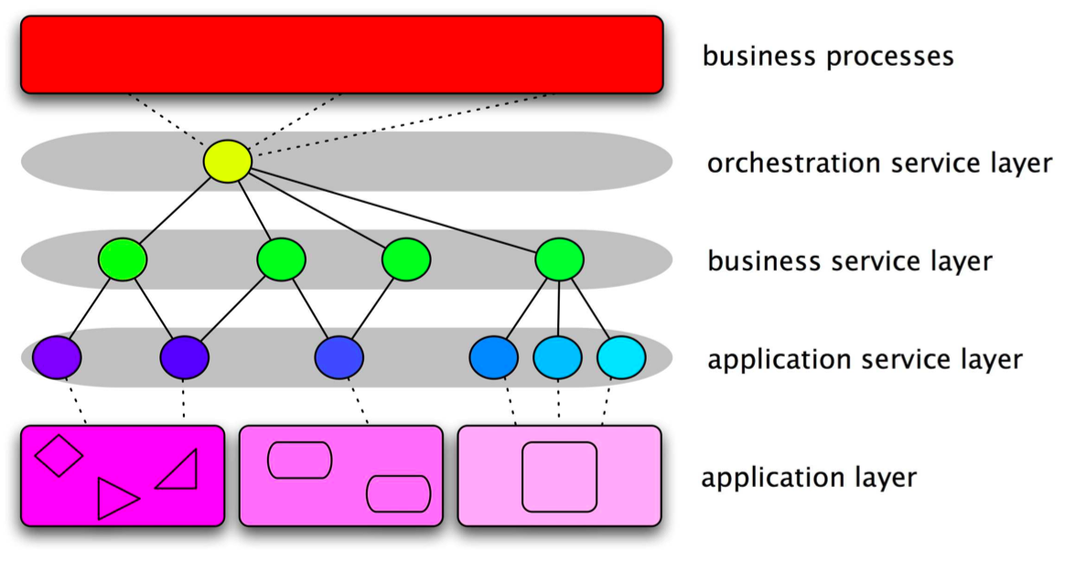
With SOA

Slide 5
SOA has an impact on organization
Refactoring of fiefdoms: – backend departments – cross-domain departments – frontend departments – “solutions managers”
Requires collaboration and trust
May change the funding model
That will pull in resistance

Slide 6
Conway’s Law
Any organization that designs a system will inevitably produce a design whose structure is a copy of the organization’s communication structure.
Melvin Conway, How Do Committees Invent?, Datamation Apr 1968, http://www.melconway.com/law/
Popularized and named by Fred Brooks in The Mythical Man-Month: “If you have four groups working on a compiler, you’ll get a 4-pass compiler.”

Slide 7
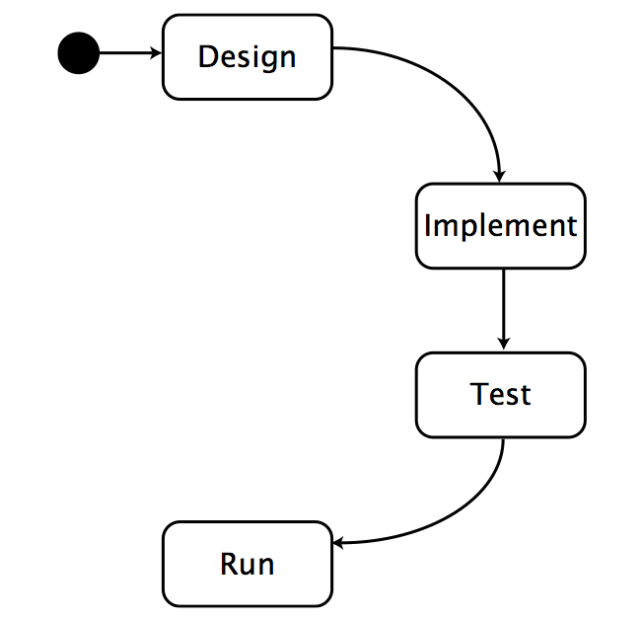
Software Development Lifecycle

Slide 8
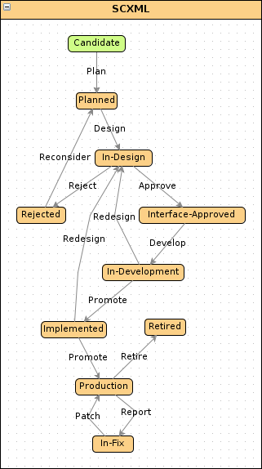
Not that simple!

Slide 9
High level governance
Visions, objectives, business case, funding model
Why are we doing this? How will we pay for it?
Reference architecture Fundamental decisions: preferred technology, message exchange patterns, metamodel, etc
Rules and responsibilities
who drives and cares about issues
Policies, standards, formats, processes, lifecycles
decide and document, in standard notations

Slide 10
Technical Governance
Documentation
important for transparency; promotes non-technical issues
Service management
repositories and registries for services and contracts
Monitoring
conformance to policies, meeting SLAs, preparing for withdrawal
Change and configuration management
Code lifecycle, DevOps, SOA, the intersection

Slide 11
Establishing SOA
Developer-driven, grass-roots
leads to technological experience; likely to be uncoordinated
Business-driven
proof of concept helps adoption; limited benefit from early projects
IT-driven
effective for infrastructure; focus on technical aspects
Management-driven
top-down coordinated, driven by business priorities; expensive, disruptive, risky

Slide 12
Design Time Governance

Slide 13
UDDI
An XML-ization of the Windows Registry
Lots of nasty UUIDs
But aimed at Internet Scale
Launched with the concept of major public UDDI servers (like DNS)
Universal Business Registry (UBR)

Slide 14
UDDI
A UDDI business registration consists of three components:
White Pages — address, contact, and known identifiers;
Yellow Pages — industrial categorizations based on standard taxonomies;
Green Pages — technical information about services exposed by the business.

Slide 15
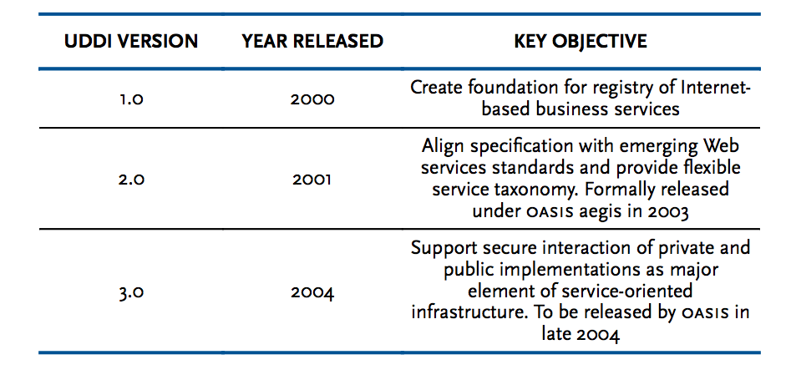
History

Slide 16
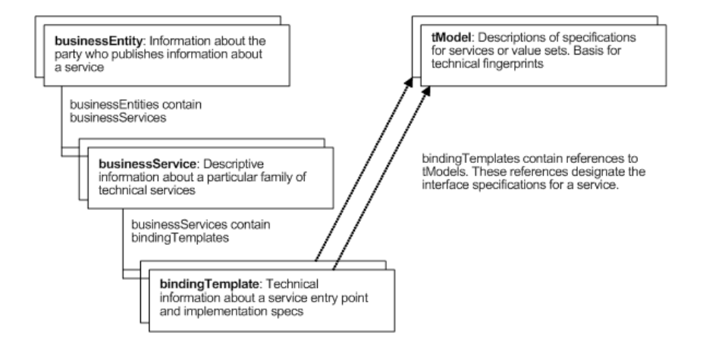
Key Data Types

Slide 17
UDDI problems
tModel concept too complex and unwieldy
Lack of any standard tModels
No simple link into WSDL
Doesn’t address the major issues of Service Registry and Governance
Lifecycle management
Notification
Dependency Management

Slide 18
SOA Repository Artefact Model and Protocol (S-RAMP)
In progress at OASIS
Based on Atom/AtomPub concepts
Aimed at solving the real world problems left unanswered by UDDI
Which WSDLs and schemas import a particular schema
Which of my services are in production?
Which services are governed by a specific SLA?
What is the latest version of service X?

Slide 19
Aspects of “real” registries
Meta-Modelling
Taxonomies
Versioning
Associations and Properties
Lifecycle Management
Dependency Management
Repository
Search
Machine and Human interfaces

Slide 20
Meta-Modelling
Creating / modifying the model to support new artefacts
e.g. Teams, Projects, Organizations, etc
Also used for extending more technical attributes
e.g. adding WADL or Swagger support

Slide 21
Versioning
Micro-versioning/revision management
Keeping track of every minor update to a WSDL
Permanent URLs for given versions
“Business” Versioning
Service A is available as
1.2.3 deprecated
2.5.1 current

Slide 22
Associations and Properties
Properties
General name / value pairs attached to resources
Associations
Named Links between resources
e.g.
A isUsedBy B
B isManagedBy C

Slide 23
Lifecycle Management
Each service in the corporate datacentre MUST:
Start as “In Design”
Be approved by the Design Review Team
Iterate through Development
Pass validation tests before entering Staging
Be approved by the Security and Performance Teams before entering Production
Be deprecated when no longer supported

Slide 24
Dependency Management
Each Service Sn depends on Schemas {Y1..n}
Schema Y depends on Schemas {Z1..n}
Schemas are shared between services
Owners and users of services need to be made aware of new versions of schemas they depend on (even if they didn’t know it!)

Slide 25
Interfaces
Registries are used by humans, but shouldn’t always be!
e.g. Maven build rather than forcing developers to use a website
One company I know hires a “Registry Monkey” who ONLY enters services into a registry
Each service takes 83 steps
He hasn’t yet committed suicide

Slide 26
Registry, DevOps, SCM
Ideally need to connect:
The Source Code Management (CVS, SVN, Git)
The build and test environment
Hudson, Jenkins, Bamboo
Selenium, JUnit, etc
The production management process
DevOps, Puppet, Chef
The design time registry
The runtime registry

Slide 27
Runtime Governance
Finding services at runtime
Monitoring services at runtime
Managing SLAs
Correlation
Acting on situations

Slide 28
WS-Discovery
A simple(r) protocol just aimed at finding “live” endpoints
For example used by HP printers for network printing
Though my own experience is that mine is a bit hit and miss!
Supports UDP and TCP
Managed or Ad-Hoc mode

Slide 29
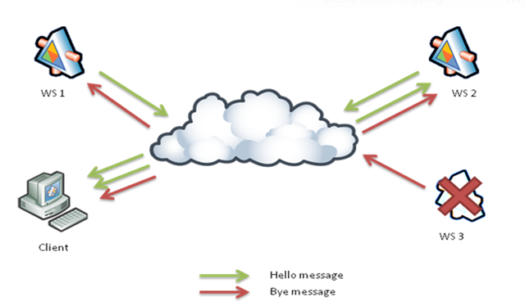
WS-Discovery “ad-hoc”

Slide 30
WS-Discovery Message Types
Hello messages
Bye messages
Probe messages
Probe match messages
Resolve messages
Resolve match messages

Slide 31
Hello
<wsd:Hello>
<wsa:EndpointReference >
<wsa:Address>urn:uuid:50bccd63-8c1f-4f9d-a0db </wsa:Address>
</wsa:EndpointReference>
<wsd:Types xmlns:a="http://echo..wso2.org">a:echoPortType </wsd:Types>
<wsd:Scopes>http://…/ws-dd/ns/discovery/2009/01/DefaultScope </wsd:Scopes>
<wsd:XAddrs>https://localhost:8243/services/echo http://localhost:8280/services/echo</wsd:XAddrs>
<wsd:MetadataVersion>1</wsd:MetadataVersion>
</wsd:Hello>

Slide 32
Runtime Monitoring

Slide 33
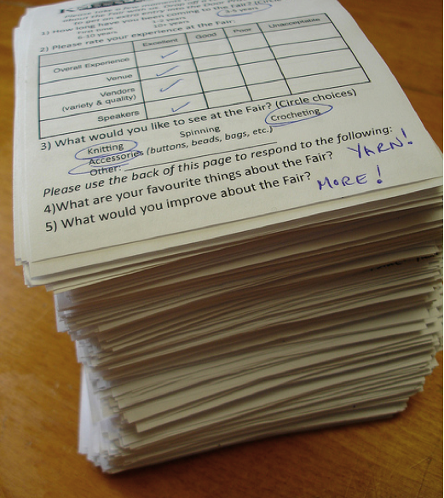
Aggregation
Gathering data
How to collect data efficiently
How to store data effectively
What data to capture

Slide 34

Analysis
Data operations
Defining KPIs and analytics
Operating on large amounts of historical or current data
Creating intelligence

Slide 35
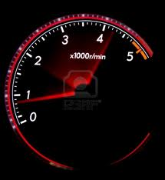
Presentation
Visualization
Dashboards
Reports

Slide 36
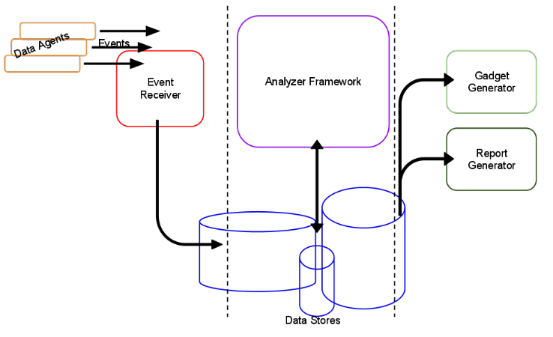
BAM visually

Slide 37
Closing the loop
SLAs are time based rules about performance data
Is service X responding in under 50ms for more than 99% of calls within the last 5 mins?
Does the sales team respond to leads within 4 hours?
Has the average CPU utilization over the last day gone more than 50% higher than the weekly average

Slide 38

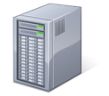
Event Processing ?
 | Storage based Applications | Event-driven Applications
Query Paradigm | Ad-hoc queries or requests | Continuous standing queries
Latency | Seconds, hours, days | Milliseconds or less
Data Rate | Hundreds of events/sec | Tens of thousands of events/sec or more
Event
output stream
request
input stream
response

Slide 39
Scenarios of Event Processing
Months
Days
hours
Minutes
Seconds
100 ms
< 1ms
Relational Database
Applications
CEP Target Scenarios
Operational Analytics
Applications
Latency
Data Warehousing Applications
Web Analytics Applications
Manufacturing
Applications
Monitoring
Applications
Financial Trading
Applications
0 | 10 | 100 | 1000 | 10000 | 100000 | ~1M
Aggregate Data Rate (Events/seconds)

Slide 40
Event Processing
Simple Event Processing
Simple filters (e.g. Is this a gold or platinum customer?)
Event Stream Processing
Looking across multiple event streams and joining multiple event stream etc.
Complex Event Processing
Processing multiple event streams to identify meaningful patterns, using complex conditions & temporal windows
E.g. There has been a more than 10% increase in overall trading activity AND the average price of commodities has fallen 2% in the last 4 hours

Slide 41
CEP Queries
Types of queries are following
Filters and Projection
Windows – events are processed within temporal windows (e.g. for aggregation and joins).
Time window vs. length window.
Ordering – identify event sequences and patterns (e.g. for a credit card new location followed by small and a large purchase might suggest a fraud)
Joins – join two streams

Slide 42
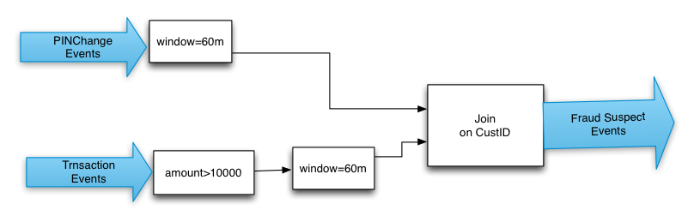
Example Query
from p=PINChangeEvents#window.time(3600) join t=TransactionEvents[amount>10000]#window.time(3600)
on p.custid==t.custid
return t.custid, t.amount;

Slide 43
Acting on runtime situations
SOA infrastructure →
Business Activity Monitoring stream →
Complex Event Processing rules →
SOA infrastructure
e.g. when utilization of my cloud web farm is > 75% start a new server

Slide 44
Resources
UDDI
http://uddi.xml.org/
S-RAMP
https://www.oasis-open.org/committees/tc_home.php?wg_abbrev=s-ramp
WS-Dynamic Discovery
http://docs.oasis-open.org/ws-dd/ns/discovery/2009/01
WSO2 Governance Registry
http://wso2.com/products/governance-registry/

